Slide 1
Chicken Wings and Love
Working with Children from Trauma in Schools
Matt Snyder
Regional Superintendent of Schools
Macon-Piatt ROE #39
Decatur, IL

Slide 2
What We Know About People
People Have to Live and Work Together to Survive
People Cannot Live and Work Together Without Conflict
Someone Controls Every Group

Slide 3
Question to Ponder
What do you know about the children you teach?
https://www.youtube.com/watch?v=cTu9qngVc-Q#action=share
Notes:
Do you have a child in your class who has been abandoned by a parent? Who has lost a loved one/ Has a parent in jail? Goes to bed hungry?

Slide 4
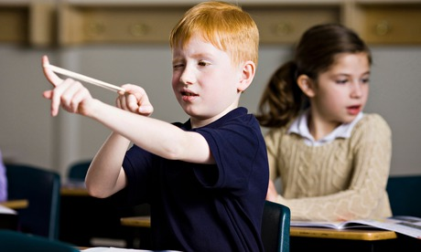
That Kid

Slide 5
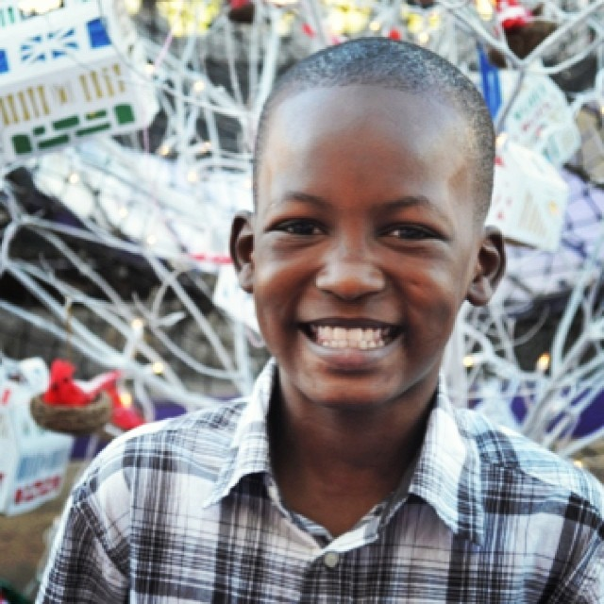
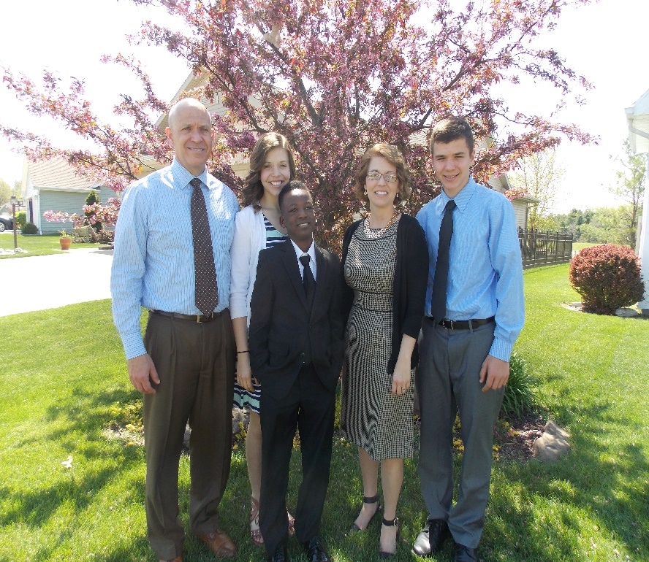
Our Journey

Slide 6
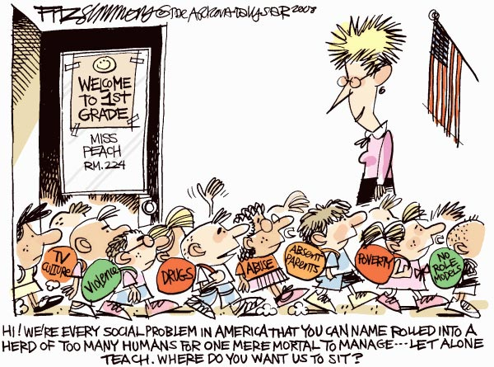

Slide 7
“Students who are
LOVED at HOME,
come to school to
learn, and students
who aren’t, come to
SCHOOL to be LOVED.”
-Nicholas A. Ferroni

Slide 8
Trauma
Any event that is more overwhelming than which is normally expected.
Such an event puts a child in a place of feeling out of control, scared, terrified, worthless, unlovable, or insecure.
Child’s life becomes one of FEAR and SURVIVAL.

Slide 9
Causes of Childhood Trauma
Death
Divorce
Abandonment
Separation
Abuse
Neglect
Lack of Affection
Malnutrition
Lack of Love or Care
Being Bullied
Ridicule / Teasing
Chronic Illness
Natural Disasters
Notes:
Child learns not to trust

Slide 10
Infant Neurochemistry
A mother’s emotional circumstances during pregnancy can profoundly affect her child.
Highly stressed mothers may have children with imbalanced neurochemistry.
Fetal brain development is affected by mother’s nutrition.
Well-tended children learn trust and their brains build neurological pathways of learning and social contact.
A child’s brain learns language comprehension and speaking skills during this time.
The Connected Child, Dr. Karyn Purvis

Slide 11
In Utero Studies
Studies have shown stress during pregnancy causes the mother to release cortisol, epinephrine, and norepinephrine into the fetus.
Studies have shown that children exposed to increased levels of cortisol in the womb may have trouble paying attention or solving problems later in life.
Studies show that stress in the womb can affect a baby’s neurobehavioral development.
Help for Billy, Heather Forbes

Slide 12
Brain and Trauma
How Trauma Affects the Cognitive Structures of the Brain
Secure Attachment
Trauma Triggers
https://www.youtube.com/watch?v=lPftosmseYE

Slide 13
How Trauma Affects the Cognitive Structure of the Brain
Notes:
The human brain is programmed by experience.

Slide 14
Downstairs Brain vs. Upstairs Brain
Downstairs – Brain Stem and Amygdala
Basic Functions
Innate Reactions and Impulses
Strong Emotions
Upstairs – Cerebral Cortex and Pre-Frontal Cortex
Thinking
Imagining
Planning
The Whole Brain Child, Siegel and Bryson

Slide 15
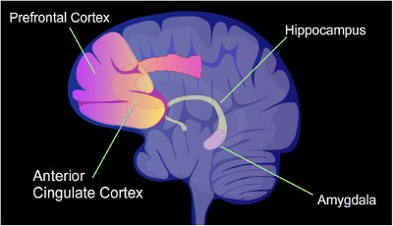
Human Brain

Slide 16
Adverse Childhood Experiences
www.acestoohigh.com

Slide 17
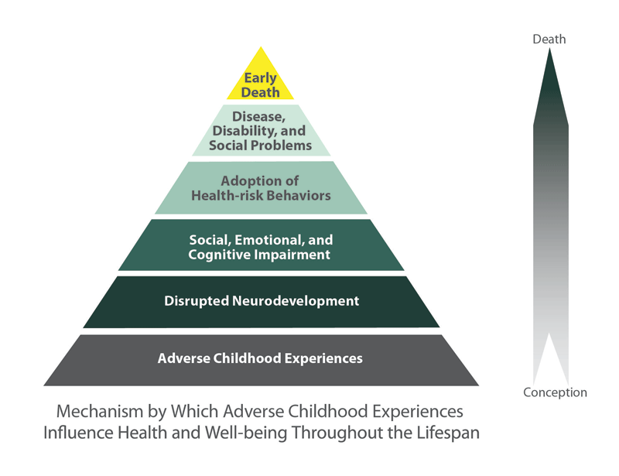
Childhood Trauma Impact
(2004, http://www.acestudy.org)

Slide 18
The Impact of Trauma
Trauma impacts the ability to trust.
These children often misread the motivations of others, both children and adults.
Trauma produces self-regulation deficiencies.
Notes:
Stress is stress. Excitement equals fear. Ball game examples.

Slide 19
Every word a person says
and
Every behavior a person exhibits,
Seems rational to them at the time.

Slide 20
Josh Shipp
https://www.youtube.com/watch?v=oZBdZEG7PSI
15 min.

Slide 21
A Child’s Behavior Is Often An Expression of Need

Slide 22
Characteristics of Children from Trauma in the Classroom
Increased tension, irritability, and inability to relax.
Increased startle response.
Lack of or avoidance of eye contact.
Extreme neediness.
Bouts of rage and aggression.
High anxiety when separated from primary care giver.
Avoidance behavior.
Elusive and vague answers.
Sneaky
Manipulative
Combative
Irrational

Slide 23
Stress is Stress
To a child, fear and excitement feel the same.
A child from trauma often reacts to each the same way.
New or unfamiliar tasks, events, and situations make these children uncomfortable.

Slide 24
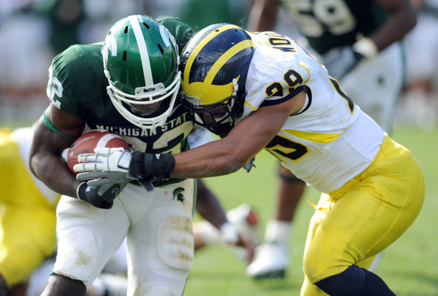
What is Predictable
Is Preventable.
Dr. Robert Anda

Slide 25
Fear-Misbehavior Cycle
Fear
Poor Behavior
Overreaction
Inappropriate Punishment
Increased Anxiety

Slide 26
If Not You,
WHO?
If Not Now,
WHEN?

Slide 27
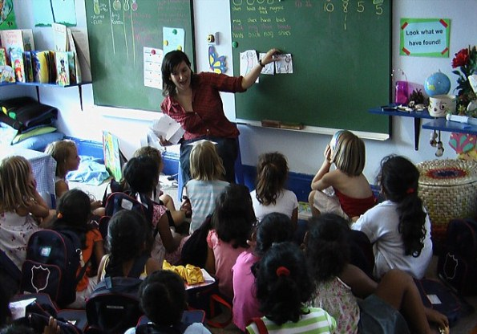
T.E.A.C.H Method©
Notes:
Tone means both verbal and non verbal stance. Monty reacts to the verbal tone of a conversation as well as the non verbal cues he interprets. He says you have a mad face or mean face. He personalizes an adult being loud with another student or the entire class. He becomes scared.

Slide 28
Tone
If You Want To Get Into A Shouting Match With A Child,
Start Shouting

Slide 29
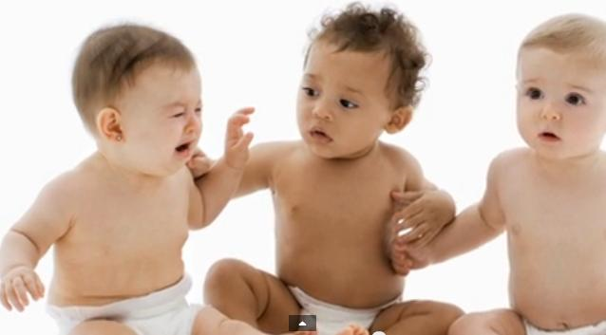
Empathy
If You Judge People,
You Have No Time To Love Them
-Mother Teresa

Slide 30
Appropriate
Be Sure To Taste Your Words
Before You Spit Them Out
-Unknown

Slide 31
Consistent
Actions Open Doors,
Consistency Keeps Them Open
-Rob Stanmore

Slide 32
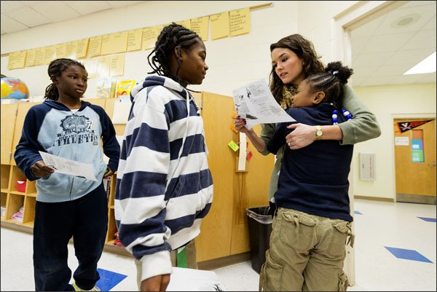
Healthy Touch
Nothing Is So Healing
As The Human Touch
-Bobby Fischer

Slide 33
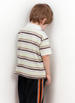
New Strategies
Issue Consequences
Issue Punishments
Kick Children Out
Should be Listening
Should be Comforting
Should be Developing Strategies

Slide 34
Tolerance vs. Acceptance
Tolerance
Being capable of allowing something to occur without adverse reaction.
Acceptance
Believing or coming to recognize something as valid or correct.
Tolerance
Acknowledging that something is wrong with the child and trying to get the poor behavior to stop.
Consequences/Punishment
Short-term fix.
Acceptance
Acknowledging that something has happened to the child and trying to help the behavior to improve.
Support Given
Long-term fix.

Slide 35
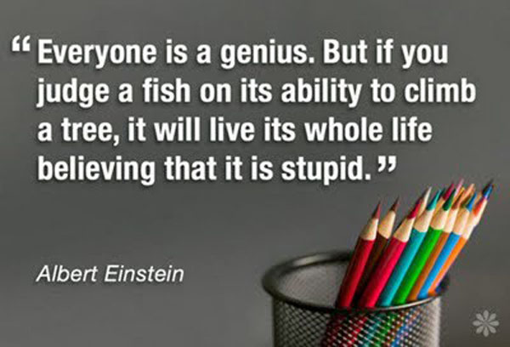

Slide 36
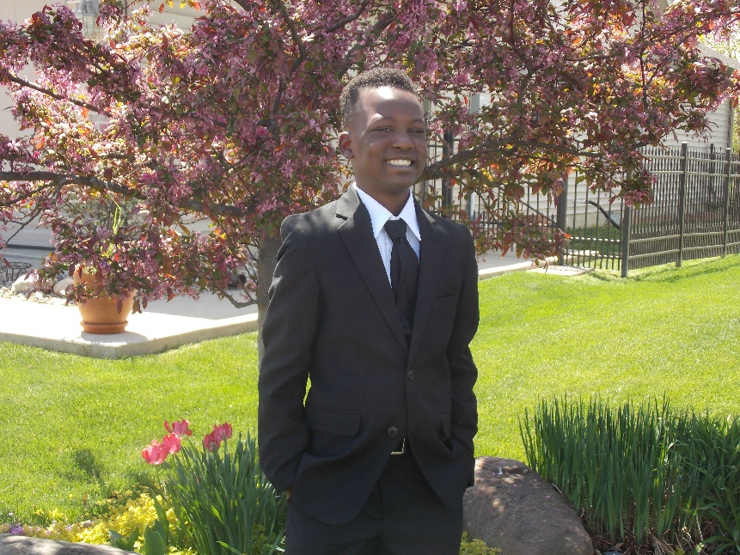
Fear Will Bully A Child
Into Poor Behavior
- Dr. Karyn Purvis

Slide 37
Classroom Strategies
Predictable Structure
Consistent Routines
Post Expectations
Keep Expectations Realistic
Reduce Sensory Overload in the Classroom
Physical Security
Plan all Transitions and Movement
Give Children Time to Process
Emphasize the Positive
Use Students Names Often
Give Students Feedback
Allow Student Feedback
Create Calm Zones
Develop Positive Send-Offs

Slide 38
When an Issue Arises
Respond Immediately
Do not get in a Discussion
Use Few Words
Be Instructive and Corrective
- The Connected Child, Dr. Karyn Purvis

Slide 39
Implementing Classroom Strategies

Slide 40
The Three R’s of Teaching
Relationships
Relationships
Relationships

Slide 41
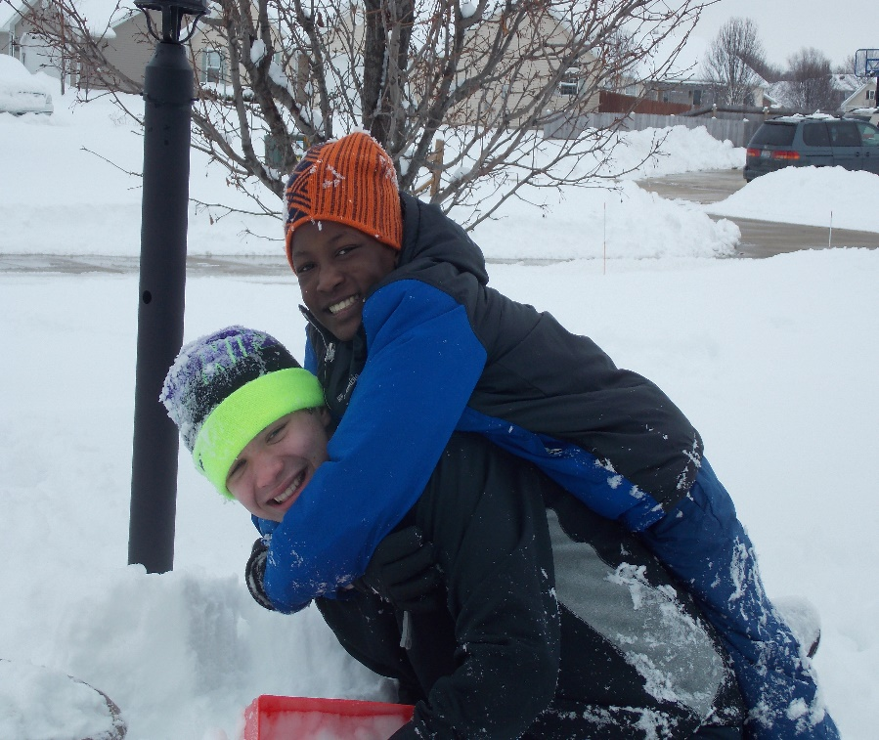
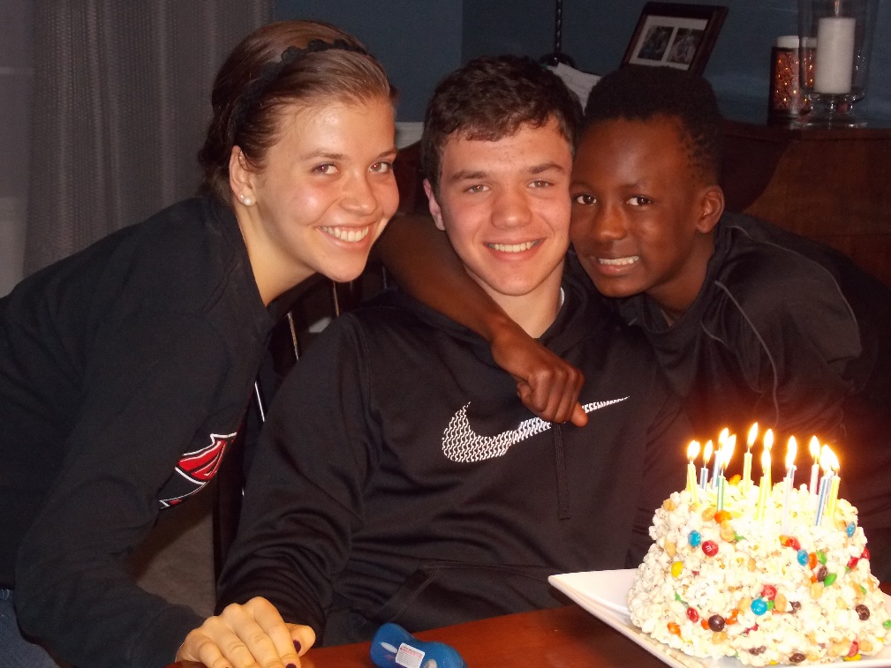
Relationships Heal What
Relationships Harm
- Dr. Karyn Purvis

Slide 42
6 Lessons From Monty
Do not assume children understand rules, social cues or cultural norms.
Trust must be earned by the adult.
The feelings children have are real to them.
Do not take behaviors personally.
Everyone is an expert on child psychology.
Every day is a new day.

Slide 43
Do Not Assume That Children Understand Rules or Cultural Norms
We falsely assume children will quickly understand and adapt to our rules and norms.
When misbehavior occurs we become impatient and punish for things children may not know are wrong.
Children need to be told repeatedly about expectations and how to act in certain situations.
Adults must model proper behavior constantly.
Praise children for the smallest accomplishments.
Give do-overs when children struggle.

Slide 44
Trust Must Be Earned By The Adult
Children want to be loved and want to trust adults.
Children from trauma fear trusting adults.
When trust is broken, we must start again.
Children in our classrooms owe us very little.
Every child DESERVES a trusted adult in their life.
When children see an adult being mean or disrespectful to another child they lose trust.
Children from trauma have been hurt and let down by adults in the past so if it happens in the classroom it reinforces past experiences.

Slide 45
The Feelings Children Experience Are Real
The prevailing feeling that children from trauma experience is FEAR.
Most misbehavior is rooted in fear.
If we can ease the fear, behavior will improve.
When we simply state that everything is OK and there is nothing to be afraid of, we increase the fear.
Adults must listen and validate the child’s feelings.
When feelings are dismissed, fear intensifies, misbehavior occurs, punishments are imposed and fear grows, creating a cycle of misbehavior.

Slide 46
Do Not Take Behaviors Personally
All children will act out at times even if they love and trust the adults in their lives.
Children act out for a myriad of reasons.
Adults often try to save face when this occurs in front of others.
Adults must NEVER take poor behaviors and decisions personally.
Children act out when they feel an inability to control a situation and need adults to help them calm down.
Do not use threats or issue punishment during the misbehavior.

Slide 47
Everyone Is An Expert In Child Psychology
No matter how you deal with a situation, someone has a better way.
Do not take unsolicited advice personally.
You must know your children and have strategies in place to deal with situations that arise.
You must trust that what you are doing will work.
You will fail at times and that is OK.
Have a support system in place for when advice is needed.
Be confident and be brave.

Slide 48
Every Day Is A New Day
What happened is in the past and you can only control your own behavior and reactions.
Children from trauma may be set off by small events such as a look, a word, or a request.
When children from trauma get in trouble they think they are hated or unloved.
Adults must reinforce that it is the behavior that we do not like, not the child.
Adults must make children understand that we look forward to seeing them and spending time with them.

Slide 49
Truly Amazing Teacher 10 min.
https://www.youtube.com/watch?v=j9RDfv5OAZQ

Slide 51
www.chickenwingsandlove.com
mattsnyder@roe39.k12.il.us

Slide 52
Resources
Forbes, H. and Post, B. (2009). Beyond Consequences, Logic, and Control: A Love Based Approach to Helping Children with Severe Behaviors. Boulder, CO: Beyond Consequences Institute, LLC.
Forbes, H.(2012). Help for Billy: A Beyond Consequences Approach to Helping Children in the Classroom. Boulder, CO: Beyond Consequences Institute, LLC.
Kranowitz, C. (2005). The Out-of-Sync Child: Recognizing and Coping with Sensory Processing Disorder. New York: Penguin Press.
Purvis, K. (2007). The Connected Child. New York: McGraw Hill.
Seigel, D. and Bryson, T. (2012). The Whole Brain Child. New York: Bantam Books.

