Slide 1
College Access and Success for Youth Experiencing Homelessness: National Supports and Local Collaboration
Christina Dukes, NCHE
Deb Albo-Steiger, Miami-Dade County Public Schools
Tori Nuccio, West Chester University of Pennsylvania
Notes:
Emcee/host

Slide 2
Meet Your Presenters
Christina Dukes, Federal Liaison National Center for Homeless Education (NCHE) cdukes@serve.org
Deb Albo-Steiger, Program Manager Project UP-START Homeless Education Program Debalbo@dadeschools.net
Tori Weigant Nuccio, Assistant Director of Financial Aid West Chester University of Pennsylvania tnuccio@wcupa.edu
Notes:
Presenters introduce themselves in the order in which they appear on the screen.

Slide 3
Time to move! What’s your role?

Slide 4
Session Outline
Context-setting
National-level supports
Program spotlight: Helping our Miami-Dade Youth, H.O.M.Y. Collective (Florida)
Program spotlight: Supporting Students Experiencing Homelessness (Pennsylvania)
Q&A
Small group discussion and next steps
Notes:
Presenter 1

Slide 5
Context Setting and National-Level Supports
Notes:
Presenter 1

Slide 6
Why College Access and Success?
We are in a time of
MOMENTUM
and
INTEREST
Notes:
Chapin Hall Report Wisconsin HOPE Lab work
HUD YHDP
New ESSA statutory requirements
Proposed legislation

Slide 7
Why College Access and Success?
⇧
Education
⇧
Income
Breaking cycles

Slide 8
Why College Access and Success?
New
EVERY STUDENT SUCCEEDS ACT
mandates

Slide 9
Why College Access and Success?
Youth experiencing homelessness may need a
HELPING
HAND
to get where they’re capable of going

Slide 10
ESSA mandates
State homeless education plans must include a description of how youth experiencing homelessness will receive college advising, preparation, and readiness assistance from school counselors
Local liaisons must inform unaccompanied youth of their independent student status on the FAFSA and help these youth receive verification of this status

Slide 11
Support through Waivers
Youth experiencing homelessness are eligible for
Advanced Placement exam waivers: http://professionals.collegeboard.com/testing/waivers/guidelines/ap (*ESSA block granting may affect availability)
ACT exam waivers: https://www.act.org/content/dam/act/unsecured/documents/FeeWaiver.pdf
SAT exam waivers: https://collegereadiness.collegeboard.org/sat/register/fees/fee-waivers
College application fee waivers through the College Board (https://bigfuture.collegeboard.org/get-in/applying-101/college-application-fee-waivers/participating-colleges) or NACAC (https://www.nacacfairs.org/learn/fee-waiver/)
Notes:
Presenter 1

Slide 12
Total range
$250-$1000
General SAT test $45+ per
+
ACT $42.50+ per
+
SAT subject test $26/basic fee + $20 and up/exam ea
+
College application* $41 average ea
=
AP test $93 ea
+
*The College Board recommends that students apply to between 5 and 8 colleges.
Notes:
Presenter 1

Slide 13
Support for FAFSA Completion
Students need to complete a FAFSA at https://fafsa.gov each year
Based on the information submitted on the FAFSA, institutions calculate the Expected Family Contribution (EFC)
Encourage all students to fill out the FAFSA as soon as possible!
State and institutional deadlines vary; learn more at https://fafsa.gov/deadlines.htm?sf64104271
Notes:
Presenter 2

Slide 14
Support for FAFSA Completion
Under ESSA, local liaisons must inform unaccompanied youth of their independent student status on the FAFSA and help these youth receive verification of this status
Dependent Student (*youth experiencing homelessness with their family)
Must report parent information on FAFSA
EFC is based on parents’ and student’s income and assets
Independent Student (*unaccompanied youth)
Does NOT report parent information on FAFSA
EFC is based on student’s income and assets
Notes:
Presenter 2

Slide 15
Age Criteria
*New for the 2018-2019 FAFSA*: The definition of youth (previously defined as 21 or younger) was removed from the FAFSA
Unaccompanied homeless students ages 23 or younger or still enrolled in high school on the date he/she signs the FAFSA qualify as independent students
Students ages 24 or older automatically qualify for independent student status
Notes:
Presenter 2

Slide 16
Subsequent Year Determinations
Per Guidance from ED, local liaisons have the option to make subsequent year determinations for UHY if they have access to the information necessary to make such a determination
See question Q-2 at http://www2.ed.gov/policy/elsec/leg/essa/160240ehcyguidance072716.pdf for more information
Notes:
Presenter 2

Slide 17
Tools
For local liaisons and shelters SchoolHouse Connection Template (Independent Student Status of Unaccompanied Homeless Youth: Determination for the 2018-2019 FAFSA) available at https://www.schoolhouseconnection.org/wp-content/uploads/2017/10/SHC__FAFSA_Determination_2018_FINAL.doc
For financial aid administrators NCHE FAA Tool (Making Student Status Determinations for Unaccompanied Homeless Youth: Eligibility Tool for Financial Aid Administrators) available at http://nche.ed.gov/pr/faa_tool.php
Notes:
Presenter 2

Slide 18
Private Scholarships
Encourage students to check with their counselor for a list of scholarships
Give Us Your Poor/Horatio Alger Scholarship: https://scholars.horatioalger.org/
NAEHCY Scholarship: http://naehcy.org/naehcy-scholarship-fund/about-the-fund
SchoolHouse Connection Scholarship: https://www.schoolhouseconnection.org/youth-leadership/scholarship-program/ (Nov 8 deadline)
Free and reputable scholarship search engines:
Fastweb!: http://www.fastweb.com/
College Board: https://bigfuture.collegeboard.org/scholarship-search
U.S. Department of Education: http://studentaid.ed.gov/types/grants-scholarships/finding-scholarships (includes scholarship search tips and guidelines)
Notes:
Presenter 1

Slide 19
Proposed Legislation
The Higher Education Access and Success for Homeless and Foster Youth Act (S.1795/H.R. 3740; Sept 2017)
The Fostering Success in Higher Education Act of 2017 (S. 1792/H.R. 3742; Sept 2017)
The College Student Hunger Act of 2017 (H.R. 3875; Sept 2017)
The Community College Student Success Act (H.R. 2960; June 2017)
Notes:
The Higher Education Access and Success for Homeless and Foster Youth Act (HEASHFY; S.1795/H.R. 3740; Sept 2017)
Eliminates the need for a yearly determination of independent student status for UHY barring a change in circumstances and/or conflicting information
Requires the Federal Student Aid Ombudsman to resolve disputes for UHY and foster youth who are denied independent student status
Provides in-state tuition for homeless and foster youth
Requires post-secondary institutions to
Designate SPOCs to assist homeless and foster youth
Disseminate information about FAFSA access for UHY and foster youth
Prioritize homeless and foster youth for campus housing
Develop a plan to support housing access during and between academic terms for UHY and foster youth
The Fostering Success in Higher Education Act of 2017 (FSHEA; S. 1792/H.R. 3742; Sept 2017)
Creates a grant program to enable states to establish or expand initiatives that improve college access and success for homeless and foster youth
Requires states to award subgrants to higher education institutions to develop campus-based support services and financial assistance for homeless and foster youth, including
Establishing a POC to meet regularly with homeless and foster youth
Establishing support programs to assist with financial aid and other critical areas
Adjusting the COA to include housing during periods of non-enrollment
Providing institutional aid to meet the COA not covered by other aid
Subsidizing fees associated with student orientation
Ensuring the availability of student health services
Establishing early alert systems to help students struggling academically
The College Student Hunger Act of 2017 (H.R. 3875; Sept 2017)
Amends the Food and Nutrition Act to expand the eligibility of students to participate in the Supplemental Nutrition Assistance Program
The Community College Student Success Act (H.R. 2960; June 2017)
Funds a competitive grant program to help post-secondary institutions plan and implement programs that provide comprehensive support services and resources designed to increase transfer and graduation rates at community colleges
Supports include academic advising, tutoring, and financial support in the form of a tuition waiver to cover the gap between tuition; fees and financial aid, and a financial incentive, such as a transportation pass or gas card, at least once per month

Slide 20
Poll: What do you think?
Chevon is a high school senior staying in a RHYA shelter. Who can determine that he’s an independent student?
Notes:
Emcee/host
James is a high school senior staying in a RHYA shelter. Who can determine that he’s an independent student?
The local liaison for her school district
The RHYA shelter director or designee
A HUD shelter director or designee
A financial aid administrator

Slide 21
Poll: What do you think?
Who can determine that Chevon is an independent student?
✔ The local liaison ✔ The RHYA shelter director or designee ✘ A HUD shelter director or designee ✔ The financial aid administrator
Notes:
Emcee/host
James is a high school senior staying in a RHYA shelter. Who can determine that he’s an independent student?
The local liaison for her school district
The RHYA shelter director or designee
A HUD shelter director or designee
A financial aid administrator

Slide 22
Q&A
Notes:
Emcee/host

Slide 23
Program Spotlight: Florida
Notes:
Presenter 1

Slide 24
Hello from Florida & Miami-Dade County
* M-DCPS 4th Largest District
* Approximately 400 schools
* 350,000 students
* Over 2,000 square miles
Florida State Statute 1009.25 (f)
Fee exemptions for workforce education programs, Florida College System institutions, or state university
Notes:
Presenter 1

Slide 25
District homeless liaisons & teamwork
LEA Homeless Liaison
Students
High School-Based Staff
ALL Post Secondary Institutions
Notes:
Presenter 1

Slide 26
Students
UP-START Staff meet with every senior identified in our program and provide verification of their status
Needs Assessment done by Project UP-START staff for seniors
Emphasis on post-secondary readiness among all UP-START students, especially UHY
UHY must be told of their independent student status on FAFSA & we inform them about Florida State Statute 1009.25 (f)
Notes:
Presenter 1

Slide 27
High School Based Staff
Presentations:
*School Counselors *School Social Workers *Registrars
*College Advisors *School Administrators *Agency staff
*Athletic Directors *Activities Directors *Teachers
Ensuring high school staff understand which students qualify
Updates to staff throughout the school year about deadlines, new programs, & other information to assist UP-START seniors
Notes:
Presenter 1

Slide 28
Single Points of Contact
State Universities
State Colleges
Public Technical Colleges
District Homeless Liaison
Notes:
Presenter 1

Slide 29
Helping Our Miami-Dade Youth (H.O.M.Y)
Data & Research
Funding
Well Being
Stable Housing
Permanent Connections
Education & Employment
Youth Voice
Outreach/PR
Notes:
Presenter 1

Slide 30
Education and Employment
Education and Employment includes high performance in and completion of educational and training activities, especially for younger youth, and starting and maintaining adequate and stable employment for older youth.
M-DCPS, Project UP-START
Educate Tomorrow
Florida International University – Fostering Panther Pride (FIU-FPP)
Miami-Dade College Single Stop (MDC)
M-DCPS Technical Colleges
CareerSource South Florida & Partner Agencies
Miami Job Corps
UM Children & Youth Law Clinic
Our Kids of Miami-Dade/Monroe
Casa Valentina
Concept Health Systems
Notes:
Presenter 2

Slide 31
FIU’s Fostering Panther Pride (FPP)
Began in Fall 2013 thanks to the efforts of FIU’s leadership and Educate Tomorrow
FPP offers tailored academic and other support services to students identified as former foster youth or homeless
Additionally FPP partners with FIU’s Golden Scholars program, a summer bridge program
FPP Starts working with UP-START students in high school
Notes:
Presenter 1

Slide 32
FPP Components
Program Director – SPOC
Student Success Coach
Mentoring Program
Research
Graduation Success Initiative (GSI)
Internal and External Partnerships
Housing Scholarships and Book Vouchers
Food, toiletries, clothing, and a care package first semester.
Notes:
Presenter 1

Slide 33
FIU’s Model of success: removing barriers
Notes:
Presenter 1

Slide 34
Educate tomorrow at MDC’s single stop
College coaches on different campuses to assist students who qualify for the program
Executive Internship Program:
Interns earn three college credits
Interns are given a $1,500 stipend
Often interns are offered positions after internship ends
Mentorship
Weekly emails to promote employment, scholarship, community resource, volunteer and other opportunities
Notes:
Presenter 1

Slide 35
M-DCPS Technical Colleges
7 M-DCPS Technical Colleges
SPOCs on each campus
Communications between District Homeless Liaison & Technical Colleges to assist with transition from high school to post-secondary
Career-in-a-Year: 65+ job training programs
Joint Apprenticeship Programs
Notes:
Presenter 1

Slide 36
Notes:
Mission: To provide a path to independence for at-risk, homeless and foster youth through education, mentoring, and life-skills programming.
Education should be an attainable goal for even the most dis-advantaged. That's why we're here. Educate Tomorrow provides a continuum of care for transitioning foster and homeless youth into adulthood focusing on higher education, and employ-ability.
We want college coaches(That specifically serve foster care/homeless youth) EVERYWHERE!

Slide 37
Working together – it takes a village!
Verification letter: All institutions are in agreement on a form
District Homeless Liaisons: Make sure you know who you are verifying!
Communitywide initiative: Unaccompanied Youth Homelessness
Community support: Collaboration with your Continuum of Care
Verification Assessment: Homeless Outreach Team
Notes:
Presenter 1

Slide 38
Q&A
Notes:
Emcee/host

Slide 39
Program Spotlight: Pennsylvania
Notes:
Presenter 1

Slide 40
West Chester University of Pennsylvania
17,000 Undergraduate and Graduate Students
Located 40 minutes outside of Philadelphia, PA.
We see about 25-30 students identify and participate each year.
Committee started in 2013, Housing started in 2014, Emergency Funding Account in 2015, Resource Pantry 2016 and finally in fall 2017 we pulled these service together to launch the WCU Promise Program.

Slide 41
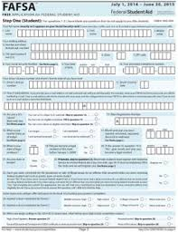
WCU Promise Program: “Supporting Students 365 Days of the Year”
Identifying Students
Foster Youth Comment Code: 166
UHY Comment Code: 163
Rejected FAFSA Forms
On-campus training: Referrals.
Single Point of Contact Model.
CASA, McKinney-Vento Liaisons
Provide guidance on website

Slide 42
WCU Promise Program: “Supporting Students 365 Days of the Year”
Different Statuses: Similar Needs
Unaccompanied Homeless Youth: students under the age of 24 who are not in the care of their parents and are lacking adequate fixed nighttime residence.
Unaccompanied Foster Youth: Students under the age of 24 who meet qualifications for UHY, but are marked independent due to response on FAFSA.
Independent student via appeal: May or may not be at-risk of being homeless or youth, but is without support from other adults.

Slide 43
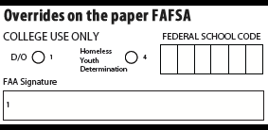
WCU Promise Program: “Supporting Students 365 Days of the Year”
Knowing what is needed:
A Homeless Youth Determination is not a dependency override or a case of professional judgment!!

Slide 44
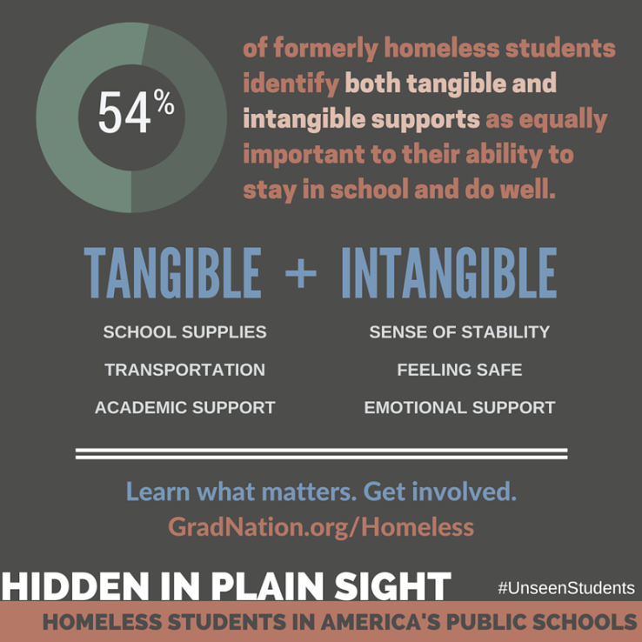
WCU Promise Program: “Supporting Students 365 Days of the Year”
Barriers to success:
Stereotypes and lack of awareness.
Under-identification.
High mobility resulting in lack of school stability and educational continuity.
Enrollment requirements (school records, health records, proof of residence, guardianship).
Poor health, fatigue, hunger.
Emotional trauma, depression, anxiety.
Lack of transportation.
Lack of school supplies, clothing, etc.

Slide 45
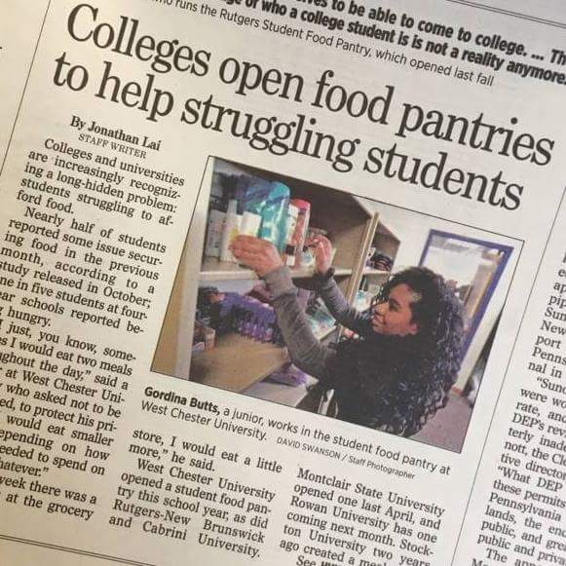
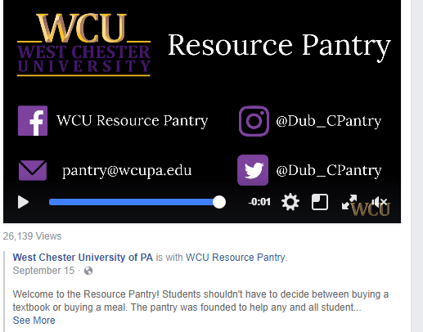
WCU Promise Program: “Supporting Students 365 Days of the Year”
WCU Resource Pantry:
Open to ALL students
47 users in first year already over 107 users for 2017
Supported by Food Bank
Staffed by Work Study Students
Community Partnerships: “Wings for Success”
On-campus programming
Weekly Newsletter
Operation S.N.O.W

Slide 46
WCU Promise Program: “Supporting Students 365 Days of the Year”
Housing
Accommodations for summer, winter, and breaks?
Partner with local transition housing options and/or shelters. Seek out programs such as:
Rent subsidies
Valley Youth House for Foster Youth
Host families
Partner with other colleges in the area with residential halls.
Plan ahead!

Slide 47
WCU Promise Program: “Supporting Students 365 Days of the Year”
WCU Promise Program: Supporting Students 365 Days of the Year
Date | Event | Location
Tuesday 9/26 7pm | WCU Fin Lit Game Night | Sykes Ballroom A
Wednesday 9/27 5pm | Carlino's Dinner | At Carlino's meet outside of Tori's office at 4:30pm
Thursday 9/28 7pm | Fireside Chat with the President | RSVP to pantry@wcupa.edu at Tanglewood
Monday 10/2 | FAFSA for 2018-19 is available | Email Tori at tnuccio@wcupa.edu to schedule an appointment
Wednesday 10/11/2017 | Cooking Demonstration Dinner | RSVP to pantry@wcupa.edu
Thursday 10/12/17 7pm | WCU Fin Lit Walking Debt | Sykes Ballroom A
Friday 10/13/17 10:30am | Pantry Open House and Ribbon Cutting | At the Pantry (Snacks on Residential Quad at 11am)
Wednesday 10/18 11am-3pm | Career Fair | Sykes
Thursday 10/19 5pm | Carlino's Dinner | At Carlino's meet outside of Tori's office at 4:30pm
Friday 10/20/17 | Email Tori for Housing Plans | tnuccio@wcupa.edu Thanksgiving/Winter Housing plans
Thursday 11/9/17 5pm | Carlino's Dinner | At Carlino's meet outside of Tori's office at 4:30pm
Tuesday 11/14/2017 7pm | WCU Fin Lit Fall Cash Bash | Sykes Ballroom A
Tuesday 12/5/17 7pm | WCU Fin Lit Holiday Bingo | Sykes Ballroom A

Slide 48
WCU Promise Program: “Supporting Students 365 Days of the Year”
Promise Program Committee: Working together on campus
Student Mentors: Working via assignment with small groups
Admissions/Financial Aid
Housing
Advising
Summer Bridge Programs
Tutoring
Alumnae
Campus Gardens
Foundation Representation

Slide 49
WCU Promise Program: “Supporting Students 365 Days of the Year”
Working together in the community to create long-term stability
Valley Youth House/County Taskforce
University of Pennsylvania’s Field Center: Foster Care to College Cohort
ECYEH Coordinators and H.S. Liaisons
Affordable Housing Options
Case Study of GPA/Test Scores of H.S. Upperclassmen
College Prep Nights and Financial Literacy Events
Campus tours
Partner with local restaurants
AAUW Chapters
Alumnae Fundraising Campaigns

Slide 50
Q&A
Notes:
Emcee/host

Slide 51
Discussion
Collaboration is based on contribution and mutual benefit. Go around your group and share what strength you might contribute to a new local collaboration.
What is your next step?
Notes:
Emcee/host

