Slide 1
Connecting the Dots: Turning Awareness into Action and Implementation Part 1
October 29, 2017

Slide 2
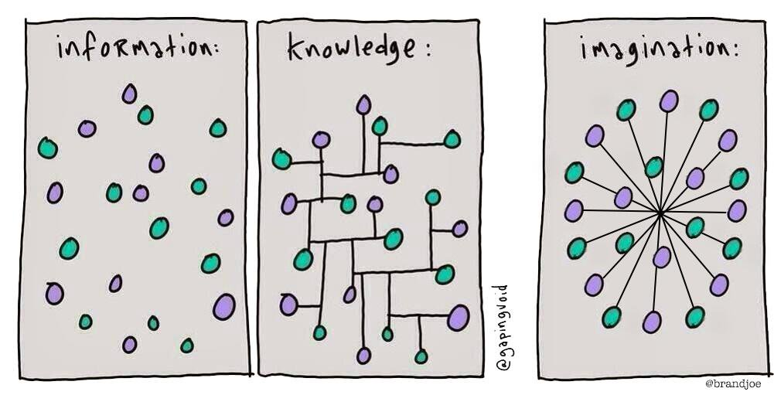
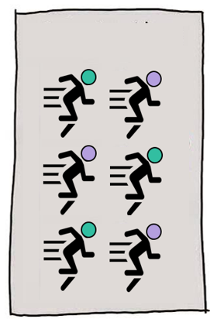
Connecting the Dots
Action:
Implementation & Practice:
Sustainability:
Notes:
KATARA
Latest is 2015-16 school year.
1 in 27 students experienced homelessness. ~1 in each classroom.
39, 671 total
More than double since 8 years ago
We suspect this is partially due to better counting, although there has probably been a rise in homelessness as well.

Slide 3
Tapping into Your Expertise
What is a barrier or problem for the children, youth, or families you work with (e.g., healthcare access)?
What is one solution that you think would have the biggest impact to eliminating this barrier (e.g., medical consent for unaccompanied homeless youth)?

Slide 4
Three Things
Anyone can be an advocate, but there are strategies that can make your advocacy more effective.
How to create meaningful partnerships and why they matter.
Awareness building and advocacy is only a means to an end.

Slide 5
Presentation Roadmap
Tell the story of Schoolhouse Washington.
Discuss state and local advocacy strategies.
Highlight implementation and practice strategies.

Slide 6
Schoolhouse Washington
Schoolhouse Washington improves housing stability and advances educational success for students experiencing homelessness.
Identify & advance promising practices
Cultivate a network of champions
Share data & success stories
Advocate for policy & funding changes
Notes:
KATARA
This partnership asks systems to come together to solve the problems for kids and families.
Educators have looked at the problem and solved it the best way they know how - with students, inside the building.
But we also have to focus on what happens outside the school building.
We're trying to change the culture of how schools serve homeless students.
We bubble this up from on-the-ground experience by piloting new approaches, testing building-level changes we can make, and helping schools connect with other systems that can help.
And we take it to scale by pursuing policy and practice fixes that will reach even more students across the state.
This is a data-driven effort. [NOTE TO KATARA: Funders particularly requested that we make this point.]
We start by studying OSPI data, and we share our analyses with the field and with policymakers.
When we make grants, we include a robust evaluation and regularly review data with grantees.
So that grantees can make real-time improvements.
And so that we can learn about what is most effective, and develop proof points that will help us spread those effective practices to more communities.

Slide 7
But that’s not where we started…

Slide 8
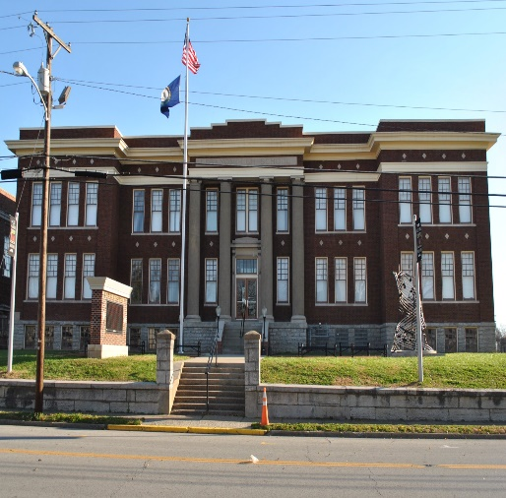
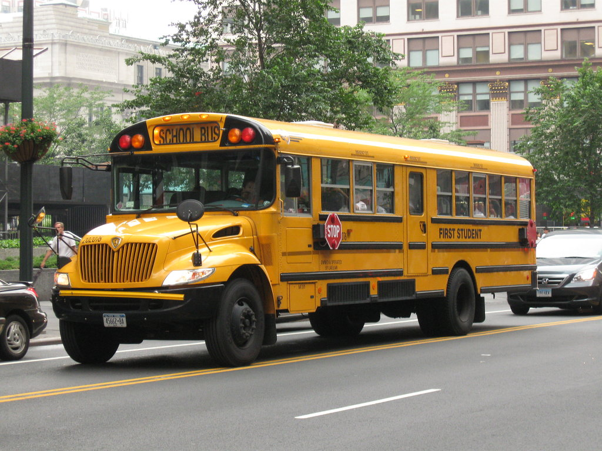
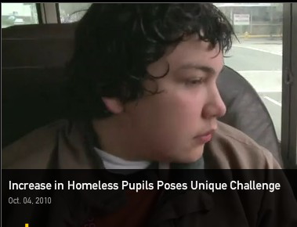
We had some of the dots…

Slide 9
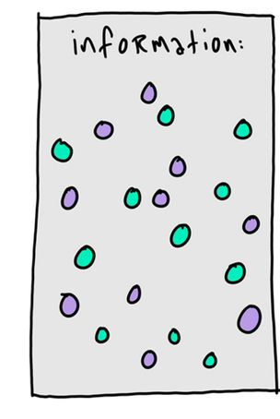
Information Gathering
Convened stakeholders
Provided training
Requested public records from schools
Compiled and analyzed existing data

Slide 10
Identifying the Problem
Homeless Students by Grade
Row Labels | Sum of elementary total | Sum of middle school | Sum of high school total
2006-07 | 8301 | 3411 | 5141
2007-08 | 9118 | 3706 | 5764
2008-09 | 10016 | 4155 | 6532
2009-10 | 10304 | 4394 | 7033
2010-11 | 12691 | 5088 | 8269
2011-12 | 13174 | 5497 | 8719
2012-13 | 15020 | 6102 | 9487
2013-14 | 16313 | 6333 | 9893
Grand Total | 94937 | 38686 | 60838

Slide 11
Where to find data?
State Education Agency
National Center for Homeless Education https://nche.ed.gov/
Department of Education
Local School District
Kids Count Data Center

Slide 12
Identifying & Defining the Problem
Row Labels | Sum of elementary total | Sum of middle school | Sum of high school total
2006-07 | 8301 | 3411 | 5141
2007-08 | 9118 | 3706 | 5764
2008-09 | 10016 | 4155 | 6532
2009-10 | 10304 | 4394 | 7033
2010-11 | 12691 | 5088 | 8269
2011-12 | 13174 | 5497 | 8719
2012-13 | 15020 | 6102 | 9487
2013-14 | 16313 | 6333 | 9893
Grand Total | 94937 | 38686 | 60838

Slide 13
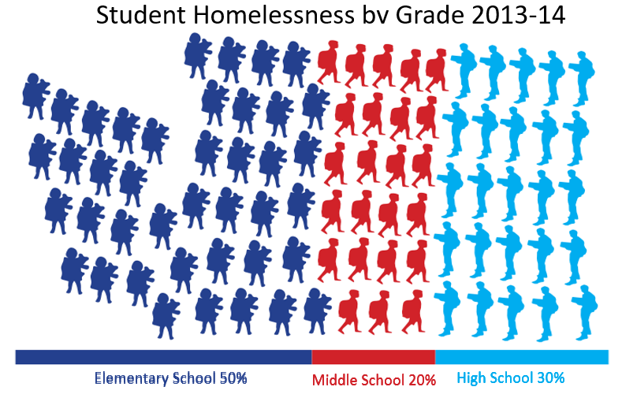
Identifying & Defining the Problem

Slide 14
Game Changer: Top State Official Takes Notice
“Children who are homeless and hungry can’t learn; we need to make sure that they have an equal opportunity to succeed in school and in life."
Washington Housing Alliance Action Fund, Legislator of the Week, https://housingactionfund.org/blog/legislator-week-1

Slide 15
Even with some data…
…there was so much we did not know about students experiencing homelessness.
What were their education outcomes?
Were students of color disproportionately homelessness?
Were they more likely to be truant or disciplined?

Slide 16
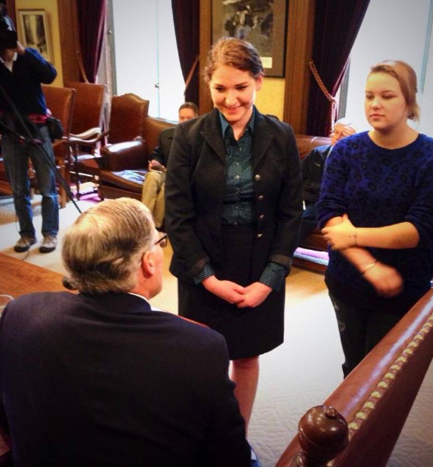
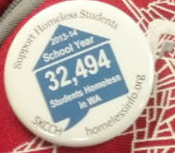
Collaborating on Solutions

Slide 17
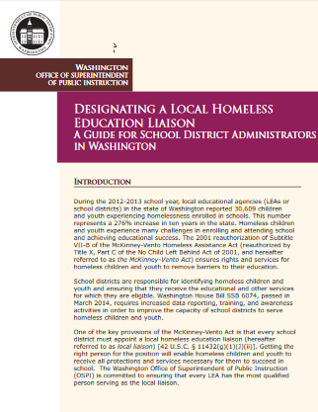
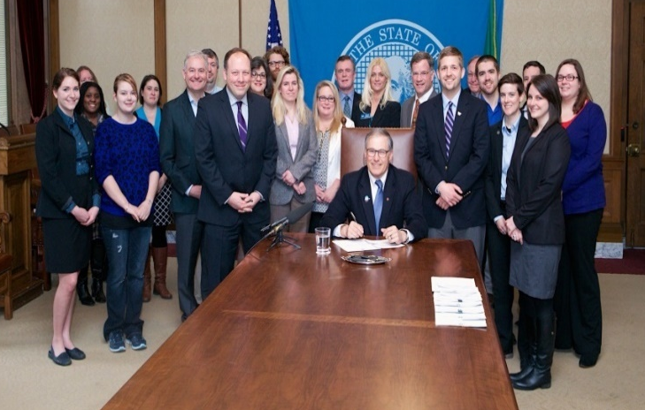
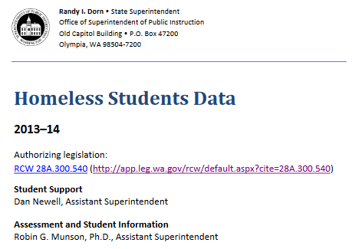
Homeless Children Education Act
Bi-annual legislative report on status of homeless students
Annual report to OSPI must include dropout rates for grades 7-12
Best practices handout on how to choose a liaison
Training video on State agency’s website – strongly encourage annual all staff review
Must include materials at beginning of school year
Effective 6/12/2014

Slide 18
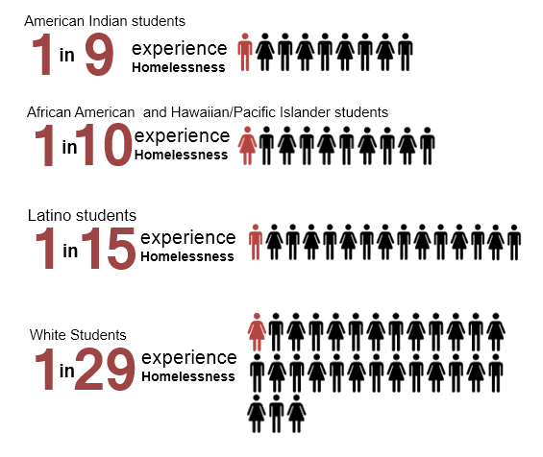
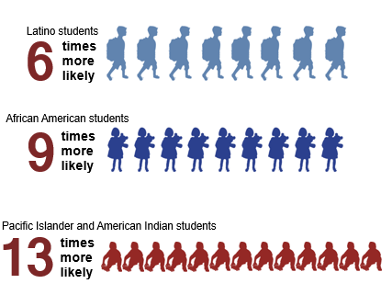
Communicating the Problem

Slide 19
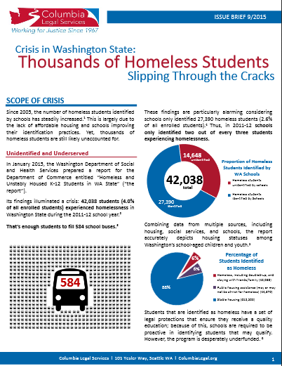
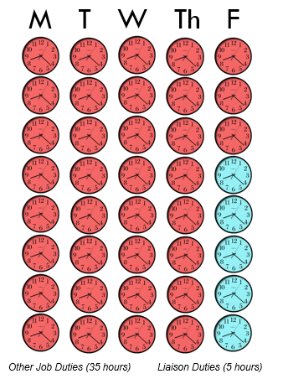
Communicating the Problem

Slide 20
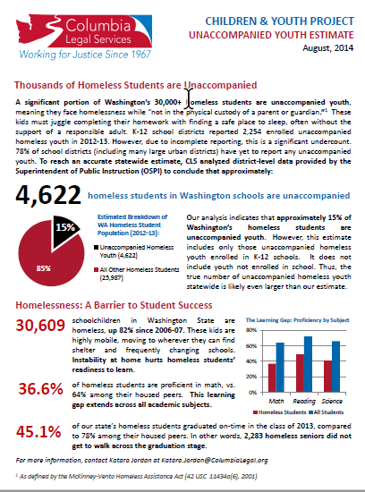
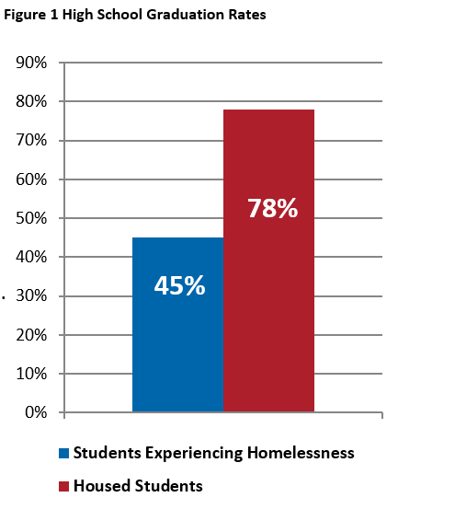
Communicating the Problem
45.1%
Of our state’s homeless students graduated on-time in the class of 2013, compared to 78% among their housed peers.
In other words, 2,283 homeless seniors did not get to walk across the graduation stage.

Slide 21
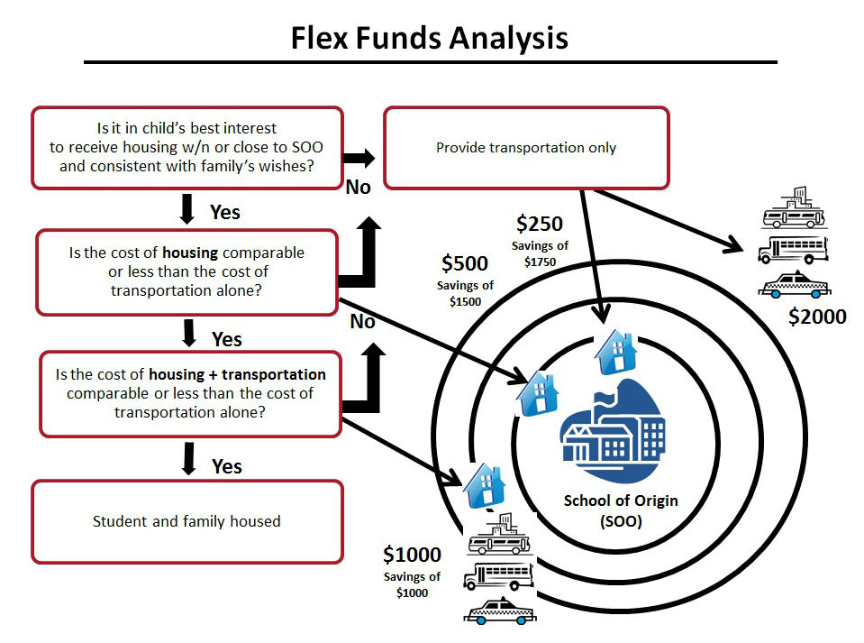
Developing Solutions

Slide 22
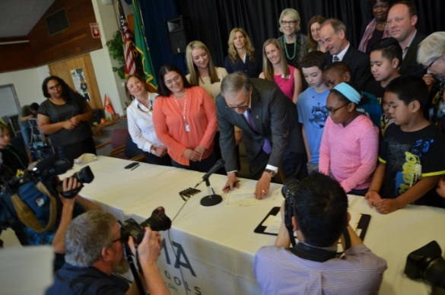
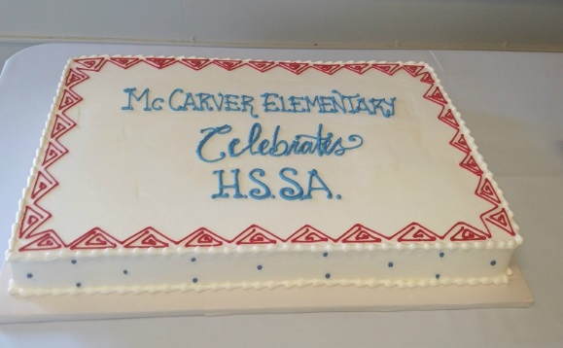
Homeless Student Stability Act
Significant statement on homeless students
Grants to schools to identify and serve more homeless students
Grants for school housing partnerships
Requires data on unaccompanied youth and disproportionality
Requires staff in middle and high schools focused on unaccompanied youth
Allows unaccompanied youth to access preventative healthcare

Slide 23
More Districts Receive Funding

Slide 24
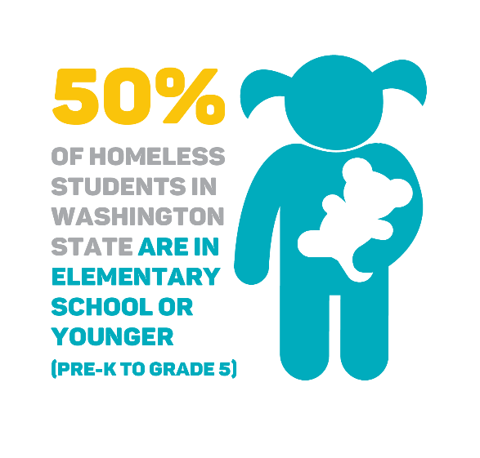
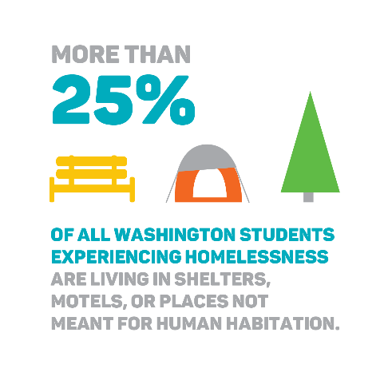
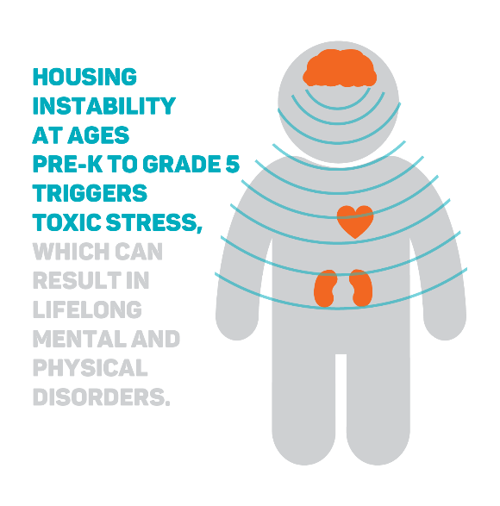
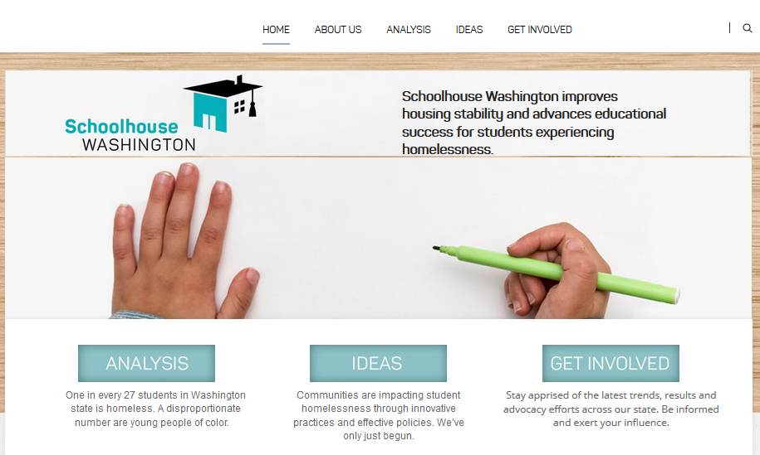
Schoolhouse Washington
Notes:
KATARA
This partnership asks systems to come together to solve the problems for kids and families.
Educators have looked at the problem and solved it the best way they know how - with students, inside the building.
But we also have to focus on what happens outside the school building.
We're trying to change the culture of how schools serve homeless students.
We bubble this up from on-the-ground experience by piloting new approaches, testing building-level changes we can make, and helping schools connect with other systems that can help.
And we take it to scale by pursuing policy and practice fixes that will reach even more students across the state.
This is a data-driven effort. [NOTE TO KATARA: Funders particularly requested that we make this point.]
We start by studying OSPI data, and we share our analyses with the field and with policymakers.
When we make grants, we include a robust evaluation and regularly review data with grantees.
So that grantees can make real-time improvements.
And so that we can learn about what is most effective, and develop proof points that will help us spread those effective practices to more communities.

Slide 25
Questions?
Notes:
KATARA
So, that’s Schoolhouse Washington.
We’re ambitious, but we also know this is the right time to dream big for students experiencing homelessness.
Really appreciate that all of you were willing to take time to hear what we’re up to.
We have some time for questions now. In addition to Helen and Jonathan, Liza Burell is also here – she oversees the Schoolhouse Washington partnership.
Any questions?
THANK YOU!

Slide 26
Katara Jordan
Policy & Advocacy, Building Changes
206-805-6112
katara.jordan@buildingchanges.org
Brandy Sincyr
Policy Analyst, Columbia Legal Services
brandy.sincyr@buildingchanges.org

Slide 27
Connecting the Dots: Turning Awareness into Action and Implementation Part 2
October 29, 2017

Slide 28
Three Things
Anyone can be an advocate, but there are strategies that can make your advocacy more effective.
How to create meaningful partnerships and why they matter.
Awareness building and advocacy is only a means to an end.

Slide 29
Presentation Roadmap
Tell the story of Schoolhouse Washington
Discuss state and local advocacy strategies
Highlight implementation and practice strategies

Slide 30
Let’s Revisit Connecting the Dots
Action:
Implementation & Practice:
Notes:
KATARA
Latest is 2015-16 school year.
1 in 27 students experienced homelessness. ~1 in each classroom.
39, 671 total
More than double since 8 years ago
We suspect this is partially due to better counting, although there has probably been a rise in homelessness as well.

Slide 31
Schoolhouse Washington
Schoolhouse Washington improves housing stability and advances educational success for students experiencing homelessness.
Identify & advance promising practices
Cultivate a network of champions
Share data & success stories
Advocate for policy & funding changes
Notes:
KATARA
This partnership asks systems to come together to solve the problems for kids and families.
Educators have looked at the problem and solved it the best way they know how - with students, inside the building.
But we also have to focus on what happens outside the school building.
We're trying to change the culture of how schools serve homeless students.
We bubble this up from on-the-ground experience by piloting new approaches, testing building-level changes we can make, and helping schools connect with other systems that can help.
And we take it to scale by pursuing policy and practice fixes that will reach even more students across the state.
This is a data-driven effort. [NOTE TO KATARA: Funders particularly requested that we make this point.]
We start by studying OSPI data, and we share our analyses with the field and with policymakers.
When we make grants, we include a robust evaluation and regularly review data with grantees.
So that grantees can make real-time improvements.
And so that we can learn about what is most effective, and develop proof points that will help us spread those effective practices to more communities.

Slide 32
Our Story
Row Labels | Sum of elementary total | Sum of middle school | Sum of high school total
2006-07 | 8301 | 3411 | 5141
2007-08 | 9118 | 3706 | 5764
2008-09 | 10016 | 4155 | 6532
2009-10 | 10304 | 4394 | 7033
2010-11 | 12691 | 5088 | 8269
2011-12 | 13174 | 5497 | 8719
2012-13 | 15020 | 6102 | 9487
2013-14 | 16313 | 6333 | 9893
Grand Total | 94937 | 38686 | 60838

Slide 33
Information Gathering
Identify the Problem
Convene stakeholders
Talk to school districts
Speak with community partners

Slide 34
Knowledge Building
Build the case for your issue
Review and analyze existing data
Conduct needs assessments
Collect personal stories
Research

Slide 35
Application & Action
Action:
Develop a plan
Use your knowledge building to tell a compelling story.
Develop solutions with the coalition.
Work with coalition to help tell the story.

Slide 36
Application & Action
Action:
Act on plan
Bring the issue and your proposed solution to policymakers
Develop and implement a social media strategy to cover the issue
Create and look for opportunities to highlight the issue before the legislature or other decision-making body.

Slide 37
Stop! Lobbying? Advocacy?

Slide 38
You are an Advocate!
Lobbying: asking legislators to take a specific position on a specific piece of legislation, or urge others to do the same (IRS definition for non-profits)
Advocacy: any activity that a person or organization undertakes to influence policy - includes educating, providing information, arguing a cause.
If you can’t lobby:
Advocate!
Notes:
Find others to “make the pitch” for you.
Act as a private individual - you don’t lose your rights as a citizen just because you work for government

Slide 39
Why Advocacy?
Why should you get involved?
You're experts
No one else likely will
You have the power to make change
Many of the policies and practices affecting children, youth, and their families are state and local

Slide 40
Implementation & Practice Strategies
Cultivate Partnerships with community providers and other important stakeholders
Implementation & Practice:

Slide 41
Partnerships! Partnerships! Partnerships!

Slide 42
Implementation & Practice Strategies
Other Implementation and Practice Strategies
Peer Learning Groups
Use pilot projects that bring together cross sectors
Share learnings from projects with partners and legislators
Implementation & Practice:

Slide 43
I don’t know about this advocacy thing…

Slide 44
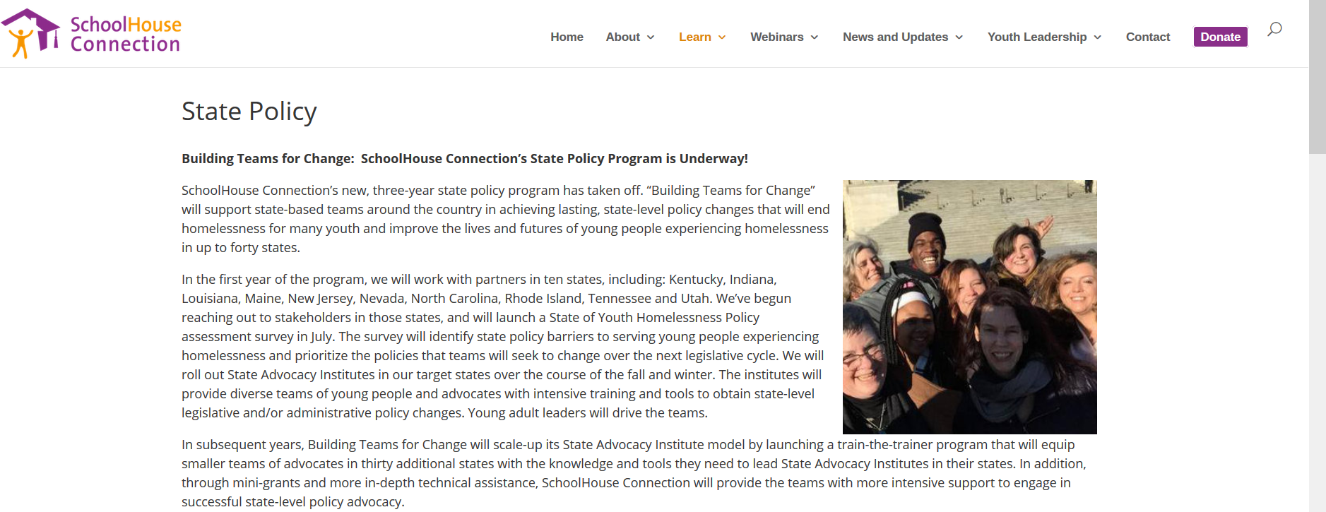
Still hesitant, but really want to act?
https://www.schoolhouseconnection.org/
Barbara Duffield
Executive Director
Phone: 202.364.7392
barbara@schoolhouseconnection.org
Patricia Julianelle
Director of Program Advancement and Legal Affairs
Phone: 202.436.9087
patricia@schoolhouseconnection.org

Slide 45
Your Turn!
Step 1: Identifying and define problem
What are the barriers to success for your students?
Notes:
Break into groups of 6, 2 giant sticky notes for each group
The diversity of your group: different states, different population (rural, urban) is very reflective of the diversity within a state. We all share similar problems, but we have to find solutions that consider the diversity of communities.
10 minutes for first question:
10 minutes: Share out to group
10 minutes for second question
10 minutes to share out

Slide 46
Your Turn!
Step 2: Develop Plan & Communicate Problem
Does it need a legislative, administrative, or school board fix?
Who should you partner with?
Who do you need to talk to?
What information would you put on a one-pager?
Notes:
Chose one that is the best legislative fix…
Break into groups of 6, 2 giant sticky notes for each group
The diversity of your group: different states, different population (rural, urban) is very reflective of the diversity within a state. We all share similar problems, but we have to find solutions that consider the diversity of communities.
10 minutes for first question:
10 minutes: Share out to group
10 minutes for second question
10 minutes to share out

Slide 47
Your Turn!
Step 3: Prepare for the state legislature,
school board, school administration, or even supervisor?
Notes:
Break into groups of 6, 2 giant sticky notes for each group
The diversity of your group: different states, different population (rural, urban) is very reflective of the diversity within a state. We all share similar problems, but we have to find solutions that consider the diversity of communities.
10 minutes for first question:
10 minutes: Share out to group
10 minutes for second question
10 minutes to share out

Slide 48
Questions?
Notes:
KATARA
So, that’s Schoolhouse Washington.
We’re ambitious, but we also know this is the right time to dream big for students experiencing homelessness.
Really appreciate that all of you were willing to take time to hear what we’re up to.
We have some time for questions now. In addition to Helen and Jonathan, Liza Burell is also here – she oversees the Schoolhouse Washington partnership.
Any questions?
THANK YOU!

Slide 49
Katara Jordan
Policy & Advocacy, Building Changes
206-805-6112
katara.jordan@buildingchanges.org
Brandy Sincyr
Policy Analyst, Columbia Legal Services
brandy.sincyr@buildingchanges.org

