Slide 1
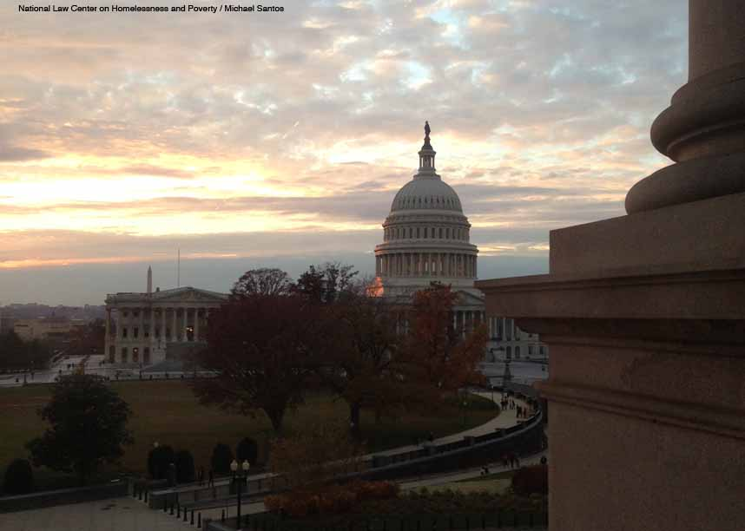
Coordinating & Collaborating to Prevent & End the Criminalization of Homeless Children & Youth
nlchp.org

Slide 2
Coordinators should also coordinate and consult with State and local policymakers to ensure that legislation and policies do not create barriers for the education of homeless children and youths, which may in some cases fall under their ongoing obligation to review and revise such barriers. . . For example, status offense laws or ordinances that criminalize homelessness can make it more difficult for homeless families and youths to get to school ready to learn.
Notes:
Schools are unique – greater expectations to address multiple problems; critique overreliance with law enforcement to fix problems

Slide 3
FAMILY HOMELESSNESS
Homeless households with at least 1 adult and 1 child (HUD)
Homeless families are 35% of the total homeless population
Mainly women and children
2.5 million children
More than 90% of homeless mothers reported experiencing physical and/or sexual abuse
Different from recognizable “street” homelessness
Invisible
Doubled-up
Motels
Cars, vans, trucks
Shelters
Campgrounds
Notes:
Read statistics.
People fleeing domestic violence experience a state of uncertainty, gathering clothes, children, and medicine as they leave. What are their housing options? A shelter, a friend's couch, public housing, the street?
Recognize that living doubled-up and having other living arrangements compared to those living on the streets makes identifying DV homelessness, in some cases harder to identify.

Slide 4
WHAT? HOW? WHY? Listening Session

Slide 5
WHAT IS CRIMINALIZATION?
Notes:
Federal vs. state/local

Slide 6
Federal Concerns
Constitutional
4, 5, 14A: Rights to Be Free from Unreasonable Seizure and Not To Be Deprived of Liberty or Property Without Due Process of Law
8A: Cruel & Unusual Punishment
1A: Right to Free Exercise of Religion
Fair Housing Act
Policing and efficient use of resources
Efficient use of resources and need for providing trauma-informed care and services
Collaboration Across Sectors and Systems
Funding – incentivizing decriminalization
Policy
Notes:
Policy:
Policing and efficient use of resources: (1) Public and private stakeholder engagement
Elected officials
Planning, Parks & Rec, Public Works
Mental health workers, etc.
Landlords
Philanthropy
Leadership within the camp
(2) Broad based support is critical
(3) Strong communication is critical
(4) Outcomes of effective collaboration:
Maximize efficiency
Align resources
Address system gaps

Slide 7
Constitutional Concerns
“[i]t should be uncontroversial that punishing conduct that is a universal and unavoidable consequence of being human violates the Eighth Amendment. . . Sleeping is a life-sustaining activity—i.e., it must occur at some time in some place. If a person literally has nowhere else to go, then enforcement of the anti-camping ordinance against that person criminalizes her for being homeless.”
Notes:
Policy:
Policing and efficient use of resources: (1) Public and private stakeholder engagement
Elected officials
Planning, Parks & Rec, Public Works
Mental health workers, etc.
Landlords
Philanthropy
Leadership within the camp
(2) Broad based support is critical
(3) Strong communication is critical
(4) Outcomes of effective collaboration:
Maximize efficiency
Align resources
Address system gaps

Slide 8
Policy Concerns
“…. Moreover, enforcing these ordinances is poor public policy. Needlessly pushing homeless individuals into the criminal justice system does nothing to break the cycle of poverty or prevent homelessness in the future. Instead, it imposes further burdens on scarce judicial and correctional resources, and it can have long-lasting and devastating effects on individuals’ lives.”
Notes:
Policy:
Policing and efficient use of resources: (1) Public and private stakeholder engagement
Elected officials
Planning, Parks & Rec, Public Works
Mental health workers, etc.
Landlords
Philanthropy
Leadership within the camp
(2) Broad based support is critical
(3) Strong communication is critical
(4) Outcomes of effective collaboration:
Maximize efficiency
Align resources
Address system gaps

Slide 9
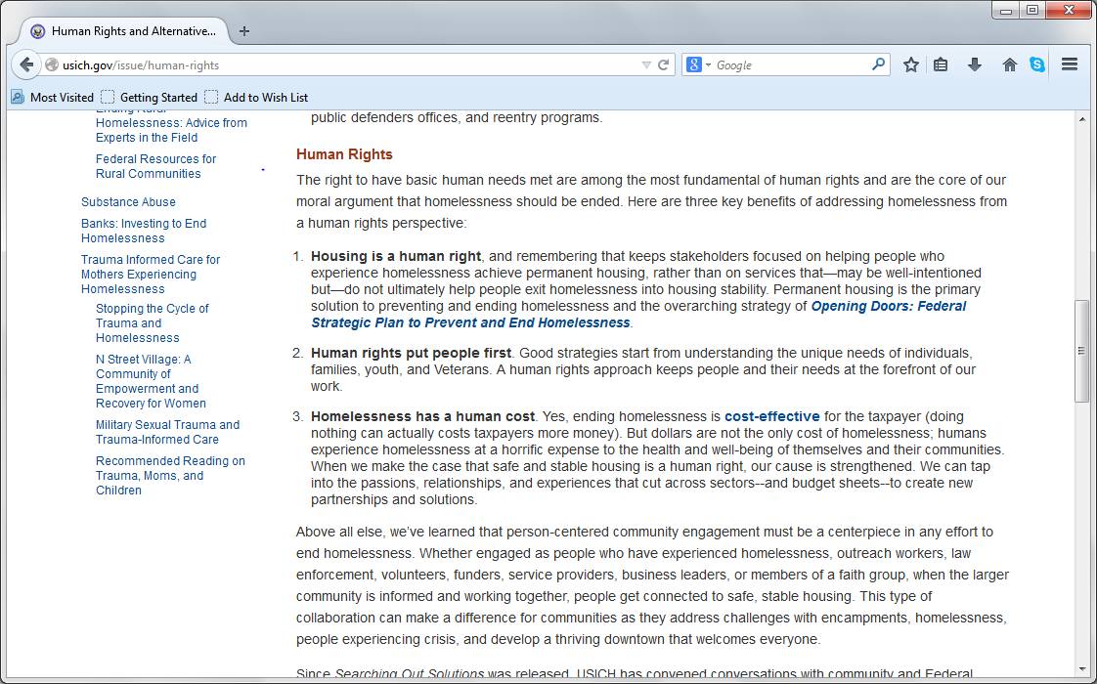
9. Make the Rights Real
nlchp.org
Map yourself to victory
Look at Administrative action especially
Notes:
– as I said there is now a whole page of the USICH website dedicated to human rights.

Slide 10
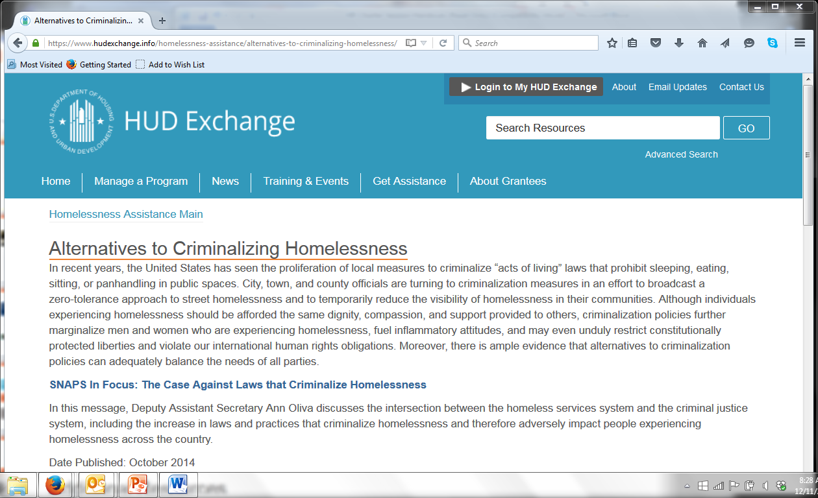
HUD web page
Notes:
And a HUD webpage citing human rights obligations

Slide 11
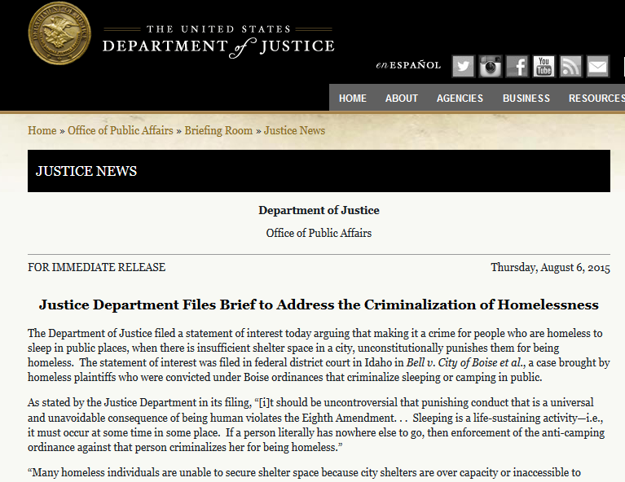
DOJ Brief
Notes:
And a DOJ brief in our case citing the human consequences of criminalization

Slide 12
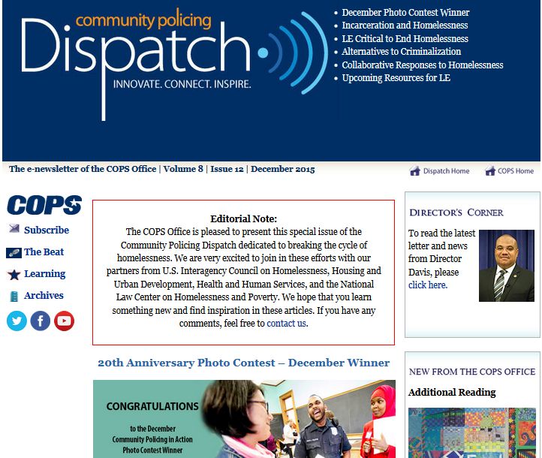
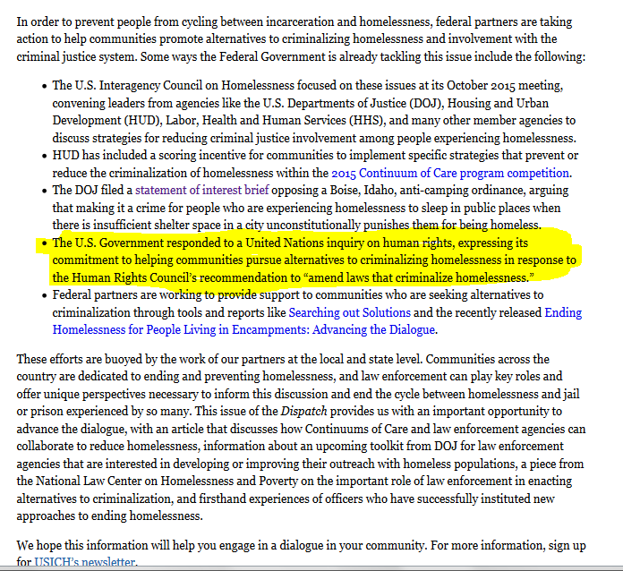
DOJ COPS Newsletter
Notes:
And a few weeks ago the DOJ put out a newsletter to 6,500 law enforcement officers across the country talking about our human rights commitments

Slide 13
HUD NOFA
Competition for HUD funding is so fierce that “half a point or a point can make a difference between being funded or not funded”
-HUD Dep. Sec. Ann Oliva, Think Progress, Aug. 18, 2015
Outreach. Up to 2 points to CoCs that demonstrate recipients have implemented specific strategies that prevent criminalization of homelessness….Applicants must describe how they are reducing criminalization of homelessness …
Notes:
And in its funding application released in September, HUD told communities for the first time that prevention and reduction of criminalization of homelessness is worth up to 2 points on their applications, and those points will matter.

Slide 15
Housing Not Handcuffs is a national campaign to stop the criminalization of homelessness, and push for effective housing policies that end homelessness.
The campaign has developed strategies around policy advocacy, communications, grassroots organizing, and litigation to strategically change local, state, and federal laws and practices that are not working.

Slide 16
Model Policy Highlights & Alternatives
Shorten Homelessness by Stopping its Criminalization
Defund, cease enforcement, and repeal criminalization laws, until sufficient affordable, safe, and decent housing is available to meet the need of homeless individuals and families.
Prevent Homelessness by Strengthening Housing Protections and Eliminating Unjust Evictions
Make it unlawful to deny housing or social services based upon an individual’s or family’s housing status or homelessness, source of income, or status as a victim of domestic violence, sexual assault, or human trafficking.
Institute Just Cause eviction laws, and provide a right to counsel in all eviction cases.
Any institution or system of care that receives public funds, such as prison/jail/detention, health/mental health care, and foster care, shall develop and implement a plan to discharge residents into housing.
End Homelessness by Increasing Access to and Availability of Affordable Housing
Institute universal protections such that no person need pay more than 30% of their income on rent, including a voucher program and minimum wage tied to housing costs.
Fully fund the National Housing Trust Fund, and establish and fund local and state housing trust funds.
Make surplus government property available to provide housing and/or services for homeless persons.
Provide adequate housing, including supportive services, for those exiting state care

Slide 17
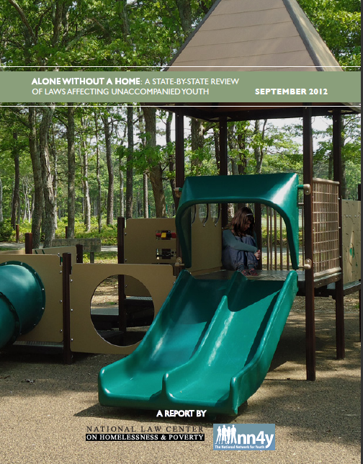
Alone Without a Home
Right to Education
Definitions
Youth in Need of Services
Emancipation
Right to Contract
Access to Healthcare
Discharge from Juvenile Justice
Access to Federal Benefits
Harboring Statutes
Services and Shelters
Status Offenses

Slide 18
Unique strategies for addressing criminalization and housing in response to youth homelessness
The 'Homeless Problem‘
Shahera Hyatt
Published on Aug 26, 2015
Nicole, a 19-year-old Sacramentan, shares her perspective on "the homeless problem" in this speech originally written to be shared with the Sacramento City Council, but when public comment got pushed to the very end, she couldn't stay and deliver it because she needed to get back to her spot along the river at a safe hour. Two weeks after this was recorded, Nicole's mom asked her to come home. She said yes. We are proud to share her voice in this must-watch video.

Slide 19
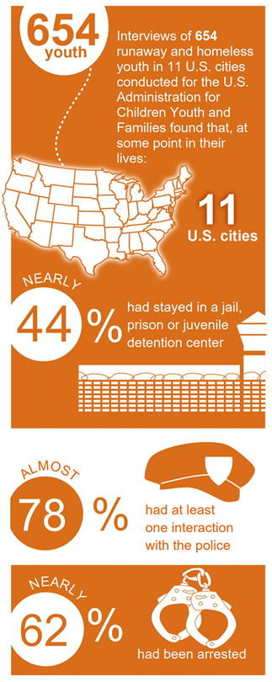
Youth Homelessness & Juvenile Justice
The National Alliance to End Homelessness estimates that 380,000 people younger than 18 will be homeless and alone for some period of time.
Each year 1 million children will have contact with the juvenile justice system.
Coalition for Juvenile Justice - Collaborating for Change

Slide 20
Immigration
nlchp.org
Notes:
Discuss sanctuary cities and human rights cities, different forms of immigration relief, crimmigration

Slide 21
Domestic Violence
nlchp.org

Slide 22
Access to Justice
nlchp.org

Slide 23
Constellation of Legal Needs
nlchp.org
Consumer Law
Child Custody
Criminalization / Fines & Fees
Domestic violence
Employment
Education
Family Law
FEMA
Housing & Renters’ Rights – barriers to obtaining or maintaining housing
Health & Other Economic Benefits
ID and replacing documents
Immigration
Insurance
Privacy and safety concerns
SSI – Supplemental Security Income
Notes:
Use 2 cases as examples: MI and TX homeless families.

Slide 24
The first thing we do, let's kill all the lawyers.
- Henry The Sixth, Part 2 Act 4, scene 2, 71–78
Notes:
Note: All lawyers would have to die in order for Cade to impose his will as king, with a list of absurd laws he would propose.

Slide 25
Role of Lawyers and Legal Advocates
nlchp.org
What are some functions of Legal Advocates?
Be the primary advocate
Be the fact-finder
Enforce laws and ensure compliance
Craft different legal remedies and address collateral consequences
Policy advocate
Notes:
Use 2 cases as examples: MI and TX homeless families.

Slide 28
nlchp.org
Michael Santos
Attorney
msantos@nlchp.org
202-638-2535 ext. 118
www.nlchp.org

