Slide 1
EnTITLEment:
Share the Wealth
Casey Gordon
caseygordon@kentisd.org

Slide 2
Who needs this?

Slide 3
1.
The State of Funding
Let’s start with the first set of slides

Slide 4
The school is the last expenditure upon which America should be willing to economize.
-Franklin D. Roosevelt

Slide 5
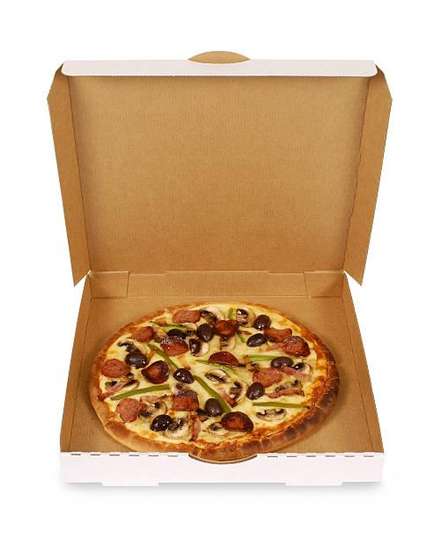
ESEA = ESSA
Elementary and Secondary Education Act = passed in 1965 to provide federal funding for improving the education of students
Every Student Succeeds Act = reauthorization of ESEA in 2015, revamped No Child Left Behind
the box
the pizza

Slide 6
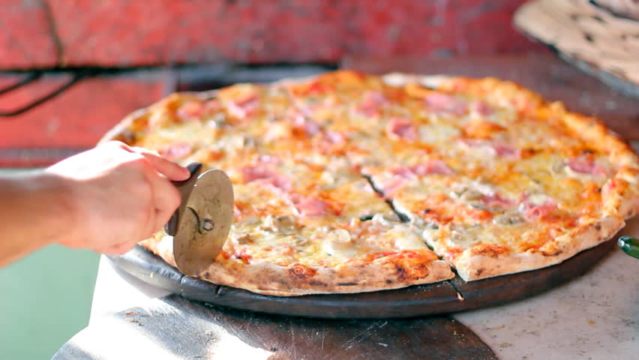
Title Programs = Slices

Slide 7
Title Programs
I | Improving Academic Achievement for Disadvantaged
II | Teachers and Principals
III | English Learner
IV | Success and Enrichment
V | Innovation and Local Flexibility (Rural Education)
VI | Indian, Native Hawaiian, and Alaskan Native Education
VII | Impact Aid (replaces lost tax base - not student program)
IX | Homeless

Slide 8
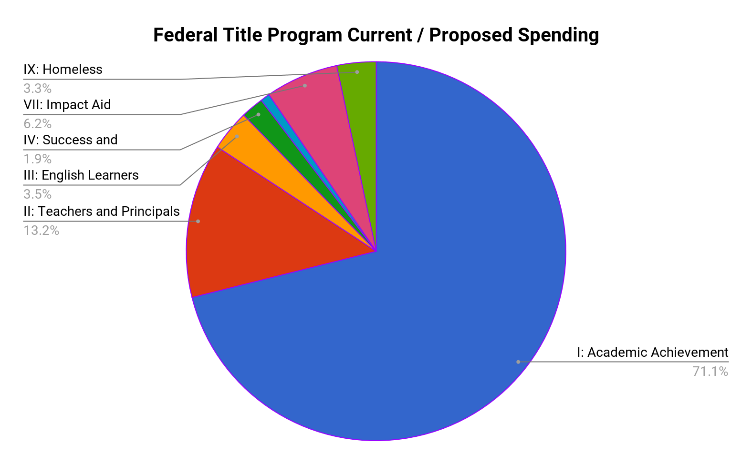

Slide 9
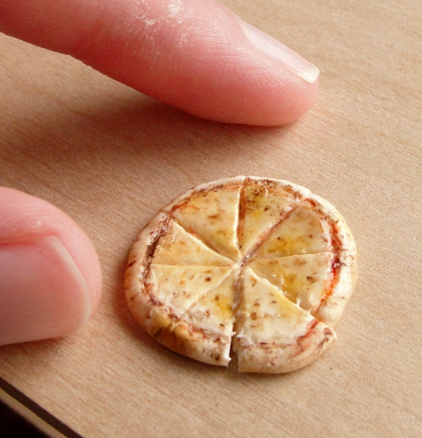
What does your slice look like?

Slide 10
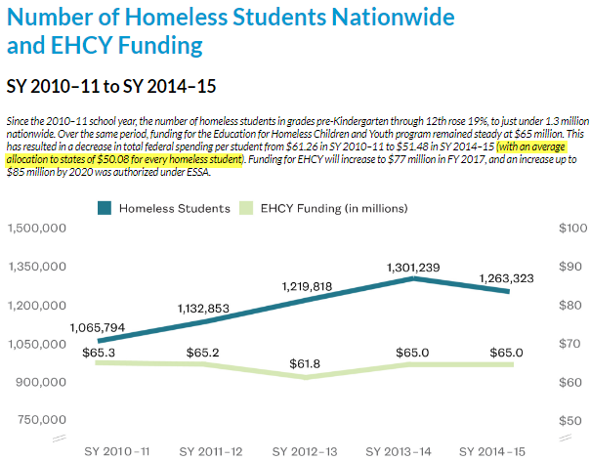
Title IX - Homeless Education

Slide 11
2.
Title Programs

Slide 12
Title 1 = the Supreme Pizza
IMPROVING THE ACADEMIC ACHIEVEMENT OF THE DISADVANTAGED
Important Parts
A = Basic Programs
C = Migrant
D = Neglected, Delinquent, and At-risk

Slide 13
Title 1 - Purpose
SEC. 1001. [20 U.S.C. 6301]
The purpose of this title is to provide all children significant opportunity to receive a fair, equitable, and high-quality education,
and to close educational achievement gaps.

Slide 14
Title 1 - Reservation for Homeless Students
ESEA section 1113(c)(3)(C)(ii))
Know what can be covered (p. 40 [42 PDF])
Non-Regulatory Guidance, 2017
Are you currently spending money on any of these items? Title 1 can cover these -
Dress code / uniform, PE clothes, birth certificates, immunizations, medical/dental, tutoring, fees for ACT/SAT/AP/IB, glasses

Slide 15
Title 1 - How Can It Help MV Students?
Migrant students
Medical / dental, transport to appointments
OSY (high school completion, adult ed)
Records from other states
All MV students
Transportation line item & Liaison salary
Counseling
Tutoring
Outreach

Slide 16
Title II = the Pepperoni Pizza
PREPARING, TRAINING, AND RECRUITING HIGH-QUALITY TEACHERS,PRINCIPALS, AND OTHER SCHOOL LEADERS
Important Part
A = Supporting Effective Instruction

Slide 17
Title II - Purpose SEC. 2001. [20 U.S.C. 6601]
The purpose of this title is to provide grants to State educational agencies and subgrants to local educational agencies to— (1) increase student achievement (2) improve the quality and effectiveness of teachers, principals, and other school leaders; (3) increase the number of teachers, principals, and other school leaders who are effective in improving student academic achievement in schools; and (4) provide low-income and minority students greater access to effective teachers, principals, and other school leaders.

Slide 18
Title II - How Can It Help MV Students?
Indirect support
Professional Development for all school staff
80% funds go to districts with high student poverty
Can be transferred into Title 1

Slide 19
Title III = the Veggie Pizza
LANGUAGE INSTRUCTION FOR ENGLISH LEARNERS AND IMMIGRANT STUDENTS
Important Parts
Language Instruction Education Programs
Immigrant
Native American Children
Native Hawaiian and Alaskan Natives

Slide 20
Title III - Purpose SEC. 3102. [20 U.S.C. 6812]
The purposes of this part are — [...] to assist all English learners, to achieve at high levels so that all English learners can meet the same challenging standards that all children are expected to meet

Slide 21
Title III - How Can It Help MV Students?
Extended day instruction
Supplemental supplies
Translation apps, bilingual resources
Family Outreach
Supplemental English instruction
Bilingual Parent / Family Liaisons
Immigrant
Community partnerships

Slide 22
Title IV = the Extra Toppings
21ST CENTURY SCHOOLS / SUPPORT AND ENRICHMENT
Important Parts
Well-Rounded Education
Safe and Healthy Students
Effective Use of Technology

Slide 23
Title IV - Purpose SEC. 4101. [20 U.S.C. 7111]
The purpose of this subpart is to improve students’ academic achievement by increasing the capacity to— (1) provide all students with access to a well-rounded education; (2) improve school conditions for student learning; and (3) improve the use of technology in order to improve the
academic achievement and digital literacy of all students.

Slide 24
Title IV - How Can It Help MV Students?
School-based mental health services
Dropout prevention
Re-entry transition programs
Community partnerships
Digital learning (rural or underserved)
College / career counseling

Slide 25
Title V = the Local Favorite
FLEXIBILITY AND ACCOUNTABILITY
Important Parts
Transferability of Funds
Rural Education
RLIS - rural, low-income schools
SRSA - small, rural, school achievement

Slide 26
Title V - Purpose SEC. 5202. [20 U.S.C. 7341a]
It is the purpose of this part to address the unique needs of rural school districts that frequently— (1) lack the personnel and resources needed to compete effectively for Federal competitive grants; and (2) receive formula grant allocations in amounts too small to be effective in meeting their intended purposes.

Slide 27
Title V - How Can It Help MV Students?
Parent / family engagement
Activities authorized under:
Title 1a
Title III
Title IV
Can be transferred to Title 1a

Slide 28
Title VI = the Specialty pizza
INDIAN, NATIVE HAWAIIAN, AND ALASKA NATIVE EDUCATION
Important Parts
Improving Educational Outcomes for Indian Children
Native Hawaiian Education
Alaska Native Education
Limited Recipients

Slide 29
Title VI - Purpose SEC. 6102. [20 U.S.C. 7701]
It is the purpose of this part — (1) to meet the unique educational and culturally related academic needs of students, so that such students can meet the challenging academic standards; (2) to ensure students gain knowledge and understanding of Native communities, languages, tribal histories,traditions, and cultures; and (3) to ensure staff have the ability to provide culturally appropriate and effective instruction

Slide 30
Title VI - How Can It Help MV Students?
Depends on program, may include:
Early childhood
Technology access
Tutoring / credit recovery
Counseling (social, college / career)
Cultural & linguistic preservation

Slide 31
3.
Title Speak
aka
How to Order

Slide 32
Coordination of Funds aka Braiding
= What other funds are you using to support this item, service, or program?
Homeless Grant
+
Community Donation
+
Title 1

Slide 33
Funding of Last Resort
Glasses or Hearing Aid
Impeding learning
Not covered by insurance or Medicaid
No local funding available
Exceeds MV grant funds
= Title programs want to be used last, after you have tried all other sources

Slide 34
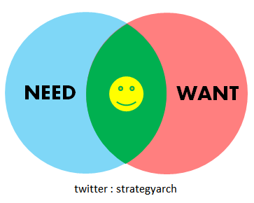
Comprehensive Needs Assessment (CNA)
= process to identify needs and performance changes within a district or school, determine root causes, identify research-based strategies and priorities for future action
Needs of homeless students must be included in your CNA or you will not be able to access Title funds
Also think about district / school improvement plans (Homeless subgroup)

Slide 35
Written Procedures
An email, phone call or conversation are not enough
Tip: include steps to meet with the MV Liaison to ensure homeless students are considered
= documented steps on how you comply with the law, program requirements, or make decisions

Slide 36
Allowable Uses
= specific areas or items covered by grant funds
Must match your item to the right Title fund
PD is Title II, student needs are Title I, immigrant outreach is Title III

Slide 37
Line Items
Specific items / services included in Title budget, based on Needs Assessment & Improvement Plan
Tutoring for homeless students at shelters who are unable to access after school program
Non-perishable food items (instant oatmeal, granola bars) for homeless youth during school breaks who cannot access local pantries

Slide 38
Timeline
Grant applications often due in May/ June
Must decide for the next year
Usually 1 amendment
Start early with your Title contacts
Trick: Unspent line items are often “amended” in Dec / Jan - may need to protect line items

Slide 39
4.
The Art of Title Negotiation

Slide 40
Ate a salad with artisan cheese, heirloom tomatoes, and Italian croutons…
Really just one big crouton covered with tomato sauce and cheese…
Fine, it was pizza. I ate pizza..

Slide 41
Know the Power of Words

Slide 42
The Educational Spin
It’s not “a field trip to the zoo”
It is “an educational experience to enhance the study of habitats and biomes”
It’s not “tutoring”
It is “supplemental, extended day, academic support to assist students in meeting rigorous content standards”

Slide 43
Try It: Put the Educational Spin on these Items
Granola bars
Graphing calculator
5th Grade Camp

Slide 44
Be the Expert - Know Your Local Resources
Fundamental misunderstanding about the availability of community resources
“No, everything is not free”
What can students access within our community? What is not available?
Unlikely to get oil pastels for AP Art from a local source? May be a Title 1 supply

Slide 45
Know Your Policies - Comparability
Homeless students have a right to comparable services
What does the district do for any student who:
Has lice or bedbugs, struggles with reading
Cannot afford a field trip
Funding is not always different just because students are MV eligible

Slide 46
Which is more compelling in a negotiation? Why?
My homeless students don’t have food, how are they supposed to worry about failing Algebra? I need access to more funds.
Without the necessary supplies, students experiencing homelessness face barriers to educational success and on-time graduation. Title 1 can reduce this by providing funds for credit recovery.

Slide 47
Sound Like a Pro
Passion is powerful, but doesn’t always work
Logic and objectivity are linguistic strategies
Focus on the idea, not the person producing it
I see the struggles every day...
The daily struggles students face are…
Words like “clearly” and “logical” lend credibility

Slide 48
We Have Mutual Interests
Title Programs
MV Liaisons
Student Success

Slide 49
What will help you to connect with your Title coordinator?

Slide 50
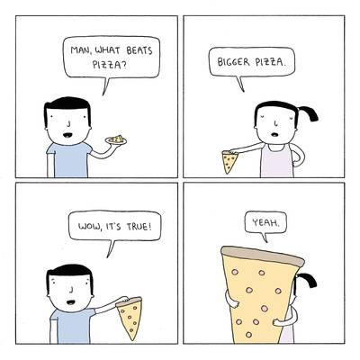
Remember, when it comes to funding...

Slide 51
Thank you!
caseygordon@kentisd.org
MV Grant Coordinator for
Kent & Allegan Counties - Michigan

