Slide 1
Red Tape & Brick Walls
Barriers to Services for Homeless Youth in Illinois
Beth Malik – Associate Director of the Law Project
Tanya Gassenheimer – Youth Futures Health Attorney
Diane O’Connell – Staff Attorney

Slide 2
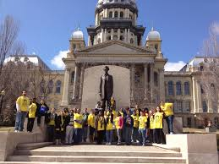
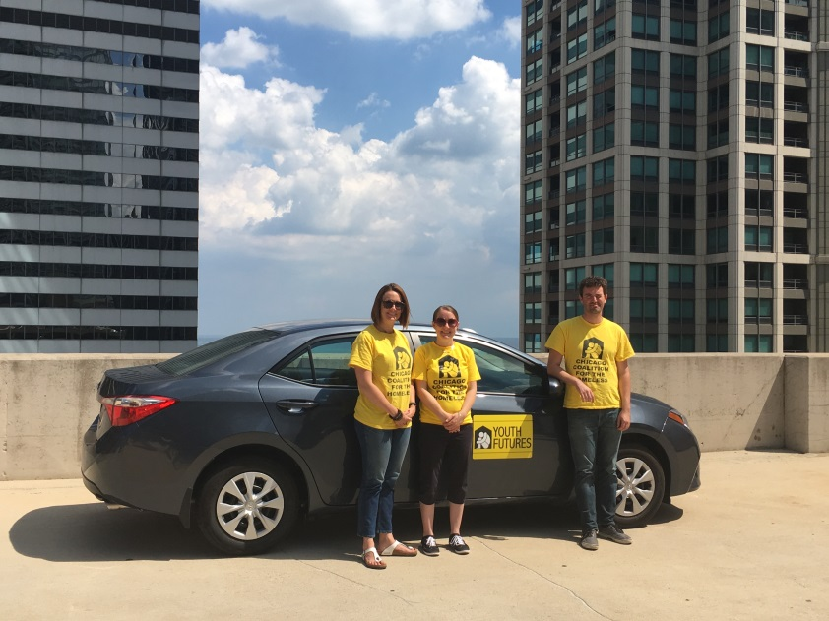
Chicago Coalition for the Homeless
Advocacy organization founded in 1980 ​
Law Project founded in 1997​
Youth Futures Mobile Legal Clinic launched in 2004 ​
Provides civil legal services to unaccompanied homeless youth through outreach ​
Three attorneys ​
1,977 cases/clients served ​
435 Cases/349 Clients in FY 2017​
Education, public benefits, identification documents, employment, civil rights, domestic relations, housing, etc.

Slide 3
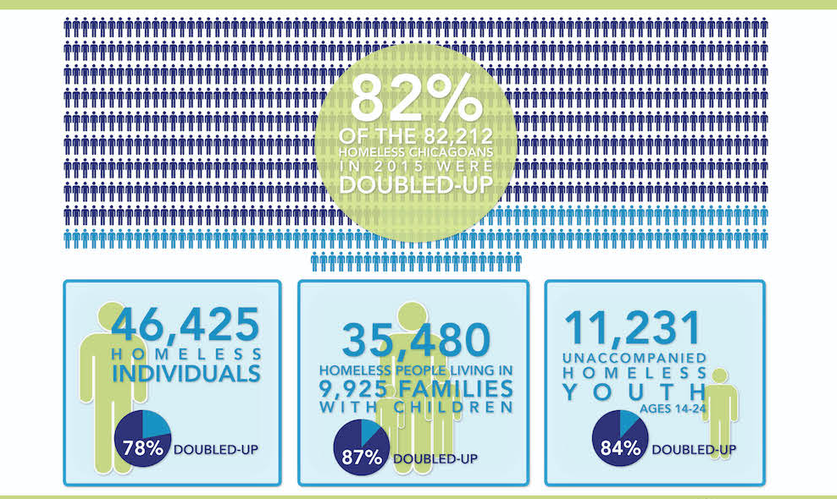
Homelessness in Chicago
In April 2017, the Chicago Coalition for the Homeless released an analysis of how many Chicagoans are homeless, per the 2015 census: 82,212.​
11,231 are unaccompanied homeless youth ages 14-24. ​
84 % are doubling-up​
Chicago Public Schools (CPS) identified 18,117 homeless students during the 2016-17 school year.​
2,396 unaccompanied students
There are currently only 375 homeless youth shelter beds in Chicago​

Slide 5
Barriers to housing
Beth Malik

Slide 6
Barrier #1: Access to shelter/housing​
Legal barriers due to age​
Minors cannot be served in adult shelters/housing programs ​
Lack of age appropriate/culturally competent resources
Cannot enter into contracts/leases- voidable ​
Basic Centers can only serve minors for 21 days​
Lack of long-term solutions for minors
HUD Prioritization ​
Doubled-up youth ineligible for HUD housing programs ​
Lack of housing/shelter options for youth ​
Cannot access Section 8/Subsidized Housing due to waiting lists

Slide 7
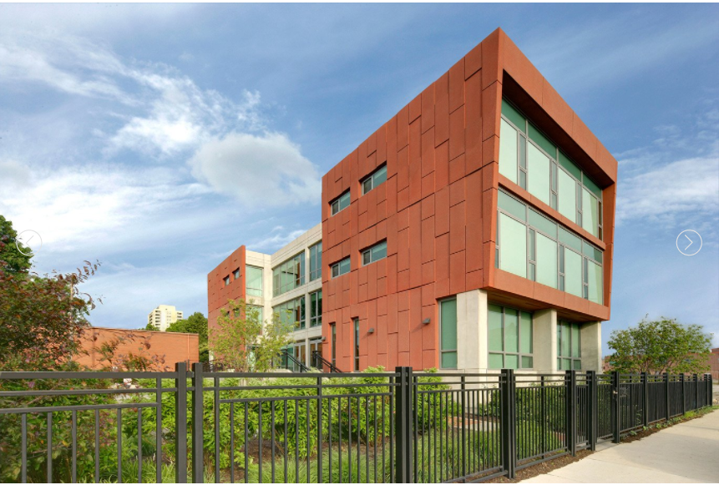
Solution #1: Youth Transitional Housing Bill ​
HB3212 Passed in 2017 – takes effect January 2018
Allows 16 and 17-year-old unaccompanied minors to consent to housing in DCFS licensed youth transitional housing programs, if family reunification is not possible

Slide 8
Solution # 2: Serving Doubled-Up Youth​
Advocated for Chicago Continuum of Care to apply for HUD Category 3 definition of homeless, which would allow HUD funded programs to serve doubled-up youth. ​
HUD Category 3: Homeless under other Federal statutes ​
Unaccompanied youth under 25 years of age, or families with children and youth, who do not otherwise qualify as homeless under this definition, but who: ​
(i) Are defined as homeless under the other listed federal statutes; ​
(ii) Have not had a lease, ownership interest, or occupancy agreement in permanent housing during the 60 days prior to the homeless assistance application; ​
(iii) Have experienced persistent instability as measured bytwo moves or more during in the preceding 60 days; and ​
(iv) Can be expected to continue in such status for an extended period of time due to special needs or barriers ​
Application still pending approval ​

Slide 9
Solution #3: Housing Authority Vouchers​
CCH Youth Committee successfully advocated with the Chicago Housing Authority (CHA) to dedicate 50 vouchers for homeless youth paired with service dollars from the Chicago Department of Family and Support Services

Slide 10
Solution #4: Youth Vulnerability Index/Prioritization ​
HUD requires priority given to chronically homeless ​
Coordinated Entry system prioritizes based on vulnerability ​
Advocated for the adoption of a youth vulnerability index, making it easier for youth to access Permanent Supportive Housing ​
Chicago Coordinated Entry system also prioritizes homeless youth in all housing categories, with the goal of ending chronic youth homelessness by the end of 2017

Slide 11
Barriers to health care
Tanya Gassenheimer

Slide 12
Minor consent to healthcare
Health Risks:
19-50% of homeless youth suffer from serious mental illness, mostly major depression
High prevalence of domestic violence and sexual abuse
27-44% of homeless adolescent girls report having been pregnant.
Increased frequency of STI/STDs
Barriers:
Lack of insurance
Inability to consent
Logistical barriers: lack of transportation, lack of address to receive cards and documents, comprehension, maturity, priorities
Sources:
-http://bphc.hrsa.gov/archive/policiesregulations/policies/pal200110.html
-U.S Department of Health and Human Services Survey (2001)

Slide 13
Minor consent to healthcare
A minor under the age of 18 cannot consent to his or her own medical treatment
Exceptions Include:
Unaccompanied Homeless Youth
Emancipated minors
Pregnant, parenting, married minors
Mental Healthcare
Certain types of treatment (e.g., emergency, sexual abuse)
Consent by Minors to Medical Procedures Act (410 ILCS 210)
Birth Control Services to Minors Act (325 ILCS 10)—with referral (physician, clergyperson, planned parenthood agency) or if necessary to prevent serious health issue
Parental Notice of Abortion Act (750 ILCS 70/1)—minor can consent to abortion but parental notification required

Slide 14
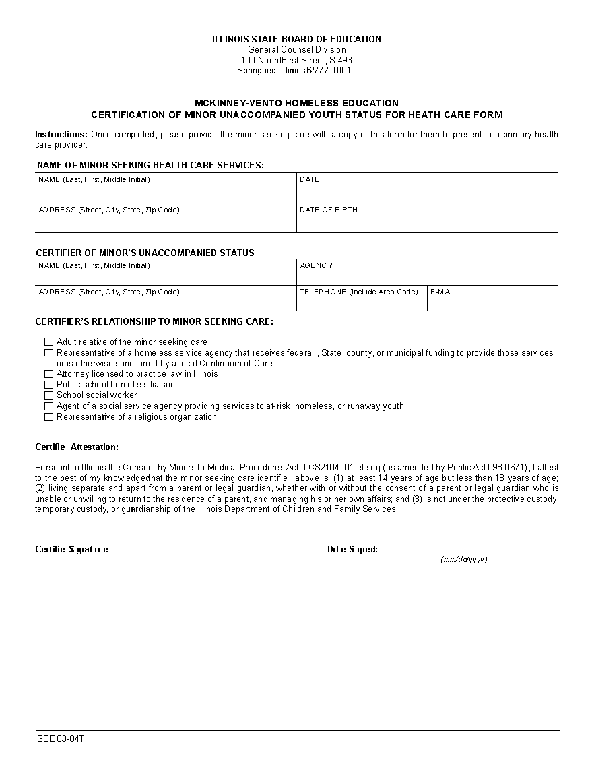
Minor consent to healthcare—Unaccompanied homeless youth
Can consent to non-invasive outpatient services
Must be 14+, not living with adult guardian, and managing own affairs
Must have written verification confirming the above from
An adult relative;
A social service provider;
An attorney;
A school liaison or social worker; or
A representative of a religious institution
IL State Board of Education’s Homeless Certification of Minor Unaccompanied Youth Status for Health Care: http://www.isbe.net/homeless/pdf/83-04T-MKV-cert-minor-health-form.pdf

Slide 15
Minor consent to healthcare—mental health HB3709, Increasing Access to Counseling Services
What does it do?
Amends Mental Health and Developmental Disabilities Code (405 ILCS 5-3/500)
Five, 45-minute sessions → Eight, 90-minute sessions
Continued counselling without adult consent if adult consent detrimental to minor’s well-being
Requiring the consent or notification would cause minor to reject the services;
Failure to provide the services would be detrimental to minor’s well-being;
Minor knowingly/voluntarily sought the services; and
Service provider believes the minor to be mature enough to participate in services productively.
Presumption of detriment if counselling related to neglect or sexual, mental, or physical abuse by the adult

Slide 16
Minor consent to healthcare—mental health HB3709, Increasing Access to Counseling Services
Who was involved?
Advocates: legal, social, and medical service providers across Illinois that work with youth
Sponsors: Rep. Wallace (D-Rockford), Sen. Lightford (D-Westchester).
Signed by Governor Rauner 8/18/17
Effective 1/1/18
Who Benefits?
Unaccompanied homeless minors
LGBTQ youth
Minors in need of early intervention for mental health crisis
Minors in conflict with their family

Slide 17
Minor consent to healthcare—mental health HB3709, Increasing Access to Counseling Services
Why is the expansion so important?
Improves quality of services
Builds trust between service providers and minors
Reduces harm by providing minors more tools to make good and safe decisions
Strengthens families by giving minors the courage and capacity to talk to their caregivers productively in a way that can strengthen their bond
“Providers are in a good position to help heal families by working with youth who are running away, homeless or otherwise estranged. This legislation expands the possibility for youth to seek help from licensed providers, get short-term support, and it often leads to reunification with their families.”
-Dr. Niranjan S. Karnik, Rush University Medical Center psychiatrist

Slide 18
Public benefits—SNAP
“Unaccompanied minors may sign their own application for SNAP, cash and medical benefits. For SNAP, a youth who meets the definition of homeless should not be required to apply for benefits as a part of the adult's household with whom they are temporarily living if they have not been there for longer than 90 days.”
DHS/HFS Unaccompanied Minors (11/24/15) Information Memo
Eligibility based on income and who the youth prepares and eats meals with (no age minimum or limit), no guardian required
US citizens and limited number of non-citizens (crime victims, refugees)
Minors <18 under “parental control” of any adult must be on that adult’s account. At 18, no longer required to be on adult’s account unless living with parents/guardians.
Must be on parent’s SNAP account until age 22 if living with parent regardless of purchasing/preparing meals together

Slide 19
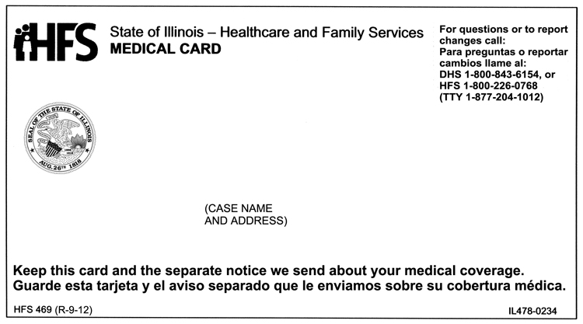
Public benefits—Medicaid
Eligibility for IL youth: live in IL, US citizen or legal resident; and low-income
Minors can get their own medical card if <19 and not living with a parent
Minors considered living on their own after 90 days
Medicaid will pay any medical bills three months prior to application date
Can apply online for SNAP, Medicaid, and cash benefits at www.abe.illinois.gov, by phone (800-843-6154), in person, or by fax

Slide 20
Overcoming Barriers to Identification
Diane O’Connell

Slide 21
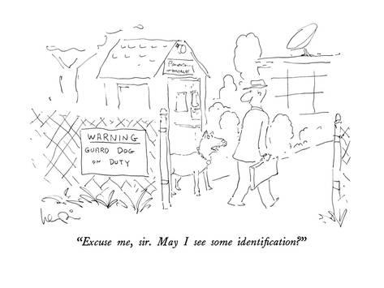
Why do Clients Need ID’s?
Work
Housing
Bank Accounts and Check Cashing
Travel
School Enrollment

Slide 22
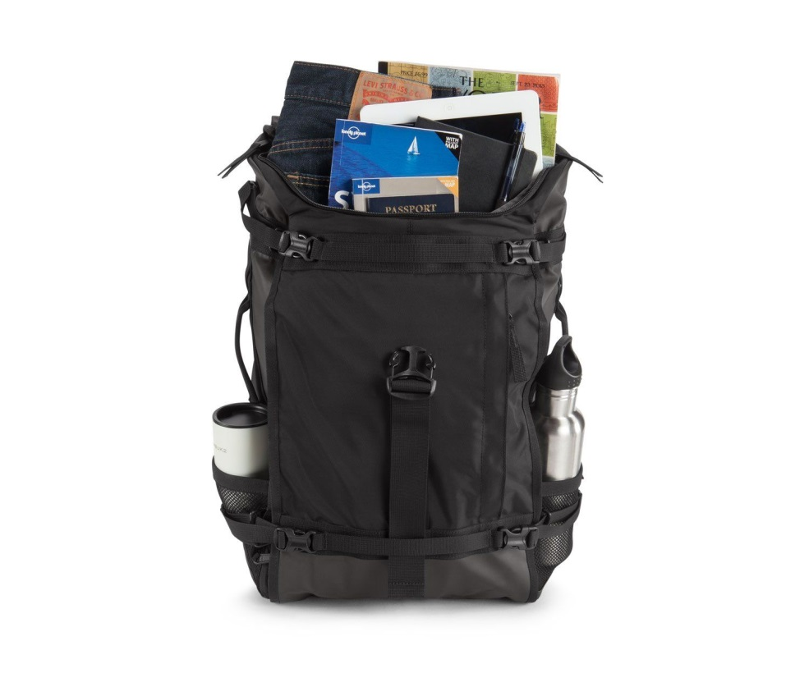
Why Don’t Clients have IDs?
Unstable housing led to losing all their possessions
Estranged from family as a youth
Came to the US as a child and don’t know their immigration status or are mistaken about it
Lost or stolen

Slide 23
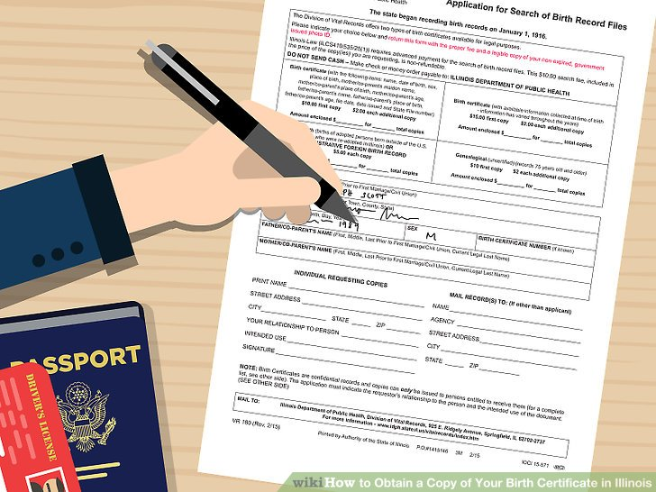
Getting an ID without any ID: a Vicious Cycle!
State ID
Birth Certificate
Social Security Card
Need BC, SS, & Proof of residency
Need ID
Need BC and ID

Slide 24
Birth Certificates for Minors and Children
In IL and other states, attorneys need written authorization from the parent to obtain a minor’s certificate
Cook County recently approved attorneys to obtain certificates for Unaccompanied Minors (under 18 and on their own) using a specific form
For Unaccompanied Minors in other states or counties, it may not be possible.
Cost =
$15 – Cook County
$10 – IL Vital Records
$8–35 – other state vital records offices

Slide 25
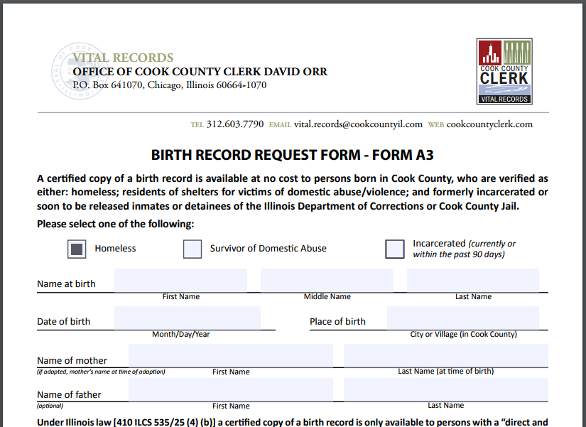
Birth Certificates are FREE in Cook County for Homeless people and others
New ordinance as of April 2017 made birth certificates free for:
Homeless (doubled-up, shelter, transitional housing)
Victims of domestic violence
Individuals in Cook County jail or IDOC, or who have been released in the last 90 days
County has special form that requires certification from a non-profit, service provider, or attorney (preview on right)
New state law takes effect January 2018 making birth certificates free for homeless people in Illinois

Slide 26
Social Security Card is Key
You can’t get a new ID in Illinois without it unless you have a Military ID, a DD214, or a Social Security Award Letter (primary beneficiary)
To get you Social Security Card, you need a US birth certificate or proof of immigration status and a second form of ID
Mailing address

Slide 27
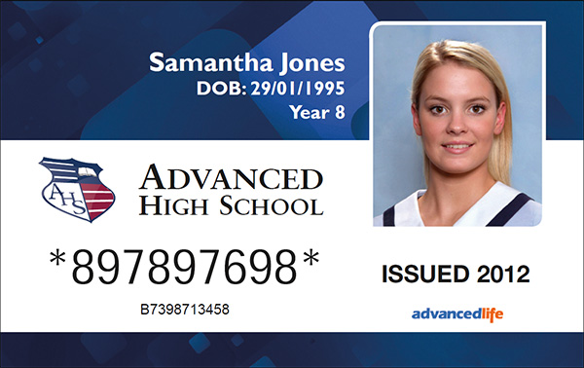
Replacement Social Security Card for US-Born Citizens
In addition to their birth certificate, they will need another document to prove their identity. These can include:
School ID
Work ID
Military ID
Official School Transcript
Medical Records
Medical Insurance Card (not paper “medical card”)

Slide 28
Social Security Card for Non-Citizens
Non-Citizens who have permission to work can apply for a Social Security Number or may have one already
For a replacement card for a non-citizen, you must provide proof of identity and proof of immigration status, such as:
Form I-551 (Lawful Permanent Resident Card, Machine Readable Immigrant Visa);
I-766 (Employment Authorization Document, EAD, work permit); or
I-94 (Arrival/Departure Record) or admission stamp in the unexpired foreign passport

Slide 29
Changes to Illinois ID Law
In 2016 the Secretary of State implemented changes to move towards compliance with Federal Real ID Act
Applicants are now issued a Temporary ID on the day of application. Valid for 45 days
Permanent ID is mailed within 30 days

Slide 30
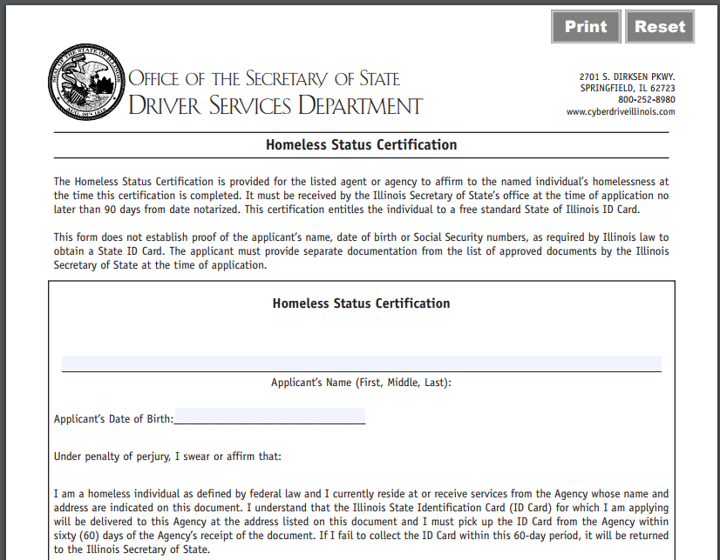
Homeless Certification Letter
Enables a homeless person to obtain a free Illinois State ID
Also serves as proof of residency!
Homeless means on the street, staying in a shelter, or couch surfing / sharing the housing of others due to economic hardship. See McKinney-Vento Homeless Assistance Act, 42 U.S.C. 11302 or 42 U.S.C. 11434a(2).
The individual must also bring a completed Homeless Status Certification Form. Can be signed by a lawyer or other service provider
Form needs to be notarized

Slide 31
Criminalization of Homeless Children and Youth

Slide 32
Criminalization of Homeless Children & Youth
Homeless people experience criminalization disproportionally because of:
Being outside
Crimes of Poverty and Survival
Racial injustice
Inability to pay bail bonds
Lack of an address
Discriminatory Parole and Probation Rules, IEM

Slide 33
Children and Youth are affected by Criminalization in Unique & Devastating Ways
Some reasons:
Overlap between school and criminal punishment
Intersection between DCFS and criminal punishment for minors
Policies and Laws that require solitary confinement for youth and restrict access to counsel for minors
Trauma

Slide 34
Criminalization Creates Barriers
Housing, including public housing
Jobs and Certifications
Education, eligibility for FAFSA

Slide 35
Advocacy that Reduces Barriers
Bond Reform
More Representation and Earlier Intervention
FDLA
Alternatives to the Public Defender (CCH, CGLA)
Decriminalization of Loitering, Trespassing, Gang Involvement, Drugs, Non-Violent Offenses
Alternative Prosecution isn’t always the answer
Sex Offender Registry
Homeless Bill of Rights

Slide 36
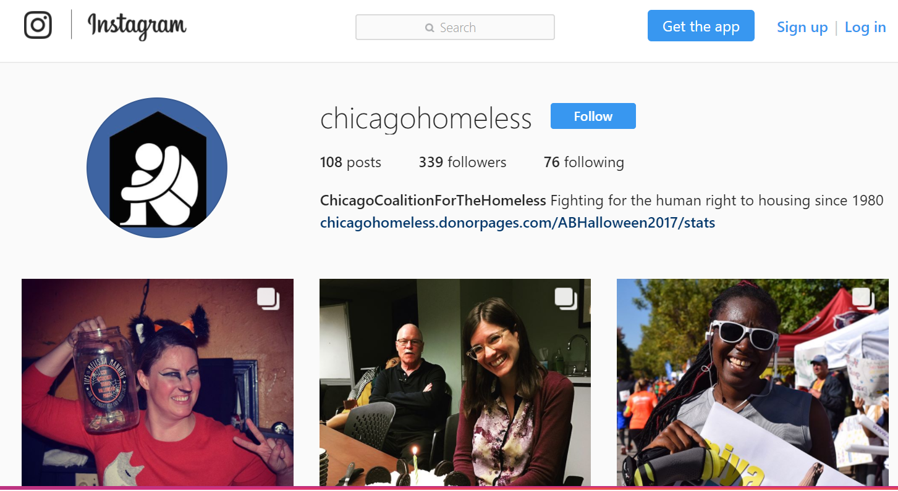
Continue to follow our work!
Follow us on:
Facebook: https://www.facebook.com/ChicagoHomeless/
Twitter: @ChiHomeless
Instagram: ChicagoHomeless
Website: chicagohomeless.org

