Slide 1

The McKinney-Vento Act as amended by the Every Student Succeeds Act of 2015

Slide 2
NAEHCY
National membership association dedicated to educational excellence for children and youth experiencing homelessness, from early childhood through higher education.
  Local Youth Task Forces, State Higher Ed Networks, Early Childhood Committee
Technical assistance on policy implementation.
Professional Development and Training
Youth leadership and support.

Slide 3
Overview
Context and data
State Coordinators and Liaisons
Eligibility and identification
School of origin
Immediate enrollment
Disputes
Title I
Higher education

Slide 4
Causes of Homelessness
Lack of affordable housing.
Poverty.
  Increase in low v. middle wage employment.
Health problems.
  Lack of health insurance.
  Addiction disorders, Mental health.
Domestic violence.
Natural and other disasters.
Abuse/neglect/family dysfunction (unaccompanied youth).
Notes:
Blue collar, “middle income” jobs (annual income $32,000-$53,000) are at a net loss of over 900,000 since before the recession. On the other hand, low wage jobs have increased. High wage jobs requiring at least a college degree also have risen. National Employment Law Project (2014), The Low-Wage Recovery. Georgetown Center on Education and the Workforce (2015), Good Jobs Are Back.

Slide 5
How many students experience homelessness?
Public schools identified 1.3 million McKinney-Vento students in the 2015–16 school year.
  4% increase nationally over previous year.
  A 104% increase since 2007.
  13% of all poor, school-age children and youth.
  30% of all extremely poor, school-age children and youth.

Slide 6
Barriers to Education for
Homeless Children and Youth
Stereotypes and lack of awareness.
Under-identification.
High mobility resulting in lack of school stability and educational continuity.
Enrollment requirements (school records, health records, proof of residence, guardianship).
Poor health, fatigue, hunger.
Emotional trauma, depression, anxiety.
Lack of transportation.
Lack of school supplies, clothing, etc.

Slide 7
Impacts of Homelessness on Children and Youth
Higher incidences of acute and chronic illnesses, depression and anxiety.
Homelessness in early childhood is associated with poor classroom engagement and poor social skills in early elementary school.
The achievement gaps between homeless and low-income elementary students tend to persist, and may even worsen, over time.
A youth who experiences homelessness is 87% more likely to drop out of school.

Slide 8

By Civic Enterprises and Hart Research Associates
www.gradnation.org/homeless

Slide 9
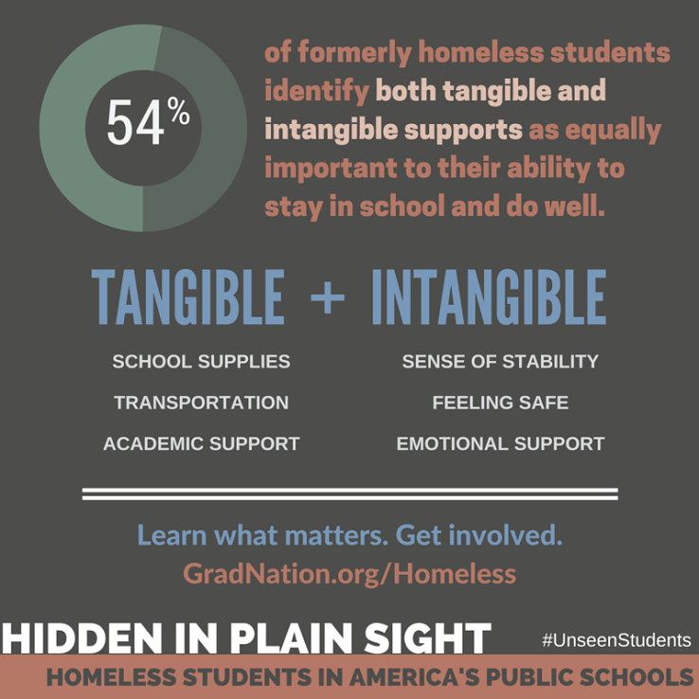

Slide 10
Hidden in Plain Sight: Youth Voices
42% say they dropped out of school at least once; 60% say it was hard to stay in school while they were homeless.
67% say they were uncomfortable talking with people at their school about their housing situation and related challenges.
61% say they were never connected with any outside organization while homeless; 87% of those who were connected found the help valuable.

Slide 11
McKinney-Vento
Homeless Assistance Act
Originally passed in 1987.
Reauthorized in 2015 by the Every Student Succeeds Act (ESSA).
  Amendments take effect October 1, 2016.
Works hand-in-hand with Title IA and other federal education programs.
$85 million authorized funding to SEAs.
  Largest percentage increase of all federal education programs.
  SEAs award competitive subgrants to LEAs.

Slide 12
McKinney-Vento
Homeless Assistance Act
Main themes:
  Identification.
  School stability.
  School enrollment.
  Support for academic success.
  Child-centered, best interest decision making.

Slide 13
Statute, Non-Regulatory Guidance, and Best Practices
Statute
  Actual law as cited
Non-Regulatory Guidance
  Guidance provided by the U.S. Department of Education which assists LEAs in interpreting implementation
Best Practice
  Suggestions on how to effectively implement statute

Slide 14
McKinney-Vento Implementers:
State Coordinators
Every state must designate a State Coordinator who can sufficiently carry out their duties.
State coordinators must:
    Conduct monitoring of local educational agencies (LEAs) and ensure compliance.
    Post on the SEA website, and annually update, a list of liaisons’ contact information and duties, and data on student homelessness.
    Respond to inquiries from homeless parents and unaccompanied youth to ensure they receive the full protections of the law.

Slide 15
State Coordinators (cont.)
State coordinators must:
  Implement professional development programs for liaisons and other LEA personnel to improve their identification of McKinney-Vento children and youth and heighten their awareness of, and capacity to respond to, specific needs in those children’s and youths’ education.
“State Coordinators should coordinate with State and local policymakers to ensure that legislation and policies do not create barriers” (Guidance E8)

Slide 16
McKinney-Vento Implementers:
Local Liaisons
Every LEA must designate a McKinney-Vento liaison able to carry out his/her legal duties. 11432(g)(6)
  LEA administrators should review: (Guidance p. 15)
  The legal requirements for the position
  Data on prevalence and needs of McKinney-Vento students
  Efforts that may be necessary to improve identification
  Past TA provided to the LEA (monitoring findings)

Slide 17
Hidden in Plain Sight: Liaison Voices
Over 90% of liaisons report that they work in another official capacity; 89% say they spend just half of their time or less on their responsibilities as liaisons.
One-third of liaisons (34 percent) reported that they are the only person within their school district who receives training to help identify and intervene with homeless youth and families.
88% of liaisons say they believe the young people they work with can graduate from high school college- and career-ready if given the right supports.

Slide 18
McKinney-Vento Liaisons (cont.)
Liaisons must ensure that—
  McKinney-Vento students enroll in and have full and equal opportunity to succeed in school.
  McKinney-Vento students are identified by school personnel through outreach and coordination with other entities and agencies.
    Identification should be part of all LEA needs assessments and school improvement plans. (Guidance F4)
  Public notice of MV rights is disseminated in locations frequented by parents, guardians, and unaccompanied youth, in a manner and form understandable to them.

Slide 19
McKinney-Vento Liaisons (cont.)
Liaisons must ensure that (cont.)—
  School personnel providing McKinney-Vento services receive professional development and other support.
  Children, youth and families have access to and receive educational services for which they are eligible, including Head Start, early intervention (IDEA Part C) and other preschool programs.
  Children, youth and families receive referrals to health care, dental, mental health, substance abuse, housing and other services.

Slide 20
McKinney-Vento Liaisons (cont.)
Liaisons must ensure that (cont.)—
  Disputes are resolved and assistance to access transportation is provided.
  Unaccompanied youth are enrolled in school and that procedures are implemented to identify and remove barriers that prevent them from receiving credit for full or partial coursework satisfactorily completed at a prior school, in accordance with State, local, and school policies.
Liaisons must participate in professional development and technical assistance as determined appropriate by the State Coordinator.
11432(g)(1)(F)(ii)

Slide 21
Eligibility—Who is Covered?
Children who lack a fixed, regular, and adequate nighttime residence— 11434a(2)
  Sharing the housing of others due to loss of housing, economic hardship, or similar reason.
  [76% of identified MV students in 2015–16]
  Living in motels, hotels, trailer parks, camping grounds due to lack of adequate alternative accommodations.
  [Motels: 7% of identified MV students in 2015–16]

Slide 22
Eligibility (cont.)
Children who lack a fixed, regular, and adequate nighttime residence—
  Living in emergency or transitional shelters.
  [14% of identified MV students in 2015–16]
  Living in a public or private place not designed for humans to live.
  Living in cars, parks, abandoned buildings, substandard housing, bus or train stations, or similar settings.
    Utilities; infestations; mold; dangers (Guidance A3)
  Awaiting foster care placement (removed 12/10/16).

Slide 23
Eligibility: Context for the Definition
Shelters do not exist in many suburban and rural areas, and often are full where they do exist.
Eligibility conditions of shelters sometimes exclude families with boys over the age of 12, or unaccompanied minors.
Youth on their own fear adult shelters and have no safe living options in many communities.
Shelters often have 30, 60, or 90 day time limits.
Motels may not be available, or may be too expensive or unsafe.
Families/youth may be unaware of alternatives, fleeing in crisis.

Slide 24
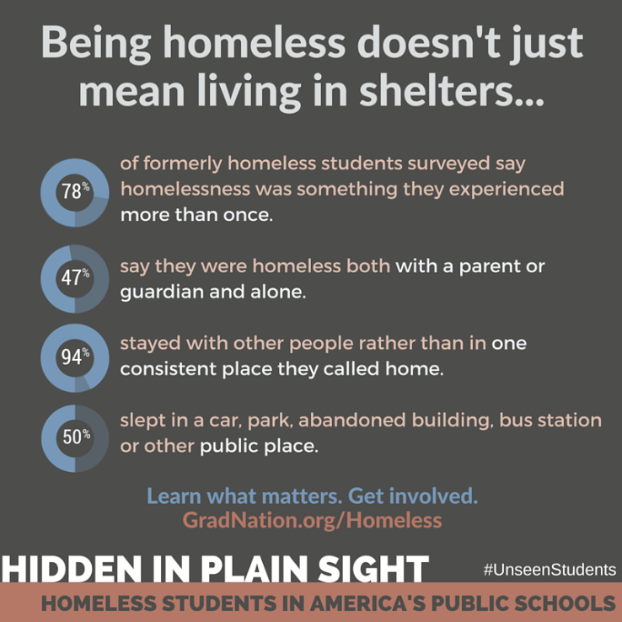

Slide 25
Unaccompanied Homeless Youth
Definition: child or youth who meets the McKinney-Vento definition and is not in the physical custody of a parent or guardian. 11434a(6)
  Many youth become separated from parents due to lack of space in living situations or shelter policies.
  Many flee abuse: 20-50% sexual; 40-60% physical.
  Many flee family dysfunction: Over 2/3 Hotline callers report at least one parent abuses drugs or alcohol.
  Roughly 1/3 homeless youth identify as LGBTQ.
  10% of currently homeless female teens are pregnant.
  Many are not enrolled in school.

Slide 26
Determining Eligibility
Case-by-case determination.
Get as much information as possible (with sensitivity and discretion).
Look at the MV definition (specific examples in the definition first, then overall definition).
Considerations for families/youth who are staying with other people:
    Where would you go if you couldn’t stay here?
    What led you to move in to this situation?
NCHE’s Determining Eligibility brief is available at http://www.serve.org/nche/downloads/briefs/det_elig.pdf

Slide 27
Identification Strategies
Avoid using the word "homeless” with school personnel, families, or youth.
Provide awareness activities for school staff (registrars, secretaries, counselors, nurses, teachers, tutors, bus drivers, security officers, drop out prevention specialists, attendance officers, administrators, etc.).
  http://www.naehcy.org/educational-resources/videos
  http://center.serve.org/nche/web/online_tr.php
Post outreach materials and posters in all schools and where there is a frequent influx of low-income families and youth in high-risk situations, including motels, campgrounds, libraries, health center, youth services.
  http://www.k12.wa.us/HomelessEd/Posters.aspx

Slide 28
Identification Strategies (cont.)
Coordinate with community service agencies, such as shelters, soup kitchens, law enforcement, legal aid, public assistance and housing agencies, mental health agencies and public health departments.
Coordinate with youth-serving agencies, such as drop-in centers, street outreach, child welfare, juvenile courts, teen parent programs, LGBTQ youth organizations.
Make special efforts to identify preschool children, including asking about siblings of school-aged children.
Use enrollment and withdrawal forms to inquire about living situations.
  www.utdanacenter.org/theo/downloads/factsheets/RP14_SRQ.doc

Slide 29
Now that We Know Who
What does the McKinney-Vento Act provide?
  School Stability.
  Enrollment.
  Support for Academic Success.

Slide 30
Research on School Stability
Highly mobile students have lower test scores and worse overall academic performance than peers who do not change schools.
Mobility also hurts non-mobile students; study found average test scores for non-mobile students were significantly lower in high schools with high student mobility rates.
Students who changed high schools even once during high school were less than half as likely as stable students to graduate, even controlling for other factors.
Hidden in Plain Sight: almost half of homeless students (49 percent) had to change schools, and many did so multiple times.

Slide 31
School Stability
Each LEA shall, according to each child’s or youth’s best interest:
Continue the student’s education in the school of origin for the duration of homelessness, and until the end of the academic year in which the student becomes permanently housed; OR
Enroll in any public school that housed students living where the student is living are eligible to attend.
11432(g)(3)(A)

Slide 32
School Stability (cont.)
School of origin is the school attended when permanently housed or school in which last enrolled, including a preschool. 11432(g)(3)(I); Guidance N4; Fed. Data Guide
  Publicly-funded program for children 0-5 for which the LEA is a financial or administrative agent, or is accountable for providing early childhood education.
  Preschools operated, administered or funded by an LEA, including those funded by Title I or similar government grants.
  Head Start program receiving LEA funding or for which the LEA is the grant recipient.
  Preschool special education.
  LEA funded or administered home-based early childhood services.
Notes:
Law just says “preschool.” I think we’re assuming (in the absence of further guidance) that it means public preschools administered by an LEA. So most preK, some Head Start and other ECE programs. Clarify that there must be an actual feeder pattern, where there actually is a designated receiving school. And that it is based on best interest (flows into next slide).

Slide 33
School Stability (cont.)
School of origin includes the designated receiving school at the next grade level for feeder school patterns, when the student completes the final grade level served by the school of origin.
  Student enrolled in School A in grade 5, the final grade level served by School A. Students at School A are designated to attend School B for grade 6. The school of origin for the student at the conclusion of grade 5 would be School B. (Guidance I3)

Slide 34
School Stability (cont.)
In determining best interest, the LEA shall:
Presume that keeping the student in the school of origin is in the student’s best interest. 11432(g)(3)(B)(i)-(ii)
  Unless contrary to the request of the parent, guardian, or unaccompanied youth.
Consider student-centered factors, including the impact of mobility on achievement, education, health, and safety.
  For preschoolers, attachment to teachers; availability and quality of services in the new area; travel time. (Guidance N3)
Give priority to the parent’s/guardian’s request.
Give priority to unaccompanied youth’s request.
Notes:
Mention that this essentially brings USED guidance into the law. Point out specifically that “to the extent feasible” no longer is in the law. Point out priority to UY (used to be “consider the wishes”)

Slide 35
School Stability (cont.)
If the LEA determines that it is not in the student’s best interest to attend the school of origin or the school requested by the parent, guardian or youth, the LEA must provide a written explanation of the reasons for its determination, in a manner and form understandable to such parent, guardian, or unaccompanied youth, including information regarding the right to appeal. 11432(g)(3)(B)(iii)

Slide 36
Transportation
1. LEAs must provide transportation to and from the school/preschool of origin, including until the end of the year when the student obtains permanent housing, at a parent’s or guardian’s request (or at the liaison’s request for unaccompanied youth).
  If staying in the same LEA, that LEA must provide or arrange transportation to the school of origin.
  If crossing LEA lines, both LEAs must determine how to divide the responsibility and share the cost, or they must share the cost equally.
  11432(g)(1)(J)(iii); Guidance J5

Slide 37
Transportation—Key Provisions
2. LEAs also must provide students in homeless situations with transportation services comparable to those provided to other students. 11432(g)(4)(A)
SEAs and LEAs must review and revise transportation policies that may act as barriers to identification, enrollment, attendance or success. 11432(g)(1)(I); Guidance J1
Transportation must be arranged promptly to ensure immediate enrollment and not create barriers to attendance, retention or success. Guidance J1

Slide 38
Transportation Strategies
Develop close ties among local liaisons, school staff, pupil transportation staff, and shelter workers.
Use technology such as a transportation database to maintain records, plot routes and make requests.
Use school buses (including special education, magnet school and other buses).
Develop formal or informal agreements with school districts where homeless children cross district lines.
Use public transit where feasible, including supporting parents to travel with younger children.
Use approved carpools, van or taxi services.
Develop a system for gas vouchers for parents and youth with access to cars.
Pursue inter-agency solutions.

Slide 39
School Enrollment:
Barriers from Hidden in Plain Sight
3 out of 5 homeless youth who had to change schools at some point during their homelessness report that this process was difficult to navigate, given the various logistical and legal barriers that they experienced.
Majorities of homeless youth said that proof of residency requirements (62 percent) and lack of cooperation between their new and old schools (56 percent) posed a major challenge for them while changing schools
Other key challenges that made changing schools or enrolling in a new school difficult included behind on credits due to missing school (48 percent).

Slide 40
School Enrollment
When remaining in the school of origin is not in the student’s best interest or what the parent, guardian or youth requests: 11432(g)(3)(C)(i)
McKinney-Vento students are entitled to immediate enrollment in any public school that students living in the same attendance area are eligible to attend; even if:
  Students do not have required documents, such as school records, records of immunization and other required health records, proof of residency, guardianship, or other documents; or
  Students have missed application or enrollment deadlines during any period of homelessness.

Slide 41
Enrollment (cont.)
“Enrollment” includes attending classes and participating fully in school activities. 11434a(1)
SEAs and LEAs must develop, review, and revise policies to remove barriers to the identification, enrollment and retention of children and youth in homeless situations, including barriers due to outstanding fees or fines, or absences. 11432(g)(1)(I)
  “Broad, on-going requirement… with regular input from homeless parents, youth, and advocates so that new barriers… do not prevent” students from full, immediate enrollment and services. (Guidance A4)

Slide 42
Enrollment (cont.)
If a student does not have immunizations, or immunization or other health records or screenings, the liaison must immediately assist in obtaining them; the student must be enrolled in the interim. 11432(g)(3)(C)(iii)
Enrolling schools must obtain school records from the previous school, and students must be enrolled in school while records are obtained.
  11432(g)(3)(C)(ii)
Schools must maintain McKinney-Vento students’ records so they are available quickly. 11432(g)(3)(D)

Slide 43
Immediate Enrollment— Strategies
Request all records from the previous school immediately, including immunization records.
  Parental signature is not required for transfer students.
  The vast majority of students have been enrolled in school before and have received immunizations.
Speak with parents and youth about the classes the student was in, previous coursework and special needs.
Call the counselor, teachers or principal at the previous school for information.
Ensure enrollment staff on every campus are aware of the law and procedures.

Slide 44
Enrollment of Unaccompanied Youth
Immediate enrollment applies, even without parent or guardian. 11432(g)(1)(H)(iv)
  Youth self-enrollment; Caregiver forms
Liaisons must help unaccompanied youth choose and enroll in a school, give priority to the youth’s wishes, and inform the youth of his or her appeal rights. 11432(G)(3)(B)(iv)
School personnel (administrators, teachers, attendance officers, enrollment personnel) must be made aware of the specific needs of runaway and homeless youth. 11432(g)(1)(D)

Slide 45
Unaccompanied Youth—Strategies
Develop clear policies for enrolling unaccompanied youth immediately, whether youth enroll themselves, liaisons do enrollment, caretakers enroll youth in their care, or another procedure is in place. Offer youth an adult and peer mentor.
Establish systems to monitor youth’s attendance and performance, and let youth know you’ll be checking up on them.
Help youth participate fully in school (clubs, sports, homework help, etc.)
Build trust! Be patient, and ensure discretion and confidentiality when working with youth.

Slide 46
Young Children and Homelessness
51% of all children in HUD homeless shelters are under the age of 6.
The age at which a person is most likely to stay in a homeless shelter in the United States is infancy (under age 1).
52,708 homeless children ages 3-5 were enrolled in public preK programs in 2015-2016; a 5% increase from the previous year and 4% of all students identified as homeless by public schools.

Slide 47
Enrollment in Preschool
State McKinney-Vento plans must describe procedures that ensure that homeless children have access to public preschool programs administered by the SEA or LEAs. 11432(g)(1)(F)(i)
Preschools are included in the school of origin definition. 11432(g)(3)(I)
Liaisons must ensure access to Head Start, early intervention (IDEA Part C), and other preschool programs administered by the LEA.
11432(g)(6)(A)(iii)

Slide 48
Preschool Enrollment— Strategies
Facilitate enrollment: include homelessness in needs assessments and priorities; put McKinney-Vento families at the top of waiting lists; provide enrollment forms on-site at shelters and motels.
Expedite records by working together: joint release forms; share records within a family.
Develop joint/streamlined procedures and forms: joint intake forms; provide uninterrupted services as children move.
Work with families and providers to meet school of origin and comparable transportation requirements appropriately for young children.
Cross-train preschool, school, and service providers.

Slide 49
Dispute Resolution
If a dispute arises over eligibility, school selection or enrollment in a school (including full participation):
The student shall be immediately enrolled in the school in which enrollment is sought, pending resolution of the dispute (including all available appeals).
The parent, guardian or unaccompanied youth must be provided a written explanation of decisions made by the school, LEA or SEA, and how to appeal them.
The parent, guardian or youth must be referred to the liaison, who must carry out the dispute resolution process as expeditiously as possible.
The liaison shall ensure unaccompanied youth are immediately enrolled pending resolution of the dispute.
11432(g)(3)(E); Guidance K2

Slide 50
Avoiding Disputes
Designate and train appropriate liaisons and school-based contacts. 11432(g)(1)(J)(ii), (iv); 11432(g)(6)(A)(ix)
Rectify concerns raised during monitoring.
  States are now required to monitor LEAs. 11432(f)(5)
Develop and implement good local policies on school discipline, identification, enrollment, retention; barriers due to fees, fines, and absences; credit accrual; full participation in academic and extra-curricular activities; enrollment of unaccompanied youth; school stability; transportation; privacy; inter-district collaboration.

Slide 51
Support for Academic Success:
Full Participation
States must have procedures to eliminate barriers to academic and extracurricular activities, including magnet school, summer school, career and technical education, advanced placement, online learning, and charter school programs. 11432(g)(1)(F)(iii)
LEAs should anticipate and accommodate the needs of McKinney-Vento students to enter these programs and consider giving them priority on waitlists. (Guidance I6)
SEAs and LEAs should develop policies to expedite full participation in extracurricular activities and work with athletic associations to adjust policies to facilitate participation. (Guidance p. 25)

Slide 52
Support for Academic Success:
Credit Accrual and School Climate
LEAs must have procedures to ensure McKinney-Vento students receive appropriate full or partial credit, such as: consulting with prior school about partial coursework completed; evaluating students’ mastery of partly completed courses; offering credit recovery. 11432(g)(1)(F)(ii); 11432(g)(6)(A)(x); Guidance O2
SEAs and LEAs should ensure school personnel consider issues related to homelessness prior to taking disciplinary action. (Guidance p. 33)
SEAs and LEAs should provide training on the traumatic impacts of homelessness and how to provide trauma-informed support. (Guidance p. 34)

Slide 53
Support for Academic Success:
Transitioning to Higher Education
All McKinney-Vento youth must be able to receive individualized counseling from counselors to prepare and improve their readiness for college, including college selection, application, financial aid, and on-campus supports. 11432(g)(1)(K); Guidance Q1
Liaisons must ensure unaccompanied youth are informed of their status as independent students and obtain verification of that status.
11432(g)(6)(A)(x)(III); Guidance Q2

Slide 54
Support for Academic Success:
Coordination with Other Laws/Programs
LEAs must coordinate McKinney-Vento and special education services within the LEA, and with other involved LEAs. 11432(g)(5)(D)
Information about a McKinney-Vento student’s living situation is a student education record subject to FERPA. 11432(g)(3)(G)
Local liaisons are authorized to affirm that students meet the Department of Housing and Urban Development (HUD) definition of homelessness, to qualify them for HUD homeless assistance programs. 11432(g)(6)(D)

Slide 55
Support for Academic Success:
National School Lunch Act
McKinney-Vento students are automatically eligible for free school meals.
USDA policy permits liaisons and shelter directors to obtain free school meals for students immediately by providing a list of names of students experiencing homelessness with effective dates.
http://www.naehcy.org/educational-resources/food
http://center.serve.org/nche/downloads/briefs/nutrition.pdf

Slide 56
Charter Schools
States receiving charter school grants under Title IV Part C (starting 2017-18 school year) must work with charter schools on recruitment and enrollment practices to promote inclusion of all students, including by eliminating any barriers to enrollment for foster youth and unaccompanied homeless youth.

Slide 57
Support for Success: Title IA
Amendments took effect 2017-18 school year.
McKinney-Vento students attending any school in the LEA are automatically eligible for Title IA services. 20 USC 6315(c)(2)(E); Guidance M1
State report cards must disaggregate achievement and high school graduation data for McKinney-Vento students. 20 USC 6311(h)(1)(c)

Slide 58
Support for Success: Title IA
Local plans must: 20 USC 6312(a)(1); (b)(6)
  Be coordinated with McKinney-Vento programs.
  Describe the services provided to McKinney-Vento students, including with reserved funds, to support their enrollment, attendance and success.
Local plans should describe: (Guidance M8)
  The method used for determined the amount of funds reserved for students experiencing homelessness;
  How the amount was determined; and
  How the liaison was involved in determining the amount.

Slide 59
Title IA: Reservation of Funds
All LEAs that receive Title IA funds must reserve (set aside) the funds necessary to provide homeless children services comparable to services provided in Title IA schools. 20 USC 6313(c)(3)
  Amount must be based on the total LEA allocation prior to expenditures or transfers.
  Amount must be sufficient to provide comparable services to homeless students, regardless of other services provided with reserved funds. (Guidance M5)

Slide 60
Title IA: Reservation of Funds
LEA set-aside amounts may be determined based on a needs assessment that reviews homeless student enrollment averages and trends over 2-3 years and multiplies by the average per-pupil cost of providing Title I services.
The needs of McKinney-Vento students should be reviewed at least more than once per school year.
Each year’s set-aside should include an evaluation of past activities’ effectiveness in accomplishing the goals of both Title I and McKinney-Vento for individual students and the overall programs. (Guidance M7)

Slide 61
Title IA Reservation (cont.)
Funds may be used: 20 USC 6313(c)(3)
    For homeless children and youth attending any school in the LEA. (Guidance M5)
    For services not ordinarily provided to other students. (Guidance M4, M5)
    To fund the McKinney-Vento liaison. (Guidance M10)
    To provide transportation to the school of origin. (Guidance J7)
    For educationally related support services, including preK.
Notes:
All of this is in the law, including the first bullet– if funds can be used for the liaison, then they can be used for students in any school, because the liaison’s duties inherently touch on ALL homeless students. You can’t distinguish whether putting up a poster or information on a website or instituting enrollment forms or trainings ONLY effect students in participating schools.

Slide 62
Title IA Reservation (cont.)
USED Examples of Uses of Title IA funds:
  Clothing, particularly if necessary for dress code or physical education classes.
  Fees to participate in the general ed program.
  School supplies
  Birth certificates necessary to enroll in school
  Food (in connection with educational programming)
  Medical and dental services, immunizations, glasses, hearing aids
  Counseling services
  Outreach services
  Extended learning time; Tutoring services
  Fees for AP, IB, GED testing (Guidance M4)

Slide 63
Title IA Reservation (cont.)
USED’s guiding principles for using Title IA funds: (Guidance M4)
  Services must be reasonable and necessary to enable homeless students to take advantage of educational opportunities.
  Funds must be used as a last resort when services are not reasonably available from another public or private source.

Slide 64
Higher Education Act:
The FAFSA and Homeless Students
Youth who meet the definition of “independent student” can complete the FAFSA without parental income information or signature.
Unaccompanied youth are automatically considered independent students.
  Must be determined to be unaccompanied and homeless after July 1 of the prior year.
Youth who are unaccompanied, at risk of homelessness, and self-supporting are also automatically considered independent students.
  Must be determined as such during the school year in which the application is submitted.

Slide 65
The FAFSA (cont.)
Determination must be made by:
  McKinney-Vento school district liaison (while student is in high school and after, for as long as liaison has information necessary to make the determination),
  HUD homeless assistance program director/designee
  Runaway and Homeless Youth Act program director or designee, or
  a financial aid administrator.
Youth who have been in foster care at any time after age 13 are also automatically independent.
More info and sample letters are available at: http://www.naehcy.org/educational-resources/higher-ed

Slide 66
Title I Part A Amendments:
Foster Care – the Short Version
Creates new Title I, Part A assurances that will provide ALL children in any stage of foster care proceedings with protections similar to McKinney-Vento (but not through MV).
LEAs are not required to provide school of origin transportation, if there are additional costs, unless they are reimbursed by the child welfare agency or agree to provide it.
Removes awaiting foster care placement from the McKinney-Vento Act one year after enactment.

Slide 67
Title I Part A Amendments:
Foster Care – State Title I Plans (1)
State Title I Plans must describe the steps the SEA will take to ensure collaboration with the State child welfare agency to ensure the educational stability of children in foster care, including assurances that:
Foster youth remain in their school of origin, unless a determination is made that it is not in their best interest.
When a determination is made that it is not in the best interest to remain in the school of origin, the child must be immediately enrolled in a new school.

Slide 68
Title I Part A Amendments:
Foster Care – State Title I Plans (2)
The SEA designates a point of contact for child welfare agencies, who will oversee implementation of the SEA responsibilities.
The SEA point of contact may not be the same person as the McKinney-Vento State Coordinator.

Slide 69
Title I, Part A Amendments:
Foster Care-- Local Title I Plans (1)
Local Title I plans must contain an assurance that the LEA will collaborate with the state or local child welfare agency to:
Designate a point of contact if the corresponding child welfare agencies notifies the LEA, in writing, that it has designated a point of contact for the LEA.

Slide 70
Title I, Part A Amendments:
Foster Care-- Local Title I Plans (2)
Within one year of enactment, develop and implement procedures for how transportation to maintain foster youth in their schools of origin, when in their best interest, will be provided, arranged and funded, which must:
    Ensure that foster youth who need transportation to the school of origin promptly receive it in a cost-effective manner, and in accordance with the child welfare agency’s authority to use child welfare funding available under section 475(4)(A) of Title IV-E of the Social Security Act to provide transportation.

Slide 71
Title I, Part A Amendments:
Foster Care-- Local Title I Plans (3)
Ensure that if there are additional costs incurred in providing transportation to the school of origin, LEAs will provide it if:
    They are reimbursed by the child welfare agency;
    The LEA agrees to pay the costs; or
    The LEA and the child welfare agency agree to share the costs.

Slide 72
General Resources
National Association for the Education of Homeless Children and Youth
http://naehcy.org
Facebook and Twitter
National Center on Homeless Education
http://center.serve.org/nche/

Slide 73
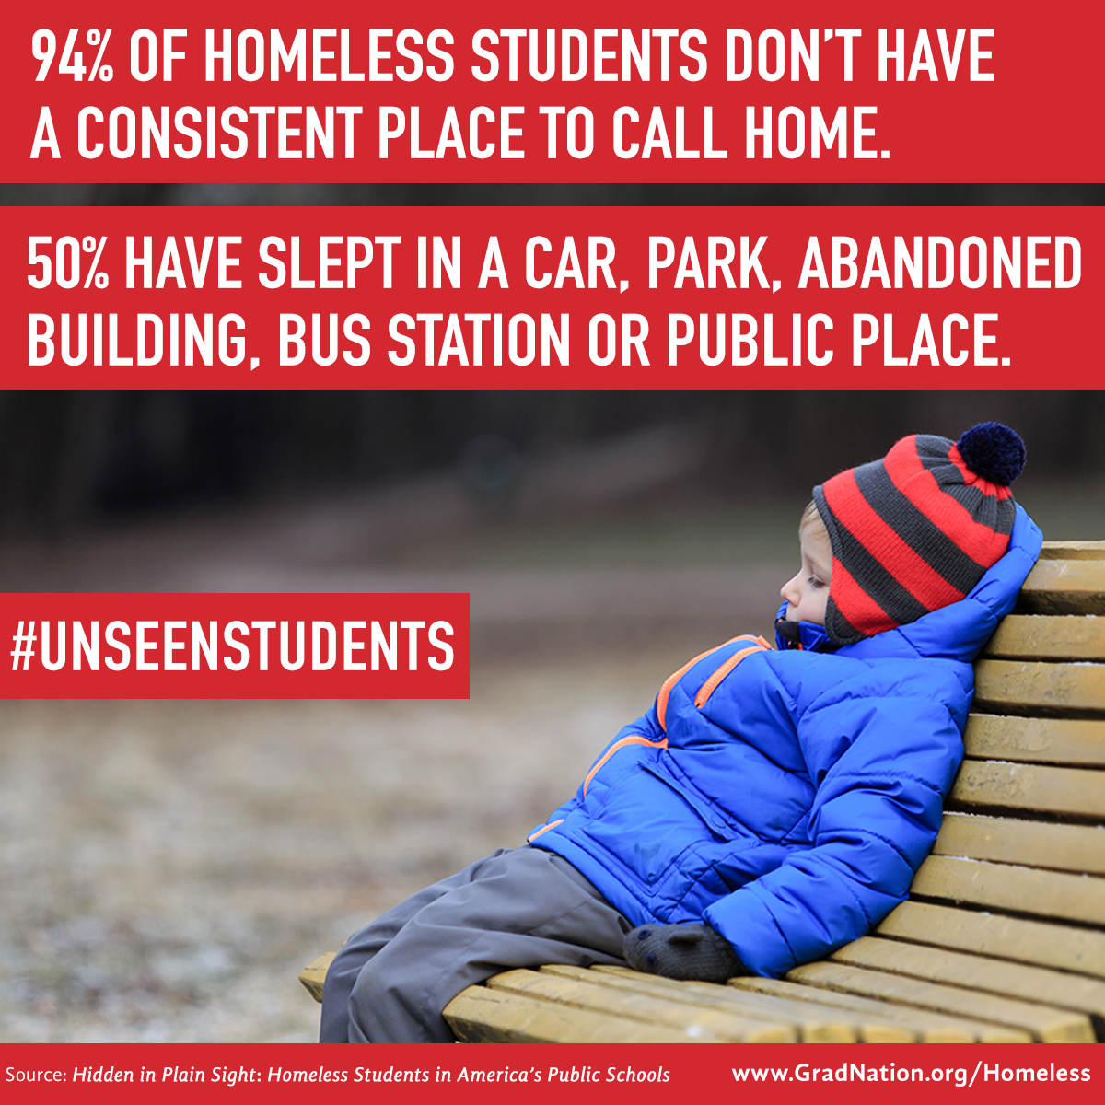
Social Media and Awareness Resources: www.gradnation.org/homeless

Slide 74
School Stability Resources
School of origin vs. Local school:
  http://center.serve.org/nche/downloads/briefs/sch_sel_checklist.pdf
Transportation:
  http://center.serve.org/nche/pr/incr_sch_stab.php
    www.utdanacenter.org/theo/downloads/factsheets/RP33b_Transportation_Rural.pdf

Slide 75
School Enrollment Resources
Immediate enrollment without documents:
  http://center.serve.org/nche/downloads/briefs/assessment.pdf
Immediate enrollment without parent/guardian:
  http://center.serve.org/nche/downloads/briefs/guardianship.pdf
Immediate enrollment without immunizations:
  http://www.naehcy.org/sites/default/files/dl/elders-memo.pdf

Slide 76
School Enrollment
Resources (cont.)
Full participation in school activities:
  http://center.serve.org/nche/downloads/briefs/extra_curr.pdf
Ensuring credit accrual and recovery:
  http://center.serve.org/nche/downloads/briefs/credit.pdf

Slide 77
Early Childhood Resources
http://www.acf.hhs.gov/programs/ecd/expanding-early-care-and-education-for-homeless-children
(Guidance, tip sheets, and more from US HHS)
http://naehcy.org/educational-resources/early-childhood
(Fact sheets, policy briefs, and more from NAEHCY)
http://center.serve.org/nche/ibt/sc_preschool.php
(Resources from NCHE)

Slide 78
Title I Part A Resources
http://center.serve.org/nche/downloads/briefs/titlei.pdf
http://www2.ed.gov/policy/gen/leg/recovery/guidance/titlei-reform.pdf
(Examples of permissible uses of funds)
http://www2.ed.gov/programs/homeless/homelesscoord0815.pdf
(August 2015 guidance on transportation/liaisons)

Slide 79
Unaccompanied Homeless Youth Resources
http://www.naehcy.org/educational-resources/youth
http://www.naehcy.org/educational-resources/higher-ed
http://center.serve.org/nche/ibt/sc_youth.php
http://www.1800runaway.org/
http://www.youtube.com/user/itgetsbetterproject
http://www.thetrevorproject.org/

Slide 80
Impacts of Homelessness Statistics
Institute for Children, Poverty, and Homelessness, Head Start and Housing (In)stability: Examining the School Readiness of Children Experiencing Homelessness, 2013.
Perlman, S. & Fantuzzo, J. (2010). Timing and influence of early experiences of child maltreatment and homelessness on children’s educational well-being. Children and Youth Services Rev. 32, 874-883.
Obradovic, J., Long, J.D., Cutuli, J.J., Chan, C.K., Hinz, E., Heistad, D. & Maston, A.S. (2009). Academic Achievement of homeless and highly mobile children in an urban school district: Longitudinal evidence on risk, growth, and resilience. Development and Psychopathology, 21(2), 493-518.
America’s Promise Alliance, Center for Promise at Tufts University (2015). Don’t Call Them Dropouts.
American Psychological Association. Effects of Poverty, Hunger and Homelessness on Children & Youth. http://www.apa.org/pi/families/poverty.aspx
Notes:
Source for infancy as the most likely time for entering a homeless shelter: the full references are:
AHAR HMIS 2012: https://www.onecpd.info/resource/3297/2012-ahar-volume-2-estimates-of-homelessness-in-the-us/
Census: 2012 Population Estimates: PEPSYASEXN - Annual Estimates of the Resident Population by Single Year of Age and Sex for the United States: April 1, 2010 to July 1, 2012, Accessed through American Fact Finder2 11/12/2013.

Slide 81
Unaccompanied Homeless Youth Statistics
Toro, P., Dworsky, A. and Fowler, P. (2007). “Homeless Youth in the United States: Recent Research Findings and Intervention Approaches.” Toward Understanding Homelessness: The 2007 National Symposium on Homelessness Research.
Benoit-Bryan, J. (2011). The Runaway Youth Longitudinal Study.
The National Gay and Lesbian Task Force and the National Coalition for the Homeless (2007). Lesbian, gay, bisexual and transgender youth: An epidemic of homelessness.
Hammer, H., Finkelhor, D., & Sedlak, A. (2002). “Runaway / Thrownaway Children: National Estimates and Characteristics.” National Incidence Studies of Missing, Abducted, Runaway, and Thrownaway Children.
Greene, J. (1995). “Youth with Runaway, Throwaway, and Homeless Experiences: Prevalence, Drug Use, and Other At-Risk Behaviors.” Research Triangle Institute.

