Slide 1
Immigration Update-How to Support Our Students During Challenging Times
Presented
By
Dave Schrandt - NAEHCY Vice President/Conference
Co-Chairperson
Rebecca Paz-Ford Ph.D - Lurie Children’s for Childhood
Resilience
Dagmara Avelar - Illinois Coalition for Immigrant and
Refugee Rights

Slide 2
Definition of Immigrant Children and Youth
Are age 3 through 21
Were not born in any state
Have not been attending one or more schools in any one or more states for more than 3 full academic years

Slide 3
Definition of Refugee
A person who has fled his or her country of origin because of past persecution or a fear of future persecution based upon race, religion, nationality, political opinion or membership in a particular local group

Slide 4
Unaccompanied Immigrant Youth Process
DHHS through ICE takes custody of children as they cross the border or when discovered in the United States.
Within 72 hours (could be longer) children are transferred to the custody to DHHS.
DHHS through ORR provides immediate shelter (often on military bases) and basic services including education.

Slide 5
Process Continued…
ORR seeks appropriate longer-term placements including:
Other Sponsor
Group Home or Shelter
Foster Family
Detention

Slide 6
Immigrant Students’ Educational Barrier to Success
Deficits in previous education from large gaps in schooling or from never having been in school
Post-Traumatic Stress Disorder, anxiety, grief, and other emotional issues
Perceived lack of academic support from parents
Language barriers

Slide 7
Barriers Continued…
Different culture and learning styles
Difficulty tracking students due to high mobility and language barriers
Varied definitions and classification systems of ELL
Lack of quality staff development programs for administrative, instructional, diagnostic and support staff in school districts

Slide 8
Barriers Continued…
Lack of parental materials in native languages
Discrimination/rejection – often from lack of accurate information and cultural misunderstandings
Few classes for students who must work full-time to help their families

Slide 9
Strategies to Reduce Barriers
Connect with the local immigrant leadership groups, churches, mosques, parent advisory councils, etc to become more familiar with immigrant cultural and barrier issues
Work closely with refugee resettlement agencies in order to determine McKinney-Vento eligibility on a case-by-case basis
Arrange for immunization or retrieve immunization records

Slide 10
Strategies Continued…
Make referrals to health care, dental, mental health, and other service providers
Arrange transportation for parents and ensure that interpreters are available for parent meetings
Have materials translated into immigrants’ native languages

Slide 11
Points to Consider
Immigrant children placed with family members often have never met, or cannot remember the adults with whom they are placed.
Essentially, these adults are foster parents, without financial or service coordination support.

Slide 12
Points Continued…
Children placed with family friends or acquaintances (27% of unaccompanied immigrant children) commonly have no relationship with that adult and are at a particularly high risk of labor and sex trafficking. The children are afraid to inform authorities that they do not know these supposed acquaintances.

Slide 13
Points Continued…
According to child advocates and McKinney-Vento liaisons, many unaccompanied immigrant children are forced out of their sponsor’s home or leave after experiencing abuse or exploitation.
Sponsors sign an agreement stating they will care for the child placed with them. However, there is little, if any, monitoring of compliance with this agreement.

Slide 14
Contact Community Services
Increase awareness of McKinney-Vento by providing posters, conducting workshops for staff, etc.
Find out what services are available in the community and discuss ways to coordinate community and school services.
Acquire more information on local laws/policies related to immigrant families.

Slide 15
Services Continued…
Find assistance with translating materials and provide transportation at meetings for parents.
Help develop procedures by which agencies will refer children and families who may be eligible for McKinney-Vento services to the local liaison.

Slide 16
McKinney-Vento
Eligibility hinges upon the CHILD’S living situation.
Is the living situation fixed, regular, and adequate for the child?
The sponsor’s housing status is not relevant, unless the sponsor is homeless (in which case the child living with the sponsor also would be homeless).

Slide 17
Homeless Liaison will Help Eligible Students to:
Enroll in school immediately, even without documents typically required for enrollment.
Remain in the school of origin, if feasible (in the student’s best interest) even if they move to another district.
Receive transportation to and from their school of origin.

Slide 18
Liaison Checklist Continued…
Access support; tutoring, free meals, medical, dental, and mental health services, etc.
Obtain clothes, school supplies, etc.

Slide 19
Services Available
Title 1 Part A
IDEA (Special Education)
Title III (ELL)
McKinney-Vento
Migrant Education Programs (MEP)

Slide 20
Liaison Challenges

Slide 21
Building Resilience of Refugee/Immigrant Children and Families
Rebecca Ford-Paz, PhD
Clinical Psychologist
Lurie Children’s Center for Childhood Resilience
October 28, 2017
Notes:
Introduce yourself and share about your immigration experience as necessary and as much as you feel comfortable?
May want to ask who is in the room (e.g., How many social workers, case managers, clergy, community volunteers)
1:30 Dave 15-20 min
-Identifying homeless students at school
ESSA
1:50 Rebecca 1 hr – 1 hr 15
stats
cut KYR, Fam Prep, advocacy efforts
2:45 Break 15 min
Rebecca finishes
3:30 Dagmara – 45-50 hr

Slide 22
Acknowledgements
These slides were developed in collaboration with:
Center for Childhood Resilience at Ann and Robert H. Lurie Children’s Hospital of Chicago
Illinois Childhood Trauma Coalition’s Ad-Hoc Committee on Refugee and Immigrant Children and Trauma
Illinois Refugee Mental Health Task Force
Coalition for Immigrant Mental Health
Focus groups of refugee and “dreamer” students who shall remain anonymous
Please do not copy, replicate, disseminate or modify without express written permission from the Center for Childhood Resilience at Ann & Robert H. Lurie Children’s Hospital of Chicago
© 2017 Ann & Robert H. Lurie Children’s Hospital of Chicago All rights reserved.
Notes:
We are a learning collaborative model. PLEASE DO NOT COPY OR DISTRIBUTE WITHOUT PERMISSION!

Slide 23
Objectives
Increase awareness of the experience of refugee/immigrant children and families distressed in current sociopolitical climate
Equip youth-serving adults to respond to the distress, instill hope, and create safe environments
Increase refugee/immigrant engagement in mental health supports
Share specific strategies to apply to a variety of settings to build resilience in refugee/immigrant populations
© 2017 Ann & Robert H. Lurie Children’s Hospital of Chicago All rights reserved.
Notes:
We are a pediatric hospital, and although our focus is on how to build capacity for youth-serving adults, much of what we discuss today will be applicable to work with adults as well!
will discuss how the current sociopolitical climate and changes to immigration policy is affecting immigrant children, youth and families and how those working with these population can support them by instilling hope, promoting adaptive coping, increasing a sense of agency, and connecting with resources. Finally, the session will provide a brief overview of what schools can do to create welcoming environments and adopt trauma-informed practices to improve educational outcomes for these students.

Slide 24
Self-Care Alert!
Step out and take a break
Reach out to someone you trust
Use relaxation skills like deep breathing
© 2017 Ann & Robert H. Lurie Children’s Hospital of Chicago All rights reserved.
Notes:
SAY: Today’s presentation can be difficult because we will be focusing on the stressful social and political events. This material and our discussion can be emotionally loaded regardless of your own background and experience.
We’ll be talking about refugee/immigrant populations today, and we want to recognize that some staff members in the audience may themselves identify with these groups and may be experiencing some of the distress we will describe today. For those staff members, we hope that this information will serve to help you not only to manage your own distress, but also to help support your clientele experiencing similar stress.
What we discuss may remind you of something you yourself experienced or something that a loved one is currently experiencing and may bring up unexpected emotions or reactions. Remember you are in a safe place, you are among friends.
Please take care of yourself and feel free to step out of the room at any time during the presentation. Self-care is extremely important and we will be going into more detail about self-care later today.

Slide 25
Refugee/Immigrant Children and Families: Current Sociopolitical Climate
Notes:
25

Slide 26
Terminology: Immigrants
Migrant
Unaccompanied alien child
Mixed status
Refugee
Dreamer
Alien
Undocumented status
Immigrant
Asylum seeker
DACA
© 2017 Ann & Robert H. Lurie Children’s Hospital of Chicago All rights reserved.
Notes:
First, we wanted to clarify some terminology because these are sometimes used interchangeably, but in fact are slightly different.
Refugee vs. immigrant: Immigrant is the most inclusive term and includes any foreign-born non-citizens who choose to leave their countries of origin with the intention of residing permanently in new country.
Immigrants may come voluntarily or involuntarily, by legal or unauthorized processes. This population includes naturalized citizens, lawful permanent residents, refugees and asylees, persons on certain temporary visas or humanitarian visas (U or T visa), and the unauthorized.
For many immigrants, the reasons for which people are leaving their countries of origin today are increasingly involuntary in nature, rather than the result of a free decision, including as a result of community violence, natural or environmental disaster, or abject poverty
Immigrants of undocumented status: Foreign-born non-citizens residing in the U.S., having either entered without authorization or overstayed their visa
More and more, we are encouraging people to avoid saying “illegals” because actions and objects are illegal, not human beings. If a pedestrian crosses the road outside a crosswalk, we don’t call them an illegal pedestrian. To call someone a illegal is innaccurate and pejorative.
Refugee vs. Asylum Seeker:
Refugee is a person located outside the US who has been forced to flee his or her country of origin because of war, violence, or persecution or well-founded fear of persecution due to race, religion, nationality, membership in a particular social group or political opinion.
Asylum seeker is someone who flees their own country and seeks sanctuary in another country and applies for refugee/asylum status upon arrival to the new country. This person must demonstrate that his or her fear of persecution in his/her home country is well-founded. S/he may enter the country as students, tourists, businessmen, or even in undocumented status.
Dreamers vs. DACA:
The DREAM Act (Development, Relief, and Education for Alien Minors Act) was stalemated in Congress for some time and never was passed. Although the DREAM act failed, the name stuck, and now the term “Dreamers” is used to refer to immigrants of undocumented status under the age of 35 seeking full or partial legalization/amnesty.
DACA (Deferred Action for Childhood Arrivals) was an executive order signed by President Obama that essentially protects eligible individuals from deportation for a 2-year period. During this period, DACA-eligible individuals could obtain a driver’s license, SS# and work authorization. An estimated 800,000 DACA youth came out of the shadows and registered with the U.S. government. DACA does not provide a pathway to citizenship.
SAY: We put these definitions up to highlight the differences between eligibility and access to government benefits and services. We also know that there is a dynamic of the “good” vs. the “bad” immigrant when people make distinctions between legal status and how people came to be here that serves to further marginalize segments of the population.
Refugees and asylum seekers have certain protected legal status and access to government benefits and a pathway to citizenship, but immigrants of undocumented status do not.
Dreamers and those who qualified for DACA also were afforded a certain level of privilege – being able to study and work – that other immigrants of undocumented status were not. The terms DACA and Dreamers perpetuate the good vs bad narrative because these individuals have been identified as “good” immigrants have parents or siblings of undocumented status who are not able to access DACA.
Now that DACA has been rescinded, DACA youth are feeling some of the same stress that has been a constant for other people of undocumented status. Distress is mounting now that immigration officials deported the first DACA student in April who did not have a criminal record.
Another consideration for many refugees/immigrants, is that many times family members may have different legal statuses – some with DACA, some citizens, some undocumented.
Over 9 million people are in mixed-status families and have at least one undocumented adult and at least one US-born child (Passel, et al., 2014)
So threatening to bar entry to or deport particular groups affects millions of families, communities and schools.

Slide 27
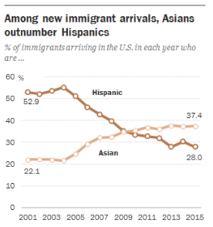
Where are Immigrants Coming From?
Changes in trends
Pew Research Center (2015)
Top 4 countries of origin (2015):
India (110,000)
Mexico (109,000)
China (90,000)
Canada (35,000)
1 in 7 people in Illinois are immigrants, which is 12% of the number of registered voters in the state
© 2017 Ann & Robert H. Lurie Children’s Hospital of Chicago All rights reserved.
Notes:
KNOW: Information on this slide came from the American Immigration Council
SAY: The size of the US immigrant population has grown over time from 4.7% of the population in 1970 to 13% of the population in 2014, but 13% is still a relatively small percentage of the population.
If we include foreign born individuals AND their US-born children, in 2014 this population numbered approx. 81 million people or 26% of the overall US population
Historically, Mexican immigrants have been the largest immigrant group in the US – close to 28% of the immigrant pop
However, immigration from Asia has started to surpass immigration from Latin American countries.
Starting in 2015, the top country of origin for new immigrants coming to the US was India.
Here you can see the 4 top countries of origin for immigrants to US listed.
In IL, 1 in 7 people are immigrants
12.2% of registered voters

Slide 28
Immigrants of Undocumented Status in Illinois
~11 million unauthorized immigrants live in the U.S.
~511,000 immigrants of undocumented status live in IL
4% of the state population in 2012
36% live in Chicago
54% live in the suburbs of Chicago
~11% (58,000) are < 18 years old
Largely from Latin America (84%)
Mexicans (77%)
Asians (9%)
Philippines, India, Korea, China
Europeans (5%)
Poland, former Soviet Union
Paral et al. (2014) IL Coalition for Immigrant and Refugee Rights
© 2017 Ann & Robert H. Lurie Children’s Hospital of Chicago All rights reserved.
Notes:
SAY/SUMARIZE: Approximately 11 million immigrants of undocumented status living in US today (2012 estimate from Dept of Homeland Security)
Approx 511,000 immigrants of undocumented status live in IL – American Immigration Council
4% of the state population in 2012
36% live in Chicago
54% live in the suburbs of Chicago
IL was one of top states of residence for DACA applicants
Approx 11% or 58,000 are under the age of 18
Largely from Latin America – 84%
Mexicans make up 77%
Asians make up 9% - fastest growing immigrant population with undocumented status
Philippines, India, Korea, China
Europeans make up 5%
Optional:
87% of households that include at least one undocumented immigrant are mixed-status household, including at least 1 US citizen
47% of undocumented immigrants in IL have not earned a HS diploma, and about half have little to no English language skills.

Slide 29
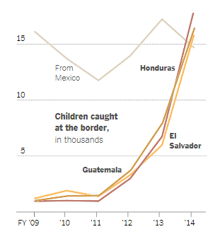
Unaccompanied Immigrant Children
2014: Dramatic increase in unaccompanied minors apprehended on the border
2013: 38,759
2014: 68,541
2014: Central Americans outnumbered Mexicans crossing the border for the first time
Happened again in 2016
Top 4 countries of origin for 2016
Guatemala
El Salvador
Mexico
Honduras
© 2017 Ann & Robert H. Lurie Children’s Hospital of Chicago All rights reserved.
Park, 2014, The New York Times
Notes:
SAY: From 2013-2014 we saw a dramatic increase in unaccompanied minors apprehended on the border
Increase of about 77%
2014 was the first time Central Americans outnumbered Mexicans crossing the border
Happened again in 2016, but apprehensions were down in part due to aggressive advertising about stricter immigration policy and turning people away at border
Top 4 countries of origin of unaccompanied immigrant children in 2016
Guatemala
El Salvador
Mexico
Honduras
What is driving this?
High rates of gang violence in the context of political unrest, dysfunctional governments and corrupt law enforcement
Central American countries have some of the highest murder rates in the world outside of war zones
According to UNICEF, the most dangerous region of the world for children (disappearances, sexual assault)
For these youth, the risks of staying perceived as higher than leaving

Slide 30
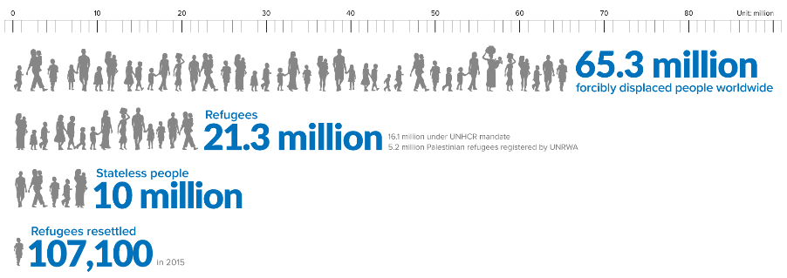
Refugee Crisis
Currently facing the greatest refugee crisis since WWII
From Syria
Over 6.6 million people displaced
4 million new refugees fled the country since 2011
51% of all refugees are children and 98,000 of these children were alone.
-UNHCR Global Trend Data, 2015
© 2017 Ann & Robert H. Lurie Children’s Hospital of Chicago All rights reserved.
Notes:
SAY: In addition to an increase in immigrants and unaccompanied minors coming the US…
We are currently facing the greatest refugee crisis since WWII – (UNHCR)
There are currently 65.3 million forcibly displaced people in the world
21.3 million of them meet the criteria for refugee status
51% of refugees are children and 98,000 of them were alone - without their parents/caretakers
In terms of how many refugees are out there and how many get resettled in a new host country – only 107,100 were resettled in 2015 – less than 1%
According to the Internal Displacement Monitoring Center, the ongoing conflict in Syria has resulted in the displacement of over 6.6 million people and the creation of at least 4 million new refugees (United Nations High Commission for Refugees (UNHCR)).

Slide 31
Vetting and Resettlement
Resettlement is only available to 1% percent of refugees considered most vulnerable
Decision of where to resettle is made by U.N. High Commission for Refugees
Vetting takes 18-24 months
None of the >3 million refugees who have entered the US through the resettlement program has killed anyone in a terrorist attack on U.S. soil (Migration Policy Institute)
© 2017 Ann & Robert H. Lurie Children’s Hospital of Chicago All rights reserved.
Notes:
SAY: Resettlement is only available to a small percentage of refugees– less than 1% of the world’s refugees are ever resettled
1. Most vulnerable populations
Women and girls at risk
Survivors of violence and/or torture
Family reunification
Medical needs
Children at risk
2. Decision of where to resettle a refugee is made by the UN High Commission for Refugees, and many refugees do not know their receiving city until their day of travel
United States Citizenship and Immigration Services determines eligibility for refugee status and resettlement and complete a medical and security screening
Vetting: The process takes 18-24 months and is conducted by:
U.N. High Commission for Refugees
US Citizenship and Immigration Services – medical and security
National Counterterrorism Center
FBI's Terrorist Screening Center
Departments of State, Defense and Homeland Security.
Fingerprints are taken, biographical information is collected. Then individuals are interviewed by U.S. officials trained to verify that they're bona fide refugees. Individuals who do finally make it to the US have to demonstrate repeatedly throughout the vetting process that they have been traumatized and their migration was not optional.
After approval, arrangements are made for placement with a resettlement agency and travel to the US
Ask audience: Of the more than 3 million refugees resettled in the US through the refugee resettlement program, what percentage have committed an act of terrorism in the US?
Despite the rhetoric that terrorists are slipping through lax vetting processes, in reality none of the more than 3 million refugees who have entered the United States through the resettlement program has killed anyone in a terrorist attack on U.S. soil. (Migration Policy Institute)

Slide 32
U.S. Refugee Policy
Previous Administration’s Projected Cap on refugee admissions in FY17:
100,000
Current Administration’s Proposed Cap on refugee admissions in FY17:
45,000
Top 3 host countries:
Turkey (2.8 million)
Pakistan (1.6 million)
Lebanon (1.1 million)
© 2017 Ann & Robert H. Lurie Children’s Hospital of Chicago All rights reserved.
Notes:
SAY: US is one of few countries with a refugee policy. Since 1975, the US has welcomed over 3 million refugees for resettlement from all over the world
But after the most recent peak 1993, the U.S. annual refugee admission ceiling steadily declined to about 70,000/yr
The previous administration proposed to significantly increase the number of worldwide refugees the United States accepts annually up to 100,000 in FY 2017.
However, the new administration has reversed this, capping refugee admissions at 45,000
Just a basis of comparison, the US accepts far fewer refugees than the top 3 host countries for refugees: Turkey, Pakistan, and Lebanon. 86% of the world’s refugees are being hosted by developing countries.

Slide 33
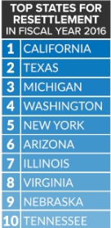
Refugees Resettled in Illinois
Illinois one of the top 10 receiving states for refugees 2008-2013
Top countries of origin of refugees arriving to Illinois Oct 2016-Jan 2017:
Syria 23%
Iraq 18%
Congo 17%
Burma 10%
Afghanistan 6%
Other 26%
© 2017 Ann & Robert H. Lurie Children’s Hospital of Chicago All rights reserved.
Notes:
SAY: IL is one of the top 10 receiving states for refugees 2008-2013 – 4% of the total – 14,000
Top countries of origin for refugees arriving to IL in the last few months were:
Syria
Iraq
Congo
Burma
Afghanistan
Other
SOURCE: Bureau of Population, Refugees, and Migration (PRM), Refugee Admissions by State and Nationality Oct. 1, 2016 through Jan. 31, 2017

Slide 34
Trauma Experience for Refugees & Some Immigrants
Unique aspects of refugee/immigrant trauma
Multiple sources of trauma
Preflight
Flight
Resettlement
Loss of choice and control
Chronic and cumulative stressors
© 2017 Ann & Robert H. Lurie Children’s Hospital of Chicago All rights reserved.
Notes:
SAY: Over the next few slides, we will break out unique aspects of refugee/immigrant trauma that might impact academic adjustment and performance
Multiple sources of trauma that prompt flight from their country of origin, that occur during their journey, and that occur after resettlement
Loss of choice
Chronic and cumulative stressors

Slide 35
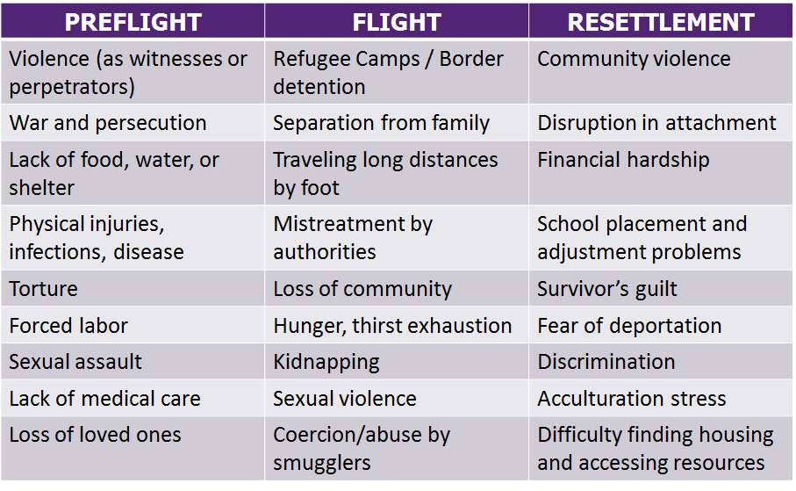
Trauma Experience for Refugees & Some Immigrants
Notes:
When we talk of emotional or psychological trauma, we are referring to events that cause children pain or distress – can be a one time event, like an accident, or a chronic stressor like domestic violence.
This event must produce an abnormally intense and prolonged response as a result in the form of physiological hyperarousal, avoidance, re-experiencing symptoms and negative alterations in cognitions and mood.
In this table, you see examples of trauma experienced by refugees and immigrants, particularly those of undocumented status that prompt flight from their country of origin, that occur during their journey, and that occur after resettlement
Much of our work with professionals and community members is getting people to better understand why people flee to the US even when it means coming without legal authorization and why parents choose to send their children unaccompanied on such a treacherous journey.
That many of these families feel they have not choice. Their choice is between life and death, and they come here because they’ve chosen to keep their families alive.
We also strive to impress on our audiences the hardship that families experience resettling here and acculturating into US society in the the current sociopolitical climate – significant homesickness and survivor’s guilt in the context of absence of social support.
OPTIONAL and ADDITIONAL BACKGROUND INFORMATION
Latino youth used half as many counseling services as used by Whites and African Americans, and that first-generation Latino immigrants used even fewer services. For example, Latino youth use fewer mean visits in school-based health centers (Juszczak, Melinkovich, & Kaplan, 2003).
lower levels of utilization of mental health services by Russian, Bosnian, and Southeast Asian immigrants (Chow, Jaffee, & Choi, 1999; Hsu, Davies, & Hansen, 2004; Weine et al., 2000).
Yeh, McCabe, Hough, Dupuis, and Hazen (2003) found that Latinos and Asian youth showed higher levels of unmet mental health needs than Whites
There are no evidence-based interventions
7.5 Million U.S. Children with Unmet behavioral Health Needs
On average only 1/5 of children in need of behavioral health services get the help they need. (Center for Health and Behavioral Health in Schools, 2012)
Children in the US population in general have poor access to and underutilization of behavioral health services, but the situation is exacerbated by refugee/immigrant status and its associated acculturative and resettlement stressors.
Refugee and immigrant families face substantial barriers in accessing behavioral health care

Slide 36
Current Sociopolitical Stressors
for Marginalized Youth
Teenagers Report a Surge in Bullying During a Divisive Election Season
In a survey of 50,000 teenagers, some 70 percent reported abusive behavior across months of a notably angry presidential campaign.
© 2017 Ann & Robert H. Lurie Children’s Hospital of Chicago All rights reserved.
Notes:
SAY: Recent policy changes affect a variety of population sub-groups such as what you see here: Syrians, undocumented, Muslims, transgender individuals, Jews. Also, such policies reinforce stereotypes of these groups. Whereas before it was less socially acceptable to use hate speech or express prejudices, political rhetoric has fostered a sense that these sentiments are sanctioned or more acceptable.
White supremacists emboldened by political rhetoric
Significant increase in vandalism, threats, intimidation (Southern Poverty Law Center)
Looking at these headlines you can see how many different groups of people living here ar feeling increased levels of distress.

Slide 37
Risk for Emotional Distress for Immigrant Children
Threat of deportation
Centrality of family
Fleeing dangerous circumstances in their countries of origin
Panic, hopelessness, and helplessness arises from:
Threat of separation from family and return to life-threatening environment creates
Threat of being removed from the only country they have ever known and returned to a country where they may not know speak the language or know anyone
Educational/employment disruption
© 2017 Ann & Robert H. Lurie Children’s Hospital of Chicago All rights reserved.
Notes:
Threat of deportation puts our youth of undocumented status and those in mixed status households at increased risk for emotional distress and crisis
For immigrant children, fear of being forcibly separated from family through deportation is clearly traumatic and threatening, especially due to many immigrant populations’ emphasis on the centrality of family.
Many youth risked their lives to come to the United States to reunite with family members and have themselves often escaped traumatic and life-threatening events in their home countries that propelled them to seek refuge among family and relatives in the U.S.
Panic, hopelessness, and helplessness arises from
The threat of separation from family, or of the return to life-threatening circumstances
For many of these youth, the U.S. is the only country they have ever known and they are scared of both educational/employment disruption and deportation to their countries of origin, many of which are plagued by violence, and where they would be completely alone, without family, education, or employment.
Despite wanting to do the right thing and go through legal channels, many immigrants of undocumented status experience helplessness because there is currently no pathway to citizenship.

Slide 38
Mental Health Repercussions for Minority/Marginalized Individuals
Anxiety
Self-Esteem
Physical illness
Absenteeism
DEPRESSION
Suicidal thoughts/behaviors
Problem behaviors
Lowered school achievement
Accumulating trauma
© 2017 Ann & Robert H. Lurie Children’s Hospital of Chicago All rights reserved.
Notes:
ASK: How has distress/anxiety about political climate shown up in your classroom in the past few months?
SAY/SUMMARIZE: *Reminder: Classroom behaviors/disruptive/anxious behaviors are related to exposure to traumatic events and ongoing stress of current political climate.
Hate speech negatively impacts self-esteem in minority groups (Boeckmann & Liew, 2002).
Perceived discrimination has been associated with lower self-esteem, internalizing symptoms including depression, and problem behaviors (Ayón et al., 2010; Zeiders et al., 2013).
Fear of deportation among parents can impact parent-child interactions, leading to depressive and anxiety symptoms, and behavioral challenges (Brabeck, Lykes, & Hershberg, 2011).
Detention and deportation contributes to the accumulating trauma already faced by immigrant families as a result of earlier trauma (Capps et al., 2007).
Bullying can result in absenteeism and lowered school achievement, suicidal thoughts/behaviors, and physical illness (headaches, sleep problems, abdominal pain, tension) (The Olweus Bullying Prevention Group, 2007)
These symptoms and effects can persist into adulthood, and children’s parents may also be experiencing similar types of mental health distress.
Given the multiple trauma exposures for refugee and immigrant populations at the various stages of their migration, we know that the prevalence rates of clinically significiant psychological distress are high
Among resettled refugee children, rates of Posttraumatic Stress Disorder are as high as 54% compared to 5% in the general population.
Among resettled refugee children, rates of depression are as high as 30%, compared to just 11% in the general population
Similarly, studies have found found higher levels of PTSD symptoms for unaccompanied minors than either norm populations or accompanied refugee minors
We know more about refugee children because immigrants of undocumented status tend to avoid participation in research due to fear of being detected and deported
REFERENCES:
Boeckmann, R.J. & Liew, J. (2002). Hate Speech: Asian American Students’ Justice Judgement and Psychological Responses. Journal of Social Issues, 58(2), 363-381
Ayón, C., Marsiglia, F. F., & Bermudez-Parsai, M. (2010). Latino family mental health: exploring the role of discrimination and familismo. Journal of Community Psychology, 38(6), 742-756. doi:10.1002/jcop.20392
Zeiders, K. H., Umaña-Taylor, A. J., & Derlan, C. L. (2013). Trajectories of depressive symptoms and self-esteem in Latino youths: Examining the role of gender and perceived discrimination. Developmental Psychology, 49(5), 951-963. doi:10.1037/a0028866
Brabeck, K. M., Lykes, M. B., & Hershberg, R. (2011). Framing immigration to and deportation from the United States: Guatemalan and Salvadoran families make meaning of their experiences. Community, Work & Family, 14(3), 275-296. doi:10.1080/13668803.2010.520840

Slide 39
Public Health Implications of the Current Sociopolitical Climate
Marginalized individuals are experiencing significant distress
Dramatic increase in the number of hotline calls
College and community counseling centers are being flooded with calls for support
Schools reporting instances of:
Hate speech
Racist vandalism
Students fearful to attend school
Having to cancel classes due to safety concerns.
Decline in compliance with medical appointments and application for public benefits
Reduced crime reporting of domestic and sexual violence
“Disrespect invites disrespect. Violence incites violence.
When the powerful use their position to bully others, we all lose.”-
Meryl Streep, 2017 Golden Globes
© 2017 Ann & Robert H. Lurie Children’s Hospital of Chicago All rights reserved.
Notes:
Social determinants of health is a buzzword these days, and one of the current social determinants of health impacting marginalized populations in serious ways is the current sociopolitical climate. In our clinical and community-based work, we have been made aware of reports that marginalized children and families are experiencing significant distress.
Individuals who have been affected include frequently marginalized youth, such as refugee, immigrant, undocumented, LGBTQ, and diverse religious and racial communities in Chicago. .
There is evidence that some students have interpreted the political rhetoric as giving them permission to bully people of color and minority status. Youth who are victimized by bullies are at risk for severe mental health concerns.
There has been a dramatic increase in the number of Illinois and national mental health and social service agency hotline calls
College and community counseling centers are being flooded with calls for support
Schools were reporting instances of hate speech, racist vandalism, students having decreased attendance at school, and having to cancel classes due to safety concerns.
Healthcare settings are seeing increases in missed appointments due to families fear of leaving home and driving
Families are increasingly reluctant to apply for public benefits to which they are entitled for fear of giving government agencies personal information.
Why we are here today: Today we are focusing on the experience of our refugee and immigrant children and families. We are asking professionals and community members who work with and know refugee/immigrant children and families to be VIGILANT for signs of serious emotional distress and suicidality now and at times of policy change to come that may impact these marginalized populations

Slide 40
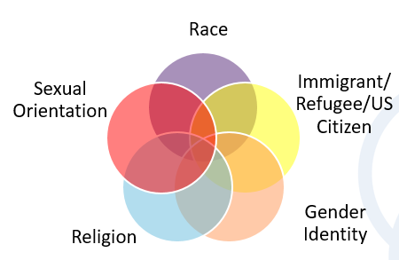
Most Vulnerable Individuals
Visible minorities
Gender non-conforming individuals
Refugee/immigrant children and adolescents
Recipients of DACA (Deferred Action for Childhood Arrivals) or “dreamers”
Those whose family members also may be undocumented & experiencing the same distress
Those with limited English proficiency
Those exposed to others’ suicidal behavior or with pre-existing risk factors for suicidal behavior:
Depression & anxiety disorders
Prior suicide attempts or non-suicidal self-injurious behaviors
Substance use
Impulsive aggressive behavior
Socially withdrawn/isolated
© 2017 Ann & Robert H. Lurie Children’s Hospital of Chicago All rights reserved.
Notes:
We also want to mention that some individuals will be at more risk for psychological distress than others. When we think about the different sub-groups of the population impacted by the current political climate, many of people have multiple identities such that an individual may not only identify as a dreamer, but also as cis-gender male, black, and gay.
Thus individuals may be at increased risk for distress if they have more than one of these characteristics
Among individuals especially vulnerable are:
Visible minorities – due to skin color, style of dress (e.g., hijab)
Gender non-conforming youth
Refugee/immigrant children and adolescents as this population may not receive the help they need as many of these families do not seek traditional mental health services and lack access to other sources of support
Recipients of DACA (Deferred Action for Childhood Arrivals) or “dreamers” as mentioned previously
Those whose family members also may be undocumented and experiencing the same distress
Those with limited English proficiency – increased barriers to help-seeking and access to care
Those exposed to others’ suicidal behavior
And those with pre-existing risk factors for suicidal behavior, such as:
o Depression and anxiety disorders
o Prior suicide attempts or non-suicidal self-injurious behaviors
o Substance use
o Impulsive aggressive behavior
o Socially withdrawn/isolated

Slide 41
Responding to Distress
Notes:
SAY: Refer to your handout (Action Plan Handout), and jot down some ideas of what you could do under each strategy in your setting.
Some of these there will be more or less for you to write. When we break out for small group discussions, this will be a place for your to record your notes.
*Note: Collect surveys at this point too.

Slide 42
Resilience & Strength
Resilience = Positive capacity of people to cope with stress and life problems.
Assets and resources to promote resilience:
Strong bonds and connectedness with parents and caring adults
Positive experiences in the community (school, church, neighborhood)
Positive cultural identity
Personal qualities, coping resources, courage, leadership
?
I don’t speak English, but I speak 6 other languages.
We make contributions to this country!
© 2016 Ann & Robert H. Lurie Children’s Hospital of Chicago All rights reserved.
Notes:
SAY: We also want to bring home the point of resiliency and strength to help well-intentioned individuals avoid taking a pity or deficit based approach. Experiencing trauma does not mean someone is doomed to fail or develop psychological conditions. A number of people manage to even thrive under terrible circumstances. There are many stories of resiliency we can probably think about that have to do with people overcoming terrible things and doing something amazing as a result
Resilience for this population often takes the form of anticipation, hope about change, and acquisition of new coping skills
Identify, notice and praise students for their strengths in the classroom to foster learning
Refugee/immigrant students have asked adults to remember that they are capable of everything other students can do.
The following assets and resources are things that we hope to promote to build resilience

Slide 43
Building Resilience for Refugee/Immigrant Children and Families Key points to remember:
Uncertainty makes us all anxious!
Their concerns are real.
Don’t make promises you can’t keep
PANIC
© 2017 Ann & Robert H. Lurie Children’s Hospital of Chicago All rights reserved.
Notes:
SAY: A couple of points before we get into specifics of how to help:
Uncertainty breeds anxiety. Think about how difficult it has been for us as adults to make sense of the sociopolitical climate. If it’s confusing for us, it is exponentially more confusing for youth. When there are no clear answers, anxious kids will often fill in the blanks with catastrophic predictions.
Immigrants/refugees are going to need us to be their rock, to help them stay calm and analyze things rationally. We cannot allow our fear, sadness, and anger to escalate to panic, hysteria, and hopelessness.
For refugees/immigrants at this time, it is important to validate their concerns and avoid dismissing or challenging their fears. We want to recognize that threats made to immigrant rights are serious, and to refrain from making promises we cannot guarantee.
We want to let them know that while we don’t have all the answers, we will seek out and share information as it becomes available and that there are people organizing to safeguard their rights.

Slide 44
Psychological First Aid Approach
Common Responses in Crisis Situations
Helpful Supports & Responses
Fear
Safety & Comfort
Anxiety
Calmness
Need to feel connected
Connectedness
Sense of being overwhelmed
Self & Community Efficacy
Hopelessness
Hope
© 2017 Ann & Robert H. Lurie Children’s Hospital of Chicago All rights reserved.
http://www.nctsn.org/content/psychological-first-aid
Notes:
SAY: One tool we want to pull from is the PFA approach. The first column highlights the normal responses to a crisis/disaster.
The 2nd column highlights the PFA principles that address with each of these core experiences. We’ve taken these basic principles and added to them to fit the chronic immigration stressors for immigrants/refugees living in the US.
Highlight Common Responses in Column 1 that many people may be experiencing right now and then highlight the helpful responses in Column 2 that we are looking for rapid responders to feel comfortable using to help families.

Slide 45
Tips for Supporting Distressed Children: Listen
Listen
Follow their lead
Stay calm even when they aren’t
Use body language that conveys interest and caring
Pick a safe place and time to have a discussion
Let them share without interruptions before offering advice or assistance
Reflect back what you heard
“What I heard you say was…”
“It sounds like…do I have that right?”
© 2017 Ann & Robert H. Lurie Children’s Hospital of Chicago All rights reserved.
Notes:
SAY: We are here to tell you that you do not need to know all the answers in order to convey hope and promote resilience!
The first thing you can do to support distressed children who share with you about their experience is to LISTEN! Being a good listener is easier said than done. But if done well, and you are able to listen (and comfort- next slide), then you will not re-traumatize young people! Instead, you will communicate that you are a safe, trusted person they can confide in.
Follow their lead: Allow youth to share when they are ready (don’t force it) and give them time to share. Don’t interrupt!
Stay calm even when they aren’t- do your best to stay calm in order to demonstrate that you can handle what they are saying. Sometimes when adults get upset, young people feel responsible and may shut down in order to protect the adult.
Use body language that conveys interest and caring- what might that look like? (leaning forward, eye contact, etc.)
Pick a safe place and time to have a discussion- not in front of others, but make sure to follow-up if you say you will talk to them at a better time!
Let them share without interruptions before offering advice or assistance- this may be challenging, but goes along with the importance of following their lead
Reflect back what you heard (active listening statements- can have participants read aloud):
“What I heard you say was…”
“It sounds like…do I have that right?”

Slide 46
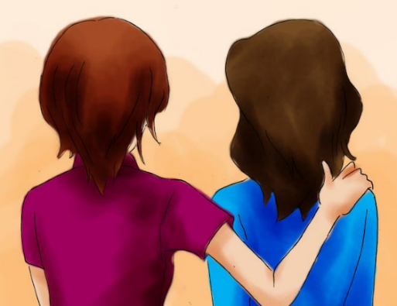
Tips for Supporting Distressed Children: Comfort
Help manage & label their emotions by connecting words to feelings:
“It sounds like you might be sad? Am I right?”
“It looks like your muscles are really tight. Are you getting angry right now?”
Resassure, validate their feelings, offer praise, and let them know you are here to help
“It sounds like this is difficult and I am here to help you…”
“I know this is hard and I will do my best to help…”
“Thank you for sharing this with me, that was very brave.”
Watch your boundaries!
Avoid giving false promises
“If you need me, you can call me day or night…”
“Don’t worry, everything is going to be alright.”
© 2017 Ann & Robert H. Lurie Children’s Hospital of Chicago All rights reserved.
Notes:
SAY: The other way you can support young people in one-on-one interactions is by conveying and offering COMFORT..
Help them manage and label their emotions by connecting words to feelings- this is not assuming feelings, but rather trying to help children recognize what they are feeling (this can be a skill deficit for some children).
“It sounds like you might be sad? Am I right?”
“It looks like your muscles are really tight, are you getting angry right now?”
“Your face looks upset, I’m wondering if you are feeling worried or overwhelmed?
Give reassurance, validate their feelings, offer praise, and let them know you are here to help.
“It sounds like this is difficult and I am here to help you…”
“I know this is hard and I will do my best to help…”
“Thank you for sharing this with me, that was very brave.”
Watch your boundaries! (giving out your cell phone number, etc.)
Avoid giving false promises. Broken promises reinforce that adults can’t be trusted.
“If you need me, you can call me day or night…”
“Don’t worry, everything is going to be alright.”- Things may not be alright right away, but rather take some time.

Slide 47
Steps To Support Refugee/Immigrant Children & Families
Model positive coping and stay calm.
Promote healthy coping
Connect with social support and decrease a sense of isolation
Ensure and promote safety.
Remind about our government’s system of checks and balances
Raise awareness of organized support for refugee/immigrant rights.
Link with available services
Familiarize yourself with signs of distress and potential signs of suicidality
© 2017 Ann & Robert H. Lurie Children’s Hospital of Chicago All rights reserved.
Notes:
We have assembled some tips for what adults can do to support youth and families struggling at this time. We will break each one of these out in the slides to follow.
We want to point out that not every distressed individual constitutes a mental health crisis.
If you think about the public health model of intervention, we would like you to consider steps 1-6 a universal intervention that likely will be sufficient to reassure, calm, and instill hope in most youth.
We would like to equip front-line people also to know when a youth needs more.
Targeted intervention will be necessary with smaller group and would entail follow-up with a trained mental health professional for further assessment and intervention.

Slide 48
1. Model positive coping & stay calm
Communicate with your words & your behavior that you will keep them safe.
Model positive coping: A-B-Cs of Self-Care
Awareness
Determine how you are feeling, what your stress level is and whether your behaviors are consistent with who you want to be
Balance
Balance among different types of activities including work, personal, family life, rest and leisure
Connections
Building social connections and supportive relationships with co-workers, friends, family and community
Adults around you will protect you.
© 2017 Ann & Robert H. Lurie Children’s Hospital of Chicago All rights reserved.
Notes:
Communicate with your words and your behavior that you will keep them safe.
Remind children that ‘Adults around you will protect you.’
Kids are scared by adult reactions, like strong emotions, violence, or talking about moving to other countries. This makes kids think that adults in their life are not in control and cannot keep them safe.
We want to avoid immersing ourselves in the news, ranting, and acting impulsively.
We need to remember that our children are watching us and are basing their reactions on ours.
It is important for parents to model taking care of themselves and good coping skills.
Flight attendant analogy: When you are on an airplane the flight attendant reminds you to put your oxygen mask first before putting the mask on the children traveling with you. The idea is that we have to make sure we are doing well so we are able to help others.
SAY: There are 3 key components to self-care.
*CAN ALSO CONNECT BACK TO THE PFA MODEL: This falls under promoting calmness and safety and comfort.

Slide 49
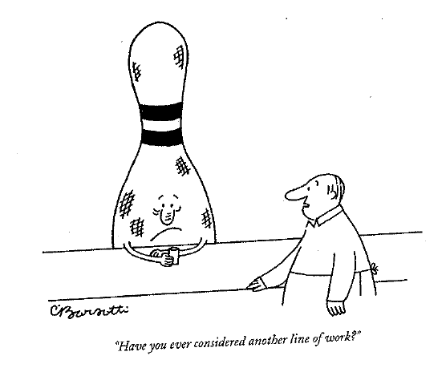
Awareness: Indicators of Stress
Physical
headaches, stomachaches, lethargy, sleep disturbance
Cognitive
trouble concentrating, preoccupied by someone else’s trauma
Emotional
feeling numb or detached, increase in anger, sadness, prolonged grief, anxiety, depression
Personal
isolation, cynicism, mood swings, irritability with spouse and family
Workplace
avoidance of certain people, tardiness, missed appointments, lack of motivation
© 2017 Ann & Robert H. Lurie Children’s Hospital of Chicago All rights reserved.
Notes:
KNOW: Parents may not be willing to admit they are experiencing some of these symptoms. Work to normalize these symptoms as common responses to general stress and fear related to changes in immigration policies by the completion of the activity to start off this slide. Emphasize that these symptoms are reversible. They can take action to improve overall health and stress levels!
SAY: So, how do you know if you’re taking on too much or are experiencing signs of stress?
Here we have indicators of stress across various domains that we’d like you to pay attention to in order to develop your own coping strategies.
But we need to watch for these indicators of stress!
Provide some examples of how you expeiences

Slide 50
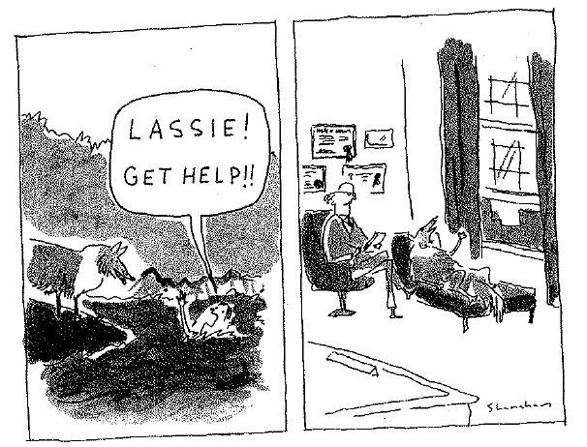
Balance & Connection: Self-Care Strategies
Physical
Sleep Well, Eat Well, Dancing, Exercise, Yoga
Emotional
See Friends, Cry, Laugh, Praise Yourself, Humor
Personal/Spiritual
Self-Respect, Pleasure Reading, Say ‘No’, Smile, Solitude, Prayer, Meditation
Workplace
Take Breaks, Set Limits, Peer Support, Get Supervision, Use Vacations
© 2017 Ann & Robert H. Lurie Children’s Hospital of Chicago All rights reserved.
Notes:
KNOW: Do not read through each one individually. Let them absorb the slide and list ones that you think are interesting.
SAY: Related to each domain, there are self-care strategies to directly affect symptoms or reactions that you might be experiencing. None of these should be new to you, however, we recommend that you make a commitment to yourself to put some of these in place, beginning today! The only way these things will get done is if you make a plan to do so! What are some strategies you currently use?
Use coping tools that are familiar to you
Deep breathing
Relaxation
Mindfulness exercises
Distraction
Social connection and talking with others
SAY: We will spending some time at the end of today’s presentation to create individual Self-Care Plans. As we continue going through the presentation you can start thinking about things that you may do that reduce stress and help you feel more balanced.

Slide 51
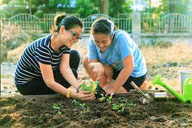
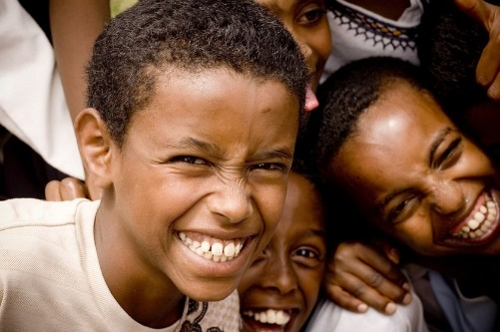
2. Promote Healthy Coping
Keeping family & school routines
Limiting media use to avoid repetitive images & messages that remind them of traumatic events.
Make time to talk about it
Relaxation practice
Talking and spending time with family, friends, or faith communities
Distraction
Using /consuming humor
Scheduling pleasant activities
Exercising
Writing in a journal
Being creative or artistic
Avoiding substance use & isolation
© 2017 Ann & Robert H. Lurie Children’s Hospital of Chicago All rights reserved.
Notes:
Our knowledge about coping with trauma has taught us several lessons that can help us guide families in promotion of healthy coping strategies.
These are some adaptive coping strategies for you to share with families that you work with:
o Keeping family and school routines – creates a sense of predictability
Keep up cultural rituals and celebrations
o Limiting media use to avoid repetitive images and messages that remind them of traumatic events.
o Make time to process what they’ve heard on a regular basis to dispel misinformation
o Relaxation practice
o Talking and spending time with family, friends, or faith communities
o Distraction
o Using humor /consume humor
o Scheduling pleasant activities – hobbies, sunset, play with a pet
o Exercising
o Writing in a journal
o Being creative or artistic
o Avoiding substance use and isolation

Slide 52
3. Connect with social support and decrease a sense of isolation
Circles of Support and other safe spaces
Connect with faith communities
© 2017 Ann & Robert H. Lurie Children’s Hospital of Chicago All rights reserved.
Notes:
SAY: To help refugee/immigrant youth and families deal with distress it is important to find ways to connect with social support and decrease sense of isolation .
*CAN ALSO CONNECT BACK TO THE PFA MODEL: This falls under building connectedness
Universities and schools can offer circles of support, and other safe spaces for students to express concerns and seek support.
Petitions to become sanctuary universities
Starting refugee or dreamers clubs or acculturation support groups – create spaces where people can talk about shared experiences
Connect with faith communities, a source of support for many refugee/immigrant communities.

Slide 53
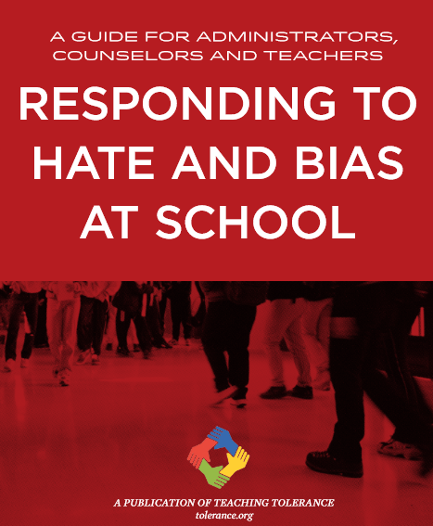
Create Welcoming & Safe Spaces
Support staff by offering consultation & on-going professional development opportunities
Train staff on trauma exposure for refugee/immigrants
Cultural humility
Inform staff and provide education about countries of origin for refugee/immigrant youth/families being served by your agency
BRYCS: http://www.brycs.org/aboutRefugees
Cultural Orientation: www.culturalorientation.net
Strengths-based approaches
Using teaching tools for staff and students to develop a school climate that fosters inclusion and promotes tolerance
Strengths-based approaches
Teaching Tolerance (www.teachingtolerance.org)
© 2017 Ann & Robert H. Lurie Children’s Hospital of Chicago All rights reserved.
Notes:
SAY: For staff working with refugees and immigrants it is important to practice cultural humility and seek out information about the countries of origin to help understand and build strong relationships with them. Even demonstrating curiosity with your clients and asking gentle questions when you don’t know something about their background can be helpful. But it is not their job to educate you about every aspect of their experience.
Staff in your agencies and in various lines of work will need training on the refugee/immigrant experience
Experiences of trauma before leaving their country, during their journey and post-resettlement
Some of the websites you see here provide fact sheets about immigration from different countries can help staff become more knowledgeable. Extent to which immigration may be due to economic factors or war, etc.
Hostile reception in US for refugees/immigrants
Strengths-based approaches – when talking with refugee/immigrant clients, we are hearing that people do not want pity!
They want people to get informed and get involved in enacting positive change
They want to be treated with respect and dignity.
Recognize that many refugees and immigrants are incredibly strong and have overcome tremendous adversities.
Using teaching tools for staff and students to develop a school climate that fosters inclusion and promotes tolerance. Consider using materials from the Teaching Tolerance website to help build a school climate that explicitly fosters inclusion and promotes tolerance

Slide 54
Create Welcoming & Safe Spaces
Create predictable & safe environments in all areas of the agency
Verbal and visual communication that the agency is a safe & welcoming environment
Routines & structure help youth know what to expect
Visual calendars or schedules, consistent routines
Create opportunities for choice (e.g., where to sit)
Use professional interpreters
Discuss confidentiality
Focus on client to build rapport
Sign created by Favianna Rodriguez: http://educationvotes.nea.org
© 2017 Ann & Robert H. Lurie Children’s Hospital of Chicago All rights reserved.
Notes:
SAY: Creating safe environments, and connectedness is important for all individuals. Especially for refugees and immigrants who may have been exposed to trauma in the process of coming to the United States. Regardless of trauma exposure, immigrant/refugee children and their families need support adjusting to new cultural norms, and norms for schools, agencies etc.
Safety and predictability matter, and help people to regulate expectations and prepare for activities. In addition to trauma histories, refugees/immigrants may also feel anxiety about entering new spaces where language and norms are new to them. They may feel edgy, irritable, anxious, fatigued and have difficulty engaging in typical tasks---a safe and predictable environment can put them at ease.
Verbal and visual communication that the agency/institution is a safe & welcoming environment: Welcoming signage and posters – Dreamers welcome, You can continue to receive your healthcare here regardless of your status. Healthcare or Education is a human right
When working with youth in an ongoing way, think about creating routines such as transitions, arrival/dismissal, etc., make sure these routines are structured in a clear and consistent manner.
Minimize procedures/lines of questioning that may cause the individual to feel unwelcome (questions about legal status, SS#, photo IDs)
Think about how to – maximize his/her sense of safety and control
Offer choices – would you like to get a drink of water or take a break? Allowing them to select where to
Even seating arrangements matter.
Sit in the room, gives them a sense of control
The use of professional interpreters is important so as to keep children out of the role of translating for parents – which often over-exposes youth to adult concerns and undermines parental authority
Discuss HIPPA and confidentiality
When using interpreters, speak to the child/family member not to the interpreter – try to keep consistent focus on the client as this is whom you are building a relationship with

Slide 55
Connectedness & Social Support
Develop caring, supportive relationships for all young people
Make children/families feel welcome
Learn to pronounce names correctly
Learn how to greet them in their native language
Speak and behave in ways that affirm the person’s culture, gender, customs, and religion
Orient them to agency space and norms
Help build a strong network of support
Link with other students who speak their language
Link with mentoring / acculturation support groups
Connect youth to sports, art, music, drama, community organization, clubs, etc. to develop students’ sense of competency and self-efficacy
Link to cultural groups & organizations that can help support the youth’s cultural/gender identity (e.g., ICIRR)
© 2017 Ann & Robert H. Lurie Children’s Hospital of Chicago All rights reserved.
Notes:
SAY: It is important that ALL refugees have opportunities to develop caring relationships with others in their community.
Make refugees/immigrants feel welcome
Learn to pronounce names correctly
Learn how to greet them in their native language
Speak and behave in ways that affirm the person’s culture, gender, customs, and religion
Use self-disclosure to build trust
Orient them to agency space and norms
Help build a strong network of supportive adults where possible.
Link with students who speak their language
Link with mentoring and/or acculturation support groups
Mentors can help with
English language acquisition
Help with finding jobs
Cultural advisor and companion
College application process
Homework help
Provide ongoing orientation class/acculturation group for refugees/immigrants on adaptation to life in the US generally
Social rules (e.g., importance of arriving on time)
Where to park car
How to handle interactions with police
How to get around on transportation
How to go shopping
What is polite/impolite
Transportation, safe navigation of the community
For youth, connection to extracurricular activities or creative outlets can develop talents and increase opportunity for social integration
Link children and families to organizations that support their identity – as a refugee/immigrant

Slide 56
4. Ensure and promote safety
Reach out to authorities and leaders who can help hold individuals accountable for promoting hatred
Calling 911
Alternatives to calling 911
Southern Poverty Law Center
Alderman
Clergy person
Refugee/immigrant serving agency: ICIRR, Alivio Medical
Center, Progreso Latino, Enlace, TRP, Centro Romero
Know your rights
Create a Family Preparedness Plan
© 2017 Ann & Robert H. Lurie Children’s Hospital of Chicago All rights reserved.
Notes:
Ensure and promote safety. - I will leave this for Dagmara to address
o Many of the racist and hateful things people say or do are not only wrong, but also against the law.
Reach out to authorities and leaders who can help hold individuals accountable for promoting hatred.
Encourage you to call 911 – anonymous reporting
Most immediate response for public safety
Accurate documentation of hate crimes
Alternatives to calling 911
ASK BEFORE CLICKING THROUGH TO HAVE ALTERNATIVES APPEAR: What other alternative strategies might you be aware of?
Southern Poverty Law Center
Alderman
Clergy person
Refugee/immigrant serving agency - ICIRR, Alivio, Progreso Latino, Enlace, Resurrection Project, Centro Romero
Know your rights
Create a Family Preparedness Plan
*CAN ALSO CONNECT BACK TO THE PFA MODEL: This falls under building safety and comfort.

Slide 57
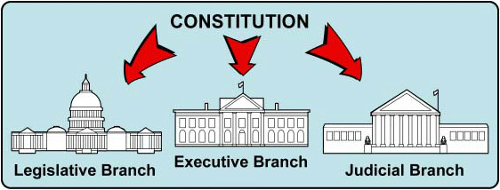
5. Remind about Checks and Balances
There are democratic processes in local, state, and federal governments.
Lawmakers can use democratic processes to prevent individuals from making decisions alone.
Repealing an executive order is different than enforcement
© 2017 Ann & Robert H. Lurie Children’s Hospital of Chicago All rights reserved.
Notes:
Remind children we have a government system of checks and balances. - Civics lesson
o There are democratic processes in local, state, and federal governments.
These processes are SLOW
o Lawmakers can use democratic processes to prevent individuals from making decisions alone.
Debate and discourse will ensue with political and community groups championing immigrant rights
As we saw the judicial branch jumped in to put a stay on the recent executive order barring entry into the US for particular refugee groups
DREAM Act has been re-proposed
Judge in Chicago ruled that the Department of Justice cannot withhold federal funds from
It is unclear, however, how new executive orders will play out in terms of actual enforcement of immigration policies.
*CAN ALSO CONNECT BACK TO THE PFA MODEL: This falls under building hope.

Slide 58
6. Raise awareness of organized support for immigrant rights
There are organizations who will safeguard their rights.
Increasing their sense of control and influence over their environment and their future promotes hope.
Donate
Volunteer
Get involved!
Help youth connect with groups that are
supportive of their identity
© 2017 Ann & Robert H. Lurie Children’s Hospital of Chicago All rights reserved.
Notes:
Remind them there is still hope, and people will fight for them.
Just knowing that there are organizations who will safeguard their rights can be reassuring.
Human and civil rights organizations have been and will continue fight for individuals’ rights and to prevent unlawful decisions.
Remind them that The United States is a country that developed through immigration.
Engraved on the Statue of Liberty it reads: “Give me your tired, your poor, your huddled masses yearning to breathe free.”
Our country is founded on the principles of freedom of religion.
We accept different opinions in a democracy, and individuals should stand up for what they believe is right.
Increasing their sense of control and influence over their environment and their future promotes hope.
By donating to or volunteering with these organizations, adults and youth both increase social support and sense of control over their situation.
*CAN ALSO CONNECT BACK TO THE PFA MODEL: This falls under building hope, and self/community efficacy and connectedness

Slide 59
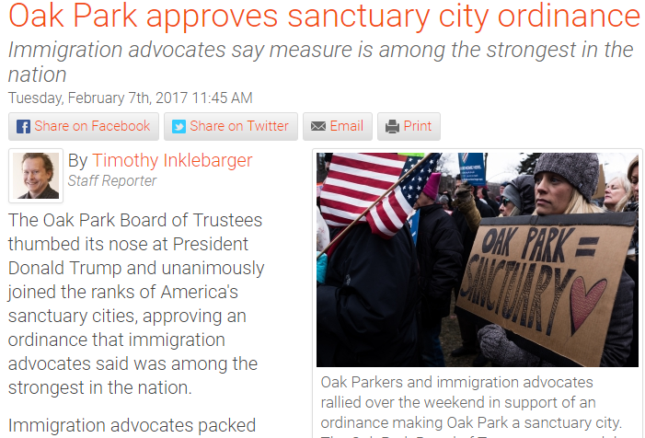
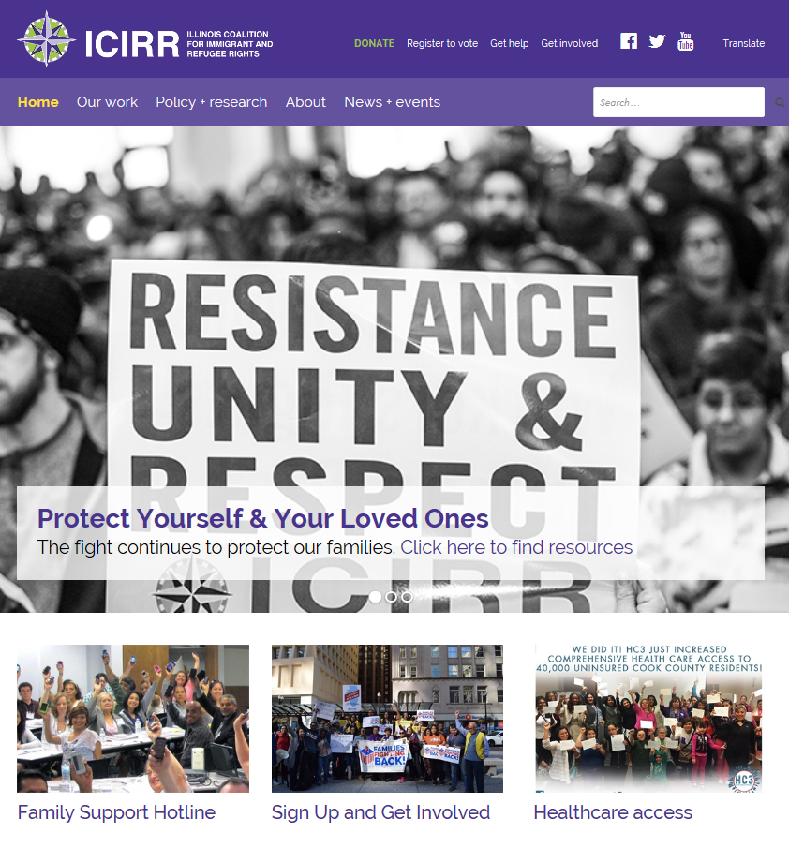
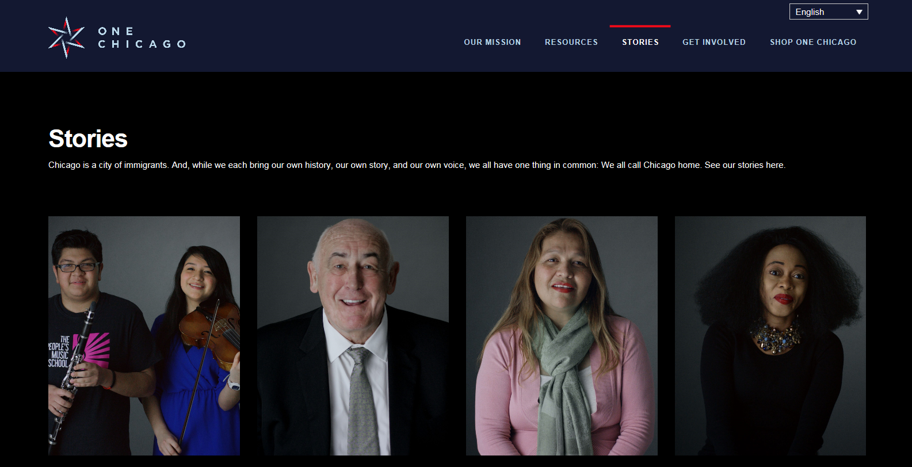
Local Activism
© 2017 Ann & Robert H. Lurie Children’s Hospital of Chicago All rights reserved.
Notes:
These are some examples of local advocacy efforts to help create welcoming environments and to fight for immigrant rights.
Becoming sanctuary or welcoming cities where law enforcement are not mandated to cooperate with ICE officials
The Chicago is With You” Task Force was launched in 2016 by Mayor Rahm Emanuel, U.S. Senator Dick Durbin, and Congressman Luis Gutiérrez. The task force ensures Chicago delivers comprehensive support to immigrant, refugees, and other disenfranchised communities by collaborating on legal services, mental health, employer diversity training, and education.
ICIRR- activism and lobbying activities
Refugees are reporting one source of relief for them is seeing people protesting new executive orders, knowing that there are people out their advocating for them

Slide 60
7. Link with available non-crisis services
Mental Health Providers across Illinois (search by zipcode)
SAMHSA Behavioral Health Treatment Services Locator
1-800-662-HELP (4357) 1-800-487-4889 (TDD)
Search by zip code: https://www.findtreatment.samhsa.gov/
IL Department of Human Services
DHS Customer Help Line (800) 843-6154 (English and Spanish)
http://www.dhs.state.il.us/page.aspx?module=12&officetype=&county=
National Association of Mental Illness
1-800-950-NAMI (M-F, 10AM - 6PM ET)
info@nami.org
Text "NAMI" to 741741
© 2017 Ann & Robert H. Lurie Children’s Hospital of Chicago All rights reserved.
Notes:
For most youth and families, we hope that steps 1-6 will be sufficient to relieve some anxiety and hopelessness. However, some people will need extra support. They may continue to have difficulties managing day to day tasks due to anxiety and may be isolating more and more.
In these cases, we may want to connect them with a mental health providers to provide them with extra support at this difficult time.
Here are useful search engines and resources to help families locate providers in their geographic location.

Slide 61
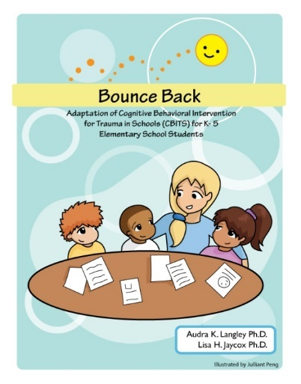
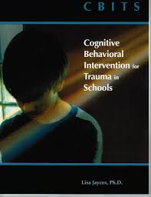
7. Link with available non-crisis services
School-based trauma interventions
Cognitive Behavioral Intervention for Trauma in Schools (CBITS, grades 3-12)
Structured Psychotherapy for Adolescents Responding to Chronic Stress (SPARCS, ages 12-19)
Bounce Back (grades K-5)
Notes:
There also are school-based trauma interventions for children. Families can contact school social worker/counselor to see what school-based services are available
Accessing mental health services at school can decrease stigma and increase likelihood of engagement and retention in treatment!

Slide 62
8. Familiarize yourself with signs of distress and signs of potential suicidality
Withdrawing from family and friends
Dramatic mood change
Threatening to kill him/herself
Talking, thinking, or writing about death or suicide
Feeling hopeless or helpless
Unusually reckless behaviors
Giving away prized possessions
© 2017 Ann & Robert H. Lurie Children’s Hospital of Chicago All rights reserved.
Notes:
Although this won’t come up often, it is important to equip front-line people so they are familiar with signs of suicidality and knowledgeable about how to intervene.
Asking about suicidality does NOT make it more likely that someone will commit suicide. That is a MYTH!

Slide 63
Crisis Resources
FOR ADULTS:
Call 911 or go the emergency room
Contact Crisis/Emergency Mental Health Partners (listed by city in IL)
http://www.dhs.state.il.us/page.aspx?item=30893
FOR CHILDREN/ADOLESCENTS:
Call 911 or go the emergency room
Call CARES Crisis Line, SASS Services (Illinois crisis mental health services program for children & adolescents)
1-800-345-9049 (voice)
773-523-4504 (TTY)
When calling 911 in Chicago, request Crisis Intervention Trained (CIT) officer
Crisis Text Line
Text HOME to 741741
http://www.crisistextline.org
National Suicide Prevention Lifeline
1-800-273-TALK (8255)
Notes:
If you do identify signs of severe distress that is not responsive to the reassurances and suggestions thus far, we want to ensure that these individuals get evaluated by a mental health professional
Obviously, it they are an immediate danger to themselves, we would want you to call 911 or take them to the nearest emergency room.
There are also several crisis lines that will help link to urgent care services.
When calling 911 in Chicago, request Crisis Intervention Trained (CIT) officer

Slide 64
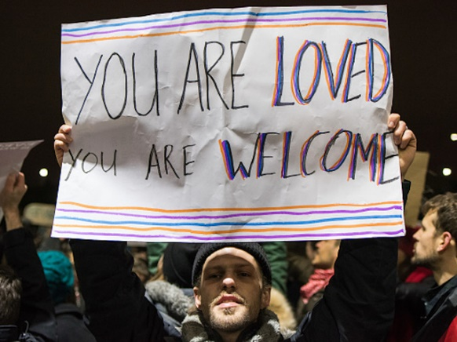
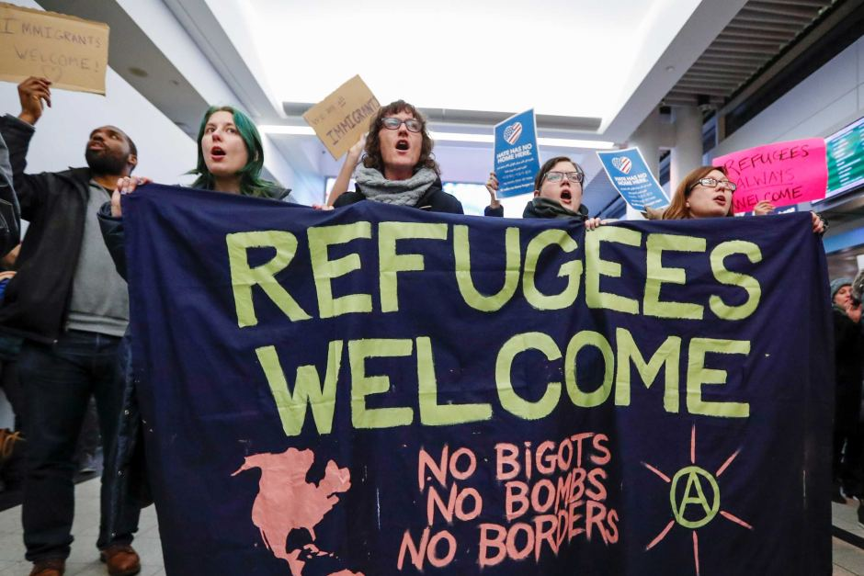
HOPE AND ACTION
You are not alone!
You are part of what makes this country great!
The fight is not over! ¡La lucha sigue!
There is still hope!
There are ways for you to get involved!
© 2017 Ann & Robert H. Lurie Children’s Hospital of Chicago All rights reserved.
Notes:
Hope and agency
To be strong, we need to help our refugee/immigrant youth and families channel emotions into positive action and remind them that they are “bien acompañados” (in good company).

Slide 65
GROUP DISCUSSION
How would you create a safe and welcoming environment, build support/connectedness, and instill hope in your setting for refugee/immigrant youth?
© 2017 Ann & Robert H. Lurie Children’s Hospital of Chicago All rights reserved.
Notes:
SAY: Time to brainstorm how to create these welcoming environments in your particular setting.
I’d like to have you split up into a few groups (groups of about 8-10 people). I want you think about what you are already doing and/or what else you could do to create a welcoming environment and create connectedness in your setting. Take about 8-10 minutes to brainstorm and then we will have some time to share out.

Slide 66
Center for Childhood Resilience
Rebecca Ford-Paz, Ph.D.
rfordpaz@luriechildrens.org
https://childhoodresilience.org/DACA
For more information, visit
LurieChildrens.org/CCR or
email ccr@luriechildrens.org
© 2016 Ann & Robert H. Lurie Children’s Hospital of Chicago All rights reserved.
Notes:
Potential ending activity
Call to action – share 1 thing you will do to change your practice when working with refugee/immigrant populations to create welcoming environments, decrease distress, and instill hope?
Share what other national resources are available to support refugee/immigrant youth?

Slide 67
Resources to Create Welcoming Environments
BRYCS http://www.brycs.org/clearinghouse/Highlighted-Resources-Immigrant-Refugee-Awareness-Instructional-Materials.cfm
Center for Childhood Resilience
You Are Not Alone Webinar & Resources
https://childhoodresilience.org/yna-resources-listing/2017/9/5/mental-health-resources-for-marginalized-youth-and-families
Teaching Tolerance http://www.tolerance.org/classroom-resources
National Child Traumatic Stress Network – Refugee Trauma
http://www.nctsn.org/trauma-types/refugee-trauma

Slide 68
Resources for Families
Family Preparedness Plan
Immigrant Legal Resource Center https://www.ilrc.org/family-preparedness-plan
Illinois Coalition for Immigrant & Refugee Rights
http://www.icirr.org/content/documents/emergency_plan.pdf
Legal Consultation
National Immigrant Justice Center
https://www.immigrantjustice.org/services/general-immigration
312-660-1370
Family Support Hotline – Illinois Coalition for Immigrant & Refugee Rights
1-855-HELP-MY-FAMILY
(1-855-435-7693)
English, Spanish, Korean, Polish
Relaxation & Stress Management
Relax.practicewise.com
http://stopbreathethink.org/
Know Your Rights
National Immigrant Justice Center
https://www.immigrantjustice.org/
The Resurrection Project
www.resurrectionproject.org
312-666-3062
© 2017 Ann & Robert H. Lurie Children’s Hospital of Chicago All rights reserved.

Slide 69
“Immigration 101: The Current Landscape and Your Rights”
NAEHCY Conference
10.28.2017
www.icirr.org
Dagmara Avelar
Programs Manager
davelar@icirr.org
6.2017

Slide 70
ICIRR is dedicated to promoting the rights of immigrants and refugees to full and equal participation in the civic, cultural, social, and political life of our diverse society.
In partnership with our member organizations, the Coalition:
educates and organizes immigrant and refugee communities to assert their rights;
promotes citizenship and civic participation; monitors, analyzes, and
advocates on immigrant-related issues; and
informs the general public about the contributions of immigrants and refugees.
www.icirr.org

Slide 71
Agenda:
The Current Landscape
DACA and Federal Legislation
Immigration Enforcement and its impact on CBO’s
Know Your Rights - Immigration
Getting Involved

Slide 72
The Current Landscape

Slide 73
Four Executive Orders in Immigration
Muslim & refugee bans: Seeks to “temporarily” halt all entry from 6 Muslim countries and all refugees; also cuts refugee entries in half. Does not impact health & benefits. Currently tied up in courts
Border enforcement: Calls for the so-called wall and increase in border patrol and detention on the southern border. No direct reference to health or benefits
Interior enforcement: Calls for changes to enforcement priorities and punishing so-called sanctuary cities. Some reference to health & benefits in memos, but does not mean much.
DACA: On September 5th, the Trump administration announced the end of DACA
www.icirr.org

Slide 74
What is going on with DACA?

Slide 75
DREAM-like legislation bills
RAC Act
Arrive before the age of 16 (1/12/2012)
10 year CPR (5 yr initial; 5 yr extension)
DREAM Act of 2017
Arrive before the age of 18 (4 yrs prior enactment)
Up to 8 years of CPR
American Hope Act
Arrive before the age of 18 (12/31/2016)
SUCCEED Act
Border Security and D.A. Recipient Relief Act
Arrive before the age of 16 (6/15/2012)
Arrive before the age of 16 (1/01/2012)
Up to 8 years of CPR
10 year CPR (5 yr initial/18 yrs of age; 5 yr extension)
10 year CPR (5 yr initial; 5 yr extension)

Slide 76
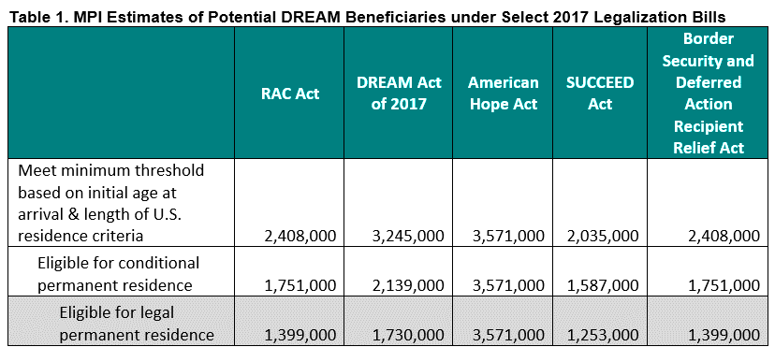
DREAM-like legislation bills
SOURCE: MPI Fact Sheet ‘Different Dreams: Estimating the Unauthorized Populations that Could Benefit Under Different Legalization Bills” https://www.migrationpolicy.org/research/differing-dreams-estimating-unauthorized-populations-could-benefit-under-different

Slide 77
Immigration Enforcement and its Impact on CBO’s

Slide 78
Implications
Chilling effect in accessing safety net services.
People wanting to stop receiving services from WIC, Medicaid, and other programs out of fear of having immigration status exposed or questioned.
Fear around the privacy of personal information found in participant records.
Fear around the use of medical services and whether patient will need to pay back
Fear of immigration enforcement actions at facilities providing services.
Fear that ICE may be at or near a facility
www.icirr.org
Notes:
Print the sensitive location memos.

Slide 79
Implications
Fear of Using Medical / Safety Net Services
If I use these benefits, will I be deported?
Under current laws, people are usually not deportable for using benefits for which they are eligible. There is confusion and fear around public charge: does not have to be. Public Charge: Cash Benefits (TANF, Long term care)
If I use these benefits, do I or a relative have to pay back for these services?
There is confusion and fear around sponsor liability, where sponsors may be held accountable for used benefits
www.icirr.org
Notes:
Print the sensitive location memos.

Slide 80
Implications
Concerns around the Privacy of Personal Information Found in Participant Records.
Is my personal and/or medical information secure or could ICE use it to find me? Existing guidance: Information submitted when applying for safety net benefits is used to determine eligibility Information is not to be used for law enforcement purposes (exception: fraud investigations) Health Insurance Portability and Accountability Act (HIPAA): Protects against disclosure of personal identifying information There’s a need for national origin and immigration status to be protected, but you do not need to ask ICE Memo clarifying use of of health care information (2011) Confirmed that information used to enroll in the ACA would not trigger immigration enforcement activity. http://www.ice.gov/doclib/ero-outreach/pdf/ice-aca-memo.pdf
www.icirr.org
Notes:
Print the sensitive location memos.

Slide 81
Implications
While there is a low likelihood that an enforcement action could occur at a health center/CBO, there are reports of ICE presence at health center parking lots and ICE arresting people across the street from a health center. Know Your Rights!
www.icirr.org
Notes:
Print the sensitive location memos.

Slide 82
Know Your Rights
At organizations:
Immigration enforcement actions at health settings are protected by the 4th Amendment
Create a Response Plan
Train your staff to NOT TALK to ICE Agents
Sensitive Locations Memos are tools to prevent against these actions
Notes:
4th amendment- The right of the people to be secure in their persons, houses, papers, and effects, against unreasonable searches and seizures, shall not be violated, and no Warrants shall issue, but upon probable cause, supported by Oath or affirmation, and particularly describing the place to be searched, and the persons or things to be seized.

Slide 83
Certain immigration enforcement action by immigration agents is discouraged at sensitive locations. Based on Policy from 2011 ICE Memo from 2011 CBP Memo from 2013 Locations “at or near:” Places of worship; Health facilities, incl. hospitals and clinics; Schools; Funerals, weddings, and other public religious ceremonies; and Public demonstrations (rallies, marches).
Sensitive Locations
www.icirr.org

Slide 84
Reports of immigration actions near sensitive locations raise questions about the memos DHS commitments that the memos remain in effect FAQ on DHS Implementation of the enforcement EO’s (Q26) https://www.dhs.gov/news/2017/02/21/qa-dhs-implementation-executive-order-border-security-and-immigration-enforcement Verbal commitment https://www.washingtonpost.com/blogs/plum-line/wp/2017/02/20/how-bad-are-trumps-mass-deportations-going-to-get-heres-a-big-thing-to-watch-for/?utm_term=.59e951bd5c71 Need to pressure DHS to ensure strict compliance with memo!!!!
The Memos Remain in Place, but….
www.icirr.org

Slide 85
Your Rights!
Law Enforcement= Police and Immigration
The US Constitution guarantees basic rights to ALL of the people of the United States--regardless of immigration status
ACTION
INFORM 1 TRUSTED FAMILY/FRIEND OF YOUR ACTION PLAN & REMEMBER THEIR PHONE #

Slide 86
Your Rights!
Law Enforcement= Police and Immigration
Regardless of your immigration status, you have the right to:
REMAIN SILENT- Show your KYR Card!
SPEAK WITH AND BE REPRESENTED BY AN ATTORNEY
Police/Court : Public Defender or your own attorney at your own expense.
Immigration Court : At your own expense
REQUEST A LOCAL TELEPHONE CALL
Memorize phone numbers of family/friends with legal status
*Preferably someone who knows/has your Emergency Plan.
Contact your Consulate- List of consulates and phone numbers is available at detention centers.
ACTION
INFORM 1 TRUSTED FAMILY/FRIEND OF YOUR ACTION PLAN & REMEMBER THEIR PHONE #

Slide 87
What To Do:
If you are in contact with law enforcement agents:
GIVE YOUR NAME AND BIRTHDATE. You are NOT required to give this information. You can choose to provide only this basic information to make it possible for family members to find you. You do NOT need to answer any further questions.
MEMORIZE YOUR ID NUMBERS: This includes your 9-digit A-Number, Jail ID # etc. → This will help your attorney or family to locate you easily. Usually written on wristband.
All detention centers provide a phone call; however, in immigration detention the charges may be billed to the inmate OR those receiving your call
ASK TO SPEAK TO AN ATTORNEY You have the right to an attorney. Disclose your immigration status ONLY to your attorney → This includes your Public Defender
ACTION
REPORT ANY INCIDENT TO OUR FAMILY SUPPORT HOTLINE, TAKE PICTURES/VIDEO!

Slide 88
What NOT To Do:
DON’T LIE. Tell law enforcement agents you want to remain silent. DON’T give explanations, excuses, or stories.
Do not claim to be a US Citizen if you are not!
DON’T SIGN any document that you don’t understand.
DON’T DISCUSS your citizenship or immigration status with anyone other than your lawyer
TIP: Don’t hang any objects from your rearview mirror. It may provide a pretext for police to pull you over.
ACTION
REPORT ANY INCIDENT TO OUR FAMILY SUPPORT HOTLINE, TAKE PICTURES/VIDEO!

Slide 89
If ICE Comes to Your Home:
DO NOT OPEN THE DOOR- You are NOT required to open the door unless ICE has a warrant signed by a judge. ASK them to show you the warrant –Slide it under your door or hold it up to the window
If they try to force the door open: Write down the agents’ badge numbers and the license plate numbers of their cars.
Immigration must have a warrant signed by a judge or permission from your employer to enter your workplace.
ICE does NOT need a warrant to search public spaces.
ACTION
RECORD ENCOUNTER OR SET YOUR PHONE TO RECORD WHILE PLACED NEAR THE DOOR!
Notes:
UNA VEZ DETENIDO
La informacion siguiente, puede ser util para asistir a los seres queridos de una persona que fue
arrestada.
• Solo diga su nombre.No de ninguna informacion adicional. Usted no esta obligado por ley a
dar ninguna informacion adicional.
• En las primeras 24 horas, los arrestados son llevados al siguiente lugar:
o 1930 Beech Street, Broadview, IL (I-290, salida 25th Avenue)
o 708-449-2985 para dar informacion de los detenidos.
• En las primeras 24 horas, los arrestados son transferidos a las carceles del County (por
ejemplo: Mc. Henry, Will, etc)
• Cuando una persona en custodia inmigratoria contacta a su familia, recuerdele hacer lo
siguiente:
o Si le preguntan que si le gustaria hacer una deportacion voluntaria, por favor
diga,”NO, me gustaria tener un juicio delante de un juez o una audiencia ante un
juez”.Entonces deben preguntar, “Cuanto es la fianza?”
o Los detenidos deben decirles a sus familiares el numero de su caso. (Empieza con
letra A seguido por 9 numeros)
o Los detenidos deben decirle a los miembros de su familia en que carcel se
encuentran.o Los familiares que sean indocumentados no deben visitar alos detenidos en
Broadview, tampoco a ninguna carcel del County

Slide 90
Sample Warrant Signed by a Judge

Slide 91
Sample Warrant Signed by a Judge (Cont’d)

Slide 92
Sample ICE Warrant

Slide 93
Sample ICE Warrant -Cont’d

Slide 94
Comparing Police
and Immigration
POLICE
Court: If you have court or probation and you do not go Warrant for your
ARREST
Bond: If you pay 10% of your bond you can go free.
IMMIGRATION
Court: If you have court or supervision and you do not go Order of Removal
Bond: If you pay 100% of the bond, you can go free. The person who pays must be a U.S. citizen or LPR.
ACTION
ACTION
ORGANIZE A KNOW YOUR RIGHTS SESSION

Slide 95
With Immigration/ICE
To find out if you have a removal order:
Call 1-800-898-7180 (Executive Office of Immigration Review) and enter your 9-digit A-number
To locate someone in ICE custody:
Go online to locator.ice.gov. You can search by either
the person’s name, date of birth AND country of birth OR
The person’s 9-digit A-number AND country of birth
ACTION
IN IMMIGRATION CUSTODY YOUR A# (9 DIGITS) IS ON YOUR ID OR WRISTBAND!
Notes:
UNA VEZ DETENIDO
La informacion siguiente, puede ser util para asistir a los seres queridos de una persona que fue
arrestada.
• Solo diga su nombre.No de ninguna informacion adicional. Usted no esta obligado por ley a
dar ninguna informacion adicional.
• En las primeras 24 horas, los arrestados son llevados al siguiente lugar:
o 1930 Beech Street, Broadview, IL (I-290, salida 25th Avenue)
o 708-449-2985 para dar informacion de los detenidos.
• En las primeras 24 horas, los arrestados son transferidos a las carceles del County (por
ejemplo: Mc. Henry, Will, etc)
• Cuando una persona en custodia inmigratoria contacta a su familia, recuerdele hacer lo
siguiente:
o Si le preguntan que si le gustaria hacer una deportacion voluntaria, por favor
diga,”NO, me gustaria tener un juicio delante de un juez o una audiencia ante un
juez”.Entonces deben preguntar, “Cuanto es la fianza?”
o Los detenidos deben decirles a sus familiares el numero de su caso. (Empieza con
letra A seguido por 9 numeros)
o Los detenidos deben decirle a los miembros de su familia en que carcel se
encuentran.o Los familiares que sean indocumentados no deben visitar alos detenidos en
Broadview, tampoco a ninguna carcel del County

Slide 96
Basic Vocabulary to Exercise Your Rights:
I wish to remain silent.
I wish to make a phone call.
I wish to speak with a lawyer.
I do not consent to your entry or search.
I will not sign any document I do not understand.
Am I under arrest? Am I free to leave?

Slide 97
Get Involved!

Slide 98
Ways service providers can be partners in supporting and protecting immigrant communities:
Create a safe space.
Host a know your rights session
Identify an immigrant rights organization and get involved!
Educate yourself and inform your community
DO NOT GIVE LEGAL ADVICE → Research qualified legal service providers in your area.
www.icirr.org
Notes:
Of the Illinois family households that include at least one undocumented individual (198,000), 87% are mixed-status. That is, they also include at least one U.S citizen or individual with lawful status and 74% include a native-born U.S. citizen. In the collar counties surrounding Chicago, 90% of family households are mixed-status, and 79% include at least one native born U.S. citizen.

Slide 99
For more information please visit:
WWW.ICIRR.ORG/FSN
THANK YOU!!

