Slide 1
Fostering Educational Stability for Children and Youth Experiencing Foster Care: ESSA Provisions and Best Practices in Implementation
Kristin Melton, Colorado Department of Human Services
Kristin Myers, Colorado Department of Education
October 29, 2017

Slide 2
Background
December 10, 2015, Every Student Succeeds Act (ESSA) is signed into law. It amends Title I, Part A of the Elementary and Secondary Education Act.
Intent of key foster care provisions
Ensure educational stability
Minimize disruptions for children in foster care
Collaboration between state and local education agencies and child welfare agencies
Emphasis on cross-agency collaboration in the Fostering Connections to Success and Increasing Adoptions Act of 2008 (Fostering Connections Act).
Source: www2.ed.gov/policy/elsec/leg/essa/edhhseffectivedatesdcl.pdf
Notes:
Requires state and local educational agencies (SEAs and LEAs) to collaborate with child welfare agencies to ensure the educational stability of children in foster care.
Builds upon the Fostering Connections to Success and Increasing Adoptions Act of 2008 (Fostering Connections), the Federal child welfare law that requires child welfare agencies to collaborate with educational agencies to ensure educational stability for children in foster care. Together, the new Title I foster care requirements and Fostering Connections ensure that children in foster care experience minimal educational disruption as the result of foster care

Slide 3
Defining Student in Foster Care
“Student in foster care” means that an individual has experienced an out-of-home placement and has been enrolled in a Colorado public school during the time period or school year referenced.
The foster care placement could be brief, such as a few days, or might occur across multiple years.”
3

Slide 4
Foster Education in Colorado
Every Transition Counts for Students in Foster Care -
3-minute video on the importance of educational stability, Colorado partnerships, and previously released research on educational outcomes for students in foster care.
The video was developed with support from the U.S. Dept. of Education.
Click here to view video
Reference: The Colorado Study of Students in Foster Care: located on the University of Northern Colorado Webpage at: http://www.unco.edu/cebs/foster-care-research/

Slide 5
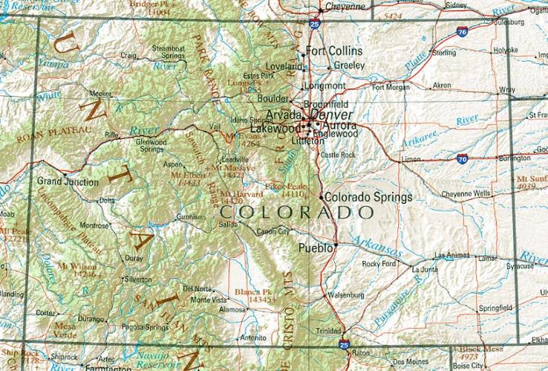
Colorado Foster Care Education Demographics
4,956
K-12 foster care students (2014-15)
44% White
Students in Foster Care
(2014-15)
55%
Students in foster care are male
(2014-15)
87%
Districts include students in foster care
60%
attend school in the Denver metro area
42.2%
(2,092)
Grades P-5
19.3%
(956)
Grades 6 to 8
38.5%
(1,908)
High School
(9th-12th grade)
37% Hispanic/Latino
12%
Black/African American
30%
Special education designation
(2015-16)

Slide 6
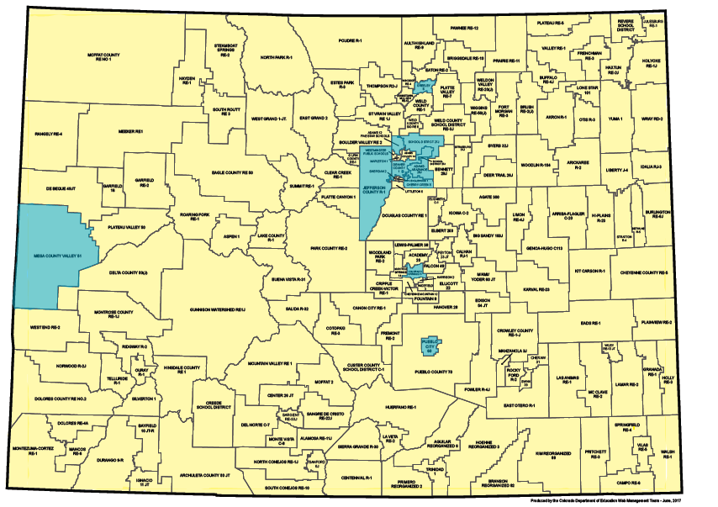
10 School Districts with 190+ Foster Students
Based on 3-year Average (2014-2016)
Adams 12
Aurora
Brighton 27J
Cherry Creek
Colorado Springs D11
Denver
Greeley
Jeffco
Mesa
Pueblo 60
Colorado School District Map

Slide 7
Foster Care Provisions
A child in foster care will enroll or remain in the child’s school of origin, unless it’s determined that it’s not in the child’s best interest.
If not in the child’s best interest to remain in the school of origin, the child will be immediately enrolled in a new school.
A new (enrolling) school immediately contacts the school of origin to obtain relevant academic and other records.
State point of contact (POC) shall be designated to oversee implementation of the educational stability provisions.
Education data reporting on students in foster care is now required.
Removes “awaiting foster care” from McKinney-Vento Homeless Assistance Act.

Slide 8
Colorado Specific Laws C.R.S. 22-32-138
C.R.S. 22-32-138 requires each school district and the state charter school institute to designate a person to act as the Child Welfare Education Liaison (CWEL).
C.R.S. 22-32-138 (1)(e) states, regarding fee waivers…this includes, but is not limited to any general fees, fees for books, fees for lab work, fees for participation in school or extracurricular activities, and fees for before-school or after-school programs.
The school district or school shall not limit the opportunity of a student in out-of-home placement to participate in-school and extracurricular activities before-school and after-school programs due to waiver of the participation fees.
Partial credit must be awarded for coursework completed in previous school
Absences from school are considered excused for court appearances or participation in court-ordered activities including, but not limited to, family visitation or therapy.
Notes:
Duties include; working with child placement agencies, county departments, and the state department to facilitate the prompt and appropriate placement, transfer, and enrollment in school of students in out-of-home placement.
Polling questions

Slide 9
Colorado Department of Human Services Social Services Rules CHILD WELFARE SERVICES 12 CCR 2509-4

Slide 10
Foster Care Toolkit
The Colorado Department of Human Services created several sample templates for child welfare agencies and school districts to coordinate transitions and transfers for children and youth in foster care. https://www.colorado.gov/pacific/cdhs/forms-20 To access the sample forms and templates, click "Child Welfare Forms & Helpful Documents" then scroll down to the "educational success" folder.
Colorado Confirmation of Foster Care Dependency
Sample best interest determination worksheet
Notice to receiving school district of out-of-home placement
Notice to school district of origin of out-of-home placement
Sample transportation agreement between child welfare and school districts

Slide 11
McKinney-Vento | Both | Foster
Best interest determination with priority given to wishes of parent/guardian/UHY (Section I of US Dept. of Ed Guidance) | School of origin rights/best interest determination | Placement determined by Best Interest Determination meeting (Child Welfare invites Schools)
LEA(s) must provide school of origin transportation (Section J of US Dept. of Ed Guidance) | Right to receive transportation to school of origin | Transportation agreements (MOU) between Child Welfare and LEA’s
Immediate enrollment even without records; school to assist in obtaining records (Section I of US Dept. of Ed Guidance) | Right to immediate enrollment even without records | Immediate enrollment; school of origin will release immediately, receiving school will request records immediately
Local funds, set-aside mandatory for Title I, Part A funds (Section M of US Dept. of Ed Guidance), McKinney-Vento subgrant | Funding sources | Title I, Part A of the ESSA (for additional costs only) Title IV, Part E of the Social Security Act (matching requirement)

Slide 12
CDHS/CDE Collaboration
CDHS/CDE Data-Sharing Agreement
Scope of work and funding for State Coordinator for Foster Care Education from CDHS
Foster care convenings (our experience in a local control state)
Collaboration on technical assistance
Interagency meetings and initiatives
Governor’s Cabinet Youth Education Task Force
Lessons learned and unique challenges

Slide 13
State Resources
Colorado ESSA State Planning – Stakeholder Engagement Opportunities
http://www.cde.state.co.us/fedprograms/essa
http://www.cde.state.co.us/fedprograms/essa_stateplandevelopment_titleprograms
Colorado Department of Education – Foster Care Education
http://www.cde.state.co.us/dropoutprevention/fostercare_index
(School District CWEL Designation Information, webinars, and guidance)
Notes:
Children in Foster Care
Effective Collaboration Webinar PowerPoint (September 7, 2016)
Collaboration Webinar Audio Recording (September 7, 2016)
Transportation Procedures Webinar PowerPoint (August 31, 2016)
Transportation Webinar Audio Recording (August 31, 2016)
Best Interest Determinations and Immediate Enrollment PowerPoint Presentation (August 24, 2016)
Education and Child Welfare Points of Contact Webinar PowerPoint (August 17, 2016)
Points of Contact Webinar Audio Recording (August 17, 2016)
An Overview of the ED/HHS Joint Guidance PowerPoint Presentation (July 27, 2016)
Overview Webinar Audio Recording (July 27, 2016)
Foster Care Guidance (June 23, 2016)
Dear Colleague Letter on Foster Care Guidance (June 23, 2016)
Dear Colleague Letter on Foster Care Timelines (June 23, 2016)

Slide 14
US Dept. of Education ESSA Resources
ESSA - Children in Foster Care
Effective Collaboration Webinar PowerPoint
Transportation Procedures Webinar PowerPoint
Best Interest Determinations and Immediate Enrollment PowerPoint Presentation
An Overview of the ED/HHS Joint Guidance PowerPoint Presentation (July 27, 2016)
Foster Care Guidance (June 23, 2016)
Dear Colleague Letter on Foster Care Guidance (June 23, 2016)
Notes:
Children in Foster Care
Effective Collaboration Webinar PowerPoint (September 7, 2016)
Collaboration Webinar Audio Recording (September 7, 2016)
Transportation Procedures Webinar PowerPoint (August 31, 2016)
Transportation Webinar Audio Recording (August 31, 2016)
Best Interest Determinations and Immediate Enrollment PowerPoint Presentation (August 24, 2016)
Education and Child Welfare Points of Contact Webinar PowerPoint (August 17, 2016)
Points of Contact Webinar Audio Recording (August 17, 2016)
An Overview of the ED/HHS Joint Guidance PowerPoint Presentation (July 27, 2016)
Overview Webinar Audio Recording (July 27, 2016)
Foster Care Guidance (June 23, 2016)
Dear Colleague Letter on Foster Care Guidance (June 23, 2016)
Dear Colleague Letter on Foster Care Timelines (June 23, 2016)

