Slide 1
HUD Definition, Dept. of Ed Definition: From Boxing to Dancing
NAEHCY Conference
Oct 30, 2017
Notes:
Introduce self
Title
Years of service
Background
Ask who is in the room? School Liaisons, educators, after school staff, CoC folks, etc.

Slide 2
Finding Our Common Ground
Why do you do this work?
https://youtu.be/O1zwe-6DSGQ
Notes:
Mention Iain and OrgCode, background on the video and Built for Zero

Slide 3
Who is in the room? Why do you do this work?

Slide 4
Agenda - NAEHCY Conference 2017
Who is in the Room?
Finding Our Common Ground
A Lay of the Land
Definitions
Collaboration
Conflict: It’s going to happen
Winning: when collaboration works

Slide 5
A lay of the Land
Dane County and Madison Metropolitan School District

Slide 6
Madison, Dane County, Wisconsin
Population: 252,551
Madison Metropolitan School District: approx. 25,0000 students
2016-2017 school year 1,400 students or 5.6% of the population identified as homeless according to Department of Education. Oct 26, 692 students have been identified
140 families on the HUD Housing Priority List
19 identified as Chronic
4 identified as having a Veteran in the household
HSC (CoC) website

Slide 7
Staffing for this work
Continuum of Care
School District
* 50 agencies
Many, many staff
*CoC Board of Directors
12 members
*1 CoC Coordinator
Hired in February 2017
Lead HUD NOFA Process
Monitor and Evaluate HUD funded programs
Ensure that community is meeting HUD’s requirements
Work to prevent and end homelessness
* Homeless Liaison
* TEP team - 3 staff

Slide 8
Definitions

Slide 9
What does the CoC do with the funds?
Homeless Prevention
Rapid Rehousing
Emergency Shelter
Permanent Supportive Housing
Transitional Housing

Slide 10
HUD Definition of Homelessness
Category 1: Lacks a fixed, regular and adequate nighttime residence:
Public or private place not designed for or used as a regular sleeping accommodation for human beings;
Supervised publicly or privately operated shelter designated as a temporary living arrangement (includes hotels paid by charitable organizations or government); or
Exiting an institution where stayed 90 days or less and who was in shelter or place not meant for human habitation immediately before entering the institution
Category 2: Imminently lose their nighttime residence
Primary nighttime residence will be lost within 14 days of application for assistance
No subsequent residence has been identified; and
Lacks the resources or support networks to obtain other permanent housing.

Slide 11
Hud definition Cont.
Category 3:
Can only be used by High Performing Communities as designated by HUD
Currently there are no High Performing Communities
This is where our definitions match
Category 4: An Individual for family who:
Is fleeing, or is attempting to flee, domestic violence, dating violence, sexual assault, stalking or other dangerous or life threatening conditions that relate to violence against the individual or family member and had taken place within the nighttime residence or has made them afraid to return to their nighttime residence;
Has no other residence; and
Lacks the resources or support networks, e.g., family, friends, and faith based or other social networks, to obtain other permanent housing.

Slide 12
Diversion!?
Diversion has to have support – as a family in our community is diverted they are provided with supports to ease the over night arrangements
Has connections to housing support
Largest family shelter recently hired a staff member to specifically support families who are part of diversion with housing needs

Slide 13
What’s the difference?
US Department of Education
HUD
On the streets or in a place not meant for human habitation
In an emergency shelter
In a safe haven
Fleeing domestic violence
Children and unaccompanied youth who lack a fixed, regular, and adequate nighttime residence, and are:
Sharing housing due to economic hardship, or similar reason
Living in motels, camp grounds, etc.
Living in emergency or transitional shelters
Living in a public or private place not designed for humans to live (cars, parks, abandoned buildings, bus stations, etc.)
Migratory children or Unaccompanied Youth living in above situations

Slide 14
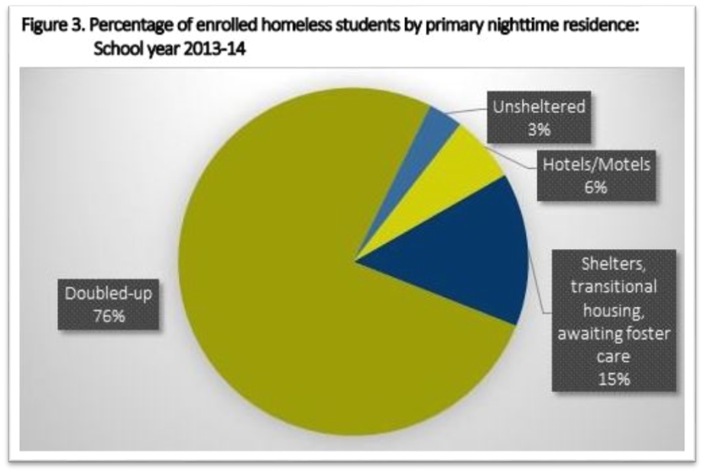
Two Federal Definitions of Homelessness
McKinney Vento – US Department of Education
Housing and Urban Development (HUD)
Excludes families who are doubled-up
Excludes families who are self-paying in motels/hotels
1,360,747 Students in the US identified as homeless

Slide 15
NCHE (National Center for Homeless Education)
Best Practices in Interagency Collaboration Brief Series
Coordinated Entry Processes: Building Mutual Engagement between Schools and Continuums of Care August 2017
Best Practices in Interagency Collaboration Brief Series Spring 2013

Slide 16
HUD’s Continuum of Care
HUD requires all communities receiving McKinney Vento Homeless funds to establish a local Homeless Continuum of Care [CoC]
Communitywide commitment to ending homelessness
Provide funding for efforts to quickly rehouse people while minimizing the trauma and dislocation caused by homelessness
Promote access to and utilization of mainstream programs
Optimize self-sufficiency among people experiencing homelessness
Notes:
CoC must have a competition for the funds
Prioritizes how to spend funds
Schools should have their voices heard

Slide 17
Why does this matter?
The CoC and the School District do have overlap in who they serve.
But, the School District is serving/identifying more people as experiencing homelessness.
CoC’s want to serve as many people as possible, but assistance is tied to funding requirements.
Important to be creative when it comes to funds not regulated by HUD.
Important for schools to be at the table when decisions are made. Need the voices of children to be heard.
Notes:
Mention diversion and how this could be a way to help those who don’t meet HUD definition
Mention FHS as a program that is non-HUD funded
CoC’s make decisions that will have lasting effects on those in need of services: Community Plan, Coordinated Entry, etc.

Slide 18
Collaboration

Slide 19
How do I connect with my CoC?
Find your CoC’s Lead
https://www.hudexchange.info/grantees/contacts/
Lists CoC’s by State, has contact information for the CoC Lead
Info may not be up to date, but a really good start
Find your CoC’s Board of Directors
Each CoC is required to have a Board of Directors
Use Google to find them
Attend your CoC’s Membership meetings
Find your CoC Coordinator/Director

Slide 20
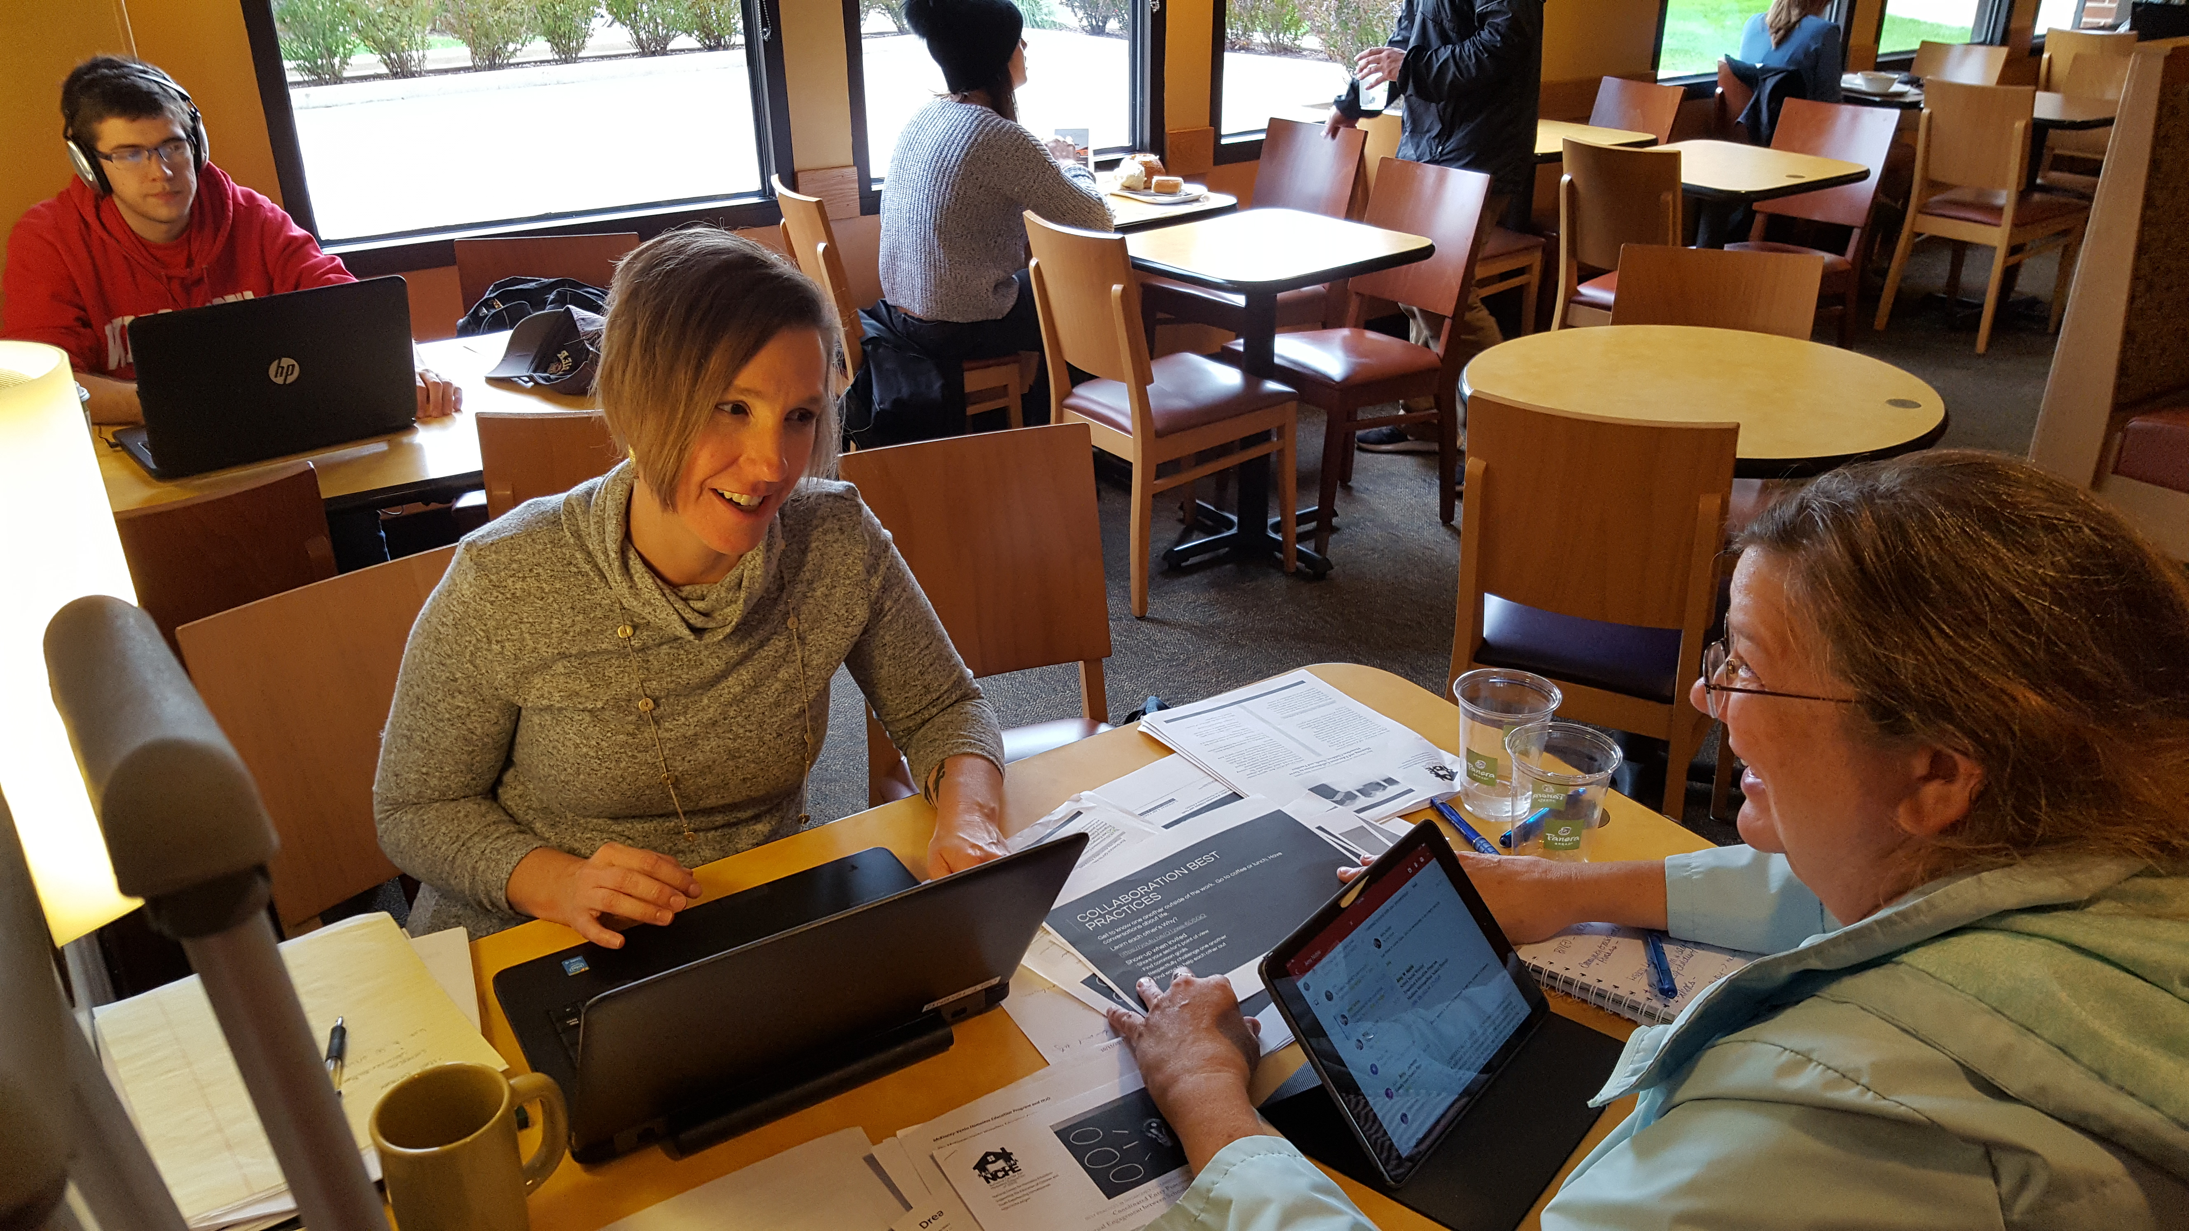
Collaboration best practices
Get to know one another outside of the work. Go to coffee or lunch. Have conversations about life.
Show-up when invited
Share your sector’s point of view
Repeat your message
Find common goals
Respectfully challenge one another
Find ways to help each other out

Slide 21
Concrete ways to collaborate
Have someone on key committees
Schools listed on release of information signed by family at assessment
Shelter staff have residents sign ROI to start communication with schools
School has a key contact for shelters
Shelter has a key contact for the schools
Schools attend Housing Placement Meetings
Provide letters of support for grants
Schools can provide documentation of homeless status
Find out what your CoC tells HUD they are doing to collaborate

Slide 22
HUD CoC Collaborative Application
Describe: (1) How the CoC collaborates with youth education providers, including McKinney-Vento local educational authorities and school districts; (2) the formal partnerships the CoC has with these entities; and (3) the policies and procedures, if any, that have been adopted to inform individuals and families who become homeless of their eligibility for educational services.

Slide 23
Madison/Dane CoC’s Answer
1. TEP staff active members of the COC; attend membership meetings
2. TEP staff attend Family Placement Meetings
3. TEP staff reach out to CoC when identifying youth and families whose situation meets HUD definition of homelessness
4. CoC Board President is a TEP staff
5. TEP staff provide education to the CoC
6. CoC’s Written Standards provide policies on informing households of their education eligibility
7. One shelter/PSH/RRH program has a designated “Education Specialist” person to provide direct educational supports to families who move into permanent housing from shelter.

Slide 24
conflict: It’s going to happen

Slide 25
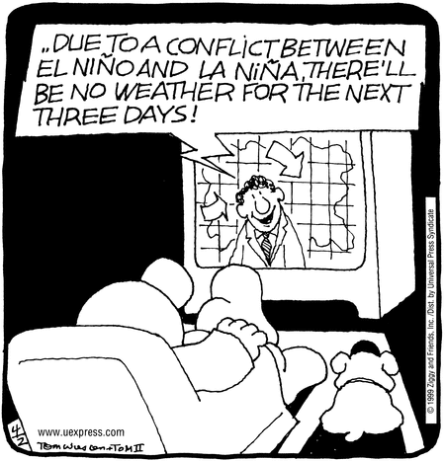

Slide 26
How to get through conflict?
Focus on shared goal: don’t let conflict get in the way of housing families
Listen to one another
Engage in healthy dialogue about the conflict
Respect the two definitions of homelessness and that we each work within our definition
Think about it as “a problem to solve instead of a roadblock”
Trust that both sides want people securely and safely housed
Be creative, think outside the box together (2 heads are better than 1)
Celebrate shared successes

Slide 27
Winning: when collaboration works

Slide 28
Successes
Connecting families to housing
Connecting with families: schools have contact info!
Continued conversation about community needs
Shared language, esp. when talking with families about housing and resources
Community outreach – sharing all our stories
Collaborative conversations about emergent situations
Including specific goals in our school district McKinney Vento Grant around attendance and parental involvement when families are in shelter and housing programs. Supporting change agent opportunities within our community.

Slide 29
Questions?

Slide 30
Contact INFO
Jani Koester
TEP – Transition Education Program
Madison Metropolitan School District
545 W Dayton, Madison WI
(608) 204-2063
jkoester@Madison.k12.wi.us
Torrie Kopp Mueller
CoC Coordinator
Madison/Dane County CoC
(608) 266-6254
tkoppmueller@cityofmadison.com

