Slide 1
Faith-based coffee model: Engaging the faith community & Social Service agencies
The National Association for the Education of Homeless Children and Youth Conference
October 2017

Slide 2
Presented by
Peggy Carlson, District Liaison for Students In Transition
&
Melanie Green, Administrator of Family Engagement & Family & Community Resource Centers
Vancouver, Washington

Slide 3
Thank you for joining us!
Raise your hand…
Homeless Liaison
School Administrator
Educator/Counselor-Social Worker
Service Provider
Government Agency
Member of a Church Community
Other
Notes:
Peggy

Slide 4
Goals & Objectives:
Participants will…
be introduced to the Faith-Based Coffee (FBC) Model.
understand the impact of the FBC Model on students and families in transition.
learn the benefits, outcomes and be given examples of successful programs that were implemented because of FBC.
receive tools and practical application steps to replicate FBC in their community.
explore the benefits and challenges of working alongside faith communities and how to successfully navigate the separation of church and state.
Notes:
Peggy

Slide 5
Our Community – Vancouver, WA
Evergreen Public Schools
26,178 Students
46% Free/Reduced meals participation
84% Graduation rate
16% students are chronically absent
Absent 18+ days of school each year
Notes:
Peggy

Slide 6
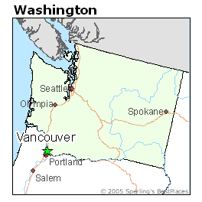
Our Community – Vancouver, WA
Population – 174,826 (July 2016)
7.6% increase from 6 years prior
July 2016 Census
80% White
12.4% Hispanic
8.6% Asian
4.6% 2+ races
4.1% Black
66,417 households
Median income
$50,626 (2015)
Half are renters
Affordable Housing Crisis
Hover around 2% vacancy rate – healthy rate for a community is 5-6%
Vancouver named top city for fastest rising rents in the nation
17,690 very-low income households
4-person household earns less than $37,000/year
78% are renters
50% spend more than half of their income on housing
Notes:
Peggy

Slide 7
Our Community – Vancouver, WA
School Year | Student Population | Students In Transition | Free/Reduced Meal
2007-2008 | 25,396 | 309 | 36%
2012-2013 | 26,461 | 532 | 47%
2016-2017 | 26,139 | 1,045 | 46%
Notes:
Peggy

Slide 8
Discussion Questions
What do you see as the greatest needs of your community?
Are there agencies/organizations/groups working together to address the needs of the community?
Notes:
Peggy

Slide 9
Our Community – Vancouver, WA
Many schools have had long-standing partnerships with church/faith organizations that provide support to students and families
Many of our faith communities are actively engaged in our community – WHO, after school clubs, holiday support, emergency response to needs, etc.
Opportunity presented itself to formalize, support and encourage partnerships between schools and churches
Notes:
Melanie

Slide 10
Undivided
Undivided documents the true story of how a suburban church unites with at-risk Roosevelt High School—once Portland, Oregon’s most outstanding but now failing and slated for closure—to create a beautiful transformation for students, the school and the volunteers serving it.
https://vimeo.com/45585846
Notes:
Melanie

Slide 11
A brief history of FBC:
Originally started as a network between DSHS and faith communities to support youth in foster care
Clark County Public Health issued 2011 Community Health Assessment
It found children in central Vancouver had a greater risk for poor health due to poor birth outcomes, high rates of chronic disease, poor SES factors, lack of school readiness, and high risk for neglect and abuse.
CCPH focused on improving conditions and building community and family resiliency.
Identified faith communities and brought them together to find out how they could engage with larger community around them.
Vancouver (west-side) Faith-Based Coffee launched in March 2012
Notes:
Melanie

Slide 12
Evergreen (east-side) Faith-Based Coffee launched in February 2015
Superintendent hosted first Faith-School Partnership Breakfast in January 2015 which provided an opportunity to “kick-off” the Evergreen FBC Meetings
Clear message that our district was supportive and encouraging of these partnerships
Personal invitation was key to bringing them to the table
Notes:
Melanie

Slide 13
Faith-School Partnership Breakfast
Annual event brings together church and school leadership to celebrate partnerships, accomplishments and strengthen existing relationships
Highlight church-school partnerships and share stories of success
Seating chart by geographical areas allows churches and schools connect to those closest to them
Discussion questions for table talk during breakfast that provided an opportunity to share needs and resources
Notes:
Melanie

Slide 14
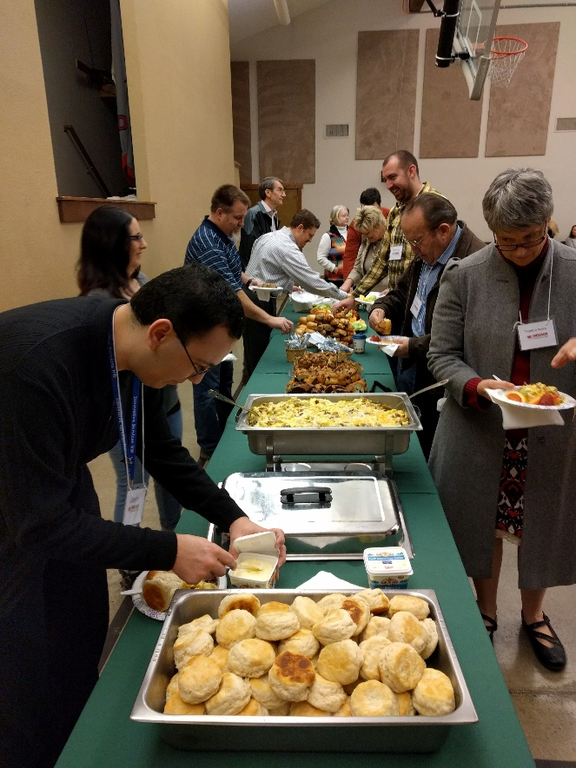
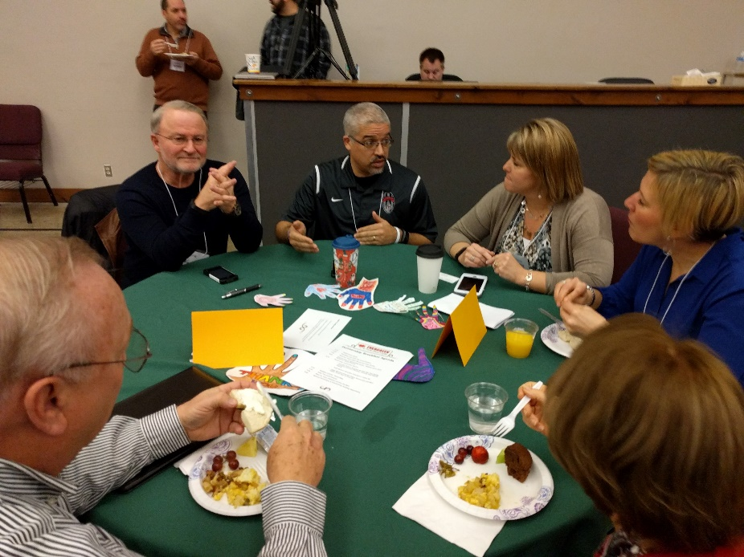
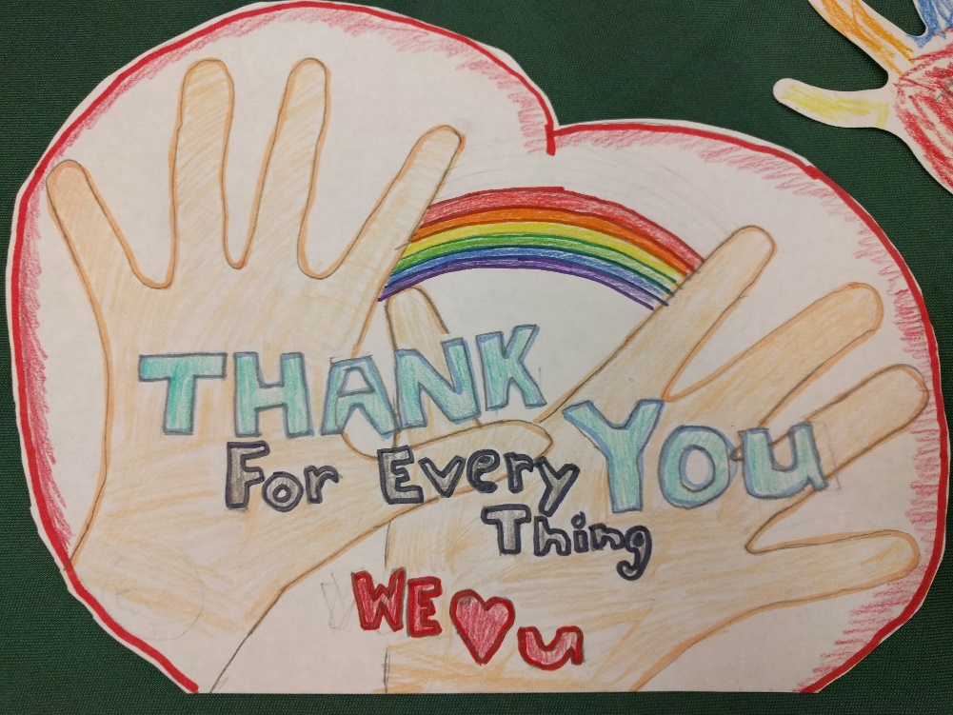
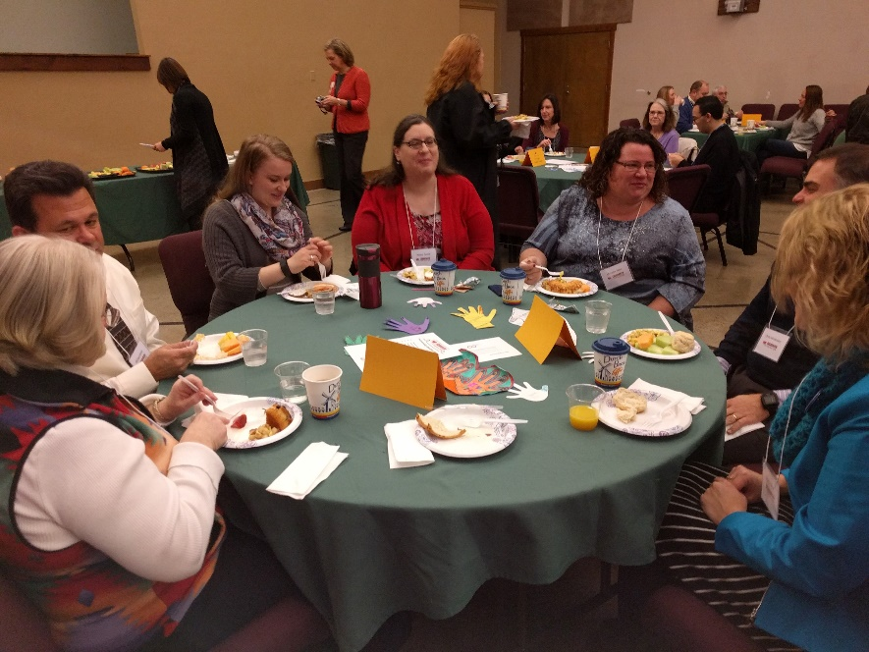
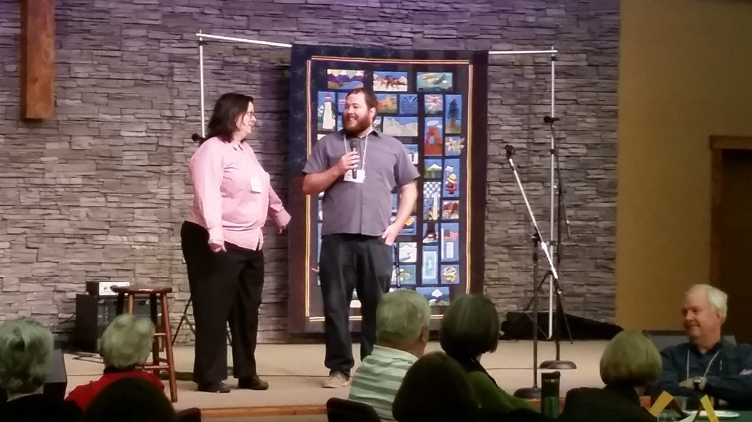
Notes:
Melanie

Slide 15
Evergreen Public Schools partners with Evergreen Faith-Based Coffee to share information about the needs of the children and families we serve.
Each month faith and community partners gather to: Support community resiliency Serve children, individuals and families Learn about needs related to those we serve Share information in a safe and inclusive environment Build new relationships and partnerships Communicate stories of impact Encourage purposeful engagement and respectful conversation
Notes:
Peggy

Slide 16
FBC Video
https://vimeo.com/186485450/7e089b122a
Notes:
Peggy

Slide 17
FBC: Getting started…
Identify key stakeholders in your community to participate
Establish a planning committee that can help identify a church host, sponsors for coffee and snacks, and develop a plan for topics to cover at meetings
Needs assessment – what is important and relevant to your community?
Educate faith partners by sharing data and about the needs and concerns of students and families in your district
Notes:
Peggy

Slide 18
Participating Members of FBC
Non-profits & Social Service Agencies:
Clark County Public Health
National Alliance on Mental Illness
Dept. of Social & Health Services
Child Protective Services
Foster care programs
Health care providers
Washington State University
Free Clinic of SW Washington
Juvenile Justice
Catholic Community Services
Mentoring agencies
Council for the Homeless…
Faith-Based Partners:
Cascade Park Baptist Church (Host)
Church of Jesus Christ of Latter-day Saints
St. Andrew Lutheran
Columbia Presbyterian
Beautiful Savior Lutheran Church
Cascades Presbyterian
Church of the Good Shepherd
CrossPointe Baptist Church
Orchards United Methodist Church
Evergreen Bible Community Church
Life Point Church
Mill Plain United Methodist Church…
Notes:
Peggy

Slide 19
Discussion Questions
Who would you identify as a key stakeholder that could help with the implementation of FBC?
Who would you select to be on a planning committee?
Who would benefit from this type of collaboration?
Notes:
Peggy

Slide 20
A typical Faith-Based Coffee Meeting
8:30 – 9:00: Welcome, Introductions & Announcements
9:00 – 10:00: Guest Presentation(s)
10:00 – 10:15: Table discussion, debrief and follow-up
10:15 – 10:30: Sharing and wrap-up
10:30 – 11:00: Optional Networking
Notes:
Melanie

Slide 21
Topics for Faith-Based Coffee Meeting: We encourage you to cover topics relevant to your community and pull in partner agencies to share information.
School-Church Partnerships 101
Foster Care supports needed in our community
College Access & Readiness
Housing crisis in our community
Cannabis Conversations: how to talk to kids about legalization of marijuana
Notes:
Melanie

Slide 22
Topics for Faith-Based Coffee Meeting:
National Alliance of Mental Illness – SEE ME Presentation
Sex Trafficking
Screening and discussion of Paper Tigers & Undivided
Adverse Childhood Experiences (ACEs)
YWCA “Where We Live Presentation” focusing on keeping kids safe from sexual violence
Mentoring Programs/Opportunities to engage in schools
FBC Debrief and planning session
Notes:
Melanie

Slide 23
Discussion Questions
What topics could you explore relevant to your community?
Which agencies connected to those topics could you invite to attend and share information?
Notes:
Melanie

Slide 24
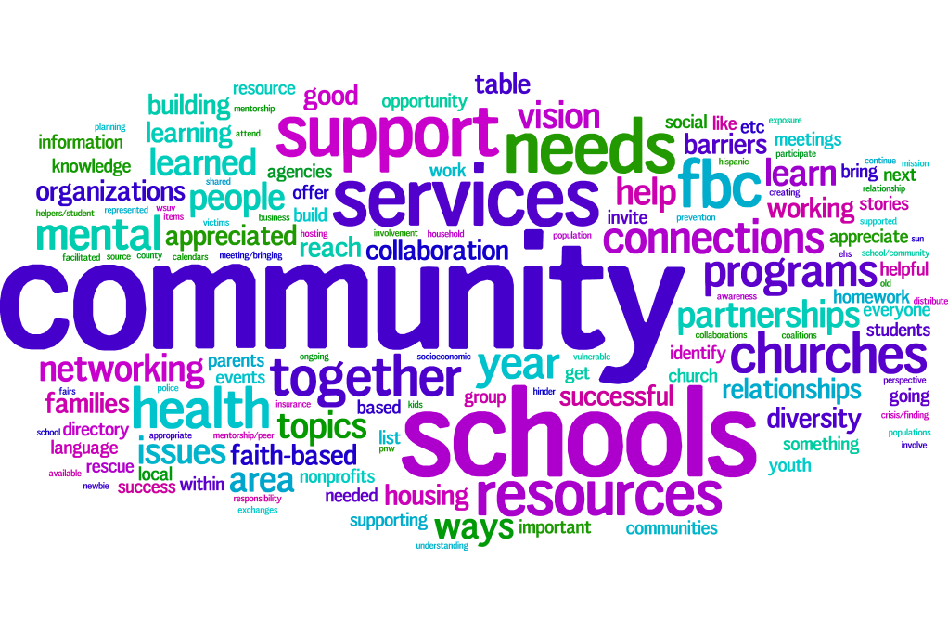
Notes:
Melanie

Slide 25
Benefits of FBC & Keys to Success
Representation from schools, faith partners and community agencies
Opportunity to build relationships between schools-faith partners-community agencies
Break down walls that separate the faith community and educational systems – shared community
Shared learning provides opportunity for collaborative thinking, followed by structure and supports as partnerships mature
Leverage resources and supports
Minimal costs – Church partner hosts meeting, coffee donations, faith partner provides snacks
Notes:
Melanie

Slide 26
Impact of FBC on students and families in transition
Church support for food and clothing pantry at high schools
Mentoring programs support:
Volunteers and students play basketball during lunch at high school
Support for Lunch & Reading Buddy Program at elementary schools
Teach One to Lead One Mentoring Program for 4th and 5th grade students
After school barbeque for students and families to enjoy prior to sporting events – entrance to game is free
Church volunteers picked up lost and found at the end of the school year and washed, folded and sorted items
Notes:
Peggy

Slide 27
Impact of FBC on students and families in transition
Fundraising supports
Clark County Quilters Guild auction to benefit SIT Program
Fresh Start Clothing Drive – new school clothes for students in transition
Family Assistance – rental support, utilities assistance
Clark County Connect – email alert system to fill emergency family needs
Church partners teaching English language classes
Community advocacy for policy change
Notes:
Peggy

Slide 28
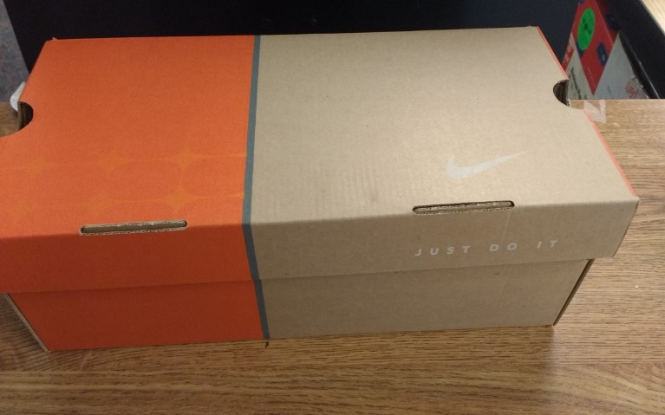
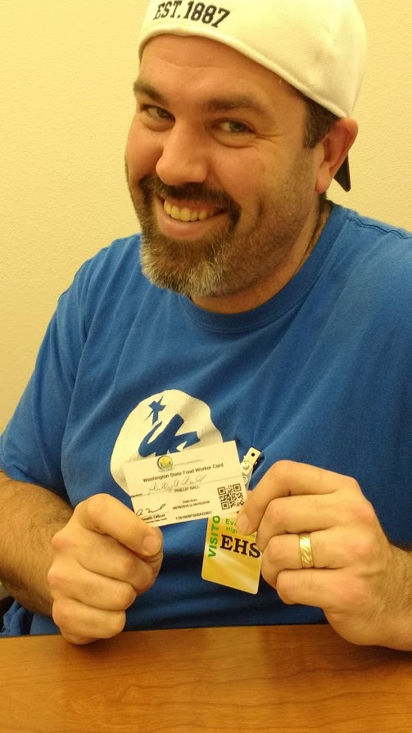
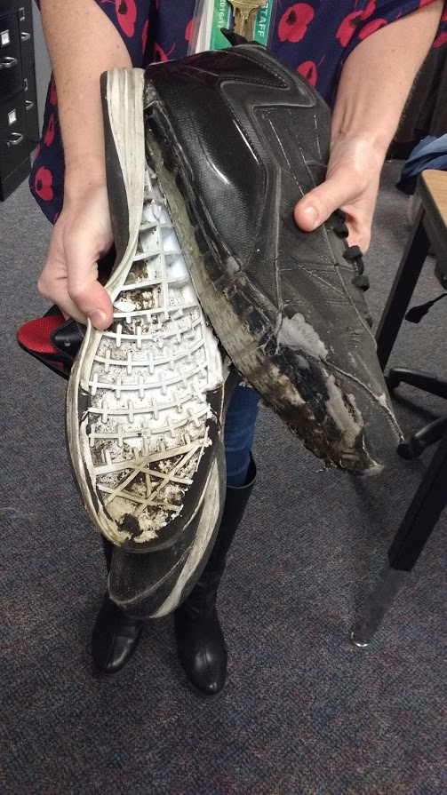
Basic Needs Support
Notes:
Peggy

Slide 29
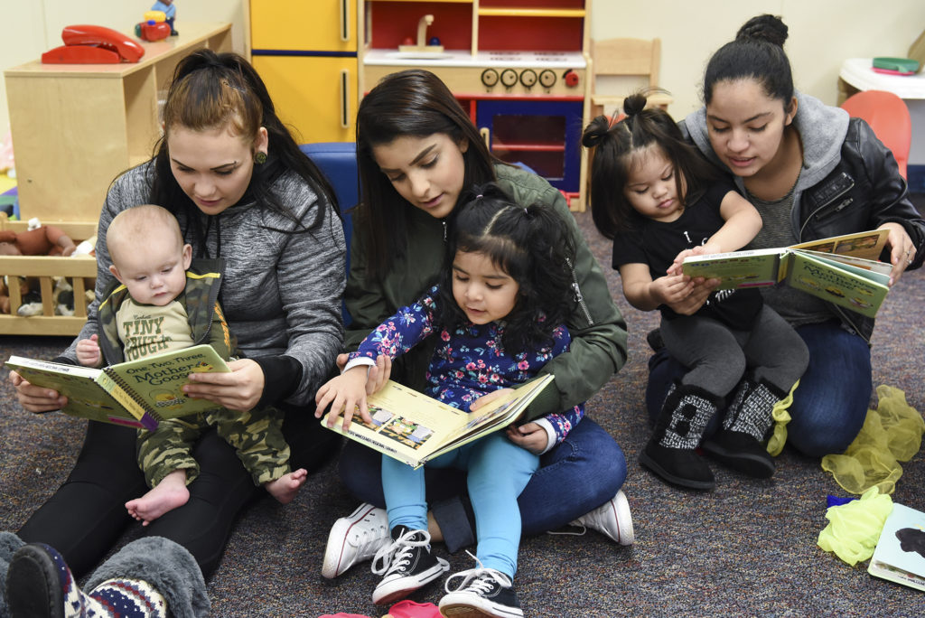
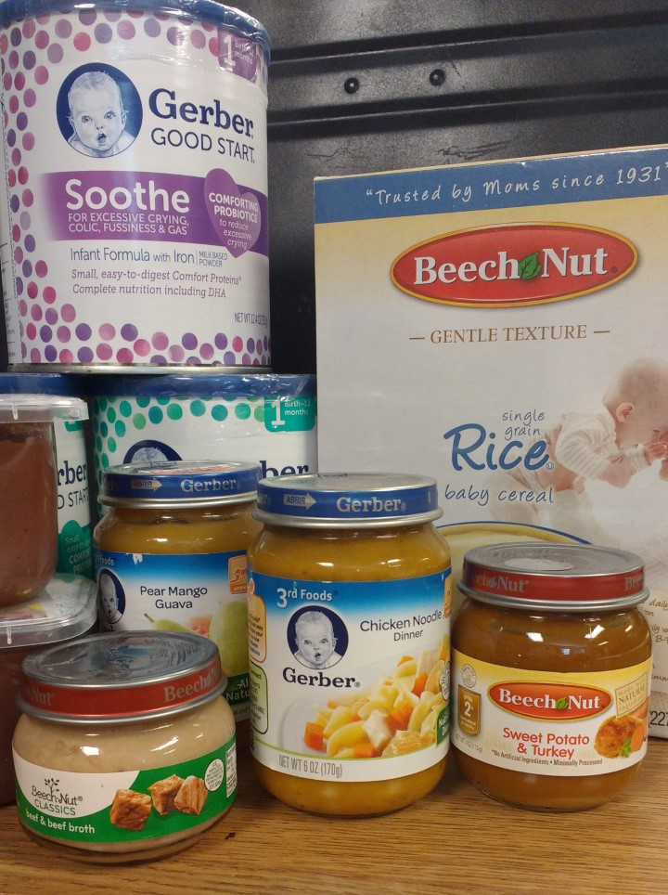
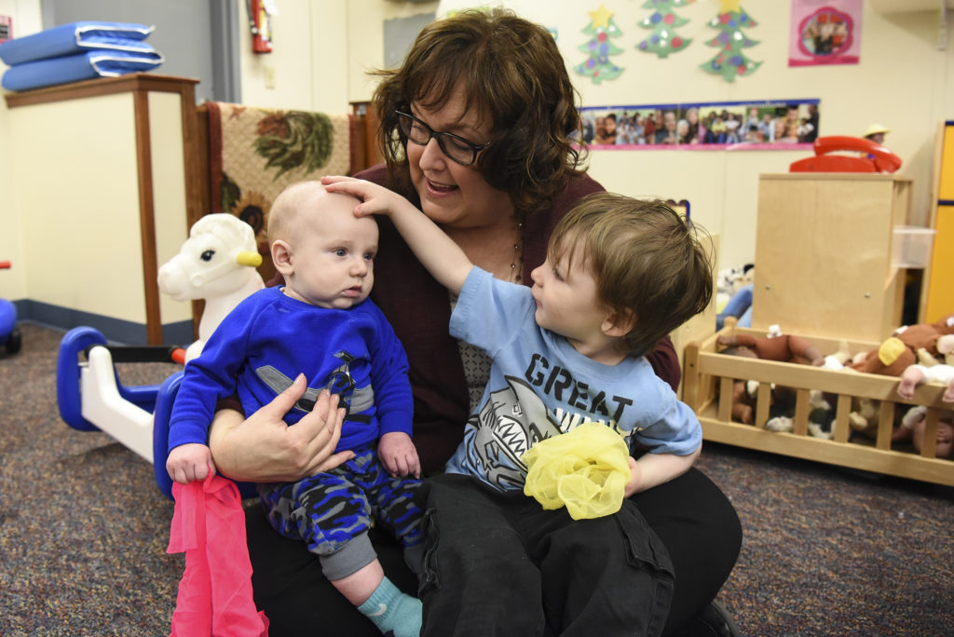
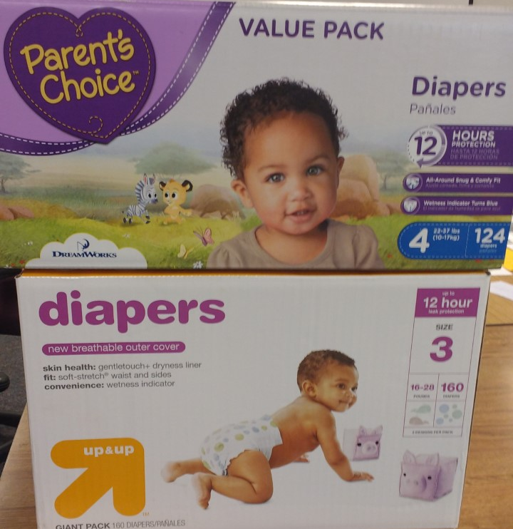
GRADS Teen Parent Program Basic Needs Supports
Notes:
Peggy

Slide 30
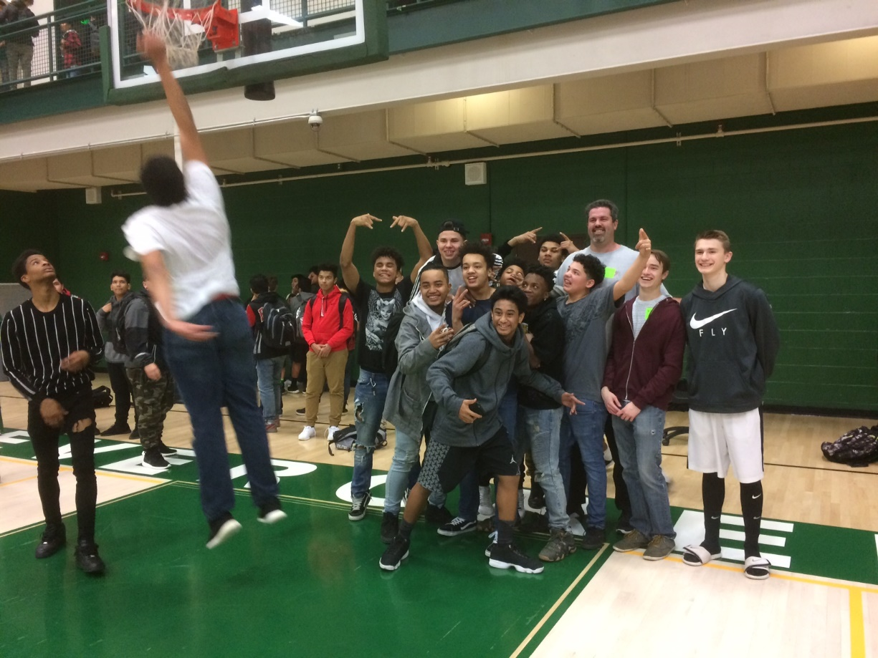
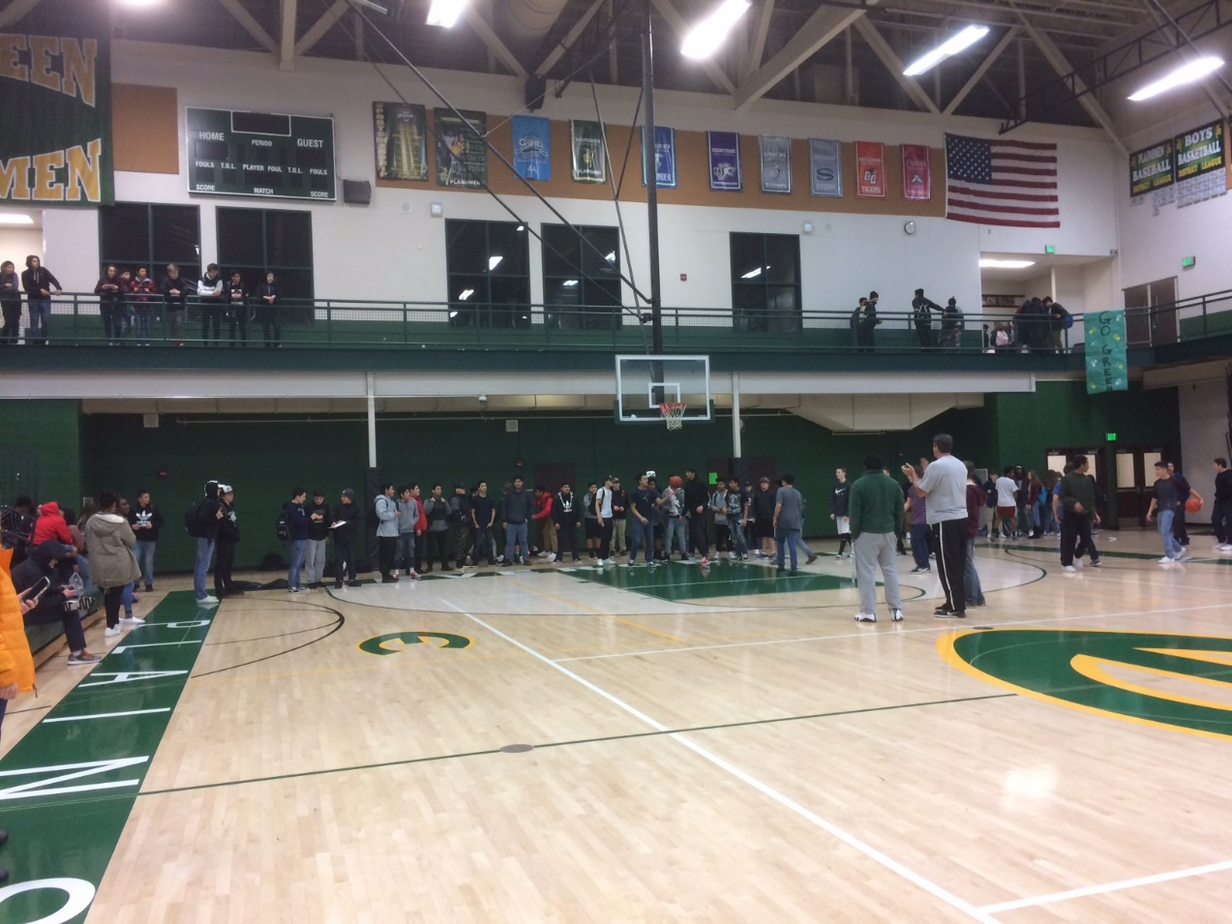
Monday Basketball - Relationships
Notes:
Peggy

Slide 31
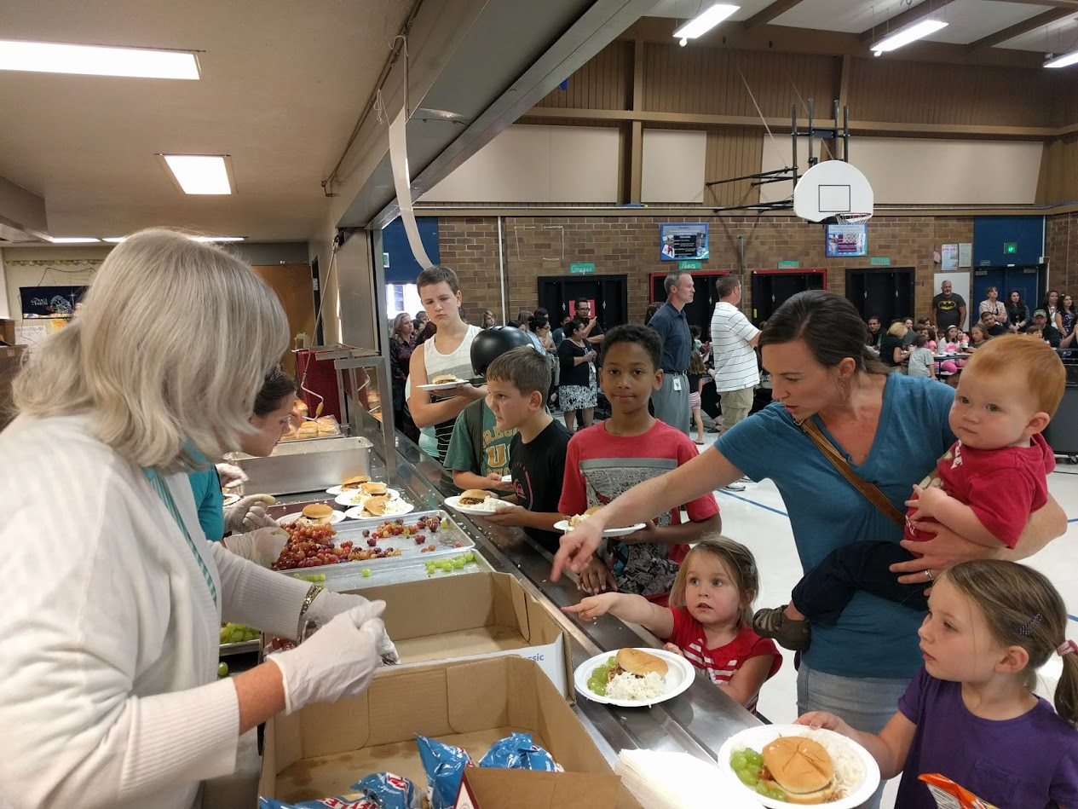
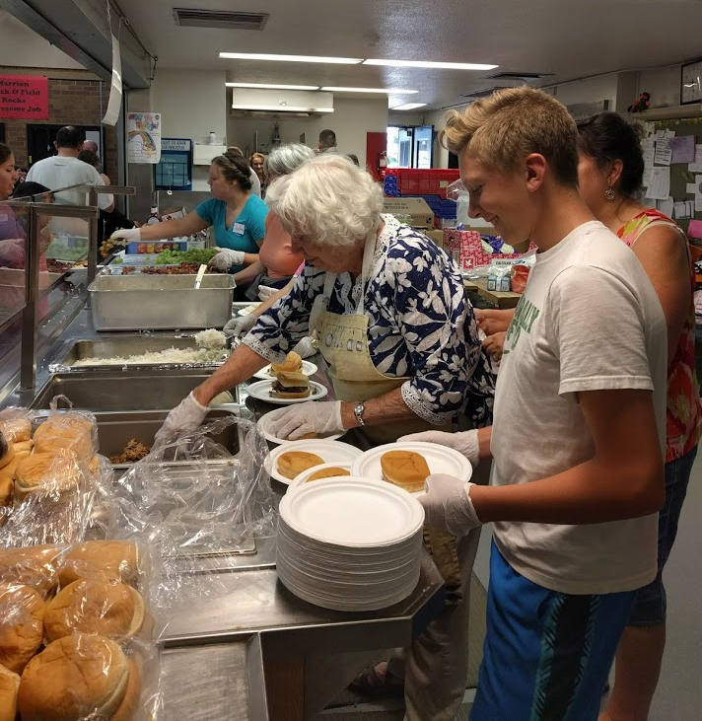
Showing faith through service – support for family events
Notes:
Melanie

Slide 32
Challenges & Suggestions:
Data collection and capturing the outcomes of partnerships formed through FBC
Churches tend to want to support their neighborhood school
Separation of church and state must be clearly defined and discussed – full transparency
Matching needs of community/schools with resources available through faith partners
On-going coordination of meetings – who can take the lead?
Notes:
Melanie

Slide 33
Challenges & Suggestions:
Create “Address Book” with a point person at each school that can be the liaison between the two agencies
Diversity in faith representation
Maintaining faith partners participation at monthly meetings
Communication between meeting to maintain engagement
MailChimp Newsletter - Includes meeting notes, upcoming events, reminders, and agenda for next meeting
Social Media (Facebook, Twitter, website, etc.)
Notes:
Melanie

Slide 34
Discussion Question
What do you see as the barriers and challenges of implementing the Faith-Based Coffee Model in your community?
Notes:
Melanie

Slide 35
National Association of County and City Health Officials recognized Faith-Based Coffee with a Promising Practice Award
Together, these organizations and individuals support a collaborative mission to build and support the development of protective community factors such as parent/family resilience, social connectedness, concrete supports, the social/emotional competence of children, nurturing/attachment, and improved parenting skills and their knowledge about child development for families and children who lived in this area.
Notes:
Melanie

Slide 36
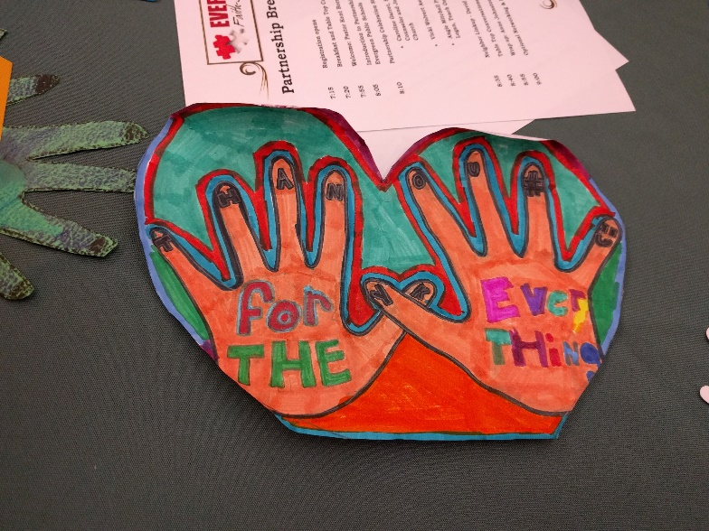
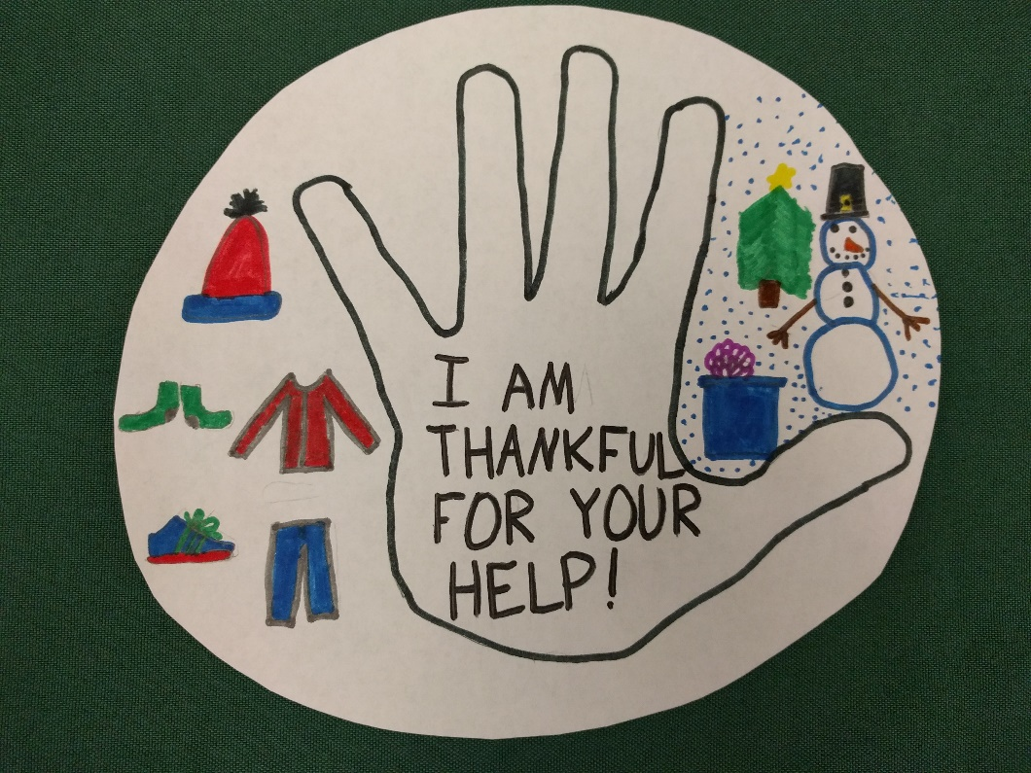
Resources
Undivided
http://beundivided.com/
School Partnership Network
http://cityservepdx.org/schools
Peggy.Carlson@evergreenps.org
Melanie.green@evergreenps.org

Slide 37
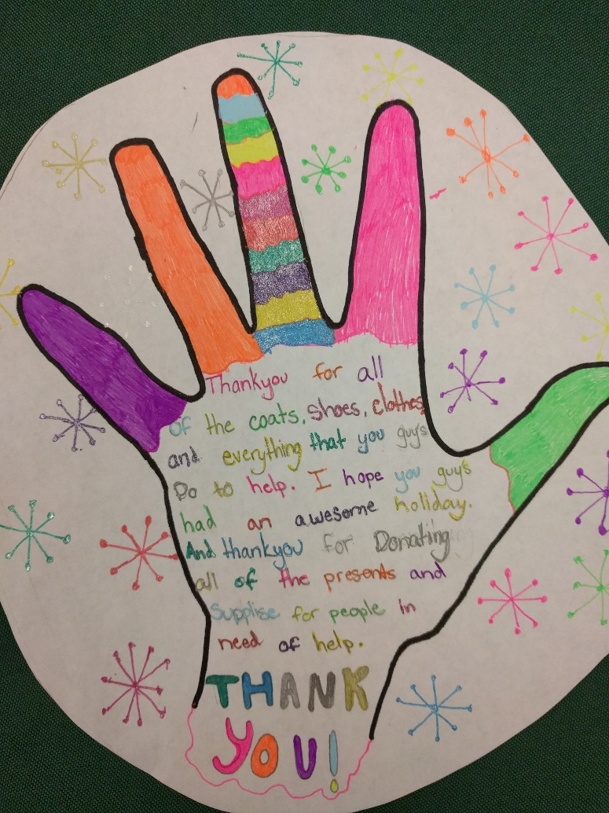
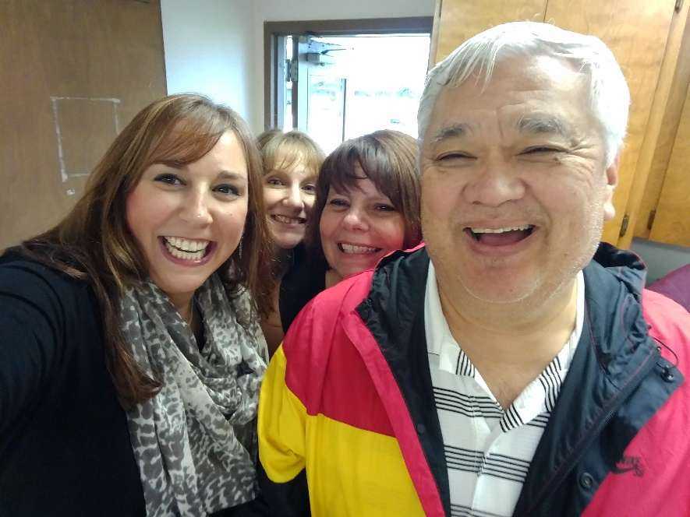
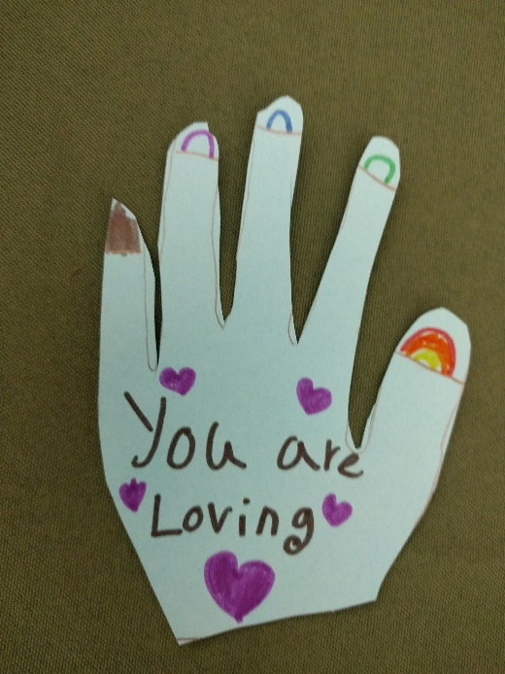
Thank you for joining us!
Questions or comments?

