Slide 1
More Than a Place to Sleep Understanding the Health and Well-Being of Homeless High School Students Rachel Barth, Policy Analyst RBarth@ICPHusa.org

Slide 2
Homelessness is More Than a Lack of Housing
Homelessness not only impacts a child’s education, but also their health and wellbeing.
It is a traumatic experience: Loss of home, friends, routine, security/feeling of safety.

Slide 3
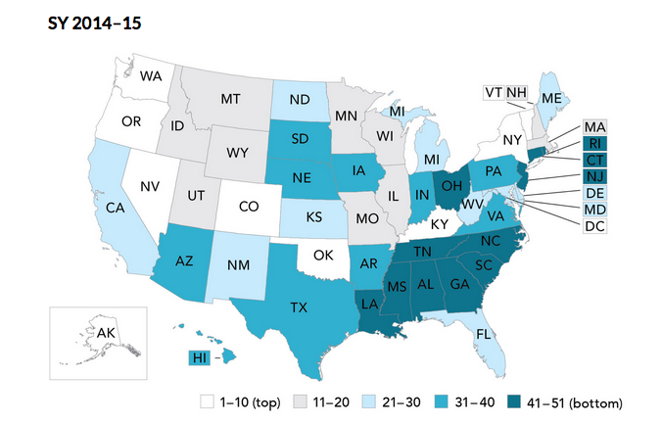
State Ranking of Identification of Homeless Students
New York State # 2
Maryland # 29
Connecticut # 49
Knowing how many students are homeless and the specific challenges they face is necessary to implement the changes to support their development.
Source: The Institute for Children, Poverty, and Homeless, Out of the Shadows: A State-by-State Ranking of Accountability for Homeless Students, 2016.

Slide 4
What is the YRBS? Youth Risk Behavior Survey
Administered by the CDC every other year in all states and some cities
In 2015, 10 surveys (3 cities and 7 states) asked students about housing status
Housing status questions added as optional questions on 2017 survey

Slide 5
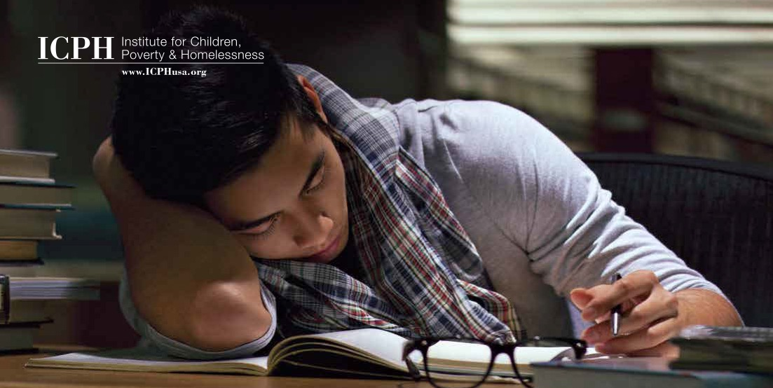
A Word About Methodology…
All figures calculated using weighted data
All data are statistically significant, meaning it is highly unlikely these relationships happened by chance
Connecticut and New York City data from 2015; Maryland data from 2014
Some questions combined for easier comparison across surveys

Slide 6
Housing Status in the YRBS
NYC: 11% homeless
21,329 high school students
Maryland: 7% homeless
16,777 high school students
Connecticut: 10% homeless
14,273 high school students
Source: Centers for Disease Control and Prevention, 2015 New York City Youth Risk Behavior Survey, 2014 Maryland Youth Risk Behavior Survey, 2015 Connecticut Youth Risk Behavior Survey, unpublished data tabulated by the Institute for Children, Poverty, and Homelessness.

Slide 7
Housing Status in this Presentation
Homeless with Family – Typically slept somewhere other than at home in the last 30 days (NYC and CT) or the last 12 months (MD)
Homeless, Unaccompanied – Lived away from their parents or guardians because they were kicked out, ran away, or were abandoned at some point in the past 12 months
All Homeless – All students who were homeless with their families, unaccompanied, and both
Source: Centers for Disease Control and Prevention, 2015 New York City Youth Risk Behavior Survey, 2014 Maryland Youth Risk Behavior Survey, 2015 Connecticut Youth Risk Behavior Survey, unpublished data tabulated by the Institute for Children, Poverty, and Homelessness.

Slide 8
Family Homelessness in the YRBS
Source: Centers for Disease Control and Prevention, 2015 New York City Youth Risk Behavior Survey, 2014 Maryland Youth Risk Behavior Survey, 2015 Connecticut Youth Risk Behavior Survey, unpublished data tabulated by the Institute for Children, Poverty, and Homelessness.

Slide 9
Unaccompanied Homelessness in the YRBS
Source: Centers for Disease Control and Prevention, 2015 New York City Youth Risk Behavior Survey, 2014 Maryland Youth Risk Behavior Survey, 2015 Connecticut Youth Risk Behavior Survey, unpublished data tabulated by the Institute for Children, Poverty, and Homelessness.

Slide 10
Demographics
More homeless students in Maryland and Connecticut reported being gay or lesbian, bisexual, or not sure than in NYC
More males were homeless, especially students in NYC who experienced both types of homelessness (66%)
More Hispanic/Latino students were homeless, especially homeless students in NYC who experienced both types of homelessness (65%)
Across the three locations, homeless students were disproportionately black.
Source: Centers for Disease Control and Prevention, 2015 New York City Youth Risk Behavior Survey, 2014 Maryland Youth Risk Behavior Survey, 2015 Connecticut Youth Risk Behavior Survey, unpublished data tabulated by the Institute for Children, Poverty, and Homelessness.

Slide 11
What Basic Necessities Do Homeless Students Lack?

Slide 12
Breakfast
In both NYC and Connecticut, over twice as many homeless students did not eat breakfast at all in the last seven days compared to housed students.
Source: Centers for Disease Control and Prevention, 2015 New York City Youth Risk Behavior Survey, 2014 Maryland Youth Risk Behavior Survey, 2015 Connecticut Youth Risk Behavior Survey, unpublished data tabulated by the Institute for Children, Poverty, and Homelessness.

Slide 13
Fruit Consumption
“I remember going to M&M World, stealing the candy and putting it in my pocket, being chased by the security guard. But I was doing it because I was hungry.… Imagine going the whole day not eating.”
Graduated, Class of 2010
Source: Centers for Disease Control and Prevention, 2015 New York City Youth Risk Behavior Survey, 2014 Maryland Youth Risk Behavior Survey, 2015 Connecticut Youth Risk Behavior Survey, unpublished data tabulated by the Institute for Children, Poverty, and Homelessness.

Slide 14
Insufficient Sleep
Homeless students were much less likely than their housed peers to get a healthy amount of sleep. In NYC, only 24% of homeless students sleep seven or more hours per night compared to 55% of housed students.
Even more striking, 42% of homeless students sleep four or fewer hours per night. This is the case for only 9% of housed students.
Source: Centers for Disease Control and Prevention, 2015 New York City Youth Risk Behavior Survey, 2014 Maryland Youth Risk Behavior Survey, 2015 Connecticut Youth Risk Behavior Survey, unpublished data tabulated by the Institute for Children, Poverty, and Homelessness.

Slide 15
How Can the Social and Emotional Needs of Homeless Students Be Met?

Slide 16
Depression
“From depression to self-esteem, from wanting and attempting suicide to abuse of drugs and alcohol to risky sexual behavior—I’ve pretty much gone through it or experienced it just to survive.”
Graduate, Class of 2010
Source: Centers for Disease Control and Prevention, 2015 New York City Youth Risk Behavior Survey, 2014 Maryland Youth Risk Behavior Survey, 2015 Connecticut Youth Risk Behavior Survey, unpublished data tabulated by the Institute for Children, Poverty, and Homelessness.

Slide 17
Suicidal Thoughts
Homeless students in Maryland are nearly three times as likely as housed students to consider suicide.
Source: Centers for Disease Control and Prevention, 2015 New York City Youth Risk Behavior Survey, 2014 Maryland Youth Risk Behavior Survey, 2015 Connecticut Youth Risk Behavior Survey, unpublished data tabulated by the Institute for Children, Poverty, and Homelessness.

Slide 18
Suicide Plans and Attempts
Across NYC, Maryland, and Connecticut, homeless students are at least three times as likely to attempt suicide (NYC, CT) or make plans to attempt suicide (MD).
Source: Centers for Disease Control and Prevention, 2015 New York City Youth Risk Behavior Survey, 2014 Maryland Youth Risk Behavior Survey, 2015 Connecticut Youth Risk Behavior Survey, unpublished data tabulated by the Institute for Children, Poverty, and Homelessness.

Slide 19
How Can Schools Be Safe Places for Homeless Students?

Slide 20
Bullying
“I don’t know what they saw, but people would always find a reason to pick on me, but to me, like that was just the norm. I’m like, life is already bad, so what was the worst that can happen? So I just accepted it as the norm.”
Graduate, Class of 2010
Source: Centers for Disease Control and Prevention, 2015 New York City Youth Risk Behavior Survey, 2014 Maryland Youth Risk Behavior Survey, 2015 Connecticut Youth Risk Behavior Survey, unpublished data tabulated by the Institute for Children, Poverty, and Homelessness.

Slide 21
School Safety
Homeless high school students miss school more often because they do not feel safe, especially in Maryland, where 23% of homeless students missed school because they felt unsafe.
Source: Centers for Disease Control and Prevention, 2015 New York City Youth Risk Behavior Survey, 2014 Maryland Youth Risk Behavior Survey, 2015 Connecticut Youth Risk Behavior Survey, unpublished data tabulated by the Institute for Children, Poverty, and Homelessness.

Slide 22
What Physical Risks Do Homeless Students Face?

Slide 23
Dating Violence
Homeless students in Maryland were nearly five times as likely as housed students to be deliberately hurt by someone they were dating
Source: Centers for Disease Control and Prevention, 2015 New York City Youth Risk Behavior Survey, 2014 Maryland Youth Risk Behavior Survey, 2015 Connecticut Youth Risk Behavior Survey, unpublished data tabulated by the Institute for Children, Poverty, and Homelessness.

Slide 24
Sexual Assault
In Maryland, 28% of homeless students were forced to perform sexual acts by an intimate partner, compared to only 8% of housed students.
Source: Centers for Disease Control and Prevention, 2015 New York City Youth Risk Behavior Survey, 2014 Maryland Youth Risk Behavior Survey, 2015 Connecticut Youth Risk Behavior Survey, unpublished data tabulated by the Institute for Children, Poverty, and Homelessness.

Slide 25
Risky Sexual Behavior
Homeless students across NYC, Maryland, and Connecticut were between three and four times as likely to be sexually active by age 13.
Source: Centers for Disease Control and Prevention, 2015 New York City Youth Risk Behavior Survey, 2014 Maryland Youth Risk Behavior Survey, 2015 Connecticut Youth Risk Behavior Survey, unpublished data tabulated by the Institute for Children, Poverty, and Homelessness.

Slide 26
Pregnancy
Students who experienced homelessness were over ten times as likely to have been pregnant or have gotten someone pregnant.
Source: Centers for Disease Control and Prevention, 2015 New York City Youth Risk Behavior Survey, 2014 Maryland Youth Risk Behavior Survey, 2015 Connecticut Youth Risk Behavior Survey, unpublished data tabulated by the Institute for Children, Poverty, and Homelessness.

Slide 27
Are Homeless High School Students at Risk for Alcohol and Drug Use?

Slide 28
Alcohol Consumption
Homeless students are more likely to engage in dangerous drinking behavior, especially in Maryland, where 38% of homeless students first tried alcohol by age 12.
Source: Centers for Disease Control and Prevention, 2015 New York City Youth Risk Behavior Survey, 2014 Maryland Youth Risk Behavior Survey, 2015 Connecticut Youth Risk Behavior Survey, unpublished data tabulated by the Institute for Children, Poverty, and Homelessness.

Slide 29
Binge Drinking
In Maryland and Connecticut, homeless students are about three times as likely to have been binge drinking in the last 30 days.
Source: Centers for Disease Control and Prevention, 2015 New York City Youth Risk Behavior Survey, 2014 Maryland Youth Risk Behavior Survey, 2015 Connecticut Youth Risk Behavior Survey, unpublished data tabulated by the Institute for Children, Poverty, and Homelessness.

Slide 30
Marijuana Use
“It was just so much, I wanted an outlet, so I started to write—I write poetry. But when that wasn’t doing a lot for me, I found myself starting; using marijuana a lot. Talking about smoking seven blunts in one hour. I just didn’t want to be conscious to society, to the world.”
Graduate, Class of 2010
Source: Centers for Disease Control and Prevention, 2015 New York City Youth Risk Behavior Survey, 2014 Maryland Youth Risk Behavior Survey, 2015 Connecticut Youth Risk Behavior Survey, unpublished data tabulated by the Institute for Children, Poverty, and Homelessness.

Slide 31
Illegal Drugs
“The streets, it’s always there for you. Like someone on my block might say ‘Hey, you all right? You can come stay with me,’ and they’re a drug dealer, and it’s not like necessarily we’re doing anything bad, but it’s just the environment I’m around. So what happens after that? You know what I mean? It’s not good.”
Graduate, Class of 2013
Source: Centers for Disease Control and Prevention, 2015 New York City Youth Risk Behavior Survey, 2014 Maryland Youth Risk Behavior Survey, 2015 Connecticut Youth Risk Behavior Survey, unpublished data tabulated by the Institute for Children, Poverty, and Homelessness.

Slide 32
Prescription Drugs
In Maryland, 41% of homeless students had used prescription drugs without a prescription, compared to 12% of housed students.
Source: Centers for Disease Control and Prevention, 2015 New York City Youth Risk Behavior Survey, 2014 Maryland Youth Risk Behavior Survey, 2015 Connecticut Youth Risk Behavior Survey, unpublished data tabulated by the Institute for Children, Poverty, and Homelessness.

Slide 33
How Can Schools Provide Additional Opportunities for Medical Care?

Slide 34
Asthma Attacks
Among high school students with asthma, homeless teens are more than twice as likely to have had an asthma attack in the past twelve months.
Source: Centers for Disease Control and Prevention, 2015 New York City Youth Risk Behavior Survey, unpublished data tabulated by the Institute for Children, Poverty, and Homelessness.

Slide 35
School-Based Health Centers
“I missed school a lot because my stomach was always hurting. The hardest part was that nobody believed I was sick. Everybody just thought I was skipping school. Later I was diagnosed with Lupus and IBS. It took a really long time to be diagnosed. We were moving around. I kept going to the emergency room.”
Graduate, Class of 2016
Source: Centers for Disease Control and Prevention, 2015 New York City Youth Risk Behavior Survey, unpublished data tabulated by the Institute for Children, Poverty, and Homelessness.

Slide 36
Takeaways
Homeless students faced additional challenges in every indicator we researched. Understanding that is not because they are bad kids or make bad choices, but because they are more likely to lack resources and support and are forced into situations beyond their control, is critical.
Identifying who is homeless and how homelessness affects students is important to inform best practices and supports
Different types of homelessness create different challenges and experiences and may require different interventions
When homeless students have access to support, they use it

Slide 37
Discussion
How does this data relate to your work? Do you see similar patterns and trends on the ground?
How can data be used to raise awareness about what’s happening in schools and communities?
What supports can be offered in schools and communities to help homeless students?
What additional questions do you have about the experiences of students who are homeless? Can these questions be answered using data?

Slide 38
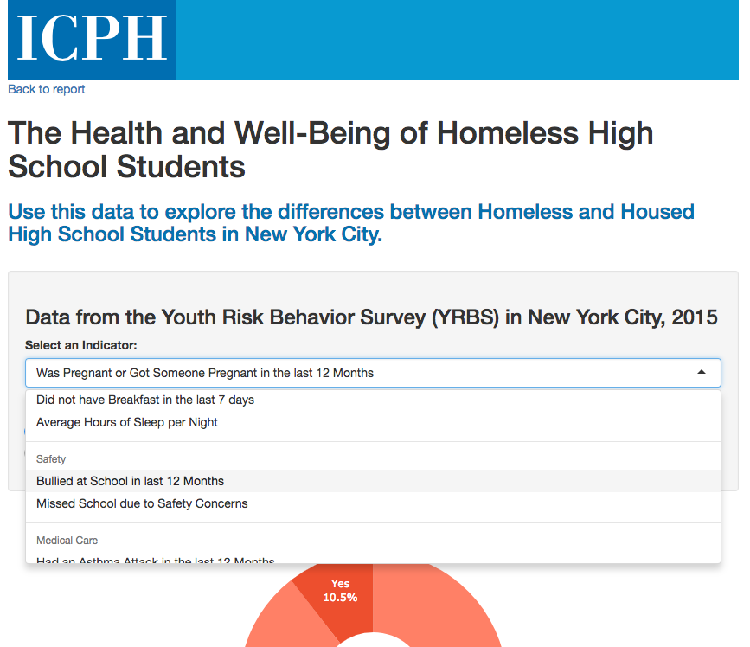
YRBS Web App (NYC)
Link:
http://www.icphusa.org/interactive_data/health-well-homeless-high-school-students/
Read the report: http://www.icphusa.org/new_york_city/homelessstudenthealth/

Slide 39
Thank You!
media@ICPHusa.org 212.358.8086
To download copies of our publications: http://www.ICPHusa.org/publications/reports/

