Slide 1
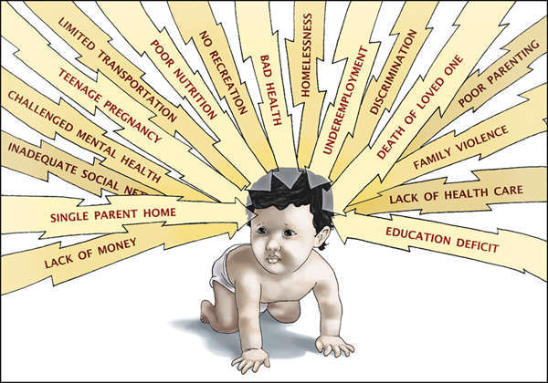
Regional Office of Education 26 & 33
Professional Development Consortium
Children Learn What They Live: How Homelessness Relates to Childhood Trauma and Toxic Stress
Notes:
Today, I would like to give you an overview of how trauma affects a child’s development and ultimately affects their health and academic performance.

Slide 2
Regional Office of Education 26 & 33
Professional Development Consortium
Today, we will…
Identify Trauma & Toxic Stress
Review the ACE Study
How to Develop a Trauma-Informed School Environment
Training Available for Illinois Schools
Notes:
Today, we will briefly hit on these main topics….read slide

Slide 3
Regional Office of Education 26 & 33
Professional Development Consortium
ILLINOIS DEFINITION OF
CHILD TRAUMA
An event a child experiences that is
emotionally painful or distressful which often
results in lasting mental and physical effects.
-National Institute of Mental Health
Notes:
Read the slide

Slide 4
Regional Office of Education 26 & 33
Professional Development Consortium
OUR GOAL: Schools need to provide a safe haven for ALL students and ensure that they have access to any additional supports they may need due to toxic stress and early childhood adverse experiences.
Comprehensive System of Learning Supports through a Trauma-Informed Lens​
Notes:
Our main goal in supporting children in their academic pursuits should be….read slide

Slide 5
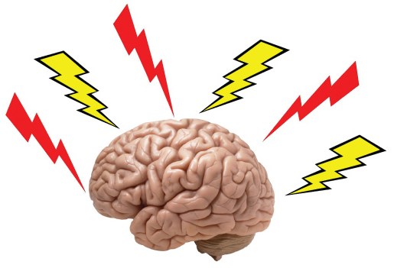
Impact of trauma on the brain
Trauma can impact the developing brain by:
Reducing the number of connections formed
Reducing the size of the cortex
Strengthening survival connection
Resulting in:
Memory problems
Attention difficulty
Language development delays
Emotional and behavioral regulation issues
Adapted from: Luft, E. (Eds.). 2016. Alive and Well STL: The Parents as Teachers National Conference Pre-Conference: Beyond Ferguson - A Journey Towards Trauma-Informed Home Visiting. St. Louis, MO.
Notes:
I initially learned a lot about how trauma impacted the brain during a pre-conference session in Ferguson MO during a presentation from Alive and Well St. Louis at the National Parents as Teachers Conference. Review slide

Slide 6
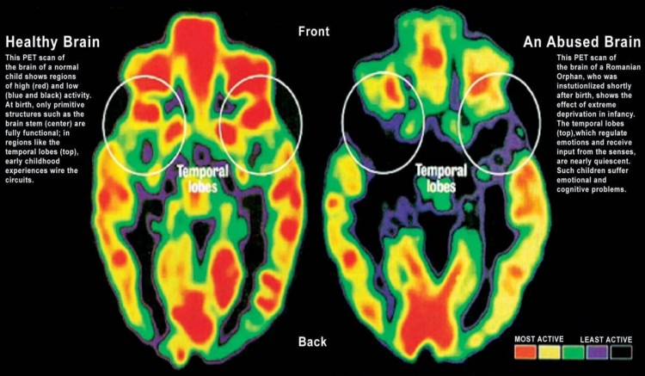
Impact of trauma on the brain developmemt
A Trauma-Informed Lens? Michele Carmichael ROE33
Notes:
The abused brain has significantly less activity in the areas of the brain that regulate impulse control and emotions.

Slide 7
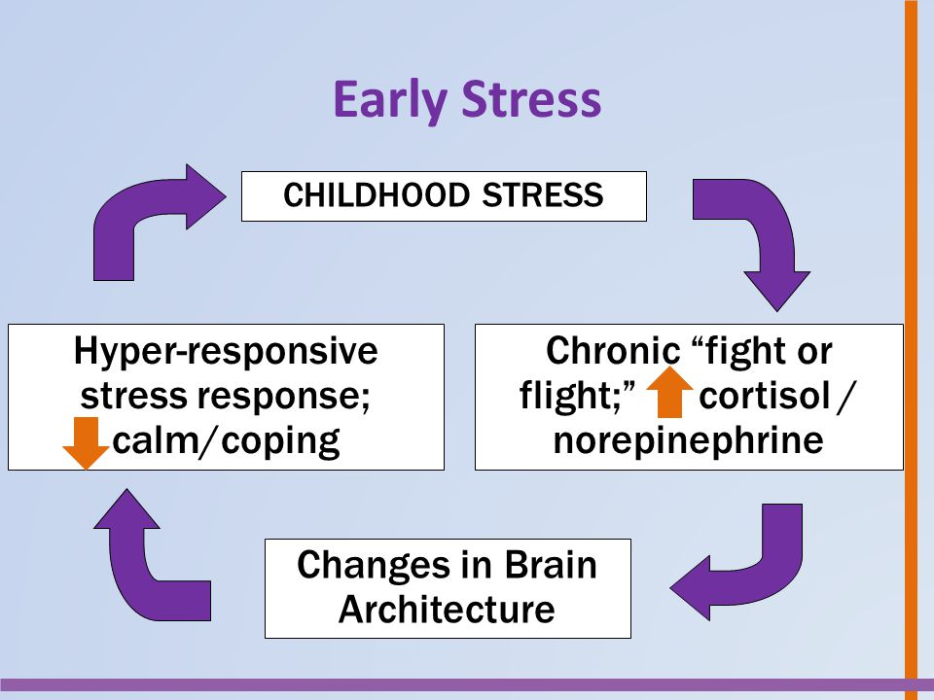
What is Toxic stress
Experiences that can affect brain architecture and brain chemistry
Usually begin during early childhood
Generally chronic in nature
Show lasting effects
Affects developmental, cognitive and social skills
Toxic Stress
Child’s Brain
Development
Adapted from : Purnell, J.Q. (Eds.). 2016. For the Sake of All: The Parents as Teachers National Conference Pre-Conference: Beyond Ferguson - A Journey Towards Trauma-Informed Home Visiting. St. Louis, MO.
Notes:
The initial break through study on Adverse Childhood Experiences was published back in 1998 but the first time I have found the term toxic stress defined in scholarly literature was in early 2000 through a landmark report entitled: From Neurons to Neighborhoods: The Science of Early Childhood Development .
from the Institute of Medicine; Division of Behavioral and Social Sciences and Education; Board on Children, Youth, and Families; Committee on Integrating the Science of Early Childhood Development; and contributing editors Dr. Jack P. Shonkoff and Deborah A. Phillips.
They first coined the phrase toxic stress and how it generally starts in early childhood and affects brain development from then on…..
Toxic Stress link: https://www.youtube.com/watch?v=-q-r_YSUGGw
Child’s Brain Development Link: https://www.youtube.com/watch?v=ak7o9nxpWD4

Slide 8
Adverse Childhood Experiences
Adversity and Stress in Early Childhood can lead to:
Changes in the brain that affects learning, memory and the ability to plan and control behavior
Increased risk for mental and physical health problems in adulthood
When we are faced with stressful situations, our mind and body automatically responds in one of three ways….
FREEZE
FLIGHT
Adapted from: Luft, E. (Eds.). 2016. Alive and Well STL: The Parents as Teachers National Conference Pre-Conference: Beyond Ferguson - A Journey Towards Trauma-Informed Home Visiting. St. Louis, MO.

Slide 9
Notes:
This is a picture that was drawn by a young girl named Michelle who lives in St. Louis, MO after the Ferguson unrest. Describe what the picture represents

Slide 10
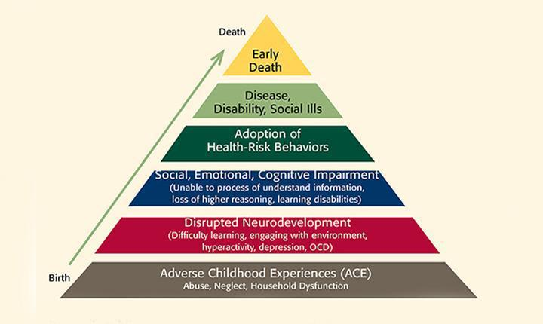
How do we identify Adverse childhood stress?
Felitti, V.J., Anda, R.F., Nordenberg, D., Williamson, D.F., Spitz, A.M., Edwards, V., Koss, M.P., & Marks, J.S. (1998). Relationship of childhood abuse and household dysfunction to many of the leading causes of death in adults: The adverse childhood experiences (ACE) study. American Journal of Preventive Medicine, 14(4), 245-258.
Notes:
Next, let’s briefly review an ground-breaking study that open the world of addressing adverse early childhood experiences that can lead to toxic stress.
Click on picture to view video clip and then review pyramid.
http://kpjrfilms.co/paper-tigers/bonus-content/

Slide 11
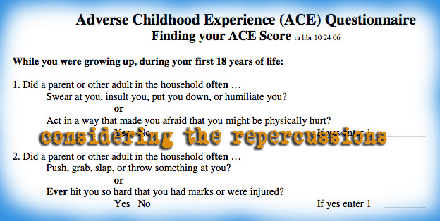
Let’s take the ACE quesitionnaire

Slide 12
What was your score?
Download Polleverywhere app on your phone to enter your ACE score

Slide 13
Notes:
Poll Title: What was your ACE Score? https://www.polleverywhere.com/multiple_choice_polls/6PeiUYvzT77GAts

Slide 14
IMPACT OF ACES ON EDUCATION
Students with 3 or more ACEs:
- Are 2 ½ times more likely to fail a grade
- Score lower on standardized tests
- Have language difficulties
- More likely to be suspended or expelled, &
- Are designated as special education more often
51% of children with 4+ ACE scores had learning and behavior problems in school compared with only 3% of children with no ACE score Illinois ACEs Response Collaborative Summit 2015 – Education Policy Brief
Notes:
Read slide

Slide 15
How to Develop a Trauma-Informed School Environment ?
Trauma-Informed Understanding:
Trauma is prevalent in the lives of children
Trauma affects learning and school performance and causes physical and emotional distress
Trauma sensitive schools help children feel safe to learn
Schools have an important role to play in meeting the social/emotional needs of students
Notes:
In order to support ALL CHILDREN, school personnel must understand the importance in recognizing the signs of trauma and setting up an environment that provides the safe foundation for learning and support.

Slide 16
How to Develop a Trauma-Informed School Environment?
Trauma-Informed Looks Like…
Building Resiliency in Children
6 core strengths
Increasing Protective Factors
40 Developmental Assets
Decreasing Risk Factors
Wrap Around Services
Increasing Student and Family Engagement
Notes:
6 Core Strengths: Attachment, Self Regulation, Affiliation, Awareness, Tolerance and Respect: Together they provide a strong foundation for future health/Dr. Perry
http://www.klamathstopthehurt.org/assets/Six-Core-Strengths-For-Healthy-Brain-Development.pdf
40 Developmental Assets: Are positive experiences and needed qualities that influence student’s development. Helping them become caring responsible and productive adults. Based on youth development, resiliency and prevention research. http://www.scouting.org/filestore/pdf/40_Developmental_Assets_Search_Institute.pdf
Increasing protective factors and reducing risk factors through building the capacity to form and maintain positive, stable relationships is the glue of a family, community and society – Dr. Bruce Perry http://dhss.alaska.gov/dbh/Documents/Prevention/programs/spfsig/pdfs/IOM_Matrix_8%205x11_FINAL.pdf

Slide 17
How to Develop a Trauma-Informed School Environment?
Trauma-Informed Looks Like…
BE AWARE: look for changes, signs, symptoms of trauma
BE AVAILABLE: Listen and help them problem solve
BE RESOURCEFUL: Consult with school mental health supports and know your community resources
Notes:
6 Core Strengths: Attachment, Self Regulation, Affiliation, Awareness, Tolerance and Respect: Together they provide a strong foundation for future health/Dr. Perry

Slide 18
Trauma-Informed in a Nutshell…
Instead of asking…..
“What’s wrong with them?”
A trauma-informed approach ask….
“What has happened to them?”

Slide 19
Supports for Illinois Schools
Trainings for Illinois Schools through ISBE:
IL MTSS Network
Trauma-Informed Lens Overview
Book Study: Boy Who was Raised as a Dog
Develop and Support of a Trauma Response School Team
Notes:
School psychologists conduct trauma informed screening with students to gain an awareness of child trauma, recognize reminders that trigger trauma symptoms and identify ways to manage these triggers and responses in school settings. They are also able to facilitate a supportive response for traumatized students and families, and provide trauma-focused cognitive behavioral therapy to children and their parents in the school setting.

Slide 20
Trauma-Informed Lens Day Long Training
This training will identify:
The three E's of Trauma: Events, Experiences and Effects."
"The four R's: Key Assumptions in a Trauma Informed Approach - Realization, Recognize, Respond, Resist Re-traumatization.
SAMHSA's Concept of Trauma and Guidance for a Trauma Informed Approach
Impact of Trauma on learning:
Academic performance
Classroom behavior
Relationships
Common triggers for children who have endured trauma
How to build resiliency through:
Increasing protective factors
Decreasing risk factors
Improving educational outcomes
Event | Experience | Effects
▪ Abuse: physical, emotional, sexual ▪ Neglect ▪ Victimization ▪ Domestic violence ▪ Community violence ▪ Homelessness ▪ Accident/illness ▪ Natural Disaster ▪ War/terrorism | • Life threatening - overwhelming • Chronic • A subjective, internal state • Varies between people • Varies over time with the same person-Developmental level • Emotional experience at the time VS later | Symptoms can include: • Nightmares • Flashbacks • Fight or Flight • Dissociation • Cutting Hyperarousal • Misinterpretation of cues • Overreaction
Notes:
The 1-2 day long training will cover these topics more indepth
https://store.samhsa.gov/product/SMA14-4884

Slide 21
Upcoming Trainings for Illinois Schools
Trainings for Illinois Schools through ISBE:
Successful Trauma-Sensitive Educational Practices
Wrap Around Approach (Lincoln Alternative School)
Mindfulness Activities (Yoga and Positive Self-Talk)
Music, Art and Cognitive Behavioral Therapy
Trauma Response School Team
Notes:
Wrap around services: health, mental health and social services at the school or in collaboration
Mindfulness activities: focused awareness, breathing and movements exercises/replacing detention/suspension with mindfulness rooms/activities
Calm Through Creativity: How Arts Can Aid Trauma Recovery: https://ncfy.acf.hhs.gov/features/thinking-creatively-family-and-youth-work/art-therapy
Cognitive Behavioral Therapy: School psychologists conduct trauma informed screening with students to gain an awareness of child trauma, recognize reminders that trigger trauma symptoms and identify ways to manage these triggers and responses in school settings. They are also able to facilitate a supportive response for traumatized students and families, and provide trauma-focused cognitive behavioral therapy to children and their parents in the school setting.
School Teams trained in Youth Mental Health First Aid and crisis response

Slide 22
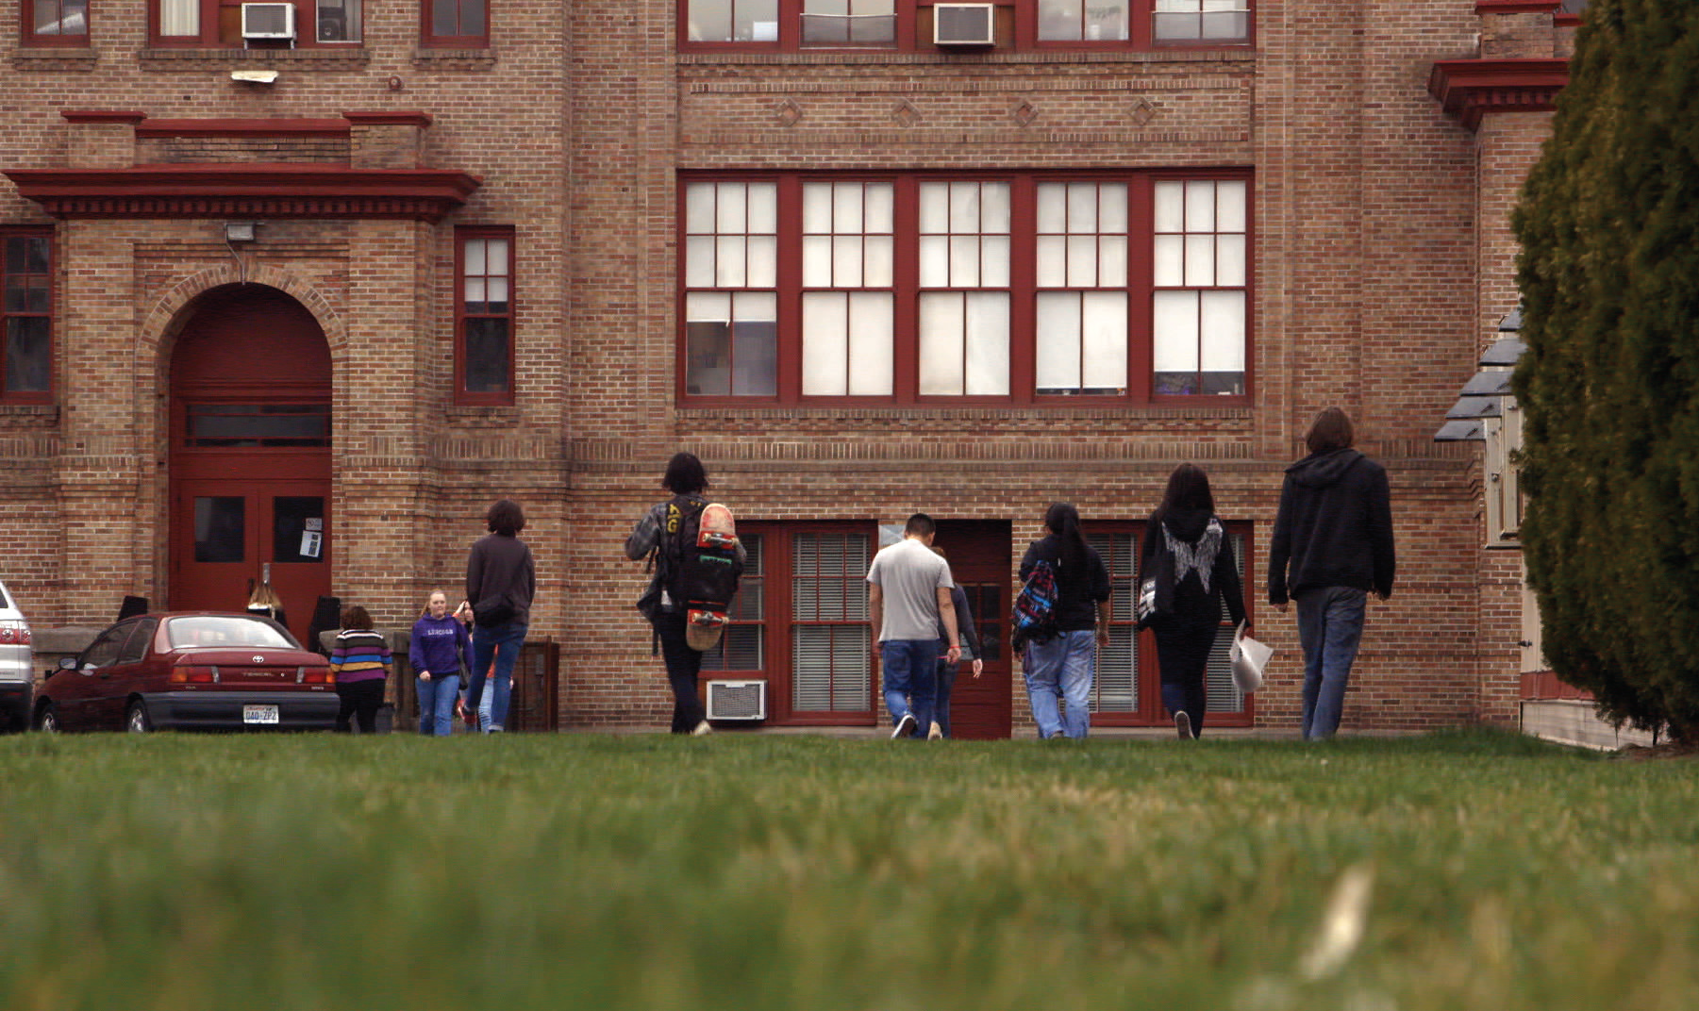
Notes:
How many of you have seen this documentary? Here is the trailer to this inspirational documentary.
http://kpjrfilms.co/paper-tigers/

Slide 23
Any Questions?
Childhood Trauma & Brain Development?
Toxic Stress?
The ACE Study?
How to Create a Trauma-Sensitive
School Environment?
Paper Tigers?
Trainings Available for Illinois Schools?

Slide 24
Resources
Illinois State Board of Education
https://www.isbe.net/Pages/Trauma.aspx
Illinois Multi-Tiered System of Support Network
http://www.ilmtss.net/
Paper Tigers
http://kpjrfilms.co/paper-tigers/
Child Trauma Academy – Dr. Bruce Perry
http://childtrauma.org/
The ACE Study
https://www.cdc.gov/violenceprevention/acestudy/index.html

