Slide 1
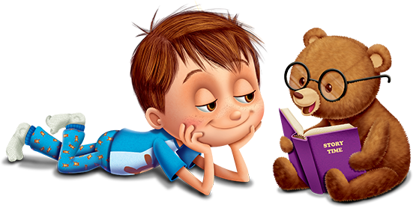
The stories we Tell
Helping Homeless Children Use Literacy to transform experience
Abigail Wengerd, LPC, M.S.Ed., NCC & Laura Wengerd, M.Ed.

Slide 2
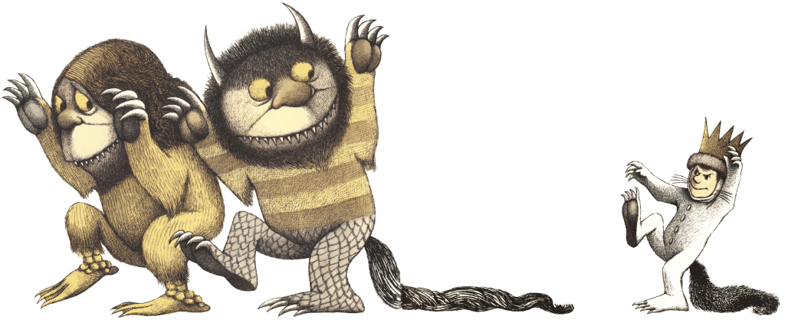
Think about a story that impacted you:
What was it about the story that drew you in?
Why did this particular story have meaning for you?
Did it have to do with something that you were experiencing at a particular time?
What are the lingering effects the story had on you?
How does the story continue to affect you today?

Slide 3
Why do we need stories?
Our brains are captive to a good story
Connect us to friends and family
Bring us comfort
Give us meaning
Provide us hope and healing
When they touch our hearts:
We embrace them
They stay with us
Who would we be without stories?

Slide 4
Help us to answer questions:
How could this happen?
Why did this happen?
Am I alone?
Where do I come from? (family stories)
What am I here for?
Who I am?

Slide 5
Stories give us opportunities to:
Clarify our identity
Make meaning of our experience
Rehearse potential difficulties
Learn how to solve problems
Deal with real life experiences
Broaden our perspective
Become immersed in other worlds

Slide 6
Stories also:
Entertain
Capture interest
Opportunity to work through fears & conflicts
Rehearsal for life’s problems
Transport us to another world
Open us to new experiences in another world
Allow us to imagine new ideas or possibilities

Slide 7
How much time do we give to stories?
Watch TV
Play video games based on story
Create stories or watch the stories of others
YouTube
Facebook
Twitter
Blog about inner experience

Slide 8
Important considerations
Why do we get so deeply involved in things such as videogames, movies, or TV shows?
Why is it that we can have such strong emotional responses?
How are we able to read other people’s body language?
What allows us to connect deeply when we watch others?

Slide 9
Mirror Neurons
Brain circuitry helps us whenever we look at another person
Gives us the ability to connect with one another
Translates what we see so we can relate and understand it
Mirror neurons fire as if you were experiencing the action yourself
Not just actions, but feelings expressed in facial
Allows us to empathize

Slide 10
What’s Oxytocin got to do with it?
“Love Hormone” that drives urge for human connection
Neurochemical released through any time of social connectivity
Also triggers the release of serotonin resulting in happy feeling
Motivates cooperation with others
Increases our empathy or ability to experience others emotions
Character driven stories tend to create more oxytocin in the brain
Generates sense of identification
Engages empathetic feelings

Slide 11
How does this related to stories?
When we read a novel, mirror neurons simulate the actions, feelings, and experiences we are reading about
Allows us to become invested in the lives of imaginary characters
Making the characters real to us
Reading fiction can help make us more empathetic
Allows for self-reflection
Narratives can help to focus pain or experiences

Slide 12
What the research tells us about stories:
Compelling evidence that fiction can be even more powerful to impact or influence behavior than self-help of non-fiction books. (Appel & Richter, 2007; Djikic, Oatley, Loeterman & Peterson, 2009; Meek 2014)
Effects of listening, reading or watching stories may permanently alter the architecture and neural connections in the brain (Berns, Bliane, Prietula & Pye, 2013)
Stories can create neural representations of visual, auditory, or motor experiences that feel as real as anything we experience in daily life (Speer, Reynolds, Swallow, & Zacks, 2009)

Slide 13
What does all of this mean?
Brain does not know difference between reading about an experience and encountering it in real life
Olfactory: “The smell of coffee wafting through the house”
Sensory Cortex: “He had leathery hands”
Motor cortex: “Nolan kicked the soccer ball.”
Auditory cortex: “The siren of the ambulance fading”
Visual Cortex: “The amber glow of a round gem”

Slide 14
In stories we often see…
Child protagonist that is threatened by monsters, ogres, witches, evil stepmothers, abuse, abandonment, etc.
Characters must solve problems resolve conflict, and look inside for courage to survive the situation
Characters deal with obstacles, traps, tortures, and mysteries
Transformation takes place from confronting adversity
Internal or external

Slide 15
Stories with children experiencing homelessness
Living with uncertainty, chaos, and unpredictability
Trauma can be seen as a disordered story
Something not coded in long term memory
Often stored in implicit memory
Books are often in storage with other personal items
Might not know how to write about experiences as a means to cope
Stories make sense of our experiences

Slide 16
Stories with children experiencing homelessness
The stories we tell ourselves are integral to our well-being
“I’m not good enough”
Lingering effect of trauma is the need to tell the story of what happened and what it means
Story needs to be told in order to be processed
Stories work well with children due to active imagination and openness to fantasy experiences
“She has a treasure map. We are looking for gold.”
Different perspective or framework to understand what happens based on life experiences

Slide 17
Stories with children experiencing homelessness
Juchniewicz (2012) found that:
Reading and writing provided control for those experiencing homelessness
Learned the value of their own personal stories
Created order in their lives with literacy tools

Slide 18
“Zora’s story… wasn’t a lie. It was her way of making things make sense, explaining our lives through a story. And just as stories guard the pictures of the selves and the worlds we cherish most, sometimes we have to defend our stories.”
“Zora had made me a story out of events that were too huge and too frightening for me to hold. She had put them neatly into places that let me step back and see them, name them, understand them, and do something about them.”
-Zora & Me by T.R. Simon & Victora Bond

Slide 19
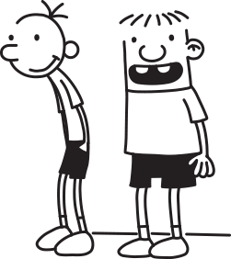
Stories to Improve Literacy
“This is a great movie, isn’t it?”

Slide 20
Power of reading with children…
The more we read, the more proficient readers we become
Those who read very little often have poor reading skills
Read something according to specific interests
Give them time to read
Make sure book matches reading level
One on one reading with them

Slide 21
Using hands on experiences to develop story skills
Start with a rough draft
Use story organizer to decide what elements are important
Don’t worry about spelling
Cross out instead of erasing so you have it if you change your mind
Create a clean copy
Offered opportunities for them to type writings on computer

Slide 22
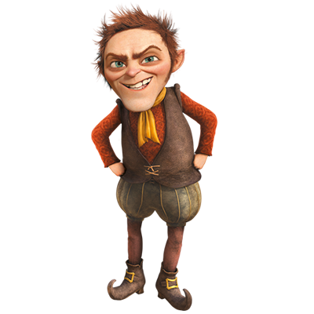
Using hands on experiences to develop story skills
Used a variety of field trips as a launch pad for writing about experiences
Trip to see Rumplestiltskin
Many of the children had not read the fairy tale
Opportunity to look at it in a book as related to what they had seen
Science program came in with various activities including electricity & fossils
Art program to create therapeutic art projects
Programs with library

Slide 23
Clarify for comprehension
The large ball crashed right through the table because it was made of Styrofoam.
What was made of Styrofoam,
the large ball or the table?

Slide 24
Clarify for comprehension
Vocabulary is fluid
Different meanings for different people at different times
Culture also plays a role in how we use and understand language
Prior knowledge influences our ability to make inference
“Tell me what happened in that story”
If retell is inaccurate, they really did not get the meaning

Slide 25
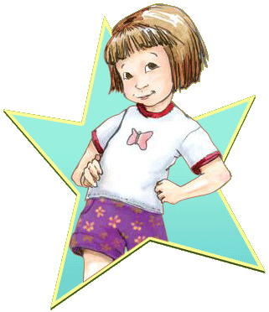
Clarify for comprehension
Beezus and Ramona written in 1955 from 9 year old Beezus’ point-of-view
Her little sister was playing the mouth organ
Why would she have an organ in her mouth?
My teacher said an organ is a heart, liver, or kidney
She was embroidering a steaming tea kettle
What is embroidering?
Does she know what a steaming tea kettle is?
When we don’t understand what is happening, and have no one to help us, it can be easy to just stop!

Slide 26
Being sensitive to culture…
“Next we play with basketball try to put it in the garbage can. That was awesome but everybody was acting a fool.”
“He was going hard rapping like he had a rap scar. Rapping to beauty like we going to a feast. He was going to feasty. We went to the gym. He was right there. It got a little scary and hairy.”

Slide 27
hands on experiences develop story skills
Allowed children at shelter to plant different seeds
Each week they used pages to record the progress of the seeds
Both drawings and describing what they watched
“I planted beans, and beans healthy for you, make your bones strong, and you could run fast and you will be excited.”

Slide 28
Being patient is important…
“Thank you for being patient with me when you helping me with the bracelets and the necklace. I loved it, and I hope we could do it again.”
“It was fun, but the mask was fun with the glitter it was everywhere on your hair and stuff that I still need glitter That was fun. You told me no more glitter because I put it everywhere so thank you.”

Slide 29
Developing partnerships
Ceramics studio: “I loved the ceramics that we did. It was so fun. I can’t wait to see my teacup. Mr. Luke was a gentleman with the colors. Thank you for coming here to do the ceramics with us.”
Going to the farm: “Today we went to a farm. We picked blueberries. I picked two basketfuls. After we finished, we went on a tour of the farm. I got a chance to feed some animals. Once the tour was finished we ate lunch. Lonell, our bus driver, went over to see a goat, cow, chickens and a rooster.
Origami: “She can do origami and we made a piano we made a box we made a boat we made a hat and we made a kite.

Slide 30
Writing as a coping skill expressing thoughts and feelings
“I need help sometime and I go to the learning center every day and I have a mom who help me when I need help sometime.”
“I liked learning about electricity this week. It tickled a lot when I got shocked”
“Ms. Abby why you have to be so mean everyday”
“Ms. Abbey I don’t need your help no more never and ever and never or ever”

Slide 31
What happened next…
Development of writing as a coping skill
Desire to write about experiences
“I went to a cookout with my family. We had fun with each other and me and my two cousins went to catch some light bug and we went to see the fireworks.”
Journals to children experiencing homelessness
Writing things for other people
“Miss Leslie you’re the best cooker in the whole wide world.”

Slide 32
collaborative relationships with local libraries
Summer reading programs or after school programs
Are there programs that they can bring to you?
Help children to learn to access resources at the library

Slide 33
Ways to help children access books:
Access to books is key to successful reading development
Reading programs at libraries may give books away
RIF (Reading is Fundamental)
Have a book drive so you have books to give students

Slide 34
A final thought…
Killing Monsters: Why children need fantasy, super-heroes, and make-believe violence by Gerald Jones
Children need a place to become familiar with and control the emotions of anger and violence
Importance of distinguishing difference between what violent games mean to children and what they mean to adults
Adults often horrified with content
Children more interested in emotional meaning
“Children need to feel strong. They need to feel powerful in the face of a scary, uncontrollable world.”

Slide 35
A final thought…
The Scarred Heart: Understanding and Identifying Kids who Kill by Dr. Helen Smith
“Not one young person in my experience has ever been made violent by media influence. Young people who are already inclined to be violent do feel that violent media speaks to them. A few do get dangerous ideas from it. But more of them find it to be a way to deal with their rage.”
Studies often do not distinguish between different types of media content
Results same for those who watch Rugrats and Arthur as with violence
Story’s most important function is it’s emotional meaning
People best able to act in the face of violence are least horrified by it

Slide 36
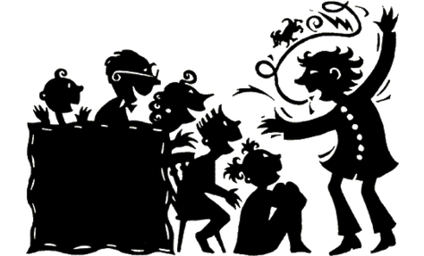
Tell me a fact and I’ll remember;
Tell me a truth and I’ll believe;
Tell me a story and it will live in my heart forever.
-Proverb

Slide 37
Questions

Slide 38
Contact Information:
Abbey Wengerd: awengerd@pittsburghmercy.org
Laura Wengerd: wewlmw2@verizon.net

Slide 39
References
Appel, M., Richter, T (2007). Persuasive effects of fictional narratives increase over time. Med Psychology 10: 113-134.
Berns, G., Blaine, K., Prietula, M.J., & Pye, B.E. (2013). Short and long term effects of a novel on connectivity in the brain. Brain Connectivity, 3(6), 590-600.
Bond, V. & Simon, T.R. (2010). Zora and me. Somerville, MA: Candlewick Press.
Djikic, M., Oatley, K., Zoeterman, S., & Peterson, J.B. (2009). On being moved by art: How reading fiction transforms the self. Creativity Research Journal, 21(1), 24-29.
Juchniewicz, M.M. (2012). Visible voices: Literacy identity and the invisible homeless. Journal of Adolescent & Adult Literacy, 55(6): 505-515.
Kottler, J. (2014). Stories we’ve heard, stories we’re told: Life changing narratives in therapy and everyday life. New York: Oxford University Pres.
Speer, N., Reynolds, J., Swallow, K., & Zacks, J. (2009). Reading stories activates neural representations of visual and motor experiences. Psychological Science, 20, 989-999
The Scarred Heart: Understanding and Identifying Kids who Kill by Dr. Helen Smith
Killing Monsters: Why children need fantasy, super-heroes, and make-believe violence by Gerald Jones

