Slide 1
Understanding Trauma and Building Pathways of Resiliency
Present by Esther Combs, MA. LPC
October 29, 2017

Slide 2

Learning Targets
Develop a basic Understand Trauma
Introduction of the ace’s study
Resiliency factors that make a difference
Increase Awareness of Self-care

Slide 3

Activity – Stress and Associated Feelings
Just Right
  Comfortable
  Not stressed or anxious
  Focused and engaged
Cool
  A little bored
  Losing my focus
Ice cold
  Totally bored
  Not focused or engaged
  Planning my escape
Very Hot
  Very uncomfortable
  Extremely stressed out and anxious
  Need to get out of here now
Hot
  Moderately uncomfortable
  Stressed and anxious
  Distracted and edgy
Warm
  Mildly uncomfortable
  Slightly stressed and anxious
  Losing my focus
Notes:
Mindful activity
In this hour we will be talking about things that maybe new to you or may bring up memories and feeling that are uncomfortable. It will be important for you to take care of yourself and recognize where you are in your comfort space. Please take care of your needs so that you will be able to support the most vulnerable population we serve.

Slide 4
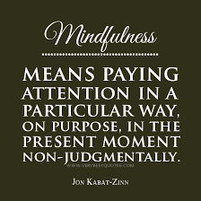

Slide 5
Activity – Stress and Associated Feelings
Just Right
  Comfortable
  Not stressed or anxious
  Focused and engaged
Cool
  A little bored
  Losing my focus
Ice cold
  Totally bored
  Not focused or engaged
  Planning my escape
Very Hot
  Very uncomfortable
  Extremely stressed out and anxious
  Need to get out of here now
Hot
  Moderately uncomfortable
  Stressed and anxious
  Distracted and edgy
Warm
  Mildly uncomfortable
  Slightly stressed and anxious
  Losing my focus
Notes:
Mindful activity
In this hour we will be talking about things that maybe new to you or may bring up memories and feeling that are uncomfortable. It will be important for you to take care of yourself and recognize where you are in your comfort space. Please take care of your needs so that you will be able to support the most vulnerable population we serve.

Slide 6
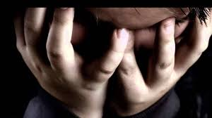
What is Trauma?
Trauma is very subjective and individual
Three types of trauma
Complex Trauma: Exposure to multiple or chronic traumas, as well as wide-ranging and long-lasting effects of this trauma exposure
Has an impact across every domain in child’s life:
  Attachment, Biology, Affect Regulation, Dissociation, Behavior Control, Cognition, Self-Concept
Trauma can stem from many different experiences
Notes:
1 out of every 4 children attending school have been exposed to a traumatic event that can affect learning and/or behavior.

Slide 7

Trauma Stems...
Childhood Abuse and Neglect
Neglect: most common form of child maltreatment
Physical Abuse
Emotional Abuse: results in impaired psychological growth & development
Sexual Abuse: 1 in 6 boys and 1 in 4 girls before age 18
Domestic Violence: between 3-10 million children in the US are witnessing every year with the majority being under the age of 8
Prenatal Trauma: substance exposure and stress
Traumatic Grief: reminders become triggers rather than consoling or comforting
Homelessness
Notes:
Abuse and Neglect
-3.6 million referrals every year to CPS involving 6.6 million children
-report of child abuse is made every 10 seconds
-between 4-7 children die everyday due to abuse and neglect
Neglect: some studies have shown that neglect can be more detrimental to child’s early brain development than physical or sexual abuse
Physical Abuse: often accompanied by other forms of child maltreatment such as emotional abuse and neglect

Slide 8
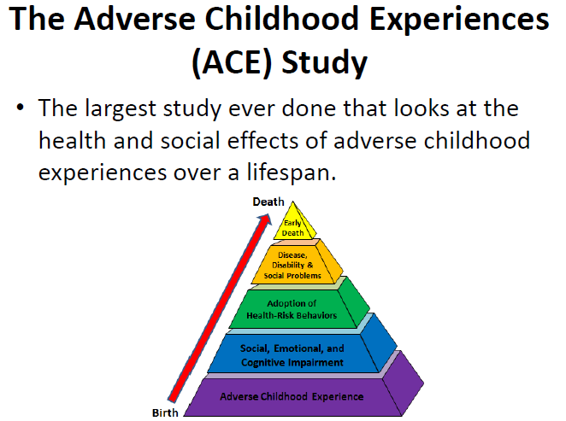
Notes:
The ACE Study changed the way the healthcare system viewed childhood trauma. The study proves that poor adult health can be linked to childhood trauma.
The ACE Study is a collaboration between Kaiser Permanente San Diego and the CDC. It is an ongoing study that was started in the mid-1990s. The initial study had 17,000 volunteers who were all Kaiser Health Plan members; majority middle-class, 80% White, 74% had attended college and the average age was 57.
The amount of ACEs reported in this common, middle-class population was surprisingly high. The study showed that only a third of this population had an ACE score of 0.

Slide 9
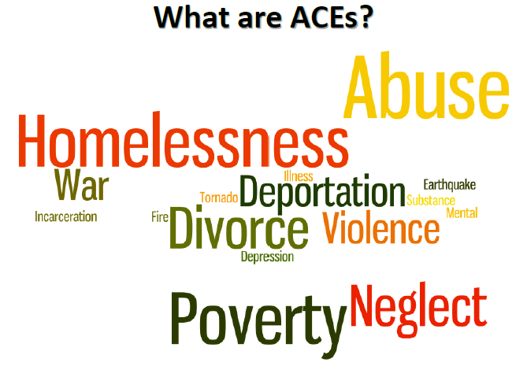
Notes:
Adverse Childhood Experiences, or ACEs, are defined as stressful or traumatic experiences, which include abuse, neglect and household dysfunction that occurred in the home before the age of 18.

Slide 10
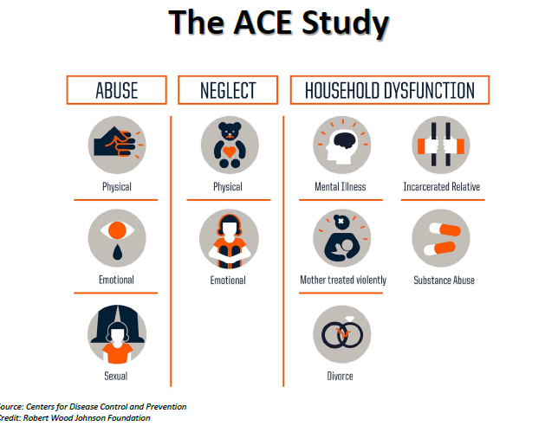

Slide 11
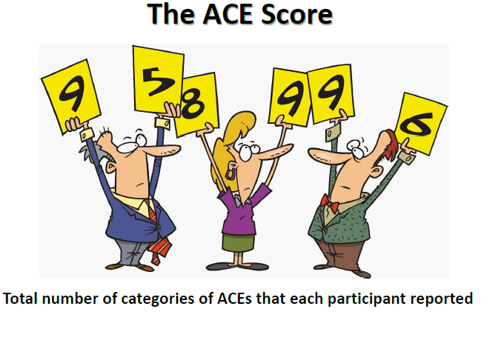
Notes:
The ACE Score is the total number of categories of ACEs that each participant reported
Example: Experiencing physical abuse as a child is an ACE score of one. Experiencing physical abuse while living with an alcoholic mother is an ACE store of two.

Slide 12
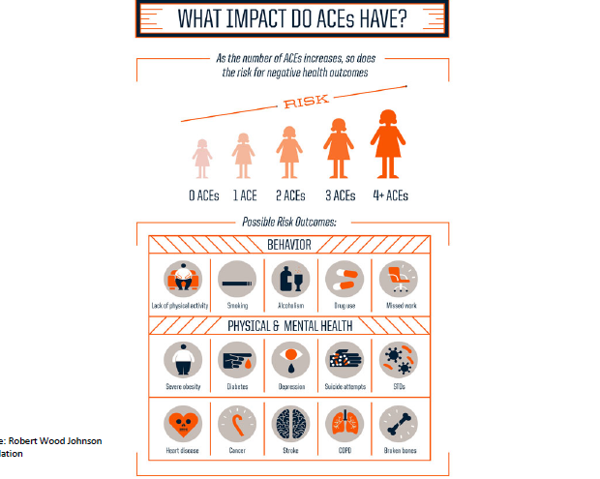
Notes:
As the ACE score goes up, so does the risk for: Depression, Post-Traumatic Stress Disorder (PTSD), Aggression, Anxiety, Attempted Suicide, Social Ostracism, Decreased Academic Achievement, Re-victimization, Sexually Transmitted Diseases (STDs), Lung Cancer, Heart Disease, Liver Disease, Drug and Alcohol Abuse, Obesity, Smoking, Intimate Partner Violence (IPV)

Slide 13
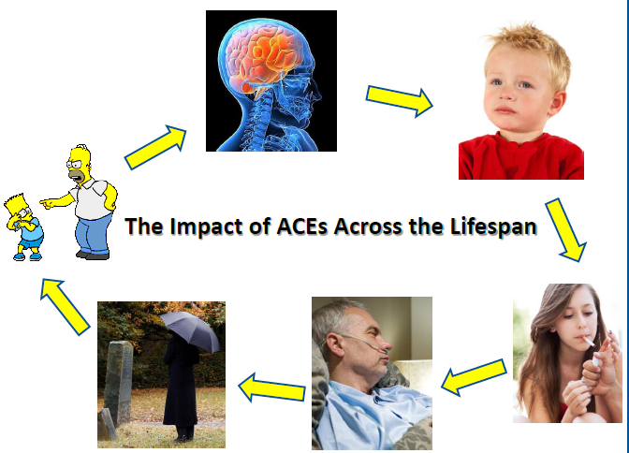
Notes:
Trauma disrupts development in the growing child
The longer lasting the trauma, the more damage to the brain
The more damage to the brain, the more vulnerable the child is to high stress
Vulnerability to stress increases the likelihood of engaging in risky behaviors such as: smoking, drug and alcohol abuse, overeating, promiscuity
Risky behaviors increase the likelihood of developing diabetes, heart disease, obesity, STDs, cancer, mental health disorders
These behaviors and diseases can lead to an early death
Without treatment, the cycle continues from generation to generation

Slide 14
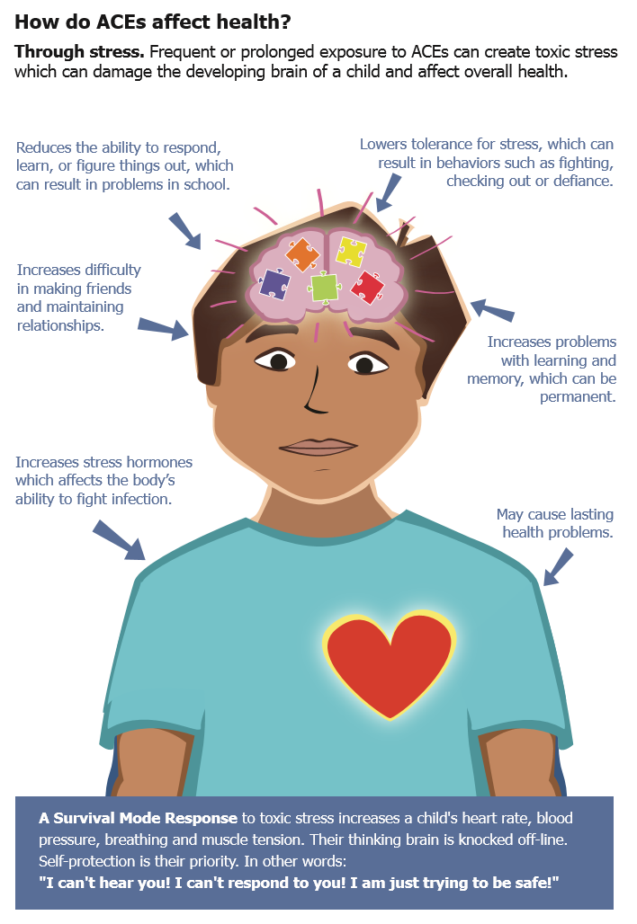
Child Homelessness & Toxic Stress
Notes:
DIRECT ATTENTION TO THE SLIDE AND QUOTES SURROUNDING CHILD.
Chronic stress is powerful because it can alter brain circuits:
Causes the child’s stress response system to go on high alert, unable to shut off.
A child’s ability to learn, regulate their emotions and behaviors, and interact in socially appropriate ways is diminished.
Helps explain some of the academic outcomes we see in children who are experiencing homelessness.
“Look at handout and share out what stands out to you.”
PROVIDE TIME FOR TABLE TALK

Slide 15

Effects on children

Slide 16
Developmental Triad
Bonding and Attachment
*Begins in-utero and progresses radically to age 3
Brain Development
*Begins at conception with most profound growth through age 3
Infant/Child Development
*Begins at conception with most significant strides in first 3 yrs
Notes:
TREMENDOUS INTER-RELATED IMPACT*****

Slide 17
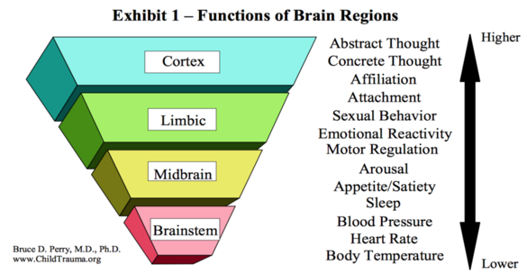
Notes:
Basic functions - developed first then moving on (and up)
Brain develops from ground up and inside out
A healthy brain should function/resemble this……

Slide 18
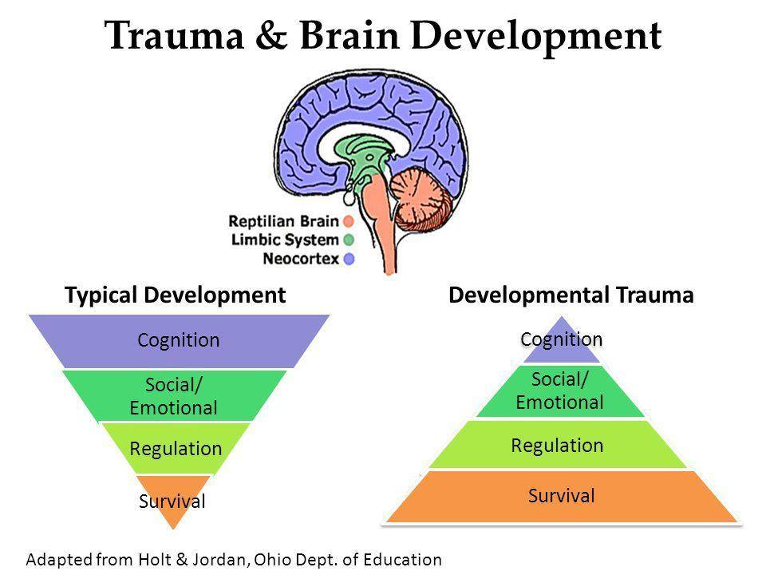
Notes:
Remember that our brains develop from the “ground up”.
If the information coming in is distorted, then development will be distorted
Survival - relatively short time “living” here if all needs met. More energy put into developing higher functioning areas of the brain
Traumatized child spends alot more time here due to unmet needs, constant activation of fight/flight/freeze system.
Survival = Animal Brain
Social/Emotional/Regulation = Emotional Brain
Neocortex = Thinking Brain

Slide 19
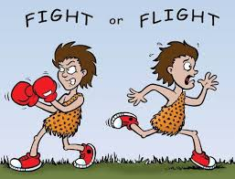
The Stress Response: A Chemical One
Notes:
Prepares the body for action when threat is detected
Helps the body respond to stress effectively

Slide 20

Trauma Impact on the Brain
Notes:
The cerebral cortex is responsible for many complex functions. (memory, attention, thinking, language, etc).
Trauma can disrupt attachment, bonding and Memory
Hippocampus is responsible critical memory functions (converting short term to long term), helps regulate corticosteroid production, and assists in behavioral inhibition - REMEMBER: this area has unique ability to produce 700 new neurons per day
Amygdala critical for coordinating behavioral, autonomic, and endocrine responses to environmental stimuli
Cerebellum regulates motor movements. Coordinates voluntary mvmts (posture, balance, coordination, and speech, Important for learning motor behaviors
Prefrontal cortex responsible for cognition, reasoning, motor skills, expressive language (Broca’s area) REMEMBER: prefrontal cortex is critical to behavior, cognition, and emotional regulation
Orbitofrontal cortex - central to emotion and social regulation
Corpus Callosum responsible for inter-hemispheric communication and other processes (ie; arousal, emotion, higher cognitive abilities) REMEMBER: This is the largest white matter structure in the brain

Slide 21
Prevalence of Trauma in Students
13 of every 30 students in a classroom will have toxic stress from 3 or more Adverse Childhood Experiences (ACEs)
Source: Washington State
Family Policy Council

Slide 22
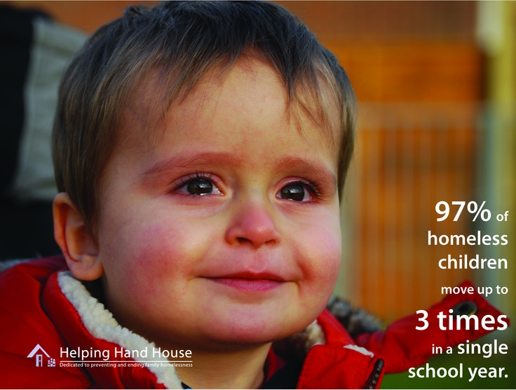
Poverty, Trauma, and Learning

Slide 23
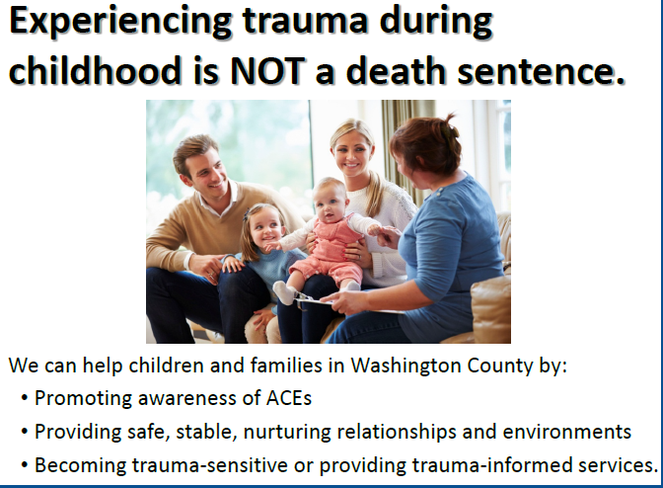
Notes:
Experiencing ACEs doesn’t always mean you will have poor health.
When parents find out their ACE Score, they better understand their own lives and how their parenting can affect their child's health and development. Education and reflection can help prevent the intergenerational transmission of trauma and motivates parents to make better choices for their children.
Safe, stable, nurturing relationships (SSNRs) and environments foster resiliency and can positively impact child development and future health.
Becoming “trauma-sensitive” means being mindful that the individuals you come into contact with on a daily basis may have experienced many different types of traumas.
Re-traumatization is a relapse into a state of trauma. A relapse can be triggered by a person, event, place or even a smell. Victims of trauma may be unintentionally re-traumatized by service providers.

Slide 24

Our Challenge
Regional Child Abuse Prevention Councils 2011
We can and must “immunize” kids against the effects of ACEs.
We can and must reduce the numbers of ACEs for all children!
Notes:
24

Slide 25

How Do
We Meet the
Challenge?
Regional Child Abuse Prevention Councils 2011

Slide 26
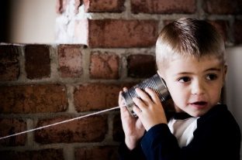
CREATE CONNECTIONS

Slide 27
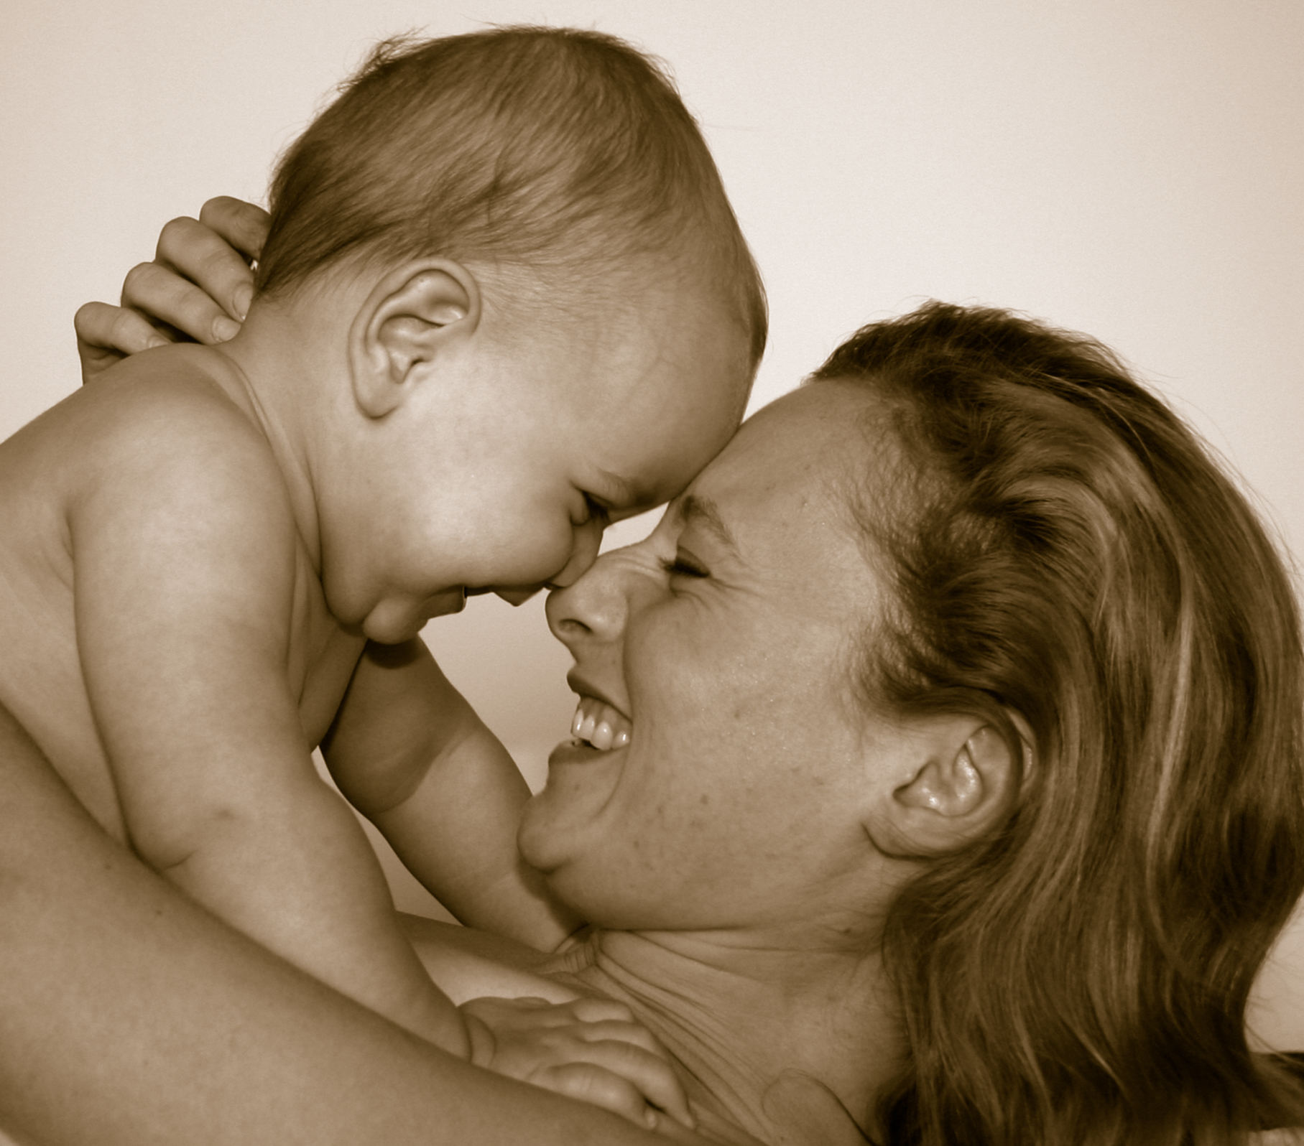
Attachment: What Is It?
Deep and enduring connection between child and caregiver
Bond: process of forming an attachment
  Set of behaviors that help lead to emotional connection
Has several key elements:
  Enduring emotional relationship with caregiver
  Brings safety, comfort, soothing and pleasure
  Loss or threat of loss of the person evokes intense distress
Absolutely necessary for survival
  Without: babies can suffer from failure to thrive and can even die
Begins in utero and progresses radically to age three
Notes:
Based in evolutionary biological necessity-infants can’t take care of themselves
Attachment behaviors must exist & be reciprocated for the infant to survive physically and psychologically
Each child has tremendous genetic potential but that potential can only be unleashed by a supportive, facilitating and nurturing external environment
Bonding experiences: holding, rocking, singing, feeding, gazing, kissing and other nurturing behaviors (all cause neurochemical activities in the brain)
Fun Fact: Mother’s rock at the same tempo as babies heart beat in utero

Slide 28
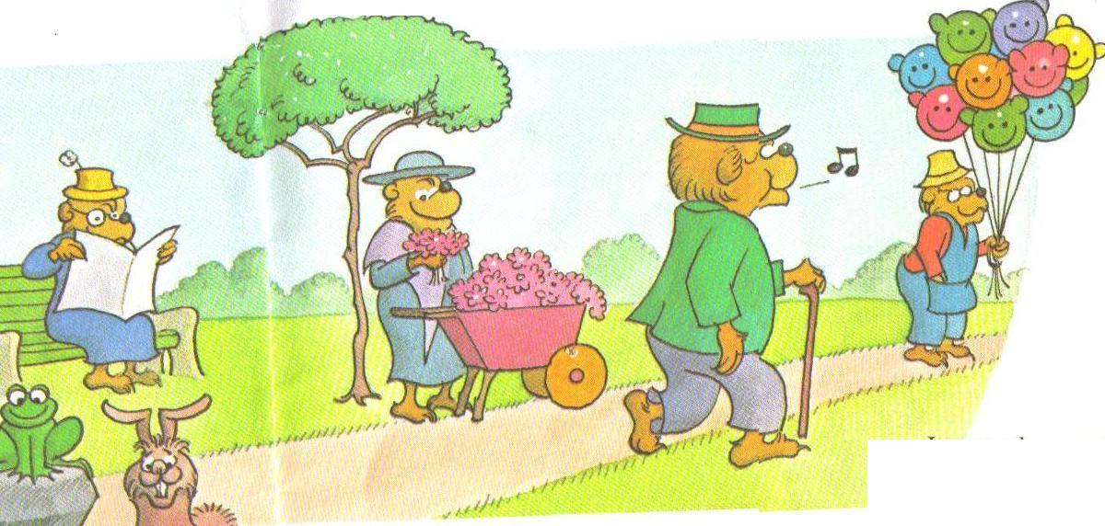
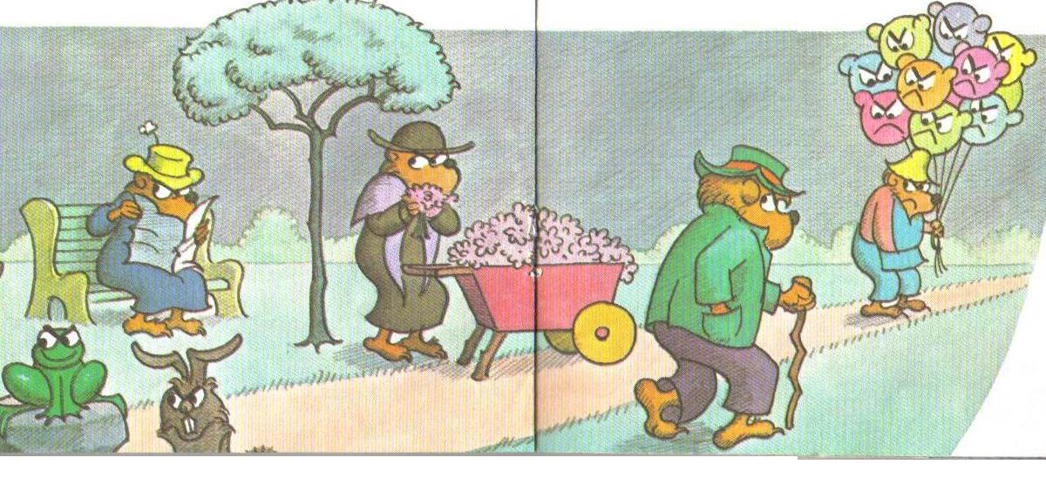
Secure Attachment Strongest predictor of child’s successful
Notes:
NOT based on quality of care, educational input, or even bond of love
The internal security that these children, adolescents and then adults carry is underpinned by the following implicit and explicit beliefs:
• The World is a relatively safe place
• The world is an interesting place which I am curious about discovering.
• I am lovable and worthy of love
• I can develop connection, trust, safety and security in relationships with others
• I can experience a range of different emotions and trust I can manage and cope with them (including negative emotions), and know when I need help.
• I can be vulnerable and reach out to others when I am distressed and trust I will get my needs me
• I can take healthy risks and believe that I can succeed (self-efficacy)
Entails a sense of confidence that needs will be met
Ensures that child will feel secure, understood, and be calm enough to experience optimal development of nervous system
A feeling of safety that results in eagerness to learn, healthy self-awareness, trust and empathy
Study found critical aspect of child-primary caretaker relationship is based on quality of nonverbal communication process

Slide 29

Window of Opportunity
The first 3 years of life: brain develops to 90% of adult size
Critical periods during which bonding experiences must be present for the brain systems responsible for attachment to develop normally (1st year of life)
When window is missed:
  Several emotional neglect-no touch, no stimulation or nurturing (rare)
  Can literally lose capacity to form any meaningful relationships for the rest of life
  Some degree of impaired bonding and attachment during early childhood
  Range from mild interpersonal discomfort to profound social and emotional problems
  Severity is related to how early in life, how prolonged and how severe the neglect has been
  May take years of hard work to help repair damage from only a few months of neglect in infancy
Notes:
Millions of children
Attachment bonds formed between infant and primary caregiver profoundly influence both the structure and function of developing brain
If attachment bond is unsuccessful and traumatic, neurological impairment and memories of a failed relationship become the basis for adult expectations

Slide 30
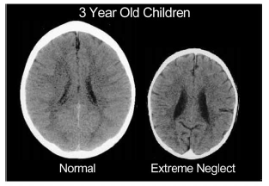
Source: Perry, BD., 2002, Childhood Experience and the Expression of Genetic Potential: What Childhood Neglect Tells Us About Nature and Nurture, Brain and Mind Vol 3: pp 79-100.
“Mom always said people worried too much about their children. Suffering when you're young is good for you, she said. It immunized your body and your soul, and that was why she ignored us kids when we cried. Fussing over children who cry only encouraged them, she told us. That's positive reinforcement for negative behavior.”
― Jeannette Walls, The Glass Castle
Notes:
“Mom always said people worried too much about their children. Suffering when you're young is good for you, she said. It immunized your body and your soul, and that was why she ignored us kids when we cried. Fussing over children who cry only encouraged them, she told us. That's positive reinforcement for negative behavior.”
― Jeannette Walls, The Glass Castle

Slide 31
Attachment & Learning: All in the Relationship

Slide 32
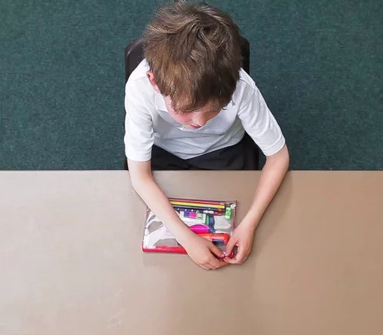
Why Attachment Matters at School
While most children enjoy life & are successful at school and in relationships, there are some that are unfocused, disruptive, controlling, withdrawn and destructive.
They tend to underachieve and are often punished and excluded.
As a result they may not fulfill their potential as an adult in employment or relationships

Slide 33

Emotions and Learning are Linked
Notes:
Attachment has an instinctive priority over the brain’s exploratory system-feeling Safe and Secure is more important than Learning.
“Research demonstrates that emotions fundamentally drive cognitive learning and, in order to generate successful learning, educators need to engage the affective dimensions of pupil’s minds.” (Immordino-Yang and Damasio, 2007
Children that can regulate emotions and responses are more popular, have fewer behavioral problems, more emotionally stable, have fewer infectious illnesses and achieve more academically
To be able to even engage in learning a student must be able to take risks, to learn new things and face new challenges.

Slide 34
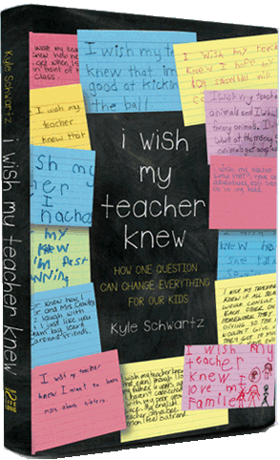
What Kids Wish Their Teacher Knew...
Kyle Schwartz
3rd Grade Teacher in Denver, Colorado
Master’s Degree in Education
Notes:
I wonder what our homeless students would say to this question?????

Slide 35
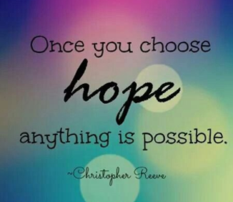
What to Do… Is There Hope?
There is absolutely HOPE!!!
Schools and Staff can provide several things that are needed for recovery from trauma:
Give kids opportunity to feel safe and secure physically and emotionally
Build relationships and secure attachments with kids
Successful interventions for kids are based on providing a structured environment with firm boundaries and nurturing empathic relationships.
“Close and supportive relationships with teachers have demonstrated the potential to mitigate the risk of negative outcomes for children who may otherwise have difficulty succeeding in school.”
Notes:
From this secure foundation other areas-developing social skills, self-esteem, emotional literacy, autonomy and self-identity-can be developed. This in turn will promote readiness to learn.
Emotional well-being must be a larger part of any learning, and by association, the educational agenda. Schools may be the optimum site for buffering the impact of stress, building resilience and enhancing individual capacities for learning.

Slide 36

First...Know Yourself
Increase your awareness of yourself:
    Have a sense of how your own past experiences can impact your interaction with others
    Know your triggers
    Know your own biases
    Check how personal you take certain behaviors
    Be aware of your emotions
    Be aware of your body language
    Be aware of tone of voice
    Be aware of facial expressions
    Check your energy level
Notes:
Take a moment and think about a challenging student you work with and do a self-check on these things and think about how they may have impacted your relationship with that student.

Slide 37
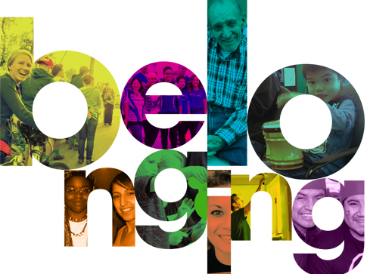
Sense of Belonging
Create a sense of belonging within the school and classroom:
Experiences that show them they are a valued member of their school and class.
Ideas to create sense of belonging:
  Know your students
  Expose yourself to their culture
  Affirm students ‘weather’
  Teach images that interest them
  Utilize peer mediation
  Share your humanity
  Multi-year instruction
  Welcome for new students
Notes:
Know your students: greet at door, chat as come into class, attend their events; read the school paper
Culture: know what is popular at their age, what are they into
Weather: show that you are in touch with school events and their interests
Teach images: use metaphors that they can relate to
Peer mediation: promotes positive peer relationships; helps them to problem solve and recognize that can be a safe, positive experience
Humanity: show your own strengths and weaknesses in proper context
Multi-Year Instruction: looping, research that leads to higher motivation, improved learning outcomes, stronger and more meaningful relationships
Welcomes: have a formal program to welcome new students
-peer support groups, adult mentors, school visits, student sponsors (act as guides and 1st friends)
-show personal interest

Slide 38
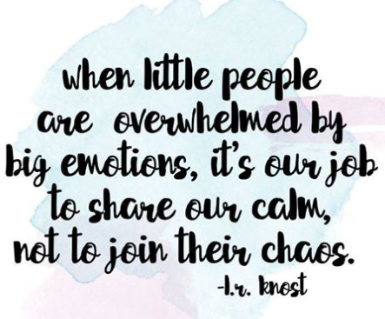
Be Authentic!
Don’t fake it...be authentic! Kids can spot a ‘phony’!
Talk about ‘why I’m here and why you are here’
Talk about yourself and share your challenges
Be consistent and predictable in your responses
Do what you say-follow through
Listen with open and unbiased mind
Keep in mind they learn from you in more ways than one
Ask genuine questions
Individualize attention/relationship
Notes:
Fake: can be a challenge to get past a surface relationship
Challenges-teachers have good days and bad days-tell them when you are having a bad day-if established a good relationship that can be the best behaved day
Predictable: they know the schedule and what to expect
Listen open mind: give them privilege of being listener and having a voice-they learn life is a two-way street
-learn there is a time to speak and time to listen
-if you listen to them they will be more likely to listen to you when you ask them to be quiet and listen
Learn from you: there is a lot of peripheral learning from your attitude, way you dress, way you speak, way you accept defeats (because you have them sometimes)
Individualize attention: identity + voice=engagement and learning

Slide 39

Monday Mornings
The Weekend
For many of us, weekends restful and something to look forward to.
For students affected by trauma, the opposite may be true as they become fully immersed in traumatic events and unhealthy relationships.
The Monday Morning Return
Many of us can return to school well rested and ready for the challenges ahead.
For students affected by trauma, they arrive tired and reverberating from chaos.
The Plan
Structure and predictability
Hold a brief class meeting
Notes:
For them schedules tend to be chaotic, sleep unpredictable, food choices limited, relationships insecure and potentials for emotional and physical harm ever present.
The plan: outline the day, post a schedule
-class meeting: seated in a circle (safety), rules and agreements reviewed, ask for celebrations or challenges, participation is a choice, model appropriate ways to connect with students who are celebrating or grieving and encourage students to do the same

Slide 40

“I Notice” Build It Up
Encouragement
Appreciation circles
Have lunch
Write post-it notes/affirmation
Say hello (always use name)
Let them teach you and class about one of their interests
Positive feedback
Talk to them privately about behavior
Visit with them outside of class time
Be compassionate
Quick gestures of friendliness/random acts of kindness
Provide suggestion boxes
Tell them they are missed when absent
Be understanding of need for space
Involve them in day-to-day operations
Personal interest inventory
Workspace permits individuality
Notes:
Affirmation notes: adolescents hear 10-15 put downs before hearing one statement of affirmation/Happy grams
Compassionate: put yourself in their shoes
Space: be careful of unexpected touches and terms of endearment
Day to day operations: Wild goose chase notes 3-4 teachers throughout building before saying oh i have that
Individuality: art designs/displays

Slide 41

“ I Notice” Build It Up
Daily check-in
Badge of honor
Two x ten strategy
Advice sessions
‘Family’ meetings
Special things t-shirt
Dialogue journals
Listening bear
Student as co-teacher
Scenario jar
Survey to parents
Get to know parents/caregivers
Home visits
Play box
Seeing with the heart
Positive notes/phone calls home
Calls after rough days
Morning check-in
Random Questions
What I learned from you
Notes:
Badge of honor: 5 boxes (1-picture, 2-goals, aspirations, passions; 3-things about me; 4-someone they admire; 5-something that makes them unique
2 x 10: 2 minutes per day for 10 days in a row talking about anything they want
Advice sessions: small chunk of time at end of day teacher will pose different questions about his/her life to class and students take turns responding
Family meetings: 10-15 minutes several times a week will circle up and share about what is going on in their lives
Special t-shirt: write all the special things about the student on the shirt and let them wear it (can involve all students and rotate through class)
Dialogue journals: morning asked to spend 10 minutes writing anything they want in dialogue journal-given choice of when or whether they want teacher to read-will often ask teacher questions
Listening bear: goes home with student who has exceptional listening that day; bear is listening, watching and participating at home; family members write in journal about bear’s visit; next day bring back with journal to read aloud to class
Co-Teacher: As a teacher, you can work with a student to co-plan and teach a lesson or topic with you for the entire period
Scenario Jar: At the beginning of the month, each student writes down a scenario that requires problem-solving. Teachers put these scenarios in a jar, pull out a scenario, and allow students to problem solve and share their responses individually, in partners, in groups or as a class during whole group instruction. This shows students how their peers would solve situations in their lives and helps create a solutions–oriented classroom.
Survey to parents: beginning of year asking for personal information that is important about child
Play box: special box near teachers desk full of wigs, glasses, microphone, funny things that can wear to gain student attention, create playfulness, role-play encourages kids to take another’s perspective
Seeing with the heart: big red heart on board and explains this heart has feelings, heart gets smaller and folds up when students are not nice to one another, how can we make heart unfold; talk about apologizing, sharing, helping, when teacher notices these things happening can add to the heart and show it growing
Calls after rough days: call student and let them know you are looking forward to seeing them the next day
Morning check in: Ask students how they are feeling today. Students raise their fingers 1-5. 1 is great, 2 is okay, 3 is fine, 4 is not good, and 5 is angry. Ask a few random students why they raised a certain finger. Note any students who raised a high number that you don’t call on so you are able to talk to them one-on-one. Pick a random student to start and have them high five the student to their right and say “Good Morning” with the student’s name. The next student then goes to their right, and this continues until all students have gone. If students are not sitting in a corner, can adjust to your needs.
Random Questions:Students take turns rolling a dice and answering the question that the dice roll corresponds to. Questions can be adjusted for the time of the year (in September have questions about what they did over summer, in February have questions about winter favorites, etc). Can take time and have students do questions as a whole class or attach the dice roll to something within the class structure. If a student wants to go to the bathroom, they have to first roll the dice. Grab random students as they enter class and have them roll dice. If a student turns in homework late, etc. Teacher can also participate in questions with students, so students get to know the teacher. Example questions: 1) What is one thing you are really good at outside of school? 2) What is your best subject in school? 3) What accomplishment in your life are you most proud of? 4) What do you want to be remembered for? 5) What are you best at in school or outside of school? 6) How do you feel when you are successful at something?
What I Learned From You: This is a time for the teacher to reflect with the class what they learned from the class as a whole or each individual student. This could be done at the end of each week or quarter by shouting out individual students or naming class accomplishments. Teachers can also have the students participate by talking to the whole class about what they learned from each other.

Slide 42
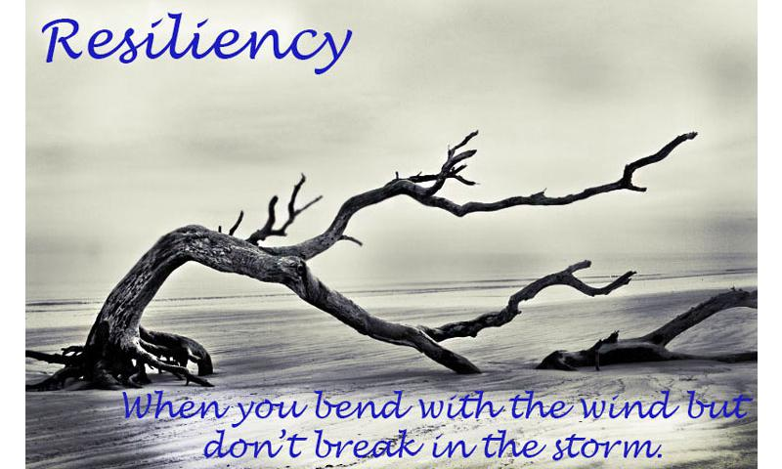

Slide 43

Natural
Our human nature
Innate life force and enthusiasm to
experiencewhat life is about
Protects us and causes us to play and learn and explore our world
Notes:
Also called “inherent”
Children under the age of 7 (if not traumatized) show an abundant and inspiring resilient approach
Experience, socialization, as-yet undiscovered components of resilience

Slide 44

Adapted
“Trial by Fire” -
“When the going gets tough,
the tough get going”
Notes:
Needs to be learned “on the spot”
Trial by Fire - challenging circumstances cause you to adapt and grow
Sometimes referred to as character
9/11 perfect example of adaptive: respond and grow in the face of adversity - problem solve to avoid or better prepare for possible repeat of event

Slide 45
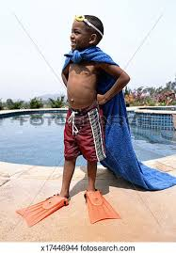
7 “C”s of Resilience
Confidence
Character
Competence
Contribution
Coping
Control
Connection
Notes:
Competence describes the feeling of knowing that you can handle a situation effectively. We can help the development of competence by……..

Slide 46

Nurturing Positive Relationships
Knowledge of Parenting and Child Development
Parental Resilience
Social Connections
Concrete Supports in Time of Need
Notes:
https://www.youtube.com/watch?v=LZe5y2D60YU&t=3s

Slide 47

Children need to know that there is an adult in their life who believes in them and loves them unconditionally
Notes:
There is no simple answer to guarantee resilience in every situation. But we can challenge ourselves to help our children develop the ability to negotiate their own challenges and to be more resilient, more capable, and happier

Slide 48
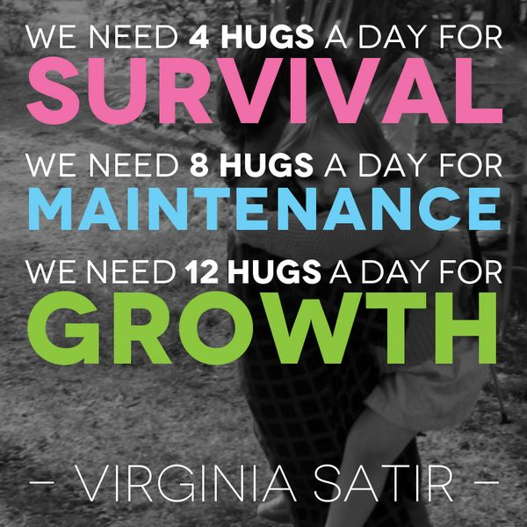
Research shows that hugging (and also laughter) is extremely effective at healing sickness, disease, loneliness, depression, anxiety and stress.
Virginia Satir is one of the key figures in the development of family therapy.
She believed that a healthy family life involved an open and reciprocal sharing of affection, feelings, and love.
Notes:
Virginia Satir was an American author and social worker, known especially for her approach to family therapy

Slide 49

The why
Notes:
https://www.youtube.com/watch?v=LZe5y2D60YU&t=3s

Slide 50

Notes:
“You can't cling to the side your whole life, that one lesson every parent needs to teach a child is "If you don't want to sink, you better figure out how to swim”
― Jeannette Walls, The Glass Castle

Slide 51
Resources
National Child Traumatic Stress Networkhttp://www.co.washington.or.us/HHS/
http://www.preventionlane.org/adverse-childhood-experiences-trauma
http://cdc.gov/ace
http://www.acestudy.org/
http://www.acestoohigh.com
Felitti VJ, Anda RF, Nordenberg D, Williamson DF, Spitz AM, Edwards V, Koss MP, Marks JS. Relationship of childhood abuse and household dysfunction to many

Slide 52
Resources
http://www.cdc.gov/brfss/index.htm
http://www.cdc.gov/mmwr/preview/mmwrhtml/mm5949a1.htm
http://www.oregon.gov/oha/Transformation-Center/Resources/ACEs-Brief-2014.pdf
http://public.health.oregon.gov/HealthyPeopleFamilies/DataReports/Documents/OregonACEsReport.pdf
http://www.rwjf.org/en/about-rwjf/newsroom/infographics/the-truth-about-aces.html
http://www.childhealthdata.org

Slide 53
Understanding Trauma and Building Pathways of Resiliency
Present by Esther Combs, MA. LPC
October 29, 2017
ecombs@maisd.com

