Slide 1
Using Data to Drive your Program to Improve Homeless Students’ Outcomes
Katie Morales Children In Transition Coordinator
Kyle Kemp Data and Research Analyst
⎪
⎪

Slide 2
What we will be covering…
Today’s Topics:
Poverty Data (Nevada and WCSD Statistics)
Data Warehouse: Business Intelligence Gateway
Real-time tracking of amongst our Children in Transition population
Tracking services given and how they may influence student outcomes.
Preview how School Climate Data and Student Voice may help CIT students

Slide 3
What are your thoughts?
How is your school or organization responding to growing poverty in your communities?
How is data used to guide these efforts?
Notes:
7 minutes
Take one minute and think about each of these questions to yourself. Write down a couple of notes in response to each. Then I am going to ask that we come together as a whole group to talk about our experiences together.
This session was intended to expand awareness about the level of poverty in schools and how poverty is expanding.

Slide 4
A Picture of Homelessness in Nevada
44th
In overall homelessness in the nation
Nevada ranks
36th
For childhood homelessness in the nation
17,172
There are currently 23,790 children experiencing homelessness in Nevada
children were identified in public schools in the 2014-2015 SY

Slide 5
Children Living in Poverty Face Many Obstacles
1 out of 5 children in Nevada
are living in a crowded house.
1 out of 4 children in Nevada
are food insecure.
1 out of 3 children in Nevada
are living with parents who lack secure employment.
Washoe Community Health Needs Assessment 2015

Slide 6
We are WCSD
64,000+ Students
8,300+ Teachers and Employees
62 Elementary Schools
14 Middle Schools
14 High Schools
6 Alternative/Program Schools
8 Sponsored Charter Schools
104 Schools

Slide 7
Unaffordable Housing Rates
In 2014, Reno-Sparks was ranked 191 out 225 metro areas for nationwide affordability, with only 55.2% of houses being affordable given the area’s median income
Currently, more people in Reno-Sparks are renting than before the recession, yet almost ½ are paying an unaffordable monthly rate
1/3 of Washoe County mortgages are unaffordable

Slide 8
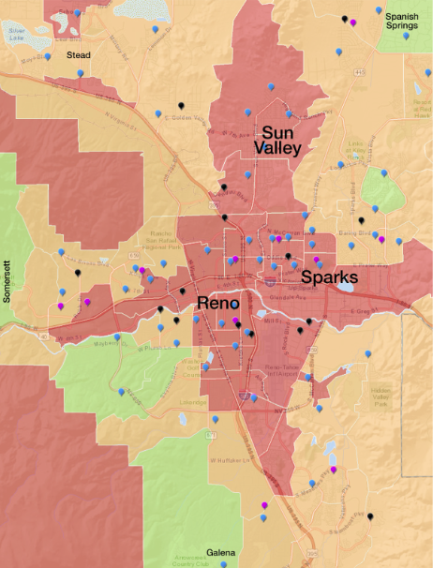
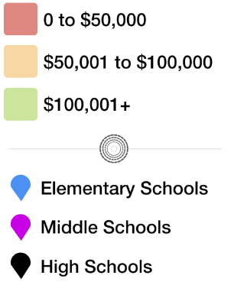
Washoe County Median Household Income (2015)

Slide 9
Number of CIT Students in WCSD
91%
Increase

Slide 10
Number of CIT Students Experiencing Homeless in WCSD

Slide 11
CIT Student Cohort Graduation Rates in WCSD
+16 Percentage Points
CIT Grads: 137
CIT Grads: 193

Slide 12
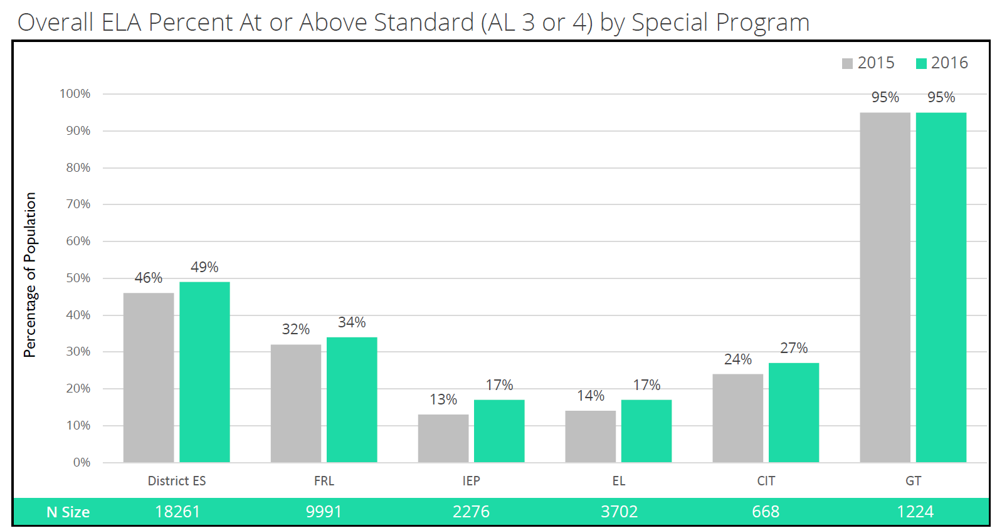
Smarter Balanced: ELA

Slide 13
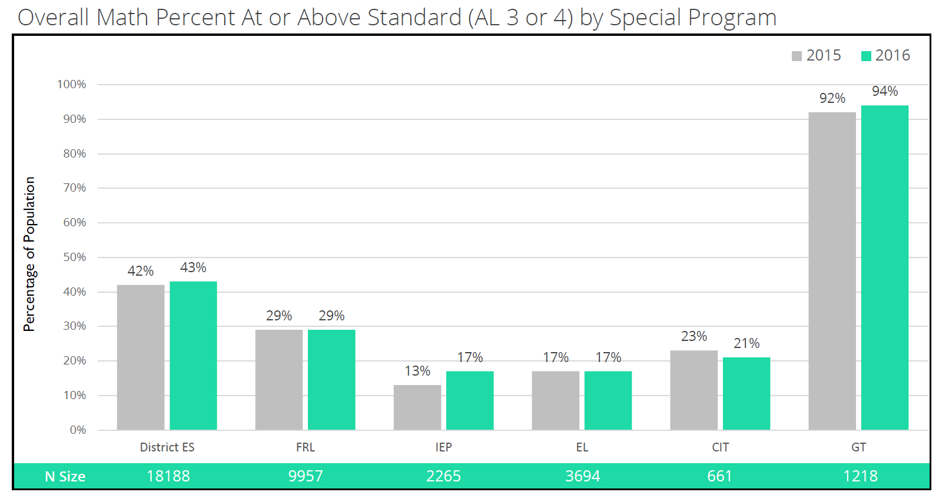
Smarter Balanced: Math

Slide 14
Game of Life
We are WCSD
Notes:
This year we are doing an activity throughout the day so we can be sure to look at different vantage points. In each session, you will get a new “We Are WCSD—Game of Life” card, with a scenario or event printed on the back. The scenario is specifically related to that session topic, so you can think of how it may impact you if you were that student and/or that students parent. So to get us started, we actually took the cards from the Demographics/Look at our Students section and stuck your card in your name tag. So let’s take one minute, take your card out, and think of that student, as yourself. How will you advocate through out the day for that student? For all of our students?

Slide 15
Game of Life Instructions
Read the Game of Life Card about Kota
Open the Student #1 Packet
Gather information about Kota
Determine some recommendations of supports

Slide 16
What Do We Know About Kota?
General Information Grade 4 Has attended K – 4 Grade in WCSD Attended 3 different schools in 15-16 Changed schools in almost every grade level | CIT Information Was living doubled up with Grandparents. Forced to leave. Now she is living in a shelter
Academics Smarter Balanced Assessment ELA: 2392 Scale Score (Level 2) Math: 2437 Scale Score (Level 3) MAP: Reading: 190 RIT (30th Percentile) Math: 193 RIT (26th Percentile) Grade Letter of F in G3: ELA | Other Information Lived at 15 different addresses Attendance/Truancy issues in recent years

Slide 17
Data Warehouse

Slide 18
Data Warehouse: Structure
Flow of Reports
Reports Available
Admin
Schools
Classroom
Student
50+ Reports
Attendance
Student Accounting
Academics
Behavior
Assessment
Extra Curricular Activities

Slide 19
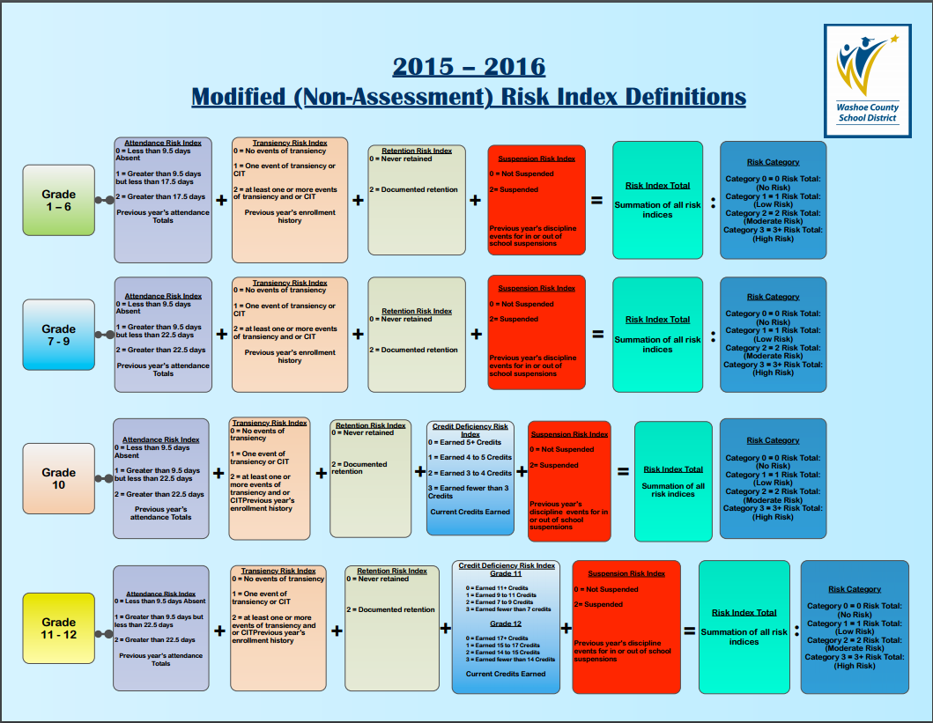
Early Warning System

Slide 20
School Dashboards
Up to date Snapshot of school data
Daily changes in attendance
New enrollments are seen next day
Administrator’s “splash-screen”

Slide 21
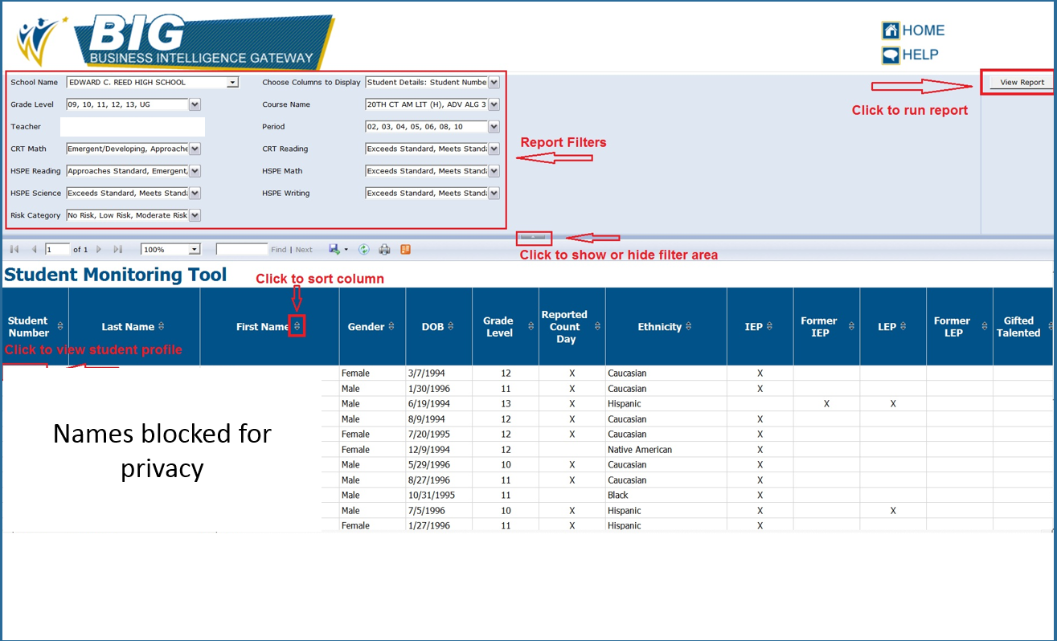
Student Monitoring Tool (SMT)

Slide 22
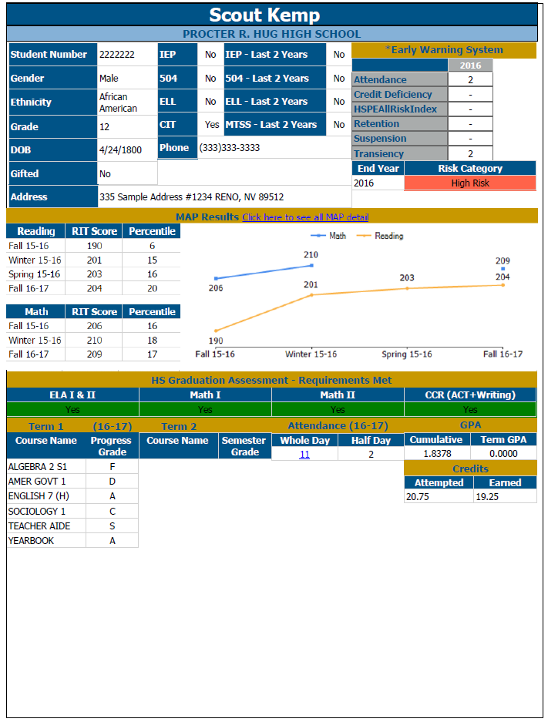
Student Profile Page (SPP)
Up to date snapshot of student data
Early Warning System
Student led conferences
Printable
Whole school PDFs are generated weekly

Slide 23
CIT Data Tracking: Custom Tabs
Transportation Tracks which mode of transportation the student is receiving Tracks Pickup and Destination addresses Keeps history for transportation services provided | Student Information Identification methods Primary Nighttime Residence Notes about individual student situations Track historical CIT status information by school year | Student Basic Needs Tracks services provided to students Financial assistance is tracked Historical records of services provided

Slide 24
Services the CIT office provides
Free breakfast and lunch
Clothing and hygiene packets
Uniforms
Transportation (best interest of the child)
School/Sport Fees
Birth certificates
Shot records
School supplies
Field trip cost support
Tutors
Cap and Gowns

Slide 25
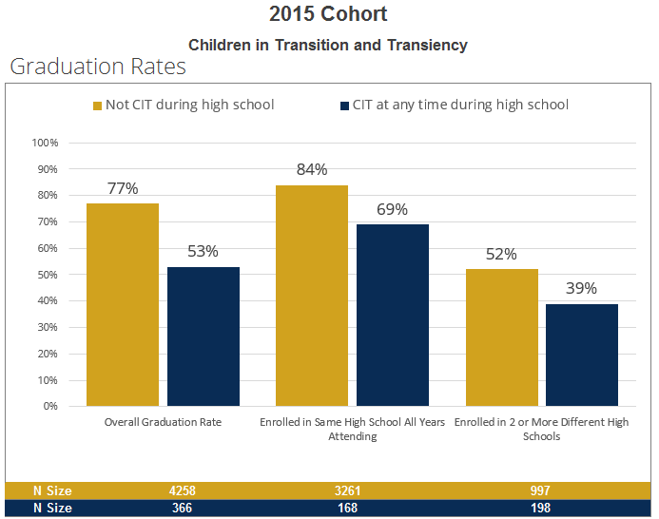
Staying at One HS Makes a Difference

Slide 26
CIT Students Receiving Transportation
Notes:
Approximately 25% of homeless children living in shelters are under the age of 6.
False – approximately 53%
True
False – approximately:
75% - at least one major developmental delay
40% - two or more major developmental delays
35% - emotional or behavioral problems
Family Housing Fund, 1999, Homelessness and Its Effects on Children

Slide 27
Identifying School Needs
Unsheltered: 3%
Unsheltered: 6%

Slide 28
School 1: CIT Service Trends
Items provided to by CIT
Date Identified

Slide 29
School 2: CIT Service Trends
Items provided to Booth ES by CIT
Date Identified

Slide 30
What do we do with all the data?

Slide 31
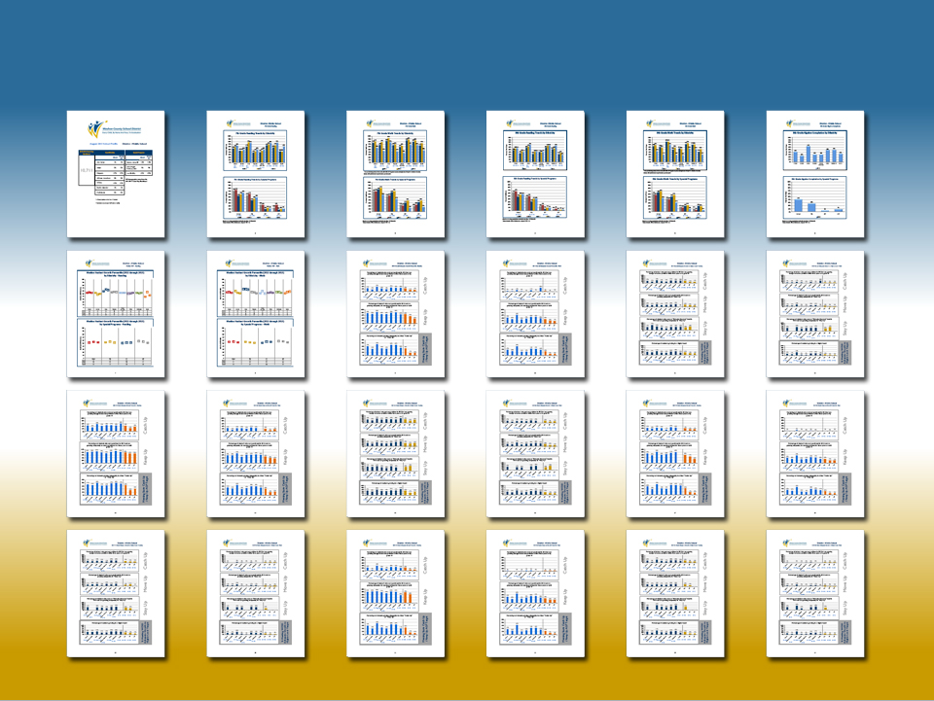
Dashboard Elements
School and District Profiles

Slide 32
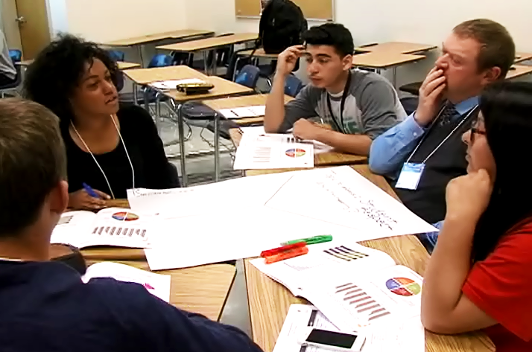
Student Data Symposium

Slide 33
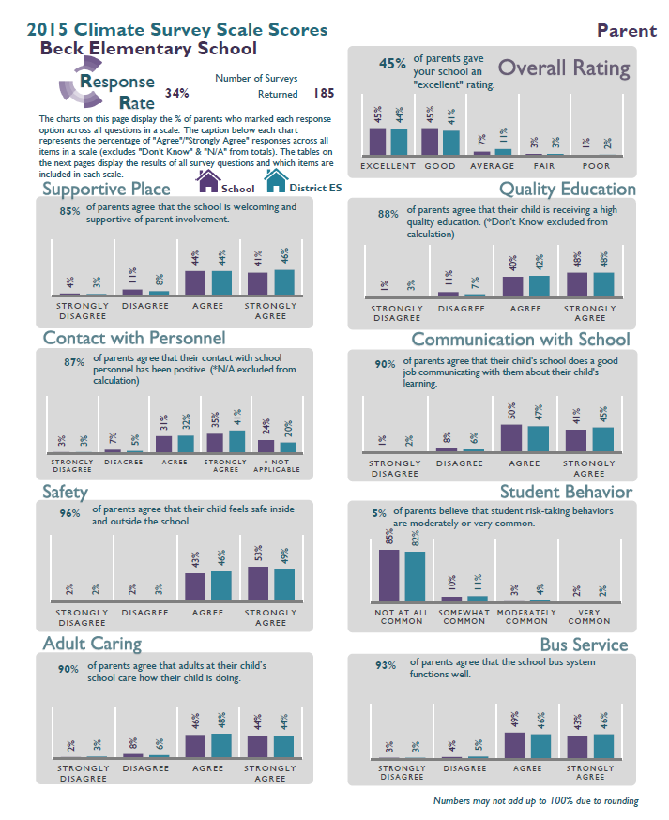
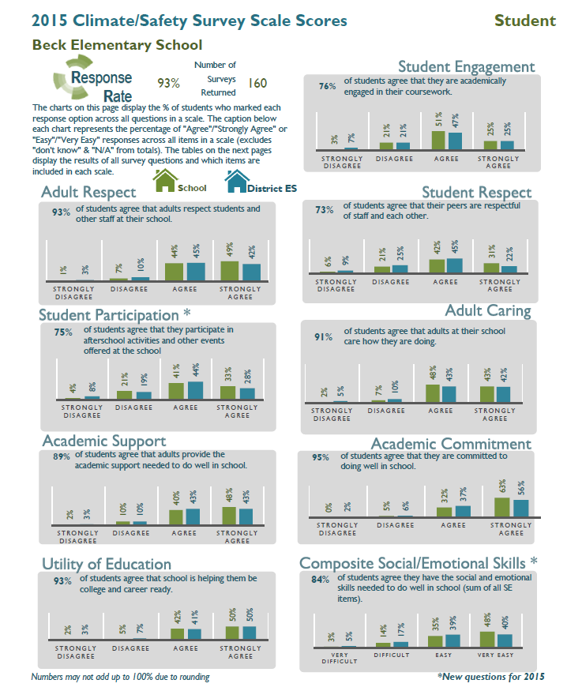
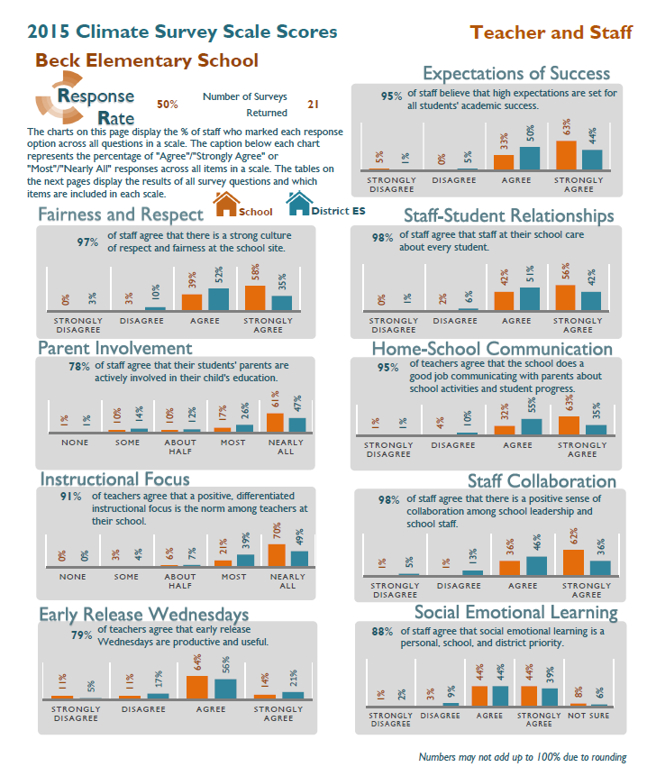
Climate Surveys
http://washoeschools.net/domain/231

Slide 35
What are your thoughts again?
Discuss:
How would you use a system like BIG in your organization?
Think about the strategies your organization is doing right now. Would your approach be different with a system like BIG?

Slide 36
Partners in Interruption
Katie Morales
kmorales@washoeschools.net
Kyle Kemp
kkemp@washoeschools.net

