Slide 1
what is stress and who is the manager?
NAEHCY Conference – Chicago, IL
October 31, 2017
Presented by Denise Ross, President
DNR Coaching & Consulting, LLC

Slide 2
Objectives for today:
Review various definitions of stress
Positive vs. Negative Stress
Causes of Stress
Symptoms of Stress
Finding Balance
Tips and Techniques for Managing Stress
HAVE FUN AND BE STRESS FREE!

Slide 4
What is stress? state of mental or emotional strain or tension resulting from adverse or very demanding circumstances an organism’s total response to environmental demands or pressure S = P > R stress occurs when the pressure is greater than the resource the body’s response to changes that create taxing demands (changes can be positive or negative)

Slide 5
Types of stress
Positive Stress (Eustress)
Focuses energy
Motivates
Short-term
Feels exciting
Improves performance
Negative Stress (Distress)
Causes anxiety or concern
Perceived as outside of our coping abilities
Can be short or long-term
Feels unpleasant
Decreases performance
Notes:
Can you give me some examples of positive stressors/negative stressors?

Slide 6
What causes stress?
INTERNAL
EXTERNAL
Chronic worry
Pessimism
Lacking flexibility
Negative self-talk
Unrealistic expectations, Perfectionism
All or nothing attitude
Major life changes
Work or school
Relationship difficulties
Financial problems
Being too busy
Children and family
Notes:
What are some of your stressors?

Slide 7
are any of these your stressors?
Trying to keep a student in his/her school of origin
Trying to assist a family/student/unaccompanied youth with finding shelter
Too heavy workload (not enough hours in the day)
Having to wear way too many hats
Deadlines for reports and other documents
Frequent interruptions for phone calls
Transportation
Resolving parent/school conflicts
Budgetary issues
Frequent and long meetings
Other

Slide 8
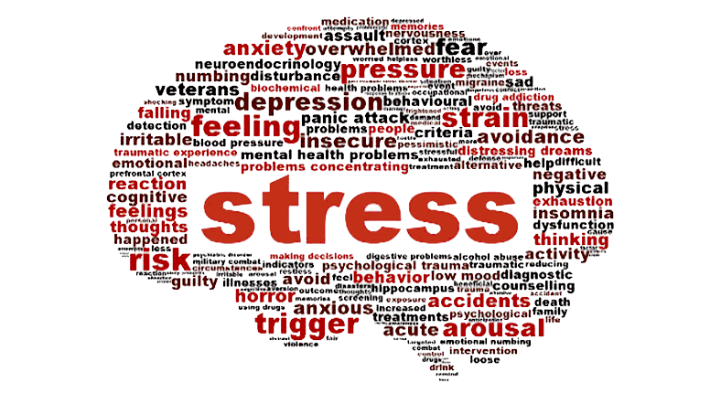
How do you know when you are stressed? How are your thoughts or behaviors different from times when you do not feel stressed?

Slide 9
Notes:
Stress can affect you behaviorally, cognitively, emotionally, and physically. Within your group list 1-2 symptoms of stress in each of these areas.

Slide 10
What does stress do to us?
Behavioral Symptoms
Cognitive Symptoms
Eating more or less
Sleeping too much or too little
Withdrawing from others
Procrastinating/neglecting responsibilities
Using alcohol, cigarettes, or drugs to relax
Nervous habits (biting nails, pacing, etc.)
Memory problems
Inability to concentrate
Poor judgement
Seeing only the negative
Anxious thoughts
Constant worrying

Slide 11
What does stress do to us?
Emotional Symptoms
Physical Symptoms
Depression or general unhappiness
Anxiety and agitation
Moodiness, irritability, or anger
Feeling overwhelmed
Isolation and loneliness
Other emotional or mental health problems
Aches and pains
Headaches
Faster or rapid breathing
Chest pain, rapid heartbeat
Increased sweating
Dizziness, nausea

Slide 12
Full plate how much is on your plate?

Slide 13
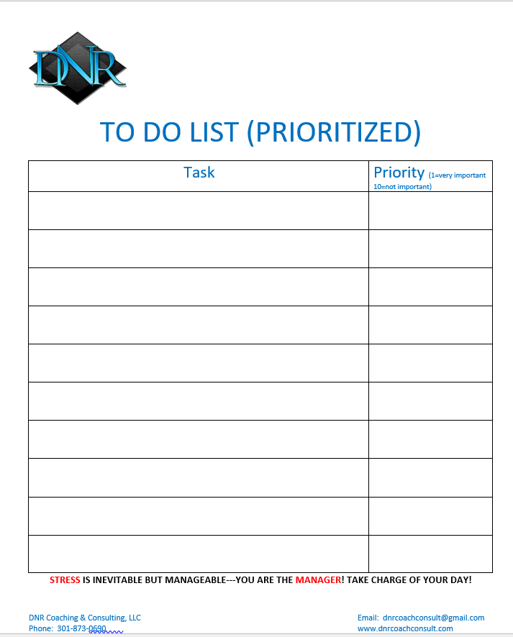

Slide 14
Stress within your comfort zone can help you perform under pressure, motivate you to do your best, even keep you safe when danger looms.
When stress becomes overwhelming, it can damage your mood and relationships, and lead to a host of serious mental and physical health problems.
Life is full of frustrations, deadlines, and demands. Many of us don’t even realize how stressed we are.

Slide 15
Burnout occurs when the difference between stressors and our ability to cope significantly increases

Slide 16
The result of imbalance is increased stress and its associated conditions.

Slide 17
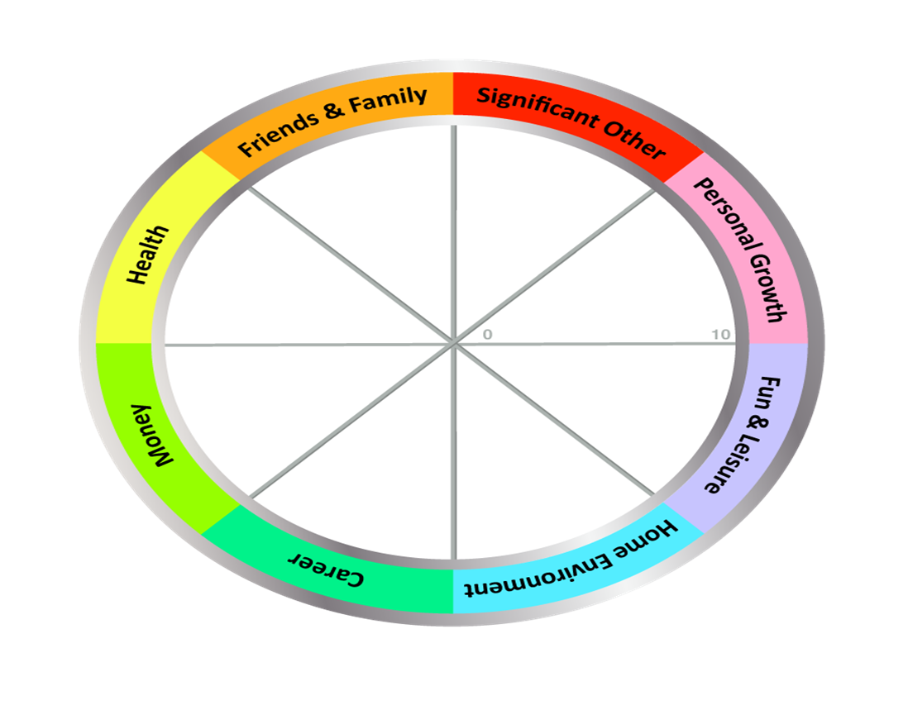
THE WHEEL OF LIFE

Slide 18
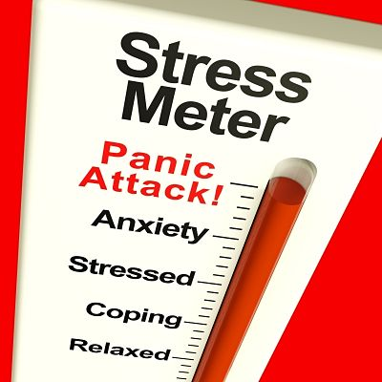
How do you control stress in your life?

Slide 20
Stress is inevitable but manageable

Slide 21
Stress is inevitable but manageable YOU ARE THE MANAGER
Determine the source of your stress (eliminate, bypass or alter the stressor).
Keep a journal (record what’s helping you deal with stress in a healthy manner).
Do what you can and don’t worry about the rest. (Work smarter not harder)
Don’t take on more than you can handle. (Manage your time and learn to say “no”)
Allow for flexibility.
Determine priorities and take on one thing at a time. (Do what’s important)
Establish a support base (family and friends).
Accept what you cannot change.

Slide 22
Stress is inevitable but manageable YOU ARE THE MANAGER
Avoid “unnecessary drama”.
If possible, avoid people who stress you out.
Decrease your “to do” list.
Don’t take work home unless it’s absolutely necessary.
Be sure to get plenty of sleep.
Schedule a visit to the spa.
Be positive about yourself/choices (begin each morning with a positive thought).
Take care of yourself (eat a balanced and nutritious diet, exercise).

Slide 23
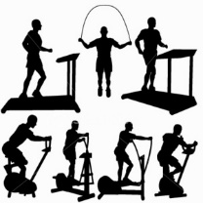
Techniques for relieving stress:
Exercise (Yoga, walking, aqua aerobics, spin class/cardio, biking, etc.)
Stretching (neck, shoulders, back)
Deep Breathing
Mindfulness/Progressive Muscle Relaxation
Notes:
Deep breathing is used to initiate the body’s relaxation response. Slower breathing decreases BP and brings on a feeling of calmness.

Slide 24
Next time you’re stressed:
Take a step back, inhale and laugh.
Remember who you are and why you’re here.
You’re never given anything in this world that you can’t handle.
Be strong, be flexible, love yourself, and love others.
Always remember, just keep moving forward.
www.dailyinspirationalquotes.in

Slide 26
I admit that I have stress in my life. Although, I may not be able to change some of my stressors, I can change my reaction to them. I realize that it’s okay to say “no”, especially if it’s for my betterment. I realize that there’s only 24 hours in a day. Surely, I deserve at least 1 hour for “me” time.

Slide 27
CONNECT AND REFLECT
How can you use the information presented today to decrease stress in your personal/professional life?
What techniques, tools, or actions will you incorporate into your daily schedule to help you manage STRESS?

Slide 28
Contact information:
Denise Ross, Founder and President
DNR Coaching & Consulting, LLC
dnrcoachconsult@gmail.com
www.dnrcoachconsult.com
Phone: 301-873-0690

