Slide 1
San Luis Obispo County

Slide 3
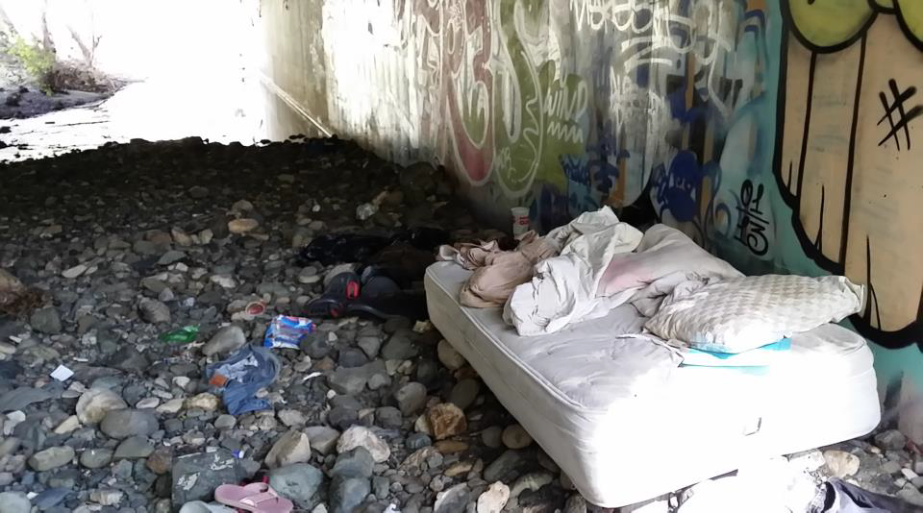
SAN LUIS OBISPO COUNTY
HOMELESS YOUTH
FINDINGS AND RECOMMENDATIONS

Slide 4
UHY Survey Partners
Homeless Services Oversight Council
Schools
Homeless Shelters
Family Resource Centers
Faith Based Street Outreach
Jail

Slide 5
Homeless Youth Survey Results SLO HSOC Ad Hoc Youth Committee, May 2015
Unaccompanied Minors are in need of:
Jobs 61%
Clothes and shoes 58%
Help paying for college 53%
Safe, stable place to live 39%
Food 33%

Slide 6
Survey Results continued
Transitional Aged Youth (18-24 years old)
are in need of:
Safe, stable place to live 86%
Food 69%
Clothes and shoes 60%
Job 57%
Transportation 49%

Slide 7
Building Teen Pathways
Board Members
Faith Based Organizations
School District Admin. Staff
Teachers / Counselors
Program donors / funders
Mentors / Coaches/ Volunteers
Non-profits
Community Based Organization
Parents
Family Advocates
SLO County Staff / CWS / Probation
SLO County Office of Education

