Slide 1
Providing Civil Legal Services to Students Experiencing Homelessness
Facilitator:
Michael Santos
Presenter Names:
Kelly Russo, ABA
Paige Joki, ELC
Patricia Nix-Hodes, CCH
Friday, September 27, 2019 | 11:30am PT / 2:30pm ET
NAEHCY Talks

Slide 2
This session will:
Objective #1
Objective #2
Understand common legal issues involving and legal services available to young people experiencing homelessness
Learn to collaborate with lawyers who work with young people experiencing homelessness

Slide 3
Sunday, November 3, 2019 @ 3:45pm:
Collaborating with Legal Aid Lawyers to Support Families and Youth

Slide 4
ABA Homeless Youth Legal Network (HYLN)
The American Bar Association Homeless Youth Legal Network was established to increase legal services for youth and young adults experiencing homelessness to remove administrative, civil and criminal legal barriers—as well as systemic policy barriers—to housing, education, employment, benefits, treatment and services.
HYLN serves a catalyst and convener to address the legal issues of homeless youth and improve outcomes for those transitioning from the child welfare system and exiting the juvenile justice system. The ABA invites federal partners and national, state and local organizations to join the effort.

Slide 5
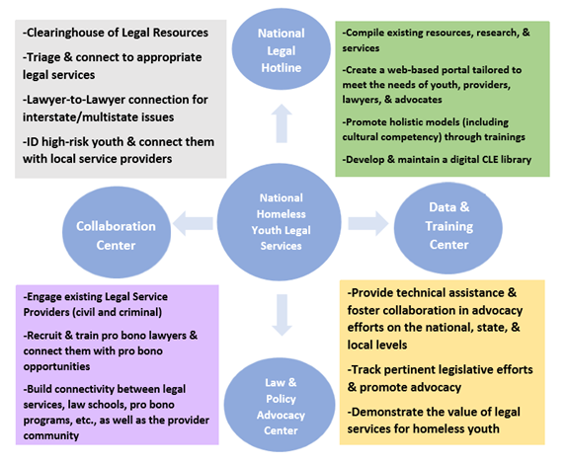

Slide 6
National directory of legal service providers
Federal advocacy and model state statutes
Technical assistance to communities and stakeholders
Model legal services programs and data
Webinars, reports, articles, toolkits and more!
Resources
Visit ambar.org/HYLN for:

Slide 7
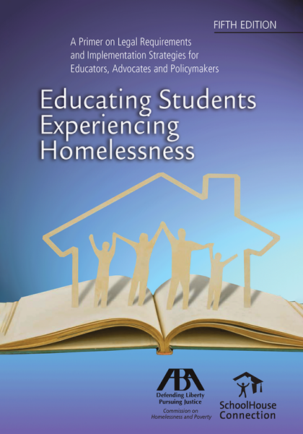
The manual provides innovative strategies for educators and school administrators, state coordinators and policymakers, and advocates and attorneys to ensure the education rights of children and youth experiencing homelessness.
The new edition addresses recent changes in federal law and regulations. It addresses redetermining homeless status, best practices for serving students displaced by natural disasters, early childhood education, relevant federal guidance, and case summaries. It includes a section on foster care, making it an excellent resource for child welfare caseworkers and advocates.
Available at ambar.org/ESEH
It is the most comprehensive resource on the education of students experiencing homelessness available. Many State Departments of Education (as well as school districts) have purchased it in bulk and distributed copies to liaisons, as well as to each school district and school administrator.

Slide 8
Engage with HYLN
Visit our website: ambar.org/HYLN
Follow us on Twitter: @ABAHYLN; and Facebook www.facebook.com/ABAHYLN
Join our listserv of over 450 advocates across the country by e-mailing hyln@americanbar.org
Request free Technical Assistance: Kelly.Russo@americanbar.org
For more information, please contact:
Kelly Russo
Director, Commission
on Homelessness and Poverty
(202) 662-1699
kelly.russo@americanbar.org

Slide 9
BayLegal’s Youth Justice Project provides young people experiencing homelessness with holistic supports, services, and legal representation and by providing early identification and intervention through a collaborative partnership with community-based organizations.
BayLegal provides technical assistance, educational resources and materials, and legal assistance (advice and counsel, brief legal services, full representation) in the following practice areas: Foster Care, Health Access, Supplemental Security Income (SSI), Education, Disability, Housing, Immigration, Family Law, Economic Safety Net Benefits, Consumer Law, Employment, Sealing Juvenile Records

Slide 10
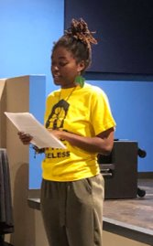
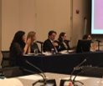
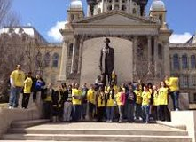
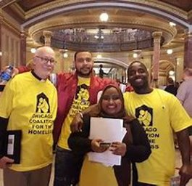
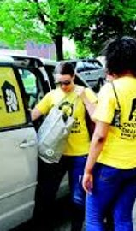
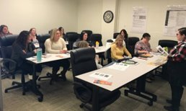
CHICAGO COALITION FOR THE HOMELESS
The Chicago Coalition for the Homeless (CCH) is an advocacy organization founded in 1980. ​
CCH's missions:
"We organize and advocate to prevent and end homelessness, because we believe housing is a human right in a just society."

Slide 11
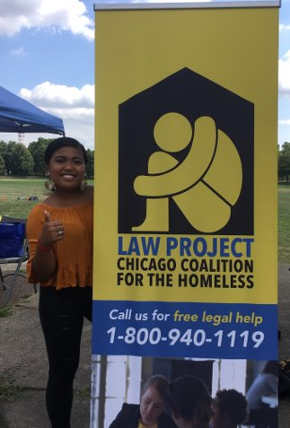
THE LAW PROJECT OF THE CHICAGO COALITION FOR THE HOMELESS
The Law Project was founded in 1997 and the Youth Futures Mobile Legal Clinic launched in 2004. ​
The Law Project provides civil and limited criminal legal services to unaccompanied homeless youths and families. ​
Youth Futures is a mobile legal aid clinic for homeless and unaccompanied youth, staffed by four attorneys. ​

Slide 12
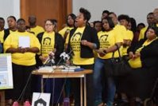
The Law Project can assist with helping homeless youth enroll in school, access transportation, fee waivers, Medicaid, SNAP, TANF and other public benefits, and identification documents.

Slide 13
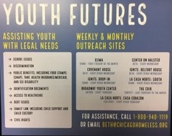
Youth Futures offers regular outreach at Chicago Public High Schools, youth drop in centers, health clinics and shelters. ​
Services included but are not limited to assistance with access to:​
Education, ​
Public benefits​
Identification documents (birth certificates, social security cards and state IDs)​
Employment ​
Civil rights​
Domestic relations ​
Housing​
In FY 2019 the Law Project closed 848 cases with 501 cases on behalf of homeless and unaccompanied youth.​
Youth futures

Slide 14
Who We Are
Education Law Center-PA (“ELC”) is a non-profit, legal advocacy organization dedicated to ensuring access to a quality public education for all children in Pennsylvania. Through legal representation, impact litigation, and policy advocacy, ELC advances the rights of underserved children, including children experiencing homelessness
Our priority areas include:
- Equal Access to Quality Schools
- Adequate & Equitable School Funding
- Dismantling the School-to-Prison Pipeline

Slide 15
ELC’s Recent Systemic Litigation
G.S. vs. Rose Tree Media School District, Civ. No. 17-2886 (3d Cir. 2018):
Amicus; Successful Motion to Convert to Precedential Opinion
McKinney-Vento Act “does not impose a time limit on the duration of homelessness”
Schools cannot unilaterality declare a student ineligible where the student’s living situation remains unchanged; settlement agreement lacked consideration
Advances the rights of students who are living doubled-up
L.R. ex rel. G.R. v. Steelton Highspire Sch. Dist 2010 WL 1433146 (M.D. Pa. Apr. 7, 2010):
Preliminary injunction granted, established enforceable rights of McKinney-Vento eligible students to remain in their school of origin regardless of duration of homelessness
State Administrative Complaint, PA Dept. of Education Re Unaccompanied Students With Disabilities (2019):
Complaint filed with Pennsylvania Department of Education Bureau of Special Education Department of Compliance (“DOC” Complaint)
Corrective action issued to remedy School District of Philadelphia’s failure to promptly appoint surrogate parents for unaccompanied students, as required by the IDEA
Ordered District to establish new system to facilitate the prompt appointment of temporary and permanent surrogate parents, includes ongoing monitoring
Issued guidance to all LEAs across the Commonwealth

Slide 16
Strategies to Advance the Rights of McKinney-Vento Eligible Students
Impact litigation
Individual Cases: consultations, direct representation
HelpLine
Partnerships
“Know-Your-Rights "Trainings
Parents, Shelter-Providers, Outreach Professionals, and Students
Legislative and Policy Advocacy
Proposed state legislation re credit transfer
Resources for Students and Families
Factsheets for Youth and Parents
Comprehensive Guides
McKinney-Vento for Shelter Providers
Special Education
Bullying and Harassment Guide

Slide 17
A Few Considerations
Privacy / Confidentiality
3rd party involvement
Client-centered/stated interest and other models of legal representation
Equitability / Disproportionality
Other Attorney / Advocate involvement

Slide 18
Tips and Best Practices
Understand that homelessness is a traumatic event
Legal representation is a process, not an event – teamwork is critical
Focus on strengths of the young person / respect client agency and self-determination
Needs go beyond legal

Slide 19
BAY AREA LEGAL AID
ABA HYLN
Kelly russo Kelly.Russo@americanbar.org
Michael santos msantos@baylegal.org
CHICAGO COALITION FOR THE HOMELESS
PATRICIA NIX-HODES patricia@chicagohomeless.org

Slide 20
EDUCATION LAW CENTER - PA
Paige Joki pjoki@elc-pa.org
215.703.7920
PHILADELPHIA 1315 Walnut Street, 4th Floor Philadelphia, PA 19107 215-238-6970
Pittsburgh 429 Fourth Avenue, Suite 702
Pittsburgh, PA 15219
412-258-2120
www.elc-pa.org
Facebook.com/EducationLawCenter
@EdLawCenterPa
This presentation is made possible by support from the Albert M. Greenfield Foundation.

Slide 21
NAEHCY Talks Webinar Follow-up
What happens after a webinar ends?
How can we continue the conversation?
How do we dig deeper and share resources?
Can we connect with others that have similar situations?
This year we have created a way to continue to the conversation after the webinar ends.

Slide 22
What is #slack? https://slack.com/
#slack is a collaborative hub where users can network, share resources, ask questions, work on projects and communicate one-on-one or in groups.
#slack is similar to Whats App, Google Hangout Rooms, etc.
As many organizations are turning to #slack, NAEHCY Talks will be the new format utilizing #slack as our webinar follow up!

Slide 23
Joining the Conversation
1. Click the #slack link in the chat box at the end of the presentation.
2. Enter your email address.
3. Check your email to verify your account.
4. Confirm your email to join NAEHCY Talks Workspace.
Following the Webinar you will receive an invitation to join our NAEHCY Talks Workspace and the channel for this webinar.

Slide 24
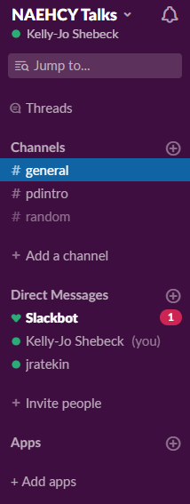
Workspace naehcytalks.slack.com
Channels:
#general: everyone automatically enrolled
#childdevelopment101: enrolled when email is confirmed
#random: just that- random.
Direct Messages:
Ask a question or comment to a specific person rather than the entire channel.
Opportunity to connect offline.

Slide 25
Channel: #uy-vulnerable-population naehcytalks.slack.com
#uy-vulnerable-population:
this channel will be open for webinar participants for 30 minutes following each webinar with presenters
this channel will continue to be available for 1 week
presenters will moderate the channel and check in regularly and answer questions as they arise

Slide 26
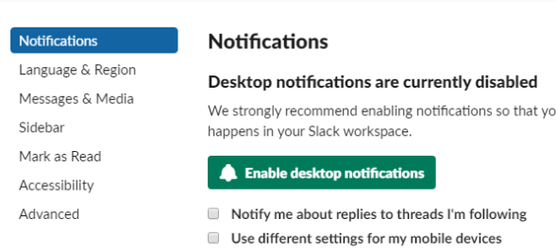
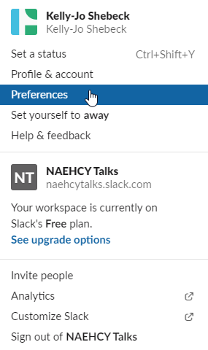
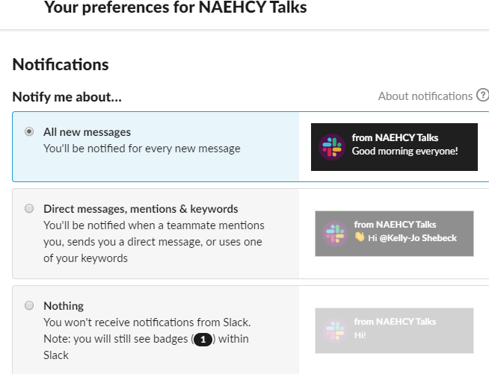
Channel: #uy-vulnerable-population naehcytalks.slack.com

Slide 27
Questions?
Email: info@naehcy.org
Phone: 866-862-2562
Fax: 612-430-6995
Thank you for joining us today!
Feel free to utilize #slack for any follow up questions or comments!

